Slide 1
Exponential improvement in precision for simulating sparse Hamiltonians
Dominic Berry Andrew Childs Richard Cleve
Macquarie University University of Waterloo University of Waterloo
Robin Kothari Rolando Somma
University of Waterloo Los Alamos National Laboratory
QIP 2014
arXiv:1312.1414

Slide 2
Summary of results
Main result: Algorithm for sparse Hamiltonian simulation
Hamiltonian simulation
Reduction
Simulating fractional queries
Oblivious amplitude amplification

Slide 3
Part I: Hamiltonian Simulation
Outline:
Problem description & motivation
Known results
Statement of our result

Slide 4

Simulating physical systems

Slide 5
Simulating quantum mechanics
Hamiltonian simulation problem:
Given a Hamiltonian H of size N x N, a time t, and ϵ>0, find a quantum circuit that performs e^{-iHt} with error at most ϵ.
Motivation:
Simulate quantum systems (original application of QCs)
No known efficient classical algorithm (and we don’t expect one)
Can be used as a subroutine [FGG08, HHL09, CCDFGS03]
Quantum computers can efficiently simulate local and (more generally) sparse Hamiltonians
Local Hamiltonian: Sum of terms that each act on O(1) qubits.
Sparse Hamiltonian: Each row has poly(log N) nonzero entries.

Slide 6
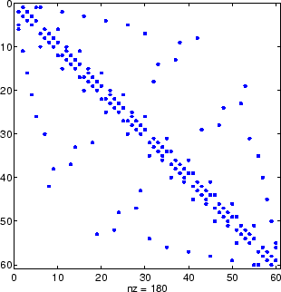
How is the input represented?
Input: H, t, and ϵ.
Local Hamiltonians: Specify H by listing all terms.
Sparse Hamiltonians:
Can have exponentially many
(exponential in log N)
nonzero entries. No explicit
polynomial size description.
Row computability: There is an efficient algorithm (or black box) to determine the j^{th} nonzero entry of the i^{th} row of H.

Slide 7
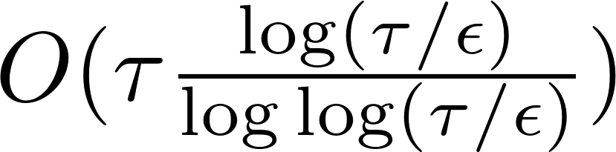
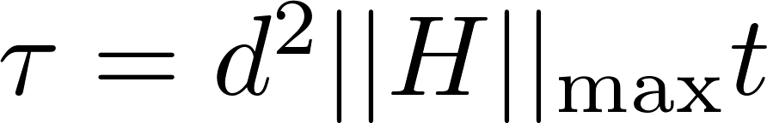
Hamiltonian simulation algorithms
Query complexity in terms of the following parameters:
N = size of the Hamiltonian t = time ϵ = error threshold
d = maximum nonzero entries in any row
[Llo96]: poly(d, log N)·(‖Ht‖/ϵ)² (local Hamiltonians only)
[ATS 03]: poly(d, log N)·(‖Ht‖/ϵ)^{1.5}
[BACS 07]: (d⁴‖Ht‖ log* N)^{1+δ} (1/ϵ)^{δ} for any δ>0
[CK11]: (d³‖Ht‖ log* N)^{1+δ} (1/ϵ)^{δ} for any δ>0
[Chi10, BC12]: O(d ‖H‖_{max} t/ϵ^{1/2})
All these results have polynomial dependence on 1/ϵ.
Our result: , where
Exponential improvement in dependence on 1/ϵ

Slide 8
Hamiltonian simulation
Algorithm with
queries where

Slide 9
Part II: Fractional-query model
Outline:
Problem description
Known results
Our result
Proof sketch

Slide 10
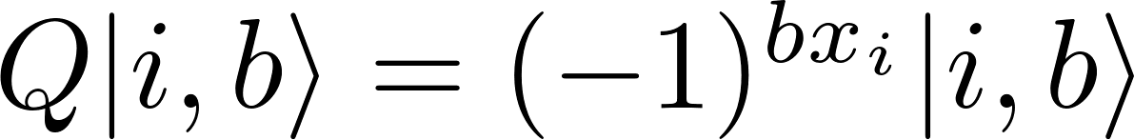
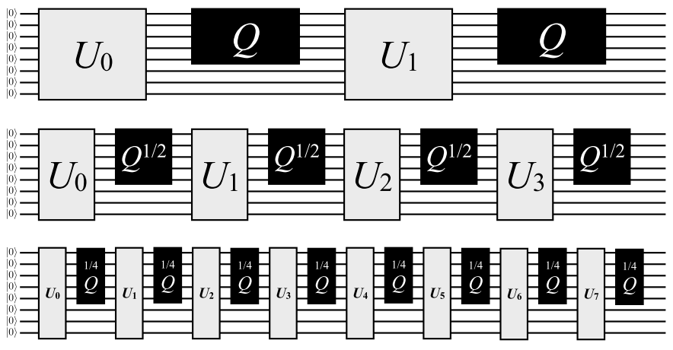
Fractional-query model
Quantum query complexity: Black box Q hides n-bit string x ∈ {0,1}^{n}
Standard (discrete-query) model:
Q puts a phase of (-1) if x_{i} = 1 and does nothing if x_{i} = 0.
….
More powerful than the discrete-query model?
2 queries
2 queries
2 queries

Slide 11
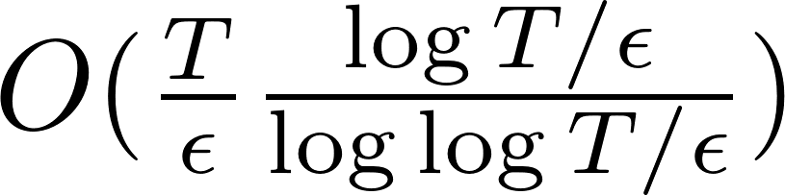
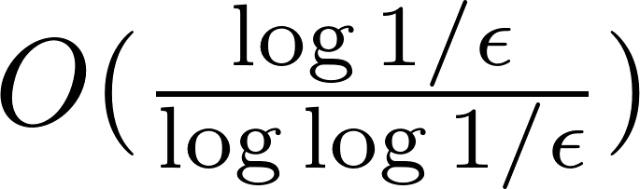
Fractional-query model
[CGMSY09]: A fractional-query algorithm that makes T queries can be simulated with queries in the discrete-query model with precision ϵ.
Proof divided into two steps:
Prove the special case where T = 1, i.e., a 1-query fractional-query algorithm can be simulated with queries.
Observe that the T = 1 case implies the general case (by dividing a T-query algorithm into T 1-query parts and applying the T = 1 result on each with error ϵ/T)
Our result:

Slide 12
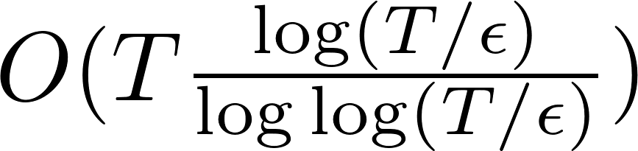
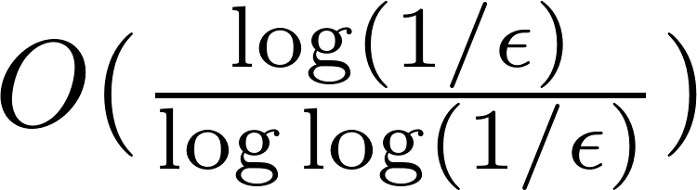
Hamiltonian simulation
Fractional-query model
Algorithm with
queries where
Simulate T-query algorithm with queries
Equivalent
Simulate 1-query algorithm with queries

Slide 13
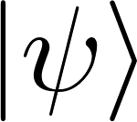
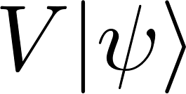
Probabilistic 1-query algorithm
Let V be a 1-query fractional-query algorithm, i.e.,
We want to implement V using queries.
Probabilistically implementing a unitary:
[CGMSY09] shows how to implement a unitary U using queries, where up to error ϵ, U is the map
for some constant 0 < p < 1 (e.g., p=0.1) for all states .
Goal: To obtain a circuit that uses U and outputs .
In [CGMSY09], they apply U and measure the first qubit. If we see 1, then undo the map using a probabilistic correction procedure. If this correction errs, then undo this error and so on…

Slide 14
Hamiltonian simulation
Fractional-query model
Algorithm with
queries where
Simulate T-query algorithm with queries
Equivalent
Simulate 1-query algorithm with queries
Simulate 1-query algorithm
probabilistically with
queries

Slide 15
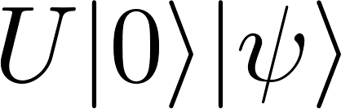
Oblivious amplitude amplification
How do we use U to perform V? (p = constant, e.g., p = 0.1)
Amplitude amplification? Standard amplitude amplification would alternate reflections about and the subspace with 0 in the first register.
But the input state is unknown! Cannot reflect about .
Oblivious amplitude amplification: In this case, using ideas from [MW05], we can show that amplitude amplification is possible without knowing the input state.
Just as in standard amplitude amplification, if p is known, we can exactly amplify the state to obtain .
Operation we know how to perform
Operation we want to perform

Slide 16
Hamiltonian simulation
Fractional-query model
Algorithm with
queries where
Simulate T-query algorithm with queries
Equivalent
Simulate 1-query algorithm with queries
Oblivious amplitude amplification
Simulate 1-query algorithm
probabilistically with
queries

Slide 17
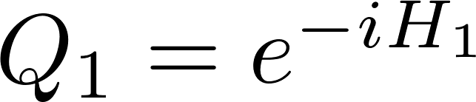
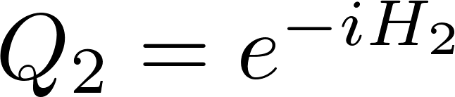
Reduction
How is Hamiltonian simulation related to the fractional-query model?
Let H = H₁ + H₂
Then
If Q₁ and Q₂ were query oracles, this would be a fractional query algorithm that makes T queries to Q₁ and Q₂.
Strategy: Decompose H into a sum of query oracles.

Slide 18
Hamiltonian simulation
Fractional-query model
Algorithm with
queries where
Reduction
Simulate T-query algorithm with queries
Equivalent
Simulate 1-query algorithm with queries
Oblivious amplitude amplification
Simulate 1-query algorithm
probabilistically with
queries

Slide 19
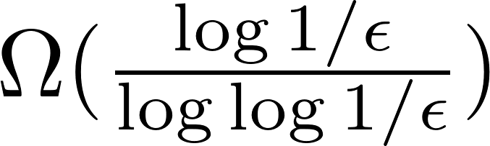
Other advantages of our algorithm
Optimal error scaling: We show a lower bound of
Gate efficient: The number of non-query gates used in our algorithm is close to the query complexity.
Time-dependent Hamiltonians: Our algorithm works for time-dependent Hamiltonians with good scaling with the time derivative of H.
Better scaling for local Hamiltonians: O(d) instead of O(d²).

Slide 20
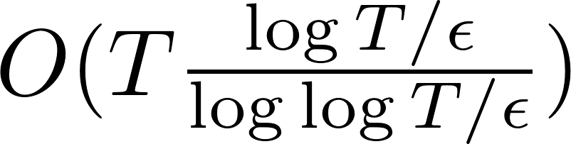
Open problems
Our algorithm’s complexity is nearly optimal.
We know lower bounds of Ω(T) and .
Can we improve the bounds? Tradeoff between T and ϵ?
Improve complexity for practically interesting instances.
Improve dependence on d from quadratic to linear?

Slide 21
Thank you
Notes:
21

