Slide 1
Nested Quantum Walks
QIP 2014
arXiv:1210.1199
arXiv:1210.1199
arXiv:1302.7316
arXiv:1210.1199
SODA 2013
arXiv:1302.7316
Andrew M. Childs
Stacey Jeffery
Robin Kothari
Frederic Magniez
arXiv:1302.7316
With arXiv:1302.3143,
ICALP 2013
Notes:
25 minutes + 5 minutes questions

Slide 2
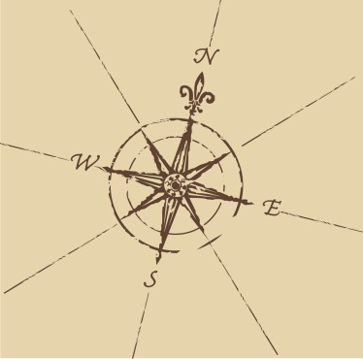
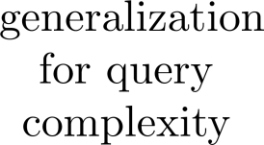





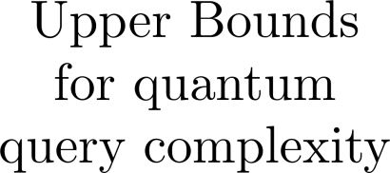

Quantum
Algorithmica
Notes:
DONE

Slide 3


Quantum
Algorithmica
Notes:
DONE

Slide 4

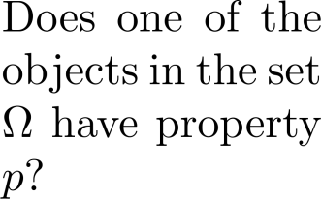
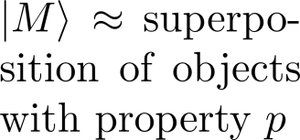

Anatomy of a Quantum Walk
Quantum Walk Algorithm
Checking
Setup
Update

Slide 5
Our First Result: Efficient Nested Checking
Setup
Update

Slide 6
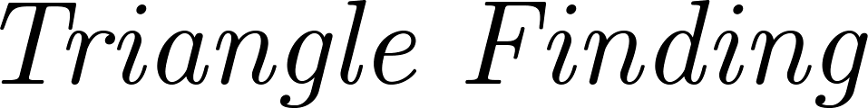
Application to Triangle Finding
Notes:
Make more attractive

Slide 7





Aside: Query Complexity
Notes:
Improve this.

Slide 8



Application to Triangle Finding
Notes:
DONE

Slide 9
Second Contribution: Nested Updates
Checking
Setup
Update
Notes:
Add complexity expression?

Slide 10

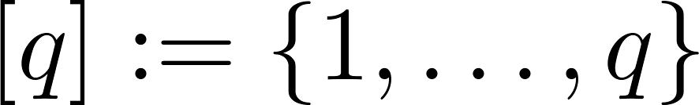

Application to k-Distinctness (k>2)
(6, 2, 12, 7, 2, 4, 1, 5, 11, 4, 5, 2, 9, 7, 6)
Notes:
XXXX

Slide 11



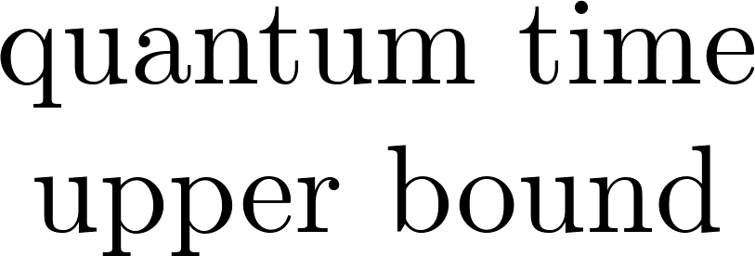







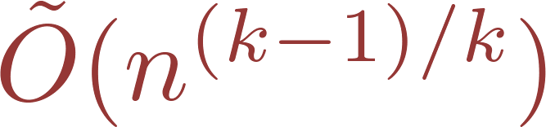

Application to k-Distinctness (k>2)
Notes:
Make prettier, use more colour, for stuff like “time” vs “query”

Slide 12

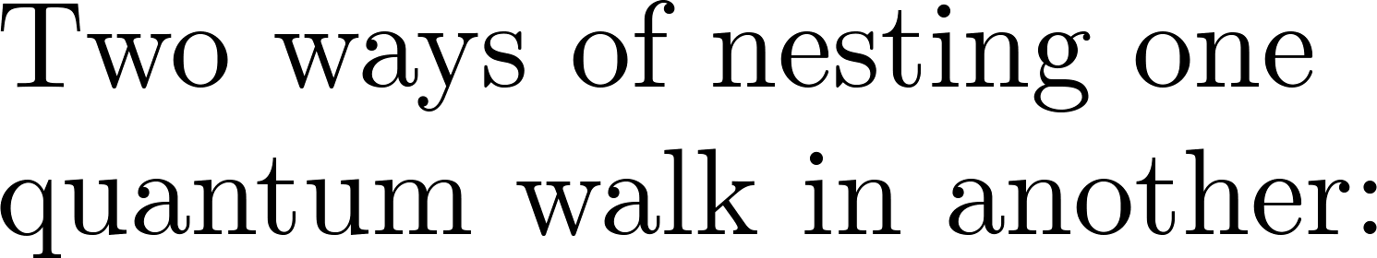

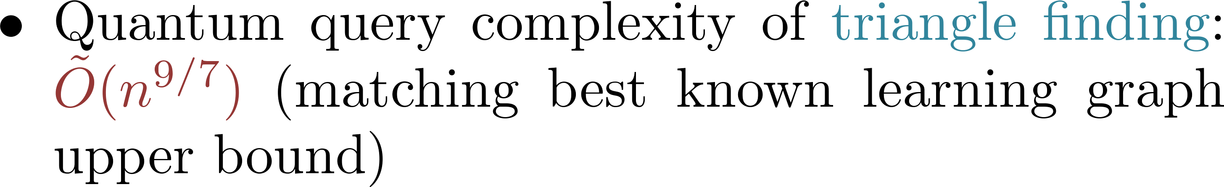
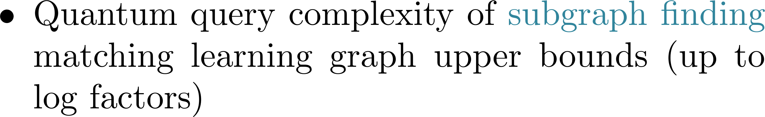
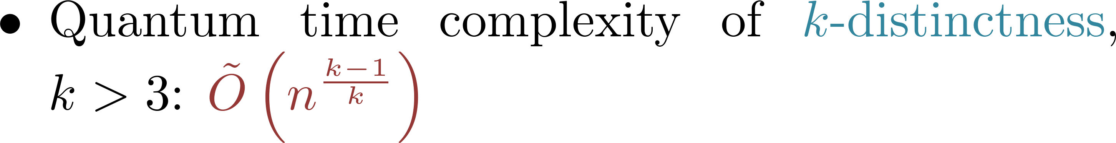
Summary of Results
arXiv:1210.1199
arXiv:1302.7316
Notes:
Also have this information at the beginning somewhere

Slide 13
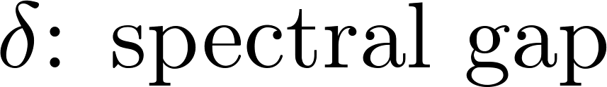






Random Walks
Notes:
Make this slide less ugly

Slide 14






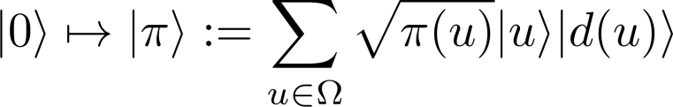


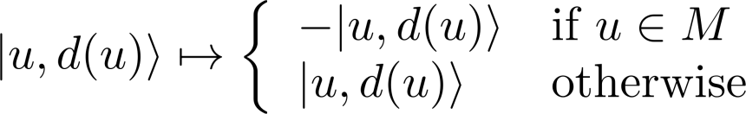




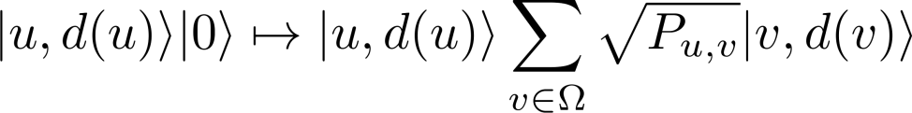



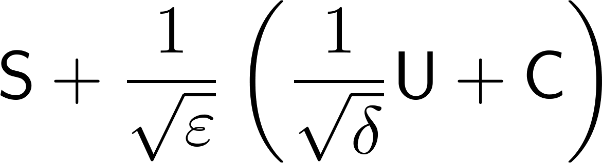
Recipe for Quantum Walk Upper Bound
Notes:
Make colours more consistent somehow

Slide 15
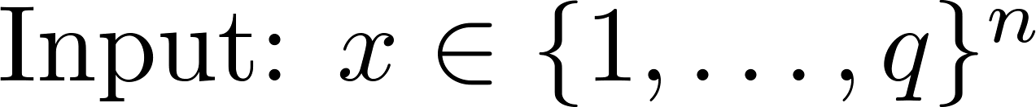







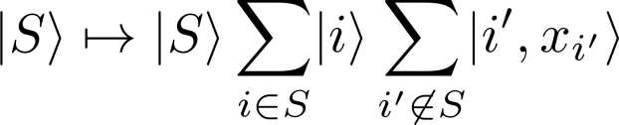










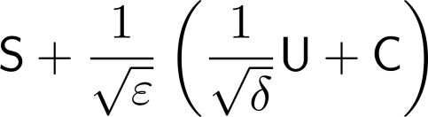


Example: 2-Distinctness
Notes:
Make colours more consistent somehow

Slide 16


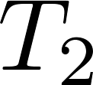






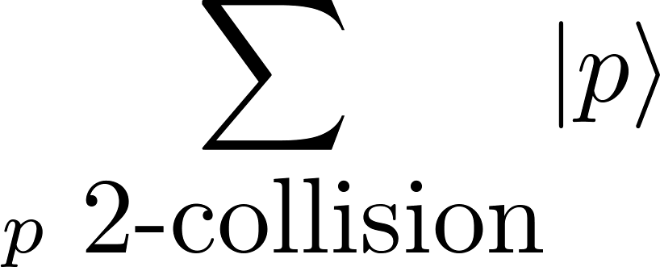






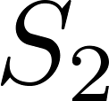
3-Distinctness Attempt
Notes:
Add colours?

Slide 17





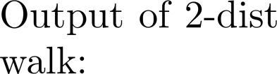







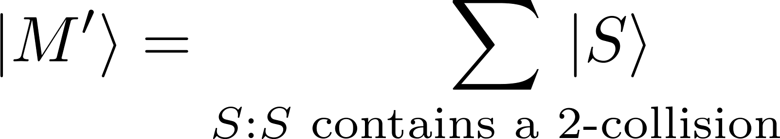

3-Distinctness Attempt
c
c
c
c

Slide 18

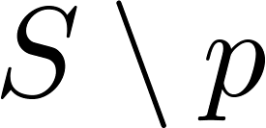

3-Distinctness Attempt

Slide 19


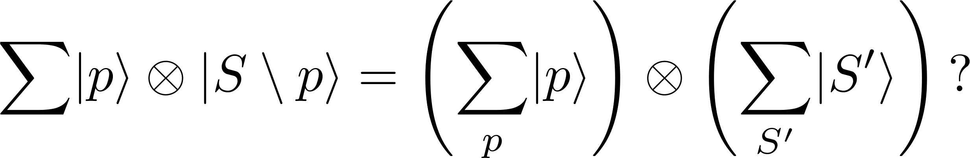
3-Distinctness Attempt

Slide 20


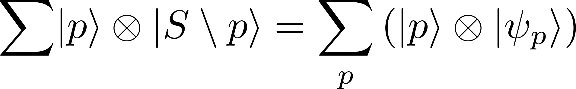

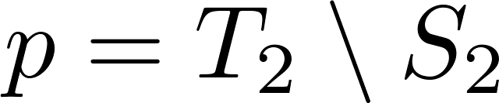

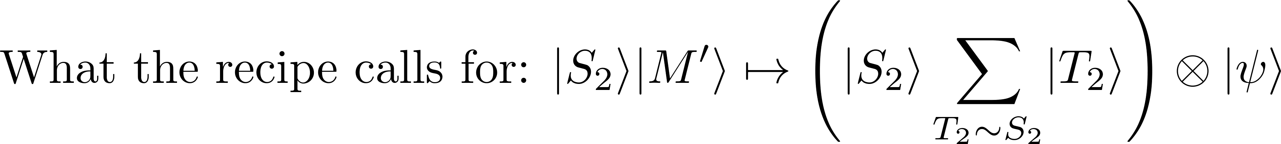

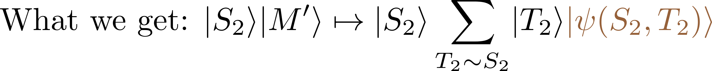

3-Distinctness Attempt

Slide 21


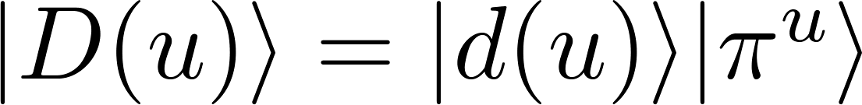




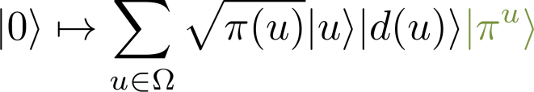














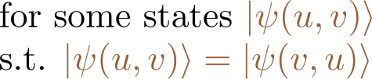


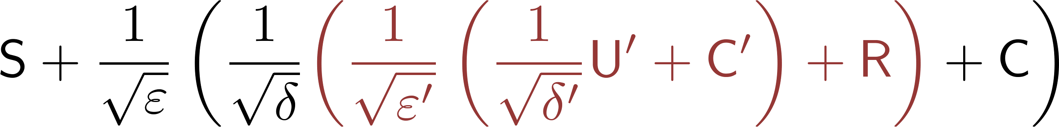
Recipe for Quantum Walk with Nested Update

Slide 23
Recap
Thanks QIP Freaks!
arXiv:1210.1199
arXiv:1302.7316
Notes:
Also have this information at the beginning somewhere

