Slide 1
Topological Quantum Computing
Nick Bonesteel
Florida State University
R
F
F
F
F
F
F
R
R
F
F
QIP 2016 Tutorial, Jan. 9, 2016

Slide 2
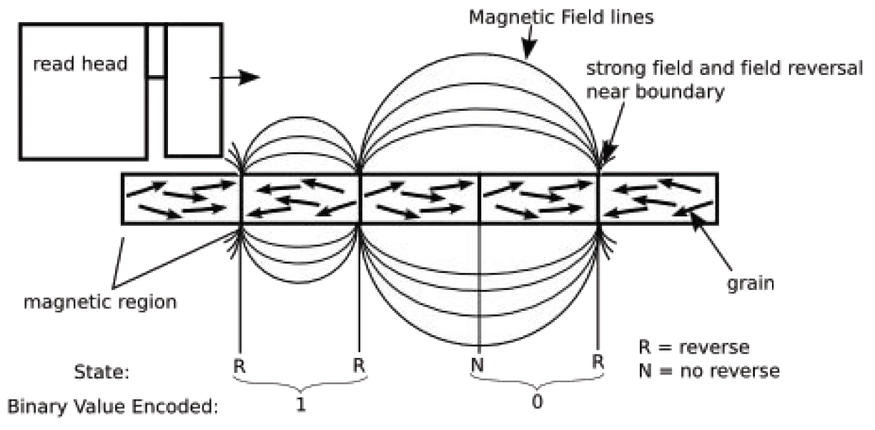
Hard Disk Drive
http://en.wikipedia.org/wiki/Hard_disk_drive

Slide 3
Magnetic Order
A spin-1/2 particle:
“spin up”
“spin down”

Slide 4
Magnetic Order
A spin-1/2 particle:
“spin up”
“spin down”
= 0

Slide 5
Magnetic Order
A spin-1/2 particle:
“spin up”
“spin down”
= 1

Slide 6
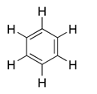
Another Kind of Order
A valence bond:

Slide 7
Another Kind of Order
A valence bond:
Use periodic boundary
conditions

Slide 8
Another Kind of Order
A valence bond:
3
1
1
1

Slide 9
Another Kind of Order
A valence bond:
3
1
1
1
Odd

Slide 10
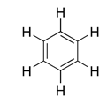
Another Kind of Order
A valence bond:
3
1
3
1
Odd

Slide 11
Another Kind of Order
A valence bond:
3
1
3
1
Odd

Slide 12
Another Kind of Order
A valence bond:
3
1
3
1
Odd

Slide 13
Another Kind of Order
A valence bond:
3
1
1
1
Odd

Slide 14
Another Kind of Order
A valence bond:
Quantum superposition
of valence-bond states.
A “spin liquid.”
Odd

Slide 15
Another Kind of Order
A valence bond:
2
2
0
2
Even

Slide 16
Another Kind of Order
A valence bond:
2
0
0
2
Even

Slide 17
Another Kind of Order
A valence bond:
Even

Slide 18
Another Kind of Order
A valence bond:
|0
3
1
3
1
Odd

Slide 19
Another Kind of Order
A valence bond:
|0
Odd

Slide 20
Another Kind of Order
A valence bond:
|1
2
0
0
2
Even

Slide 21
Another Kind of Order
A valence bond:
|1
Even

Slide 22
Is it a 0 or a 1?

Slide 23
Is it a 0 or a 1?

Slide 24
Is it a |0 or a |1 ?

Slide 25
Is it a |0 or a |1 ?

Slide 26
Is it a |0 or a |1 ?

Slide 27
Topological Order (Wen & Niu, PRB 41, 9377 (1990))
Conventionally Ordered States: Multiple “broken symmetry” ground states characterized by a locally observable order parameter.
magnetization
magnetization
Nature’s classical error correction
Topologically Ordered States: Multiple ground states on topologically nontrivial surfaces with no locally observable order parameter.
odd
odd
even
even
odd
even
odd
even
Nature’s quantum error correction

Slide 28
Conventional Order: Excitations

Slide 29
Conventional Order: Excitations

Slide 30
Conventional Order: Excitations
Magnon = one spin flip: Total S_{z} changes by +1

Slide 31
Topological Order: Excitations

Slide 32
Topological Order: Excitations

Slide 33
Topological Order: Excitations
Breaking a bond creates an excitation with S_{z} = 1

Slide 34
Topological Order: Excitations
Breaking a bond creates an excitation with S_{z} = 1

Slide 35
Topological Order: Excitations
Breaking a bond creates an excitation with S_{z} = 1

Slide 36
Fractionalization
S_{z} = 1 excitation fractionalizes into two S_{z} = ½ excitations

Slide 37
Fractional Quantum Hall States
B
Electrons
A two dimensional gas of electrons in a strong magnetic field B.

Slide 38
Fractional Quantum Hall States
B
Quantum Hall Fluid
An incompressible quantum liquid can form when the Landau level filling fraction ν = n_{elec}(hc/eB) is a rational fraction.

Slide 39
Charge Fractionalization
Electron
(charge = e)
Quasiparticles
(charge = e/3 for ν = 1/3)
When an electron is added to a FQH state it can be fractionalized --- i.e., it can break apart into fractionally charged quasiparticles.

Slide 40
Topological Degeneracy
As in our spin-liquid example, FQH states on topologically nontrivial surfaces have degenerate ground states which can only be distinguished by global measurements.
For the ν = 1/3 state:
Degeneracy
1
3
9
…
3^{N}
1
2
N

Slide 41
“Non-Abelian” FQH States (Moore & Read ‘91)
Fractionalized quasiparticles
Essential features:
A degenerate Hilbert space whose dimensionality is exponentially large in the number of quasiparticles.
States in this space can only be distinguished by global measurements provided quasiparticles are far apart.
A perfect place to hide quantum information!

Slide 42
Exchanging Particles in 2+1 Dimensions
1 time
dimension
2 space dimensions
Particle “world-lines” form braids in 2+1 (=3) dimensions

Slide 43
Exchanging Particles in 2+1 Dimensions
Clockwise
exchange
Counterclockwise
exchange
Particle “world-lines” form braids in 2+1 (=3) dimensions

Slide 44

Many Non-Abelian Anyons
Ψ
f
time
Ψ
=
Ψ
f
i
Ψ
i

Slide 45

Many Non-Abelian Anyons
Ψ
f
time
Ψ
=
Ψ
f
i
Ψ
i

Slide 46
Many Non-Abelian Anyons
Ψ
f
time
Ψ
=
Ψ
f
i
Ψ
i
Matrix depends only on the topology of the braid swept out by anyon world lines!
Robust quantum computation?
Kitaev, ‘97 ; Freedman, Larsen, and Wang, ‘01

Slide 47
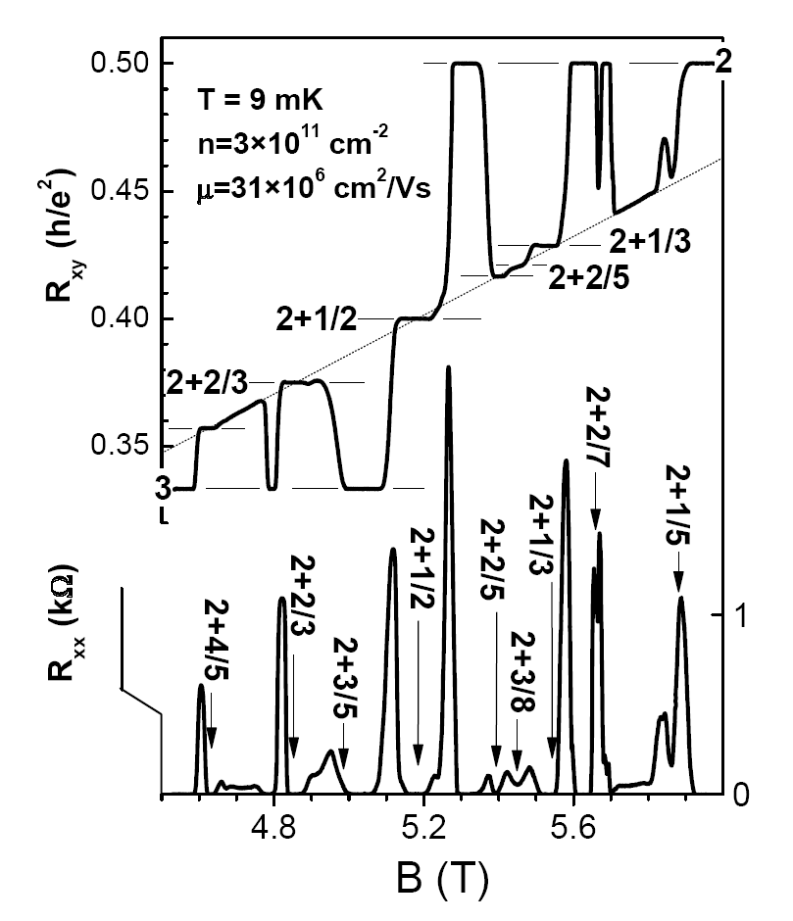
Possible Non-Abelian FQH States
J.S. Xia et al., PRL (2004).

Slide 48
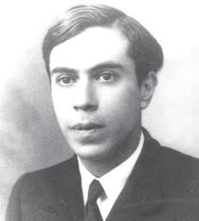
Possible Non-Abelian FQH States
J.S. Xia et al., PRL (2004).
= 5/2: Probable Moore-Read Pfaffian state.
Charge e/4 quasiparticles
are Majorana fermions.
Moore & Read ‘91

Slide 49

Possible Non-Abelian FQH States
J.S. Xia et al., PRL (2004).
= 5/2: Probable Moore-Read Pfaffian state.
Charge e/4 quasiparticles
are Majorana fermions.
Moore & Read ‘91
= 12/5: Possible Read-Rezayi “Parafermion” state. Read & Rezayi, ‘99
Charge e/5 quasiparticles
are Fibonacci anyons.
Slingerland & Bais ’01
Universal for Quantum Computation!
Freedman, Larsen & Wang ’02

Slide 53
0
Enclosed “charge”

Slide 54
1

Slide 56
0

Slide 57
1

Slide 58
1

Slide 59
?

Slide 60
0 or 1

Slide 61
0
1

Slide 62
0
1
2 dimensional Hilbert space

Slide 63
Need to measure all the way around both particles to determine what state they are in
?
Quantum states are protected from environment if particles are kept far apart

Slide 65
0

Slide 66
0
1

Slide 67
0
1

Slide 68
1
0
1

Slide 69
1
0
0
1

Slide 70
1
0
0
1

Slide 71
1
0
1
0
1

Slide 72
1
0
1
1
0
1

Slide 73
1
0
1
1
0
1
3 dimensional Hilbert space

Slide 74
1
0
1
1
0
1
3 dimensional Hilbert space

Slide 75
a
1
a can be 0 or 1

Slide 76
a
b
1
1
a can be 0 or 1
b can be 0 or 1

Slide 77
The F Matrix
a
b
1
1
a can be 0 or 1
b can be 0 or 1

Slide 78
The F Matrix
F

Slide 80
1

Slide 81
1
1

Slide 82
1
1

Slide 83
1
1
Equivalent to

Slide 84
1
1
Equivalent to
F

Slide 85
F
1
1
1
1
Equivalent to
F

Slide 86
F
1
1
1
1
Equivalent to
F

Slide 89
F

Slide 90
F
F
Notes:
STOP HERE!

Slide 91
F
F
Notes:
STOP HERE!

Slide 92
F
F
F

Slide 93
F
F
F
F

Slide 94
F
F
F
F
F

Slide 95
F
F
F
F
F

Slide 96
The Pentagon Equation
F
F
F
F
F

Slide 97
The Pentagon Equation
0
1
0
1
0
0

Slide 98
The Pentagon Equation
0
1
0
1
0
0

Slide 99
The Pentagon Equation
0
0
1
0
1
0
0

Slide 100
The Pentagon Equation
0
0
0
1
0
1
0
0

Slide 101
The Pentagon Equation
0
0
0
0
1
0
1
0
0

Slide 102
The Pentagon Equation
0
0
1
0
0
1
0
1
0
0

Slide 103
The Pentagon Equation
0
0
1
0
0
1
0
1
0
0

Slide 104
The Pentagon Equation
0
0
1
0
1
0
1
0
1
0
0

Slide 105
The Pentagon Equation
0
0
1
0
1
0
1
0
1
0
0

Slide 106
The Pentagon Equation
0
0
1
0
1
0
1
0
1
0
0

Slide 107
The Pentagon Equation
0
0
1
0
1
0
1
0
1
0
0
0

Slide 108
The Pentagon Equation
0
0
1
0
1
0
1
0
1
0
0
1
0

Slide 109
The Pentagon Equation
0
0
1
0
1
0
1
0
1
0
0
b
1
0

Slide 110
The Pentagon Equation
0
0
1
0
1
0
1
0
1
0
0
F_{0b}
b
1
0

Slide 111
The Pentagon Equation
0
0
1
0
1
0
1
0
1
0
0
F_{0b}
b
b
b
1
0

Slide 112
The Pentagon Equation
0
0
1
0
1
0
1
0
1
0
0
F_{0b}
b
b
b
1
0
0

Slide 113
The Pentagon Equation
0
0
1
0
1
0
1
0
1
0
0
F_{0b}
b
b
b
1
b
0
0

Slide 114
The Pentagon Equation
0
0
1
0
1
0
1
0
1
0
0
F_{0b}
b
b
b
1
b
1
0
0

Slide 115
The Pentagon Equation
0
0
1
0
1
0
1
0
1
0
0
F_{0b}
b
b
b
1
1
b
1
0
0

Slide 116
The Pentagon Equation
0
0
1
0
1
0
1
0
1
0
0
F_{0b}
b
b
b
1
1
b
1
0
0

Slide 117
The Pentagon Equation
0
0
1
0
1
0
1
0
1
0
0
F_{0b}
F_{b0}
b
b
b
1
1
b
1
0
0

Slide 118
The Pentagon Equation
0
0
1
0
1
0
1
0
1
0
0
F_{0b}
F_{b0}
b
b
b
1
1
b
1
0
0
Top path
Bottom
path

Slide 119
The Pentagon Equation
0
1
1
1
1
1

Slide 120
The Pentagon Equation
0
1
1
1
1
1

Slide 121
The Pentagon Equation
1
0
1
1
1
1
1

Slide 122
The Pentagon Equation
0
1
0
1
1
1
1
1

Slide 123
The Pentagon Equation
0
1
1
0
1
1
1
1
1

Slide 124
The Pentagon Equation
0
1
1
1
0
1
1
1
1
1

Slide 125
The Pentagon Equation
0
1
1
1
0
1
1
1
1
1

Slide 126
The Pentagon Equation
0
1
F₀₁
1
1
0
1
1
1
1
1

Slide 127
The Pentagon Equation
0
1
F₀₁
1
1
0
1
1
1
1
1

Slide 128
The Pentagon Equation
0
1
F₀₁
1
1
0
1
1
1
1
1

Slide 129
The Pentagon Equation
0
1
F₀₁
1
1
0
1
1
1
1
1
1

Slide 130
The Pentagon Equation
0
1
F₀₁
1
1
0
1
1
1
1
1
1
1

Slide 131
The Pentagon Equation
0
1
F₀₁
1
1
0
1
1
1
1
1
b
1
1

Slide 132
The Pentagon Equation
0
1
F₀₁
1
1
0
1
1
1
1
1
F_{0b}
b
1
1

Slide 133
The Pentagon Equation
0
1
F₀₁
1
1
0
1
1
1
1
1
F_{0b}
b
b
b
1
1

Slide 134
The Pentagon Equation
0
1
F₀₁
1
1
0
1
1
1
1
1
F_{0b}
b
b
b
1
1
1

Slide 135
The Pentagon Equation
0
1
F₀₁
1
1
0
1
1
1
1
1
F_{0b}
b
b
b
1
b
1
1

Slide 136
The Pentagon Equation
0
1
F₀₁
1
1
0
1
1
1
1
1
F_{0b}
b
b
b
1
b
1
1
1

Slide 137
The Pentagon Equation
0
1
F₀₁
1
1
0
1
1
1
1
1
F_{0b}
δ_{b,0} + δ_{b,1} F₁₁
b
b
b
1
b
1
1
1

Slide 138
The Pentagon Equation
0
1
F₀₁
1
1
0
1
1
1
1
1
F_{0b}
δ_{b,0} + δ_{b,1} F₁₁
b
b
b
1
b
1
1
1

Slide 139
The Pentagon Equation
0
1
F₀₁
1
1
0
1
1
1
1
1
F_{0b}
δ_{b,0} + δ_{b,1} F₁₁
F_{b1}
b
b
b
1
b
1
1
1

Slide 140
The Pentagon Equation
0
1
F₀₁
1
1
0
1
1
1
1
1
F_{0b}
δ_{b,0} + δ_{b,1} F₁₁
F_{b1}
Top path
Bottom
path
b
b
b
1
b
1
1
1

Slide 141
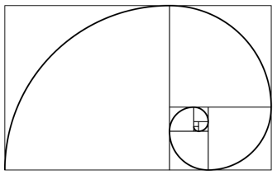
The Pentagon Equation
F
F
F
F
F
Unique unitary solution (up to irrelevant phase factors):
Golden Mean

Slide 142
Hilbert Space Dimensionality

Slide 143
Hilbert Space Dimensionality
“charge”
Bratteli Diagram
1
0
1 2 3 4 5 6 7 8 9
N

Slide 144
Hilbert Space Dimensionality
0
1
1
0
1
“charge”
States are paths in the fusion diagram
1
0
1 2 3 4 5 6 7 8 9
N

Slide 145
Hilbert Space Dimensionality
1
0
1
1
0
“charge”
Here’s another one
1
0
1 2 3 4 5 6 7 8 9
N

Slide 146
Hilbert Space Dimensionality
Hilbert space dimensionality grows as the Fibonacci sequence!
Exponentially large in the number of quasiparticles (deg ~ φ ^{N}),
so big enough for quantum computing.
Fibonacci Anyons
“charge”
1
1
2
3
5
8
13
21
1
1
1
2
3
5
8
13
0
1 2 3 4 5 6 7 8 9
N

Slide 147
Fibonacci anyon with topological “charge” 1
Fusion rules: 1x1 = 0+1; 1x0 = 0x1 = 1; 0x0 = 0
F Matrix:
Pentagon
F
F
F
F
F

Slide 148
Exchanging Particles in 2+1 Dimensions
Clockwise
exchange
Counterclockwise
exchange
Particle “world-lines” form braids in 2+1 (=3) dimensions

Slide 149
The R Matrix
a
a

Slide 150
The R Matrix
R
a
a

Slide 152
1

Slide 153
1
a

Slide 154
1
a

Slide 155
1
a
Equivalent to
a

Slide 156
1
a
Equivalent to
R
a
a

Slide 157
R
1
1
a
a
Equivalent to
R
a
a

Slide 159
F

Slide 160
R
F

Slide 161
R
F
F

Slide 162
R
F
F

Slide 163
R
F
F
R

Slide 164
R
F
F
R
F

Slide 165
R
F
F
R
R
F

Slide 166
The Hexagon Equation
R
F
F
R
R
F

Slide 167
The Hexagon Equation
0
0
1
1

