Slide 1
COLLEGE DEVOPS PROJECT
CodeOrigin
Ask a codebase why it was built this way, and get an answer grounded in its own history.
A repository-aware RAG system, packaged and delivered as a containerised, tested, monitored DevOps pipeline.
Notes:
Say: CodeOrigin answers "why was this built this way?" from a repository's code plus its history, with citations, and refuses when the history does not say. The research question: does adding repository history to an LLM-RAG pipeline improve answers? It is also a DevOps project: 7 containers, CI, monitoring.

Slide 2
THE PROBLEM
Code can’t explain itself
The current code shows what exists. The reason lives in the history around it.
Question
why JWT?
Code
auth.py
Commit
69e7bbd
PR
#8 review
Issue
#7 session fixation
→
→
→
→
Ordinary assistants
CodeOrigin
If the history is silent
See only today’s code, so “why?” becomes a guess.
Indexes commits, diffs, issues, PRs and reviews, cross-linked, and cites each claim (commit:69e7bbd).
It says so instead of inventing a story.
Notes:
Today's assistants see only current code, so a "why" question becomes a guess. CodeOrigin indexes commits, diffs, issues, PRs and reviews, links them (issue to PR to commit), and cites each claim, for example commit:69e7bbd. If the history is silent it says so instead of inventing a story.

Slide 3
RESEARCH QUESTION
A fair test, decided in advance
Does adding repository history to an LLM-RAG pipeline improve the accuracy and usefulness of answers?
no_context
code_only
code_history
oracle
Question only
Question + current code and docs
Code + commits, diffs, issues, PRs, reviews
Question + gold evidence, no retrieval
what the model guesses
how most assistants work
the hypothesis
separates retrieval from model failure
Decision rule (fixed before running)
History is useful only if code_history beats code_only on history questions by at least 0.10 correctness, the 95% bootstrap interval excludes 0, and the control category loses no more than 0.05. Same prompt shape and context budget in every mode, temperature 0, fixed seed. Results are reported per category, never as one blended score.
Notes:
Four modes, same questions. no_context shows what the model guesses. code_only is the realistic baseline. code_history is the treatment. oracle hands over the gold evidence with no retrieval, so it separates retrieval failure from model failure. Everything else is fixed: same prompt shape, same 6000-character context budget, temperature 0, seed 42. The decision rule was written before any run.

Slide 4
METHODOLOGY
How the experiment is built
Everything that could change the answer is held constant, so a difference can only come from the evidence shown.
Data
Metrics
Statistics
Reproducibility
Demo repo: 43 questions (23 dev, 20 test), used to build and tune
Held-out real repo: pallets/itsdangerous, 35 questions, 677 commits, 125 issues, 311 PRs
Dataset hash b68e5bd3… committed before the run
Correctness: share of key facts present (refusal scored for unanswerable)
Evidence recall / precision
Citation validity, unsupported-sentence ratio
Failure tag per wrong answer
Bootstrap 95% confidence intervals
Paired sign-flip permutation test
Cohen’s d_z effect size
Kappa vs LLM judges and a hand check
Temperature 0, seed 42, 300-token cap, 6000-char budget, top-k 8
Same prompt shape in every mode
Models, settings, dataset hash stored with each run
docker compose up; scripts/run_eval.py
Notes:
Two datasets. The demo repository (43 questions) was used to build and tune. The held-out set is the real pallets/itsdangerous repository: 35 questions, 677 commits, 125 issues, 311 PRs, written by other people. The held-out dataset hash b68e5bd36697c3ba was committed before the run. Correctness is the fraction of key facts found in the answer, and for questions that should be refused, 1 if the system refused. Statistics: bootstrap 95% intervals, paired sign-flip permutation test, Cohen's d_z.

Slide 5
ARCHITECTURE
Small services, one entry point
Seven containers behind one gateway. Every service has a health check and runs as a non-root user.
Browser
React + Tailwind (nginx) :5180
Gateway :8200
limits, rate limit, request IDs, API key, /metrics
Ingest :8201
git + GitHub API, SQLite
Orchestrator :8204
pipeline + guardrails
Eval :8205
runs, stats
RAG :8202
vector + BM25, rank fusion
ChromaDB :8206
vector store
LLM :8203
Ollama client + jury
Ollama (host)
llama2, codellama, starcoder2, gemma
Browser → Gateway → Ingest / Orchestrator / Eval → RAG + LLM → ChromaDB + Ollama
Notes:
Browser to gateway to ingest, orchestrator and eval services, which use the RAG service (vector plus BM25 with rank fusion), ChromaDB, and the LLM service talking to Ollama on the host. Shared code lives in one place and is copied into services; CI fails on drift.

Slide 6
ONE QUESTION, END TO END
From question to cited answer
Guardrails are enforced in code, not by asking a small model to behave.
1. Safety
G10
2. Retrieve
G8
3. On topic?
G1
4. Enough history?
G2
5. Follow links
6. Build context
G5
7. Generate
8. Check citations
G3
9. Check grounding
G4
10. Redact
G6
G1 off-topic refused with no model call · G2 says “the history doesn’t say” · G3 invented citations stripped · G4 unsupported sentences flagged
G5 commit text is untrusted data (prompt injection neutralised) · G6 secrets redacted at ingest and in output · G7 input limits · G8 repo isolation · G9 signed webhooks · G10 unsafe requests refused
Notes:
Ten steps. G10 refuses unsafe requests, G8 isolates the repository, G1 refuses off-topic with no model call, G2 says the history does not say, then links are followed, context is built with commit text treated as untrusted data (G5), the model generates, G3 strips invented citations, G4 flags unsupported sentences, and G6 redacts secrets. One honest finding from evaluation: G2 did not fire for on-topic unanswerable questions on a real repository.

Slide 7
DEVOPS
Built to be shipped
Everything below was run for real: images built, stack healthy, pipeline green on GitHub.
Containers
Compose
CI
7 multi-stage images, non-root, health checks, read-only filesystems, dropped capabilities
One base file plus dev, prod, monitoring and demo overrides; Ollama GPU profile; env-driven config
Lint, drift checks, 6 test jobs, frontend build, compose smoke test, end-to-end eval gate
Security
CD
Monitoring
gitleaks secret scan and Trivy dependency/Dockerfile scan on every push; secrets only in .env
Tag v* builds, scans and publishes every image to GHCR, then cuts a release
Prometheus + Grafana + Loki run with the demo: live service metrics, alert rules, and evaluation scores and cost as dashboards
Notes:
Seven multi-stage non-root images with health checks, Docker Compose with dev, prod, monitoring and demo overrides, GitHub Actions CI with 11 jobs, gitleaks and Trivy security scans, a release workflow that publishes to GHCR on a version tag, and optional Prometheus, Grafana and Loki monitoring.

Slide 8
PIPELINE
What CI checks on every push
All 11 jobs pass on the main branch.
lint-and-drift
test: rag
test: llm
test: ingest
test: orchestrator
test: eval
test: gateway
frontend
security (gitleaks + Trivy)
compose-smoke
eval-gate
Running it for real found real problems
A HIGH vulnerability in a frontend dependency (fixed), Dockerfiles running as root (fixed), a tool-version drift in the linter (pinned), and a wrong script call in the smoke test (fixed).
Notes:
Running the pipeline for real found real problems: a HIGH-severity vulnerability in a frontend dependency, Dockerfiles that ran as root, a linter version drift, and a wrong script call in the smoke test. All fixed.

Slide 9
CI AND CD
What CI and CD runs are, and what they did
CI: continuous integration
22
14
On every push GitHub builds the project and runs all checks automatically: lint and drift checks, 6 test jobs, frontend build, secret and vulnerability scan, compose smoke test, evaluation gate. A red run means the change broke something.
workflow runs so far
CI runs passed
1
6
CD: continuous delivery
On a version tag (v*) the release workflow builds, scans and publishes the 7 images to GHCR and cuts a release. Configured but not run yet: no tag was pushed, so nothing was published.
failed (lint, fixed next commit)
cancelled, superseded by a newer push
3.1 min
1
Problems the runs caught
HIGH dependency vulnerability, Dockerfiles running as root, linter drift, wrong script argument, wrong scanner version, and two lint errors in a new script today.
median CI run, 11 jobs
nightly evaluation run, passed
Notes:
CI, continuous integration: on every push GitHub Actions builds the project and runs all checks automatically; a red run means the change broke something. CD, continuous delivery: when a version tag is pushed the release workflow builds, scans and publishes the 7 container images to GHCR and creates a release. CD is configured but has not run yet because no tag was pushed; say so. Run history: 22 runs on the Code_Origin repository, 14 CI passes, 1 failure (lint errors in a new script, fixed in the next commit), 6 cancelled because a newer push superseded them, 1 nightly evaluation run that passed. A CI run takes about 3 minutes and has 11 jobs.

Slide 10
PROMETHEUS
What Prometheus was used for
Prometheus is the metrics database behind the dashboard: it collects numbers from our services on a schedule and keeps them.
Gateway /metrics
requests, latency, guardrails, tokens, refusals; every 15 s
Eval service /metrics
evaluation scores from stored runs; every 30 s
Prometheus :9090
stores 15 days of time series; evaluates alert rules
Grafana :3000
queries Prometheus and Loki and draws the dashboard
16 metric families collected
3 alert rules (all healthy, none firing)
Gateway (5): requests by route and status, request-time histogram, guardrail triggers G1 to G10, LLM tokens in and out, refusals by type.
Evaluation (11): correctness (per category and overall, with CI), history effect, verdict, failure taxonomy, jury score, run progress, quality metrics, latency, tokens.
GatewayDown: the gateway is unreachable for 1 minute.
HighErrorRate: more than 5% of gateway requests fail (5xx) over 5 minutes.
SlowAsk: p95 of /ask latency above 60 s for 10 minutes.
Notes:
Prometheus scrapes the gateway every 15 seconds and the evaluation service every 30 seconds, stores the time series for 15 days, and evaluates three alert rules. The gateway exports requests by route and status, a request-time histogram, guardrail triggers, LLM tokens and refusals. The evaluation service computes its numbers from stored runs at scrape time: correctness, history effect with its interval, verdict, failure taxonomy, jury score, run progress, and the quality and cost metrics. Grafana queries Prometheus (and Loki for logs). Alerts: GatewayDown, HighErrorRate over 5 percent, SlowAsk p95 over 60 seconds; all healthy, none firing.

Slide 11
GRAFANA
What the Grafana dashboards showed
Everything the dashboard showed, with the numbers. Live figures come from a handful of demo questions, not a load test.
Evaluation results (run #8)
Quality, retrieval and cost
Live metrics (demo traffic)
Correctness no ctx / code only / code + history: llama2 20 / 54 / 82%, codellama 13 / 49 / 68%, starcoder2 14 / 29 / 24%.
History effect: +0.319, +0.278, -0.021. Verdict: useful for the two 7B models, inconclusive for starcoder2.
Retrieval misses: 11 / 10 / 16 with code only, 3 / 2 / 6 with history.
The gemma:2b jury scored about 100%: too lenient.
Hallucination rate: 31%, 22%, 59%.
Evidence recall 0.14, 0.70, 1.00; precision 0.05, 0.25, 1.00 (code only, code + history, oracle).
Mean latency: 12.0 s, 14.5 s, 2.3 s. Tokens written: 126, 173, 147.
Refusal correctness 0.83 with no context, 0.89 to 1.00 with retrieval.
5 of 5 /api/ask requests succeeded; no 5xx errors.
p95 /ask latency about 26 s.
3 answers used 6,635 tokens in, 554 out.
Guardrails fired: G1, G10, G4. Refusals: off_topic, unsafe_request.
No alert firing; 3 rules healthy.
Notes:
Three groups of findings. Evaluation (run 8): correctness rises from no context to code only to code with history for both 7B models; history effect plus 0.319 and plus 0.278, minus 0.021 for starcoder2; retrieval misses dominate code-only answers and fall with history; the gemma jury scored everything near 100 percent so it is not used. Quality and cost: hallucination 31, 22 and 59 percent; recall 0.14, 0.70, 1.00; mean latency 12.0, 14.5 and 2.3 seconds. Live metrics from five demo questions: all succeeded, p95 ask latency about 26 seconds, guardrails G1, G10 and G4 fired, no alerts.

Slide 12
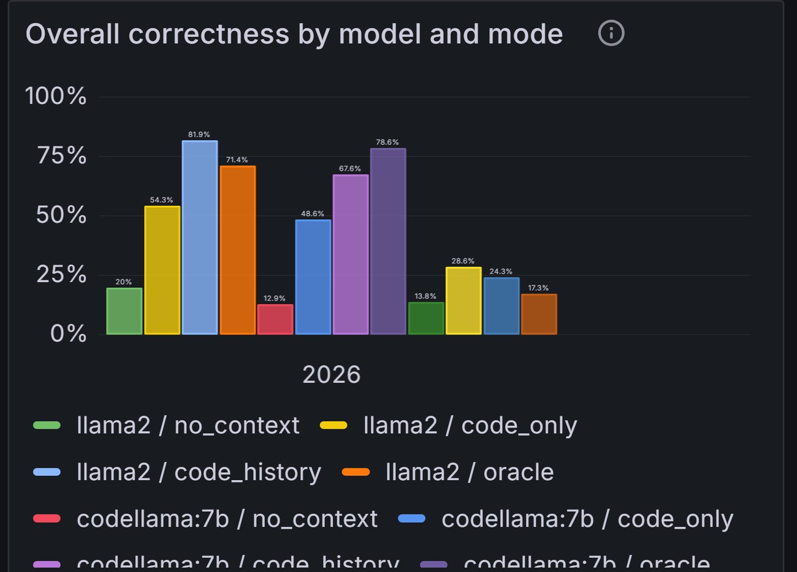
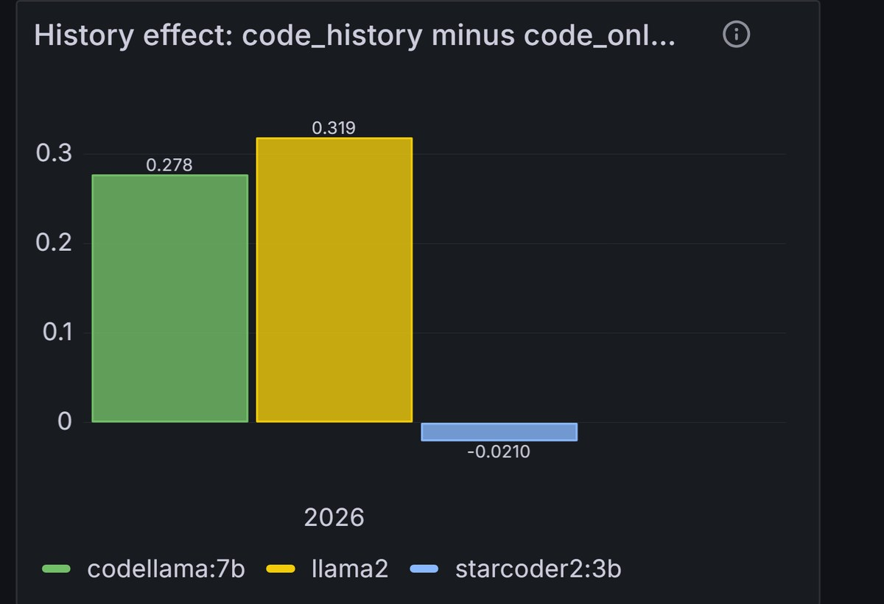
GRAFANA 1 OF 4
Evaluation results in Grafana
Left: correctness for no context, code only, code + history, oracle. Right: history effect +0.319 (llama2), +0.278 (codellama), -0.021 (starcoder2).
Notes:
Run 8, the held-out run. Left: overall correctness per model and mode; the oracle bars are the ceiling. Right: the history effect, plus 0.319 for llama2, plus 0.278 for codellama, minus 0.021 for starcoder2.

Slide 13
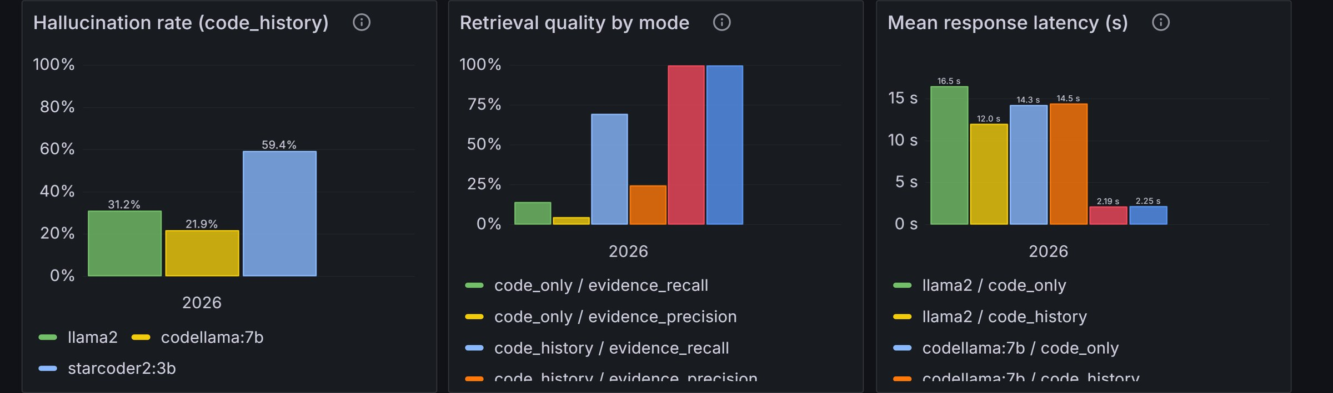
GRAFANA 2 OF 4
Quality, retrieval and cost
Hallucination: llama2 31.2%, codellama 21.9%, starcoder2 59.4%. Retrieval: recall 14% (code only), 70% (code + history), 100% (oracle). Latency: starcoder2 fastest (2.3 s) but least reliable; the 7B models take 12 to 16 s.
Notes:
Hallucination: llama2 31.2, codellama 21.9, starcoder2 59.4 percent. Retrieval: recall rises from 14 percent with code only to 70 percent with code and history to 100 percent with the oracle. Latency: starcoder2 is fastest at about 2.3 seconds but least reliable; the 7B models take 12 to 16 seconds.

Slide 14
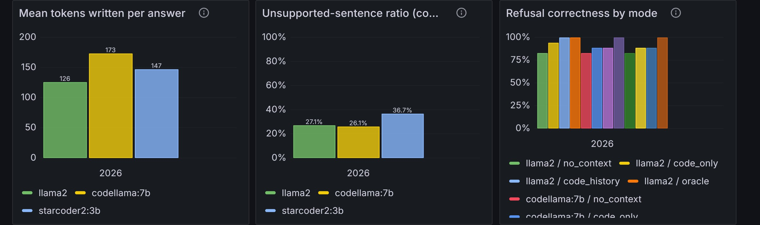
GRAFANA 3 OF 4
Tokens, grounding and refusals
Tokens written: 126 (llama2), 173 (codellama), 147 (starcoder2). Unsupported-sentence ratio: 27.1%, 26.1%, 36.7%. Refusal correctness is lowest with no context (the model answers questions it should refuse) and highest with retrieval.
Notes:
Tokens written per answer: 126 for llama2, 173 for codellama, 147 for starcoder2. Unsupported-sentence ratio: 27.1, 26.1 and 36.7 percent. Refusal correctness is lowest with no context, because the model then answers questions it should refuse, and highest with retrieval.

Slide 15
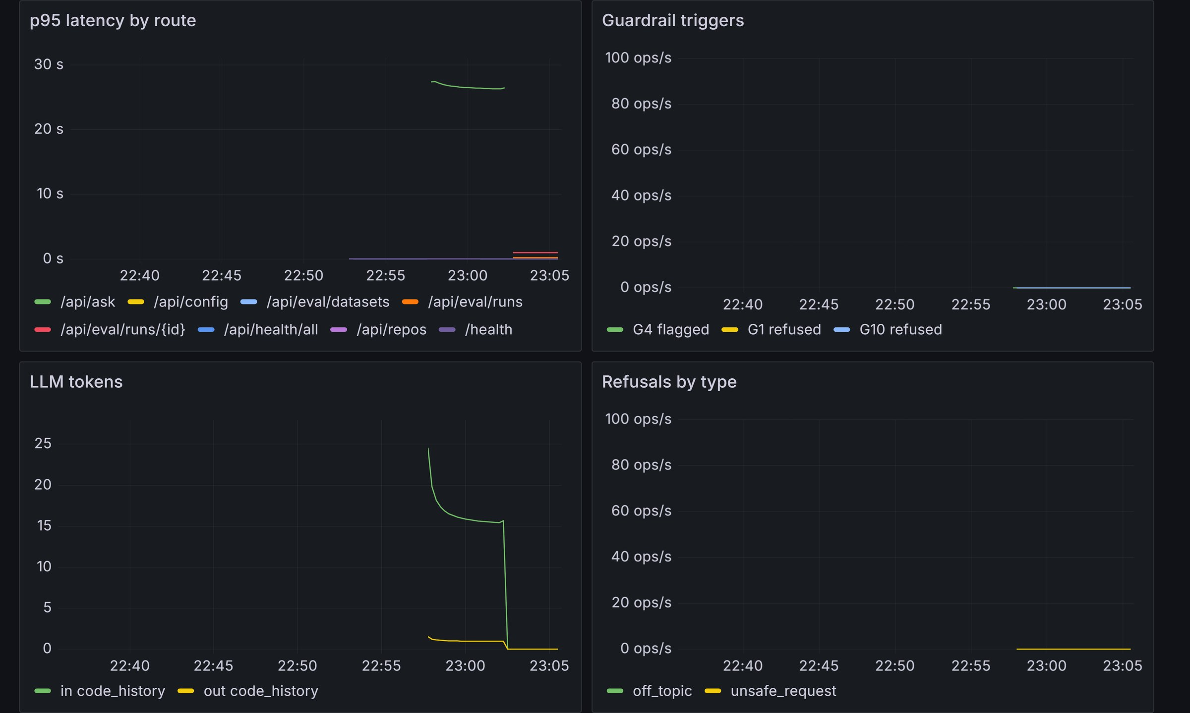
GRAFANA 4 OF 4
Live service metrics
What it shows
p95 latency of /api/ask about 26 s.
Guardrails fired: G4 (grounding flag), G1 (off-topic refusal), G10 (unsafe request refused).
LLM tokens: 6,635 in, 554 out for 3 answers.
Refusals: off_topic, unsafe_request.
No 5xx errors; no alerts firing.
Notes:
Live panels while five real questions were asked through the Ask API: p95 latency of the ask route about 26 seconds, guardrails G4, G1 and G10 fired, LLM tokens 6,635 in and 554 out for three answers, refusals off-topic and unsafe request, no 5xx errors.

Slide 16
RESULTS: HELD-OUT RUN ON A REAL REPOSITORY
What the experiment shows
Run #8: pallets/itsdangerous, 35 questions, 399 answers, real local models. Overall correctness per mode.
History vs code-only (24 history questions)
llama2
+0.32
95% CI [+0.07, +0.55]
history is useful
codellama:7b
+0.28
95% CI [+0.05, +0.49]
history is useful
starcoder2:3b
−0.02
95% CI [−0.21, +0.17]
no effect detected
Notes:
Overall correctness (all categories pooled) rises from no_context to code_only to code_history for both 7B models. The pre-registered test is the paired difference code_history minus code_only on the 24 history questions: llama2 +0.32, codellama +0.28, both with intervals excluding 0, so history is useful for them. starcoder2:3b shows no effect. Honest reading: automatic scoring, small samples, one repository.

Slide 17
RESULTS AND INTERPRETATION
What the numbers mean
Model | Repository | No context | Code only | Code + history | History effect [95% CI] | Verdict
llama2 | Real (held-out) | 20% | 54% | 82% | +0.32 [+0.07, +0.55] p 0.022 | Useful
codellama:7b | Real (held-out) | 13% | 49% | 68% | +0.28 [+0.05, +0.49] p 0.033 | Useful
starcoder2:3b | Real (held-out) | 14% | 29% | 24% | −0.02 [−0.21, +0.17] | No effect
llama2 | Demo (dev) | 26% | 67% | 91% | +0.42 [+0.15, +0.69] p 0.023 | Useful
codellama:7b | Demo (dev) | 30% | 67% | 91% | +0.42 [0.00, +0.73] | Inconclusive
starcoder2:3b | Demo (dev) | 17% | 41% | 46% | +0.08 [0.00, +0.19] | Inconclusive
It holds on a real repository
Mechanism: retrieval
Model size matters
Both 7B models pass the pre-registered rule on history written by strangers, and an independent LLM judge (DeepSeek) confirms it (+0.35). Smaller than on the demo (+0.4), as expected.
Evidence recall rises from 0.14 (code only) to 0.70 (with history). Excluding two items an independent review flagged leaves the conclusions unchanged.
starcoder2:3b gets no benefit on either repository: even with the gold evidence it mostly invents (18 of 28 oracle answers hallucinated). Caution: on 4 control questions a judge hints history can hurt.
Notes:
Top three rows are the held-out real repository. History effect is code_history minus code_only on the history questions, with a 95% bootstrap interval. It holds on a real repository: both 7B models pass the pre-registered rule, an independent LLM judge (DeepSeek) confirms it (+0.35 for both), and excluding two items an independent review flagged leaves the conclusions unchanged. starcoder2:3b gets no benefit on either repository: even with the gold evidence it mostly invents. One caution: on the 4 code-only control questions the judge hints history can hurt.

Slide 18
WHICH MODEL FOR WHICH TASK
Which model is best for what?
Task | n | llama2 | codellama:7b | starcoder2:3b | Best
Explanation (why was it built this way) | 10 | 0.75 (0.50) | 0.70 (0.45) | 0.15 (0.25) | llama2 = codellama (tie)
Bug analysis | 6 | 0.69 (0.58) | 0.61 (0.58) | 0.17 (0.00) | tie of the 7B models
Dependency understanding (issue / PR / commit links) | 4 | 1.00 (1.00) | 1.00 (1.00) | 0.50 (0.25) | tie of the 7B models
Code retrieval (look up a fact in current code) | 4 | 0.75 (0.38) | 1.00 (0.88) | 0.25 (0.25) | codellama:7b
RAG, whole pipeline (no ctx / code only / code + history) | 28 | 0.21 / 0.50 / 0.77 | 0.12 / 0.50 / 0.74 | 0.14 / 0.25 / 0.20 | llama2 = codellama
Code generation | - | not evaluated | not evaluated | not evaluated | -
Refactoring | - | not evaluated | not evaluated | not evaluated | -
Cost and reliability (code_history)
Not evaluated
Hallucination rate: llama2 31%, codellama 22%, starcoder2 59%. Median latency: 8.3 s, 16.1 s, 1.4 s (means 12.0, 14.5, 2.3). Tokens out (median): 90, 193, 44. Live in Grafana.
Code generation, refactoring and a test-pass rate: the system answers questions and does not write code, so the dataset has no such tasks. Relevance is not scored separately.
Notes:
Each task maps to a question category on the real repository. Numbers are correctness in the RAG mode (code_history), automatic score then DeepSeek judge in brackets. With 2 to 10 questions per task a gap under 0.10 is a tie. Explanation, bug analysis and dependency links: llama2 and codellama tie, starcoder2 far behind. Code retrieval: codellama leads (4 questions). RAG overall: llama2 and codellama tie on accuracy; llama2 is faster at the median, codellama hallucinated less. Code generation and refactoring were not evaluated because the system answers questions and does not write code, so there is also no test-pass rate; do not invent numbers.

Slide 19
FAILURE ANALYSIS
Where it goes wrong
Failure | Evidence | Response
Retrieval misses unusual phrasing | “Why was 1.0.0 removed from PyPI?” fetched unrelated issues; recall 0.70 not 1.00. Both 7B models invented a reason. | Query rewriting (not done)
History can distract on code questions | llama2 said the default key derivation is “hmac” and cited an unrelated commit (code says django-concat). Judge control score drops −0.25 / −0.12 (4 questions). | More control questions; filter history
Refusal gate does not transfer | On-topic unanswerable questions passed the relevance gate; codellama invented “Tristan Escalada, 2014”. Only llama2 abstained, by itself. | Recalibrate G2 on several repos
Model ignores or distorts evidence | Evidence retrieved (#111, #112) but codellama said 1.1.0 changed the default to HS512 (that was 1.0). starcoder2: 18 of 28 oracle answers hallucinated. | Instruction-tuned models
Models rarely cite the right source | Gold evidence cited in only 1–2% of answers; citation validity is high (0.9–1.0) because invented refs are stripped (G3). | Stricter answer format
Automatic scoring is generous | Full credit to 143 answers; DeepSeek rated 42 lower. Kappa 0.75 (399), GPT 0.94 / Gemini 0.69 (36). Hand check of 18 factual rows: 18/18. | Stricter key facts; more human grading
Notes:
Each failure was found in real output and traced to a cause. (1) Retrieval missed an unusual phrasing: for "why was 1.0.0 removed from PyPI" it fetched unrelated issues and both models invented a reason. (2) History can distract on code-only questions: llama2 said the key derivation is hmac and cited an unrelated commit. (3) The refusal gate G2 did not fire for on-topic unanswerable questions; codellama invented a customer name. (4) Models rarely cite the gold source. (5) The automatic score is generous: DeepSeek rated 42 of 143 full-credit answers as only partly right or wrong; agreement kappa 0.75. Human check: I graded 18 factual rows by hand and agreed 18 of 18; the 16 technical rows are LLM-judged only.

Slide 20
LIVE SYSTEM
The running stack
Shown live from the website during the talk (health is checked through the gateway every few seconds).
Gateway
healthy
Ingest
healthy
Rag
healthy
Llm
healthy
Orchestrator
healthy
Eval
healthy
What to demo
Ask: "Why does itsdangerous keep SHA-1 as its default digest?" and show the cited answer and the evidence chain.
Evaluation page: the held-out run, per-mode leaderboard, and which model is best for what.
Repositories page: the three indexed repositories (demo, itsdangerous, Nexus).
Notes:
Open the website. Show: Ask (a real question with citations, the evidence chain and the guardrail trace), Repositories (the indexed repos), Evaluation (the held-out run and the which-model-for-what panel), and the slides. Suggested demo question on itsdangerous: "Why does itsdangerous keep SHA-1 as its default digest?"

Slide 21
Questions?
github.com/IATESPAGHETTI/Code_Origin
We claim: supported on one real repository for 7B models, not yet general.
Notes:
Be ready to explain: the research question, the four modes and why oracle exists, the decision rule, why starcoder2 is inconclusive (it cannot use evidence even when given it), what went wrong (retrieval misses, refusal gate, history distracting on code questions), and what is not validated (human grading covers factual rows only).

