Slide 1
Data Mining
(and machine learning)
The A Priori Algorithm

Slide 2
Reading
The main technical material (the Apriori algorithm and its variants) in this lecture is based on:
Fast Algorithms for Mining Association Rules, by Rakesh Agrawal and Ramakrishan Sikant, IBM Almaden Research Center
Google it, and you can get the pdf

Slide 3
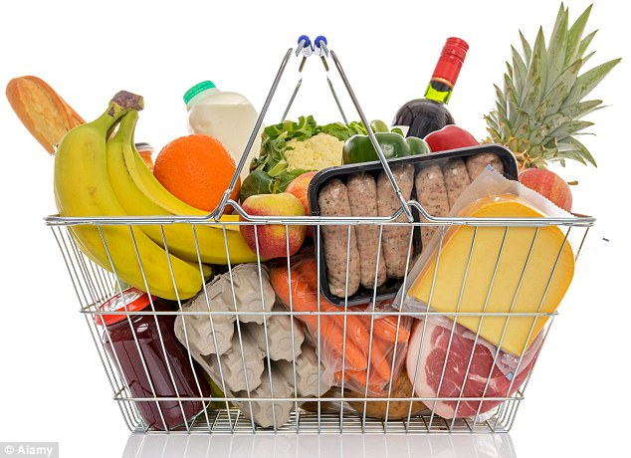


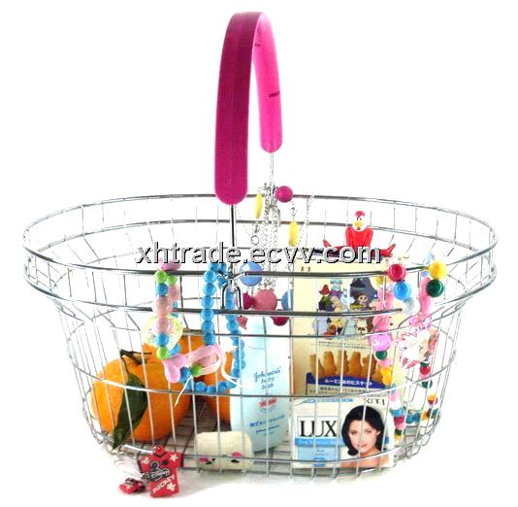
`Basket data’

Slide 4
`Basket data’
A very common type of data; often also called transaction data.
Next slide shows example transaction database, where each record represents a transaction between (usually) a customer and a shop. Each record in a supermarket’s transaction DB, for example, corresponds to a basket of specific items.

Slide 5
ID apples, bread, cheese, dates, eggs, fish, glue, honey, ice-cream
1 | 1 | 1 |  | 1 |  |  | 1 | 1
2 |  |  | 1 | 1 | 1
3 |  | 1 | 1 |  |  | 1
4 |  | 1 |  |  |  | 1 |  |  | 1
5 |  |  |  |  | 1 |  | 1
6 |  |  |  |  |  | 1 |  |  | 1
7 | 1 |  |  | 1 |  |  |  | 1
8 |  |  |  |  |  | 1 |  |  | 1
9 |  |  | 1 |  | 1
10 |  | 1 |  |  |  |  | 1
11 |  |  |  |  | 1 |  | 1
12 | 1
13 |  |  | 1 |  |  | 1
14 |  |  | 1 |  |  | 1
15 |  |  |  |  |  |  |  | 1 | 1
16 |  |  |  | 1
17 | 1 |  |  |  |  | 1
18 | 1 | 1 | 1 | 1 |  |  |  | 1
19 | 1 | 1 |  | 1 |  |  | 1 | 1
20 |  |  |  |  | 1

Slide 6
Numbers
Our example transaction DB has 20 records of supermarket transactions, from a supermarket that only sells 9 things
One month in a large supermarket with five stores spread around a reasonably sized city might easily yield a DB of 20,000,000 baskets, each containing a set of products from a pool of around 1,000

Slide 7
Discovering Rules
A common and useful application of data mining
A `rule’ is something like this:
If a basket contains apples and cheese, then it also contains bread
Any such rule has two associated measures:
confidence – when the `if’ part is true, how often is the `then’ bit true? This is the same as accuracy.
coverage or support – how much of the database contains the `if’ part?

Slide 8
Example:
What is the confidence and coverage of:
If the basket contains bread and cheese, then it also contains honey
2/20 of the records contain both bread and cheese, so coverage is 10%
Of these 2, 1 contains honey, so confidence is 50%

Slide 9
ID apples, bread, cheese, dates, eggs, fish, glue, honey, ice-cream
1 | 1 | 1 |  | 1 |  |  | 1 | 1
2 |  |  | 1 | 1 | 1
3 |  | 1 | 1 |  |  | 1
4 |  | 1 |  |  |  | 1 |  |  | 1
5 |  |  |  |  | 1 |  | 1
6 |  |  |  |  |  | 1 |  |  | 1
7 | 1 |  |  | 1 |  |  |  | 1
8 |  |  |  |  |  | 1 |  |  | 1
9 |  |  | 1 |  | 1
10 |  | 1 |  |  |  |  | 1
11 |  |  |  |  | 1 |  | 1
12 | 1
13 |  |  | 1 |  |  | 1
14 |  |  | 1 |  |  | 1
15 |  |  |  |  |  |  |  | 1 | 1
16 |  |  |  | 1
17 | 1 |  |  |  |  | 1
18 | 1 | 1 | 1 | 1 |  |  |  | 1
19 | 1 | 1 |  | 1 |  |  | 1 | 1
20 |  |  |  |  | 1

Slide 10
The Apriori Algorithm
There is nothing very special or clever about Apriori; but it is simple, fast, and very good at finding interesting rules of a specific kind in baskets or other transaction data, using operations that are efficient in standard database systems.
It is used a lot in the R&D Depts of retailers in industry (or by consultancies who do work for them).
But note that we will now talk about itemsets instead of rules. Also, the coverage of a rule is the same as the support of an itemset.
Don’t get confused!

Slide 11
Find rules in two stages
Agarwal and colleagues divided the problem of finding good rules into two phases:
Find all itemsets with a specified minimal support (coverage). An itemset is just a specific set of items, e.g. {apples, cheese}. The Apriori algorithm can efficiently find all itemsets whose coverage is above a given minimum.
Use these itemsets to help generate interersting rules. Having done stage 1, we have considerably narrowed down the possibilities, and can do reasonably fast processing of the large itemsets to generate candidate rules.

Slide 12
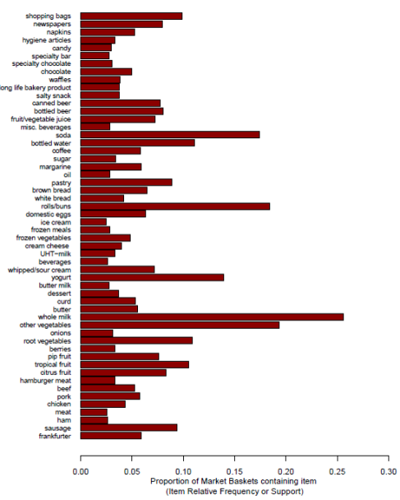
https://datastudentblog.wordpress.com/2013/10/31/market-basket-analysis/

Slide 13
Terminology
k-itemset : a set of k items. E.g.
{bread, cheese, eggs} is a 3-itemset
{cheese} is a 1-itemset
{honey, ice-cream} is a 2-itemset
support: an itemset has support s% if s% of the records in the DB contain that itemset.
minimum support: the Apriori algorithm starts with the specification of a minimum level of support, and will focus on itemsets with this level or above.

Slide 14
Terminology
large itemset: doesn’t mean an itemset with many items. It means one whose support is at least minimum support.
L_{k} : the set of all large k-itemsets in the DB.
C_{k} : a set of candidate large k-itemsets. In the algorithm we will look at, it generates this set, which contains all the k-itemsets that might be large, and then eventually generates the set above.

Slide 15
ID a, b, c, d, e, f, g, h, i
1 | 1 | 1 |  | 1 |  |  | 1 | 1
2 |  |  | 1 | 1 | 1
3 |  | 1 | 1 |  |  | 1
4 |  | 1 |  |  |  | 1 |  |  | 1
5 |  |  |  |  | 1 |  | 1
6 |  |  |  |  |  | 1 |  |  | 1
7 | 1 |  |  | 1 |  |  |  | 1
8 |  |  |  |  |  | 1 |  |  | 1
9 |  |  | 1 |  | 1
10 |  | 1 |  |  |  |  | 1
11 |  |  |  |  | 1 |  | 1
12 | 1
13 |  |  | 1 |  |  | 1
14 |  |  | 1 |  |  | 1
15 |  |  |  |  |  |  |  | 1 | 1
16 |  |  |  | 1
17 | 1 |  |  |  |  | 1
18 | 1 | 1 | 1 | 1 |  |  |  | 1
19 | 1 | 1 |  | 1 |  |  | 1 | 1
20 |  |  |  |  | 1
E.g.
3-itemset {a,b,h}
has support 15%
2-itemset {a, i}
has support 0%
4-itemset {b, c, d, h}
has support 5%
If minimum support is
10%, then {b} is a large
itemset, but {b, c, d, h}
Is a small itemset!

Slide 16
The Apriori algorithm for finding large itemsets efficiently in big DBs
1: Find all large 1-itemsets
2: For (k = 2 ; while L_{k-1} is non-empty; k++)
3 {C_{k} = apriori-gen(L_{k-1})
4 For each c in C_{k}, initialise c.count to zero
5 For all records r in the DB
{C_{r} = subset(C_{k}, r); For each c in C_{r} , c.count++ }
7 Set L_{k} := all c in C_{k} whose count >= minsup
8 } /* end -- return all of the L_{k} sets.

Slide 17
The Apriori algorithm for finding large itemsets efficiently in big DBs
1: Find all large 1-itemsets
2: For (k = 2 ; while L_{k-1} is non-empty; k++)
3 {C_{k} = apriori-gen(L_{k-1})
4 For each c in C_{k}, initialise c.count to zero
5 For all records r in the DB
{C_{r} = subset(C_{k}, r); For each c in C_{r} , c.count++ }
7 Set L_{k} := all c in C_{k} whose count >= minsup
8 } /* end -- return all of the L_{k} sets.
Generate candidate 2-itemsets
Prune them to leave the valid ones
(those with enough support)

Slide 18
The Apriori algorithm for finding large itemsets efficiently in big DBs
1: Find all large 1-itemsets
2: For (k = 2 ; while L_{k-1} is non-empty; k++)
3 {C_{k} = apriori-gen(L_{k-1})
4 For each c in C_{k}, initialise c.count to zero
5 For all records r in the DB
{C_{r} = subset(C_{k}, r); For each c in C_{r} , c.count++ }
7 Set L_{k} := all c in C_{k} whose count >= minsup
8 } /* end -- return all of the L_{k} sets.
Generate candidate 3-itemsets
Prune them to leave the valid ones
(those with enough support)

Slide 19
The Apriori algorithm for finding large itemsets efficiently in big DBs
1: Find all large 1-itemsets
2: For (k = 2 ; while L_{k-1} is non-empty; k++)
3 {C_{k} = apriori-gen(L_{k-1})
4 For each c in C_{k}, initialise c.count to zero
5 For all records r in the DB
{C_{r} = subset(C_{k}, r); For each c in C_{r} , c.count++ }
7 Set L_{k} := all c in C_{k} whose count >= minsup
8 } /* end -- return all of the L_{k} sets.
Generate candidate 4-itemsets
Prune them to leave the valid ones
(those with enough support)
… etc …

Slide 20
Generating candidate itemsets …
Suppose these are the only 3-itemsets all have >10% support:
{a, b, c}
{a, e, g}
{e, f, h}
{e, f, k}
{p, q, r}
.. How do we generate candidate 4-itemsets that might have 10% support?

Slide 21
Generating candidate itemsets …
Suppose these are the only 3-itemsets all have >10% support:
{a, b, c}
{a, e, g}
{e, f, h}
{e, f, k}
{p, q, r}
One possibility:
1. note all the items involved:
{a, b, c, e, f, g, h, k, p, q, r}
2. generate all subsets of 4 of these:
{a,b,c,e}, {a,,b,c,f}, {a,b,c,g}, {a,b,c,h},
{a,b,c,k}, {a,b,c, p},… etc … there are
330 possible subsets in this case !

Slide 22
Generating candidate itemsets …
Suppose these are the only 3-itemsets all have >10% support:
{a, b, c}
{a, e, g}
{e, f, h}
{e, f, k}
{p, q, r}
One possibility:
1. note all the items involved:
{a, b, c, e, f, g, h, k, p, q, r}
2. generate all subsets of 4 of these:
{a,b,c,e}, {a,b,c,f}, {a,b,c,g}, {a,b,c,h},
{a,b,c,k}, {a,b,c, p},… etc … there are
330 possible subsets in this case !
But, hold on: we can easily see that {a,b,c,e} couldn’t have
10% support – because {a,b,e} is not one of our 3-itsemsets

Slide 23
Generating candidate itemsets …
Suppose these are the only 3-itemsets all have >10% support:
{a, b, c}
{a, e, g}
{e, f, h}
{e, f, k}
{p, q, r}
One possibility:
1. note all the items involved:
{a, b, c, e, f, g, h, k, p, q, r}
2. generate all subsets of 4 of these:
{a,b,c,e}, {a,b,c,f}, {a,b,c,g}, {a,b,c,h},
{a,b,c,k}, {a,b,c, p},… etc … there are
330 possible subsets in this case !
But, hold on: the same goes for several other of these subsets …

Slide 24
A neat Apriori trick
{a, b, c}
{a, e, g}
{e, f, h}
{e, f, k}
{p, q, r}
enforce that subsets are always arranged
‘lexicographically’ (or similar), as they are
already on the left
Only generate k+1-itemset candidates from
k-itemsets that differ in the last item.
So, in this case, the only candidate 4-itemset
would be:
{e, f, h, k}

Slide 25
A neat Apriori trick
{a, b, c, e}
{a, e, g, r}
{a, e, g, w}
{e, f, k, p}
{n, q, r, t }
{n, q, r, v }
{n, q, s, v }
enforce that subsets are always arranged
‘lexicographically’ (or similar), as they are
already on the left
Only generate k+1-itemset candidates from
k-itemsets that differ in the last item.
And in this case, the only candidate 5-itemsets
would be:
{a, e, g, r, w}, {n, q, r, t, v}

Slide 26
A neat Apriori trick
This trick
guarantees to capture the itemsets that have enough support,
will still generate some candidates that don’t have enough support, so we still have to check them in the ‘pruning’ step,
is particularly convenient for implementation in a standard relational style transaction database; it is a certain type of ‘self-Join’ operation.

Slide 27
Explaining the Apriori Algorithm …
1: Find all large 1-itemsets
To start off, we simply find all of the large 1-itemsets. This is done by a basic scan of the DB. We take each item in turn, and count the number of times that item appears in a basket. In our running example, suppose minimum support was 60%, then the only large 1-itemsets would be: {a}, {b}, {c}, {d} and {f}. So we get
L₁ = { {a}, {b}, {c}, {d}, {f}}

Slide 28
Explaining the Apriori Algorithm …
1: Find all large 1-itemsets
2: For (k = 2 ; while L_{k-1} is non-empty; k++)
We already have L₁. This next bit just means that the remainder of the algorithm generates L₂, L_{3 ,} and so on until we get to an L_{k} that’s empty.
How these are generated is like this:

Slide 29
Explaining the Apriori Algorithm …
1: Find all large 1-itemsets
2: For (k = 2 ; while L_{k-1} is non-empty; k++)
3 {C_{k} = apriori-gen(L_{k-1})
Given the large k-1-itemsets, this step generates some candidate k-itemsets that might be large. Because of how apriori-gen works, the set C_{k} is guaranteed to contain all the large k-itemsets, but also contains some that will turn out not to be `large’.

Slide 30
Explaining the Apriori Algorithm …
1: Find all large 1-itemsets
2: For (k = 2 ; while L_{k-1} is non-empty; k++)
3 {C_{k} = apriori-gen(L_{k-1})
4 For each c in C_{k}, initialise c.count to zero
5 For all records r in the DB
{C_{r} = subset(C_{k}, r); For each c in C_{r} , c.count++ }
7 Set L_{k} := all c in C_{k} whose count >= minsup
Here, we are simply scanning through the DB to count
the support for each of our candidates in C_{k} , throwing
out the ones without enough support, and the rest become
our set of ‘large’ k-itemsets, L_{k}

Slide 31
Explaining the Apriori Algorithm …
1: Find all large 1-itemsets
2: For (k = 2 ; while L_{k-1} is non-empty; k++)
3 {C_{k} = apriori-gen(L_{k-1})
4 For each c in C_{k}, initialise c.count to zero
5 For all records r in the DB
{C_{r} = subset(C_{k}, r); For each c in C_{r} , c.count++ }
Set L_{k} := all c in C_{k} whose count >= minsup
8 } /* end -- return all of the L_{k} sets.
We finish at the point where we get an empty L_{k} .
The algorithm returns all of the (non-empty) L_{k} sets, from L₁ through to whichever was the last non-empty one. This gives us an excellent start in finding interesting rules (although the large itemsets themselves will usually be very interesting and useful).

Slide 32

From itemsets to rules
The Apriori algorithm finds interesting (i.e. frequent) itemsets.
E.g. it may find that {apples, bananas, milk} has coverage 30%
-- so 30% of transactions contain each of these three things.
What can you say about the coverage of {apples, milk}?
We can invent several potential rules, e.g.:
IF basket contains apples and bananas, it also contains MILK.
Suppose support of {a, b} is 40%; what is the confidence of this rule?

