Slide 1
DLD Project
6 Bit random NUMBER GENERATOR

Slide 2
Introduction
Project: 6-bit random number generator
The task was to create a circuit that will generate random numbers on its own without any sort of input. This circuit had to produce a 6-bit binary number and convert it into a decimal number and display it on a 7-segment display. This report is to explain the circuit and the apparatus used in it.

Slide 3
Apparatus Used:
XOR GATE
2 input XOR gate
6 x Dual D Type Flip Flop (4013)
2 x BCD into 7-segment decoder (74LS48)
2 x 7-segment common cathode display
6 x Logic Probes
Button Switch
Digital Clock Generator

Slide 4
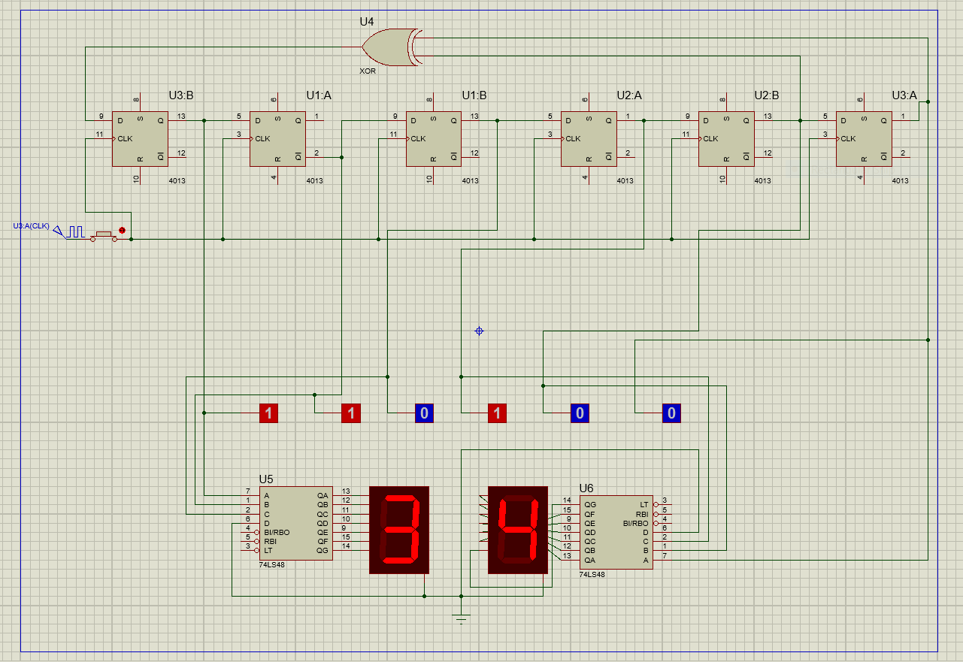
Circuit Diagram:

Slide 5
Functionality:
The circuit shown above is the work I have done for the 6-bit generator. There are problems with the circuit that I would like to point out before-hand. Unable to output a 2-digit decimal number I had to separate the 6-bit generator and make it into a 2 x 3-bit generator. The binary values were easy to output on the logic probes but due to being unable to change the 6-bit binary into decimal I converted it into 2 x 3 bit binary. The main reason for doing this was the 7-segment display. The 7-segment display is not able to output a digit greater than 9 and as the maximum output of a 6-bit binary is 63 this was problem. I was unable to find the required solution to this problem before the deadline which is why I had to resort to the method used. The challenging aspect of the project was certainly the converting the binary into decimal and outputting it.

Slide 6

Explanation of Apparatus:
Digital Clock Generator:
The D-clock generator is used to create a pulse. This pulse is random, and it shifts from 1 and 0 at regular intervals. This is then used in the clock part of the first Flip Flop of the shift register. This starts the circuit as it can be seen with a switch. If the switch is turned off the pulse does not reach the flip flop thus stopping the circuit. It is an essential part it allows to make random numbers with its pulse.

Slide 7
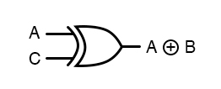
XOR GATE
The XOR gate is a type of gate which gives the output 1 when both the inputs of the gate are different. The one used in the circuit is a 2 input XOR gate. The XOR gate is connected with a shift right function to make a layout capable of generating random number sequences. This is used in making the binary output with the D Type Flip Flops. This allows to make binary which then is shown on the logic probes

Slide 8
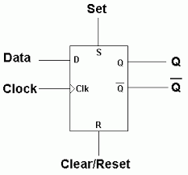
Dual D Type Flip Flop:
A Dual D Type Flip Flop is flip flop which is clocked and consists of two states. Both these are stable states. By putting these flip flops in a sequence delay circuits can be created which ultimately are used in many applications and different circuits. In this circuit 6 are used as we need 6 random bits. The flip flops are combined and make a right shift register. These then combine with the XOR gate to generate the random numbers. The position on the far right is the output and the input are the output of its previous state

Slide 9
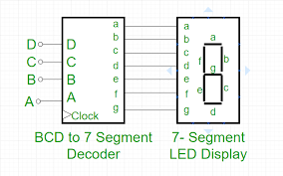
BCD to 7 segment decoder:
It is a combinational logic circuit that takes input in the form of BCD and converts the input in the form of decimal so it can be displayed by the 7-segment display. The 7-segment is an electronic display that is used to display numerical digits. They are mainly used in digital clocks. The problem was arising over here as I was unable to make 2 digit number appear on the display

