Slide 1
One-Way ANOVA
One-Way Analysis of Variance
Adopted from
https://people.richland.edu/james/ictcm/2004/

Slide 2
One-Way ANOVA
The one-way analysis of variance is used to test the claim that three or more population means are equal
This is an extension of the two independent samples t-test

Slide 3
One-Way ANOVA
The response variable is the variable you’re comparing
The factor variable is the categorical variable being used to define the groups
We will assume k samples (groups)
The one-way is because each value is classified in exactly one way
Examples include comparisons by gender, race, political party, color, etc.

Slide 4
One-Way ANOVA
Conditions or Assumptions
The data are randomly sampled
The variances of each sample are assumed equal
The residuals are normally distributed

Slide 5
One-Way ANOVA
The null hypothesis is that the means are all equal
The alternative hypothesis is that at least one of the means is different
Think about the Sesame Street® game where three of these things are kind of the same, but one of these things is not like the other. They don’t all have to be different, just one of them.

Slide 6
One-Way ANOVA
The statistics classroom is divided into three rows: front, middle, and back
The instructor noticed that the further the students were from him, the more likely they were to miss class or use an instant messenger during class
He wanted to see if the students further away did worse on the exams

Slide 7
One-Way ANOVA
The ANOVA doesn’t test that one mean is less than another, only whether they’re all equal or at least one is different.

Slide 8
One-Way ANOVA
A random sample of the students in each row was taken
The score for those students on the second exam was recorded
Front: 82, 83, 97, 93, 55, 67, 53
Middle: 83, 78, 68, 61, 77, 54, 69, 51, 63
Back: 38, 59, 55, 66, 45, 52, 52, 61

Slide 9
One-Way ANOVA
The summary statistics for the grades of each row are shown in the table below
Row | Front | Middle | Back
Sample size | 7 | 9 | 8
Mean | 75.71 | 67.11 | 53.50
St. Dev | 17.63 | 10.95 | 8.96
Variance | 310.90 | 119.86 | 80.29

Slide 10
One-Way ANOVA
Variation
Variation is the sum of the squares of the deviations between a value and the mean of the value
Sum of Squares is abbreviated by SS and often followed by a variable in parentheses such as SS(B) or SS(W) so we know which sum of squares we’re talking about

Slide 11
One-Way ANOVA
Are all of the values identical?
No, so there is some variation in the data
This is called the total variation
Denoted SS(Total) for the total Sum of Squares (variation)
Sum of Squares is another name for variation

Slide 12
One-Way ANOVA
Are all of the sample means identical?
No, so there is some variation between the groups
This is called the between group variation
Sometimes called the variation due to the factor
Denoted SS(B) for Sum of Squares (variation) between the groups

Slide 13
One-Way ANOVA
Are each of the values within each group identical?
No, there is some variation within the groups
This is called the within group variation
Sometimes called the error variation
Denoted SS(W) for Sum of Squares (variation) within the groups

Slide 14
One-Way ANOVA
There are two sources of variation
the variation between the groups, SS(B), or the variation due to the factor
the variation within the groups, SS(W), or the variation that can’t be explained by the factor so it’s called the error variation

Slide 15
One-Way ANOVA
Here is the basic one-way ANOVA table
Source | SS | df | MS | F | p
Between
Within
Total

Slide 16
One-Way ANOVA
Grand Mean
The grand mean is the average of all the values when the factor is ignored
It is a weighted average of the individual sample means

Slide 17
One-Way ANOVA-Grand Mean
Grand Mean for our example is 65.08

Slide 18
One-Way ANOVA – SS(B)
Between Group Variation, SS(B)
The between group variation is the variation between each sample mean and the grand mean
Each individual variation is weighted by the sample size

Slide 19
One-Way ANOVA – SS(B)
The Between Group Variation for our example is SS(B)=1902
I know that doesn’t round to be 1902, but if you don’t round the intermediate steps, then it does.

Slide 20
One-Way ANOVA – SS(W)
Within Group Variation, SS(W)
The Within Group Variation is the weighted total of the individual variations
The weighting is done with the degrees of freedom
The df for each sample is one less than the sample size for that sample.

Slide 21
One-Way ANOVA
Within Group Variation

Slide 22
One-Way ANOVA
The within group variation for our example is 3386

Slide 23
One-Way ANOVA
After filling in the sum of squares, we have …
Source | SS | df | MS | F | p
Between | 1902
Within | 3386
Total | 5288

Slide 24
One-Way ANOVA
Degrees of Freedom, df
A degree of freedom occurs for each value that can vary before the rest of the values are predetermined
For example, if you had six numbers that had an average of 40, you would know that the total had to be 240. Five of the six numbers could be anything, but once the first five are known, the last one is fixed so the sum is 240. The df would be 6-1=5
The df is often one less than the number of values

Slide 25
One-Way ANOVA
The between group df is one less than the number of groups
We have three groups, so df(B) = 2
The within group df is the sum of the individual df’s of each group
The sample sizes are 7, 9, and 8
df(W) = 6 + 8 + 7 = 21
The total df is one less than the sample size
df(Total) = 24 – 1 = 23

Slide 26
One-Way ANOVA
Filling in the degrees of freedom gives this …
Source | SS | df | MS | F | p
Between | 1902 | 2
Within | 3386 | 21
Total | 5288 | 23

Slide 27
One-Way ANOVA
Variances
The variances are also called the Mean of the Squares and abbreviated by MS, often with an accompanying variable MS(B) or MS(W)
They are an average squared deviation from the mean and are found by dividing the variation by the degrees of freedom
MS = SS / df

Slide 28
One-Way ANOVA
MS(B) = 1902 / 2 = 951.0
MS(W) = 3386 / 21 = 161.2
MS(T) = 5288 / 23 = 229.9
Notice that the MS(Total) is NOT the sum of MS(Between) and MS(Within).
This works for the sum of squares SS(Total), but not the mean square MS(Total)
The MS(Total) isn’t usually shown

Slide 29
One-Way ANOVA
Completing the MS gives …
Source | SS | df | MS | F | p
Between | 1902 | 2 | 951.0
Within | 3386 | 21 | 161.2
Total | 5288 | 23 | 229.9

Slide 30
One-Way ANOVA
Special Variances
The MS(Within) is also known as the pooled estimate of the variance since it is a weighted average of the individual variances
Sometimes abbreviated
The MS(Total) is the variance of the response variable.
Not technically part of ANOVA table, but useful none the less

Slide 31
One-Way ANOVA
F test statistic
An F test statistic is the ratio of two sample variances
The MS(B) and MS(W) are two sample variances and that’s what we divide to find F.
F = MS(B) / MS(W)
For our data, F = 951.0 / 161.2 = 5.9

Slide 32
One-Way ANOVA
Adding F to the table …
Source | SS | df | MS | F | p
Between | 1902 | 2 | 951.0 | 5.9
Within | 3386 | 21 | 161.2
Total | 5288 | 23 | 229.9

Slide 33
One-Way ANOVA
The F test is a right tail test
The F test statistic has an F distribution with df(B) numerator df and df(W) denominator df
The p-value is the area to the right of the test statistic
P(F2,21 > 5.9) = 0.009

Slide 34
One-Way ANOVA
Completing the table with the p-value
Source | SS | df | MS | F | p
Between | 1902 | 2 | 951.0 | 5.9 | 0.009
Within | 3386 | 21 | 161.2
Total | 5288 | 23 | 229.9

Slide 35
One-Way ANOVA
The p-value is 0.009, which is less than the significance level of 0.05, so we reject the null hypothesis.
The null hypothesis is that the means of the three rows in class were the same, but we reject that, so at least one row has a different mean.

Slide 36
One-Way ANOVA
There is enough evidence to support the claim that there is a difference in the mean scores of the front, middle, and back rows in class.
The ANOVA doesn’t tell which row is different, you would need to look at confidence intervals or run post hoc tests to determine that

Slide 37
Let’s work this example in R

Slide 38
ANOVA in R

Slide 39
More futures of ANOVA in R

Slide 40
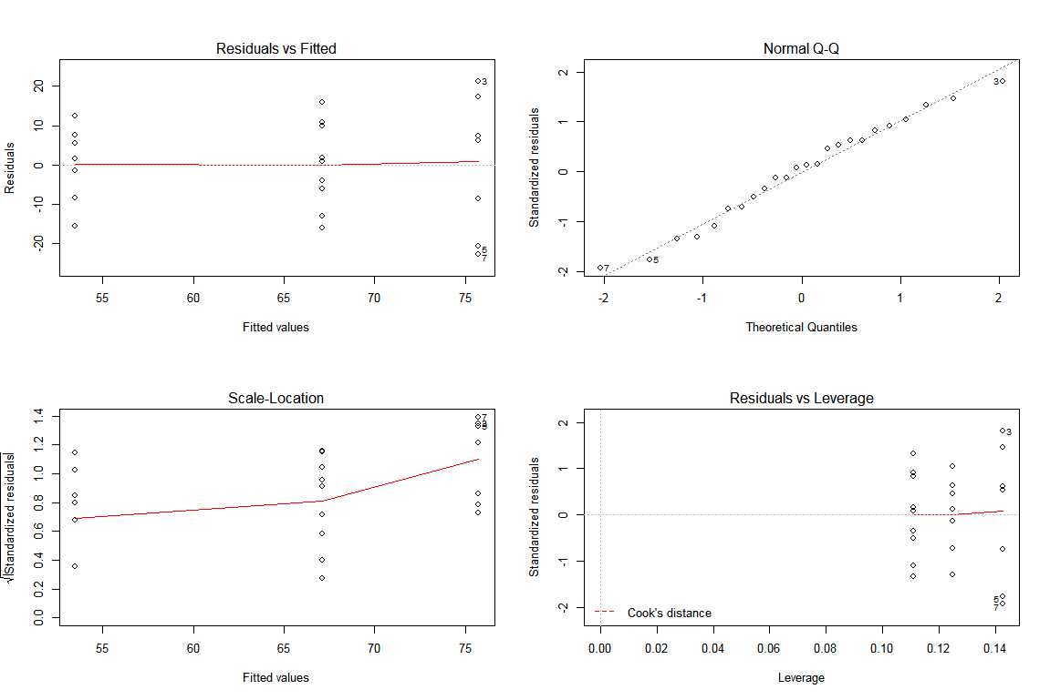
Diagnostic
Looks really good

Slide 41
ANOVA Table
Mean Sum of Squares
F-statistic
p-value
Source of variation
d.f.
Sum of squares
Between
(k groups)
k-1
SSB
(sum of squared deviations of group means from grand mean)
SSB/k-1
Go to
F_{k-1,nk-k}
chart
Within
(n individuals per group)
nk-k
SSW
(sum of squared deviations of observations from their group mean)
s²⁼SSW/nk-k
Total variation
nk-1
TSS
(sum of squared deviations of observations from grand mean)
TSS=SSB + SSW

Slide 42
Beyond one-way ANOVA
Often, you may want to test more than 1 treatment. ANOVA can accommodate more than 1 treatment or factor, so long as they are independent. Again, the variation partitions beautifully!
TSS = SSB1 + SSB2 + SSW

Slide 43
Two-Way ANOVA
Tests the Equality of 2 or More Population Means When Several Independent Variables Are Used
Same Results as Separate One-Way ANOVA on Each Variable
But Interaction Can Be Tested

Slide 44
Two-Way ANOVA Assumptions
1. Normality
Populations are Normally Distributed
2. Homogeneity of Variance
Populations have Equal Variances
3. Independence of Errors
Independent Random Samples are Drawn

Slide 45
Two-Way ANOVA Data Table
Factor
Factor B
A
1
2
...
b
Observation k
1
Y
Y
...
Y
111
121
1b1
Y
Y
...
Y
Y_{ijk}
112
122
1b2
2
Y
Y
...
Y
211
221
2b1
Y
Y
...
YX
212
222
2b2
Level i Factor A
Level j Factor B
:
:
:
:
:
a
Y
Y
...
Y
a11
a21
ab1
Y
Y
...
Y
a12
a22
ab2

Slide 46
Two-Way ANOVA Null Hypotheses
1. No Difference in Means Due to Factor A
H₀: μ_{1.} = μ_{2.} =... = μ_{a.}
2. No Difference in Means Due to Factor B
H₀: μ_{.1} = μ_{.2} =... = μ_{.b}
3. No Interaction of Factors A & B
H₀: AB_{ij} = 0

Slide 47
Two-Way ANOVA Total Variation Partitioning
Total Variation
SS(Total)
Variation Due to Treatment A
Variation Due to Treatment B
SSA
SSB
Variation Due to Interaction
Variation Due to Random Sampling
SS(AB)
SSE

Slide 48
Two-Way ANOVA Summary Table
Source of
Degrees of
Sum of
Mean
F
Variation
Freedom
Squares
Square
A
a - 1
SS(A)
MS(A)
MS(A)
(Row)
MSE
B
b - 1
SS(B)
MS(B)
MS(B)
(Column)
MSE
AB
(a-1)(b-1)
SS(AB)
MS(AB)
MS(AB)
(Interaction)
MSE
Error
n - ab
SSE
MSE
Total
n - 1
SS(Total)
Same as Other Designs

Slide 49
Interaction
1. Occurs When Effects of One Factor Vary According to Levels of Other Factor
2. When Significant, Interpretation of Main Effects (A & B) Is Complicated
3. Can Be Detected
In Data Table, Pattern of Cell Means in One Row Differs From Another Row
In Graph of Cell Means, Lines Cross

Slide 50
Different types of t-test
2 sample t tests
Related = two samples related, i.e. same people in both conditions
Independent = two independent samples, i.e. diff people in 2 conditions
One sample t tests
compare the mean of one sample to a given value
Notes:
2 sample t tests
Like e.g. above.
These may be related or independent
Related = two samples related, i.e. same people in both conditions
Independent = two independent samples, i.e. diff people in 2 conditions
Q – does fMRI always use related???
Also there are…
One sample t tests
- These compare the mean of one sample to a given value (e.g. 0)

Slide 51
Another approach to group differences
Analysis Of VAriance (ANOVA)
Variances not means
Multiple groups
e.g. Different facial expressions
H₀ = no differences between groups
H₁ = differences between groups
Notes:
ANOVA uses variances instead of means to compare groups
Unlike t-tests where only 2 groups can be compared, ANOVA can compare across 3, 4, 5 groups or more
For example, do different facial expression elicit different neuronal activity?
Could compare the neural activity associated with happy, sad, and neutral faces

Slide 52
Calculating F
F = the between group variance divided by the within group variance
the model variance/error variance
for F to be significant the between group variance should be considerably larger than the within group variance
Notes:
F = statistic computed in ANOVA
This can be defined as…
the between group variance divided by the within group variance
Or sometimes referred to as the model variance/error variance
If = 1 then means that the between and the within group variances are equal
So for F to be sig it must be noticeably larger than one, i.e. the between group variance should be considerably larger than the within group variance
Again this value and it’s associated degrees of freedom are used to find the p value

Slide 53
What can be concluded from a significant ANOVA?
There is a significant difference between the groups
NOT where this difference is
Finding exactly where the differences come from requires further statistical analyses

Slide 54
Different types of ANOVA
One-way ANOVA
One factor with more than 2 levels
Factorial ANOVAs
More than 1 factor
Mixed design ANOVAs
Some factors independent, others related
Notes:
The type that I have described is referred to as a one-way ANOVA because it has one factor which = cartoon characters (with more than 2 levels)
Can also have two-way, three-way ANOVAs
These = factorial ANOVAs
Allow for possible interactions between factors as well as main effects
For example you could have 2 factors with 2 levels each
This would = a 2 x 2 factorial design
Can also have related or independent designs or a mixture

Slide 55
Conclusions
T-tests assess if two group means differ significantly
Can compare two samples or one sample to a given value
ANOVAs compare more than two groups or more complicated scenarios
They use variances instead of means

Slide 56
A Repertoire of Hypothesis Tests
z-test – for use with normal distributions and large samples.
t-test – for use with small samples and when the pop std deviation is unknown.
F-test (ANOVA) – for comparing means for multiple groups.
Chi-square test – for use with qualitative data.

Slide 57
Null and Alternative Hypotheses
How you write the null and alternative hypothesis varies with the design of the study – so does the type of statistic.
Which table you use to find the critical value depends on the test statistic (t, F, chi-square, U, T, H).
This will be on the final exam.

Slide 58
Deciding Which Test to Use
Is data qualitative or quantitative?
If qualitative use Chi-square.
How many groups are there?
If two, use t-tests, if more use ANOVA
Is the design within or between subjects?
How many independent variables (IVs or factors) are there?

Slide 59
Summary of t-tests
Single group t-test for one sample compared to a population mean.
Independent sample t-test – for comparing two groups in a between-subject design.
Paired (matched) sample t-test – for comparing two groups in a within-subject design.

Slide 60
Summary of ANOVA Tests
One-way ANOVA – for one IV, independent samples
Repeated Measures ANOVA – for one or more IVs where samples are repeated, matched or paired.
Two-way (factorial) ANOVA – for two or more IVs, independent samples.
Mixed ANOVA – for two or more IVs, between and within subjects.

Slide 61
Summary of Nonparametric Tests
Two samples, independent groups – Mann-Whitney (U).
Like an independent sample t-test.
Two samples, paired, matched or repeated measures – Wilcoxon (T).
Like a paired sample t-test.
Three or more samples, independent groups – Kruskal-Wallis (H).
Like a one-way ANOVA.

Slide 62
Summary of Qualitative Tests
Chi Square (χ²) – one variable.
Tests whether frequencies are equally distributed across the possible categories.
Two-way Chi Square – two variables.
Tests whether there is an interaction (relationship) between the two variables.

Slide 63
Guinea pig tooth growth
A study was conducted to evaluate the growth rates of the teeth of Guinea Pigs (measured in millimeters, mm) based on different routine for vitamin C intake. N=60 Guinea Pigs were obtained from a local breeder and each received Orange Juice (OJ) or ascorbic acid (the stuff in vitamin C capsules, called VC below) at one of three dosages (0.5, 1, or 2 mg) as a source of added Vitamin C in their diets. Each guinea pig was randomly assigned to receive one of the six different treatment combinations possible (OJ at 0.5 mg, OJ at 1 mg, OJ at 2 mg, VC at 0.5 mg, VC at 1 mg, and VC at 2 mg). The animals were treated similarly otherwise and we can assume lived in separate cages.

Slide 64
Questions:
What analysis technique we should employ?
Please state the hypothesis
Perform analysis
Report the results
Data: ToothGrowth – available in R

Slide 65
The Data
The ToothGrowth datasets has data for the analysis of the effect of vitamin C on tooth growth in Guinea pigs. The data has the length of odontoblasts (teeth) in each of 10 guinea pigs at each of three dose levels of Vitamin C (0.5, 1, and 2 mg) with each of two delivery methods (orange juice or ascorbic acid).
This data frame has 60 observations and 3 variables:
len - Tooth length (numeric).
supp - Supplement type: VC-“Vitamin C”" or OJ-“orange juice” (factor).
dose - Dose in milligrams (numeric).
This following R code compactly displays the internal structure of the ToothGrowth dataset:
library(datasets) ## Loading the package "datasets" data(ToothGrowth) ## Loading the data str(ToothGrowth) ## Looking at the dataset variables

Slide 66
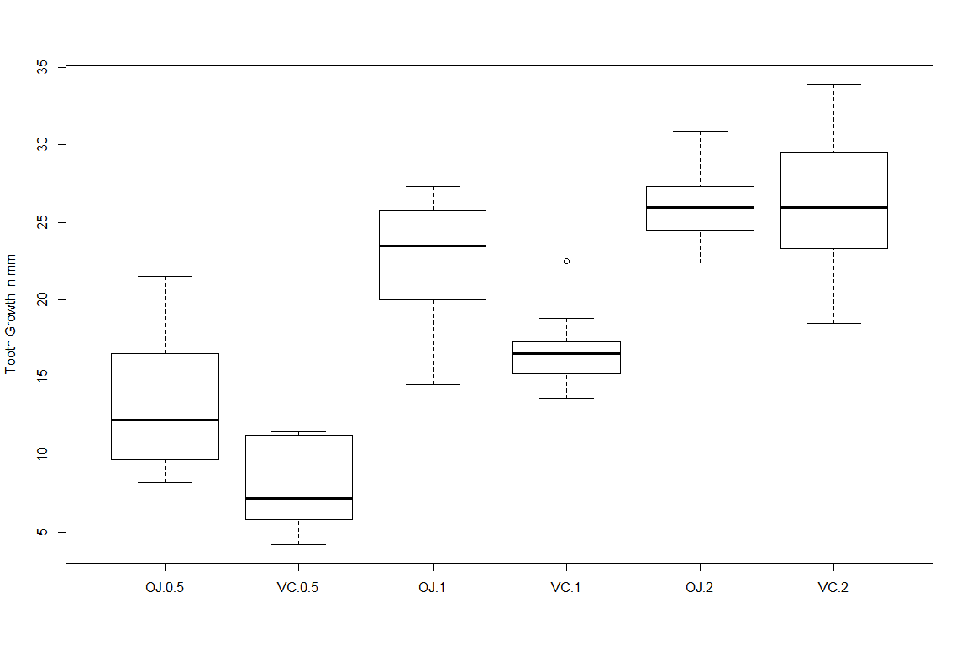
Box Plot

Slide 67
Data Summary
 | Sum | Mean | Sd | Min | Max
OJ 0.5 | 132.3 | 13.2 | 4.46 | 8.2 | 21.5
VC 0.5 | 79.8 | 7.98 | 2.75 | 4.2 | 11.5
OJ 1 | 227 | 22.7 | 3.91 | 14.5 | 27.3
VC 1 | 167.7 | 16.77 | 2.51 | 13.6 | 22.5
OJ 2 | 260.6 | 26.06 | 2.66 | 22.4 | 30.9
VC 2 | 261.4 | 26.14 | 4.8 | 18.5 | 33.9

Slide 68
What we observe
Box plot suggests that the mean tooth growth increases with the dosage level and that OJ might lead to higher growth rates than VC except at dosages of 2 mg. The variability around the means looks to be small relative to the differences among the means, so we should expect a small p-value from our F-test. The design is balanced as noted above (nj = 10 for all six groups) so the methods are somewhat resistant to impacts from non-normality and non-constant variance. There is some suggestion of non-constant variance in the plots but this will be explored further below when we can visually remove the difference in the means from this comparison. There might be some skew in the responses in some of the groups but there are only 10 observations per group so skew in the boxplots could be generated by very few observations.

Slide 69
Hypotesis
Hypotheses:
H₀: μ_{OJ0.5} = μ_{VC0.5} = μ_{OJ1} = μ_{VC1} = μ_{OJ2} = μ_{VC2} vs H_{A}: Not all μ_{j} equal
The null hypothesis could also be written in reference-coding as H₀: τ_{VC0.5} = τ_{OJ1} = τ_{VC1} = τ_{OJ2}= τ_{VC2} = 0 since OJ.0.5 is chosen as the baseline group
The alternative hypothesis can be left a bit less specific: H_{A}: Not all τ_{j} equal 0.

Slide 70
Validity conditions (1)
By design of the experiment: This is where the separate cages note above is important. Suppose that there were cages that contained multiple animals and they competed for food or could share illness. The animals in one cage might be systematically different from the others and this "clustering" of observations would present a potential violation of the independence assumption. If the experiment had the animals in separate cages, there is no clear dependency in the design of the study and can assume that there is no problem with this assumption.

Slide 71
Validly assumptions (2)2
Constant variance: As noted above, there is some indication of a difference in the variability among the groups in the boxplots but the sample size was small in each group. We need to fit the linear model to get the other diagnostic plots to make an overall assessment.

Slide 72
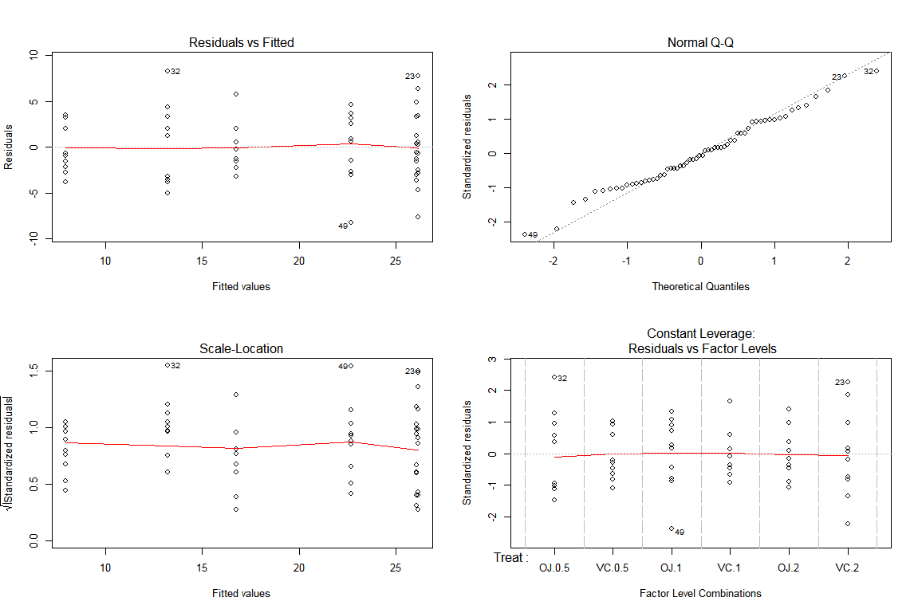
Diagnostic plots
m2=lm(len~Treat,data=ToothGrowth)
par(mfrow=c(2,2))
plot(m2)

Slide 73
Diagnostic Plot Conclusions
The Residuals vs Fitted panel shows some difference in the spreads but the spread is not that different between the groups.
The Scale-Location plot also shows just a little less variability in the group with the smallest fitted value but the spread of the groups looks fairly similar in this alternative scaling.
Put together, the evidence for non-constant is not that strong and we can assume that there is at least not a major problem with this assumption.
• Normality of residuals:
The Normal Q-Q plot shows a small deviation in the lower tail but nothing that we wouldn't expect from a normal distribution. There is no evidence of a problem with this assumption in the upper right panel

Slide 74
Running ANOVA

Slide 75
Conclusion
It seems that our assumptions about variance and normality are not violated (note that we do not say "met" - we just have no strong evidence against them).
The p-value comes from the ANOVA table as <2.2e-16. This is in scientific notation and means it is at the numerical precision of the computer and it reports that this is a very small number. You report that the p-value<0.00001 but should not report that it is 0. This p-value came from an F(5,54) distribution (the distribution of the test statistic if the null hypothesis is true).

Slide 76
Write up
Reject H₀ since the p-value is less than 5%
There is evidence at the 5% significance level that the different treatments (combinations of OJ/VC and dosage levels) cause some difference in the true mean tooth growth for these Guinea Pigs.

Slide 77
Some additional info

Slide 78
Design of experiments and sample size

Slide 79
To evaluate a study review these guidelines
Designing a statistical study
Identify the variable(s) of interest (the focus) and the population of the study.
Develop a detailed plan for collecting data. If you use a sample, make sure the sample is representative of the population.
Collect the data
Describe the data, using descriptive statistics techniques.
Interpret the data and make decisions about the population using inferential statistics.
Identify any possible errors.

Slide 80
Data Collection
There are several ways you can collect data. Often, the focus of the study dictates the best way to collect data. The following a 4 methods of data collection
Do an observational study
Perform an experiment
Use a simulation
Use a survey.

Slide 81
Observational Study
Researchers observe and measures characteristics of interest of part of a population. For example, an observational study was performed in which researchers observed and recorded the mouthing behavior on nonfood objects of children up to 3 years old.

Slide 82
Example of an Observational Study
The present study describes helping behavior of preschool children. 156 children between the ages of 18 and 76 months were observed 3 times for 10 min each, during their free play activity. The observers coded each helping act (whether it was performed in play or in reality) and noted its form (sharing, giving, aiding, and comforting), circumstances (self-initiation, compliance, and imitation), and condition (no promise of a reward, promise of social reward, promise of tangible reward and threat). The children were divided into 5 age groups. The results showed that, in general, helping behavior did not increase with age. But, with age, children performed fewer helping acts in imaginative play situations and more real helping acts. Also, with age, children performed more real comforting acts and fewer real giving acts. With regard to the other categories, no age differences were found.

Slide 83
Experiment
In an experiment, a treatment is applied to part of a population and responses are observed. For example, an experiment was performed in which diabetics took cinnamon extract daily while a control group took none. After 40 days, the diabetics who had the cinnamon reduced their risk of heart disease while the control group experienced no change.
Note: The difference between an observational study and an experiment is that in an observational study a researcher does not influence the responses whereas in an experiment a researcher deliberately applies a treatment before observing the responses.

Slide 84
Example of an Experiment
From about February 1942 to about April 1945, experiments were conducted at the Dachau concentration camp in order to investigate immunization for treatment of malaria. Healthy inmates were infected by mosquitoes or by injections of extracts of the mucous glands of female mosquitoes. After contracting the disease, the subjects were treated with various drugs to test their relative efficiency. Over 1,000 people were used in these experiments and more than half died as a result.

Slide 85
Simulation
A simulation is the use of a mathematical or physical model to reproduce the conditions of a situation or process. Collecting data often involves the use of computers. Simulations allow you to study situations that are impractical or even dangerous to create in real life, and often the save time and money. For examples, automobile manufactures use simulations with dummies to study the effect of crashes on humans.

Slide 86
Example of Simulation
National Transportation Safety Board officials say Asiana Flight 214 came in too slow and not high enough, leading to Saturday’s plane crash in San Francisco.
While investigators are still trying to figure out how and why this happened, aviation experts are recreating the deadly crash in simulators like one in Nashua, New Hampshire.
“We can do things in a simulator, we would never do in an airplane,” Steve Cunningham said.

Slide 87
Surveys
A survey is an investigation of one or more characteristics of a population. Most often, surveys are carried out on people by asking them questions. The most common types of surveys are done by interview, mail, or telephone. In designing a survey, it is important to word the questions so that they do not lead to biased results. Surveys can be used to take a census or a sampling.
A census is a count or measure of an entire population. Taking a census provides complete information, but it is often costly and difficult to perform.
A sampling is a count or measure of part of a population. For instance, every year the U.S. Census Bureau samples the U.S. Population to update the most recent census data. Using Samples is often more practical than taking a census.

Slide 88
Example of a Survey
AUSTIN (KXAN) - Depending on your point of view, a national survey published Tuesday has either staggering or sobering news for Austin.
According to the online Daily Beast, Texas' capital is the fifth drunkest city in the United States. Not as drunk as Boston, Norfolk, Va., Milwaukee and Charleston, S.C.
The publication ranked the top 25 using criteria like the average number of drinks downed per month by adults, the percentage of the population classified as "binge drinkers" and the percent of the population classified as heavy drinkers.
For Austin, the drinks-per-month figure was 14.6. The binge drinker percentage was 18.4 percent. And 5 percent of Austin's population was classified as heavy drinkers.
But those are lightweight stats compared with Boston. Drinks per month for the New England city averaged 15.6. More than 20 percent were binge drinkers and 7.4 percent was classified as heavy drinkers.

Slide 89
Deciding on Methods of Data Collection
Let’s consider the following statistical studies and decide which method of data collection would you use to collect data for each study? Explain your reasoning.
A study of the effect of changing flight patterns on the number of airplane accidents.
A study of the effects of aspirin on preventing heart attacks.
A study of how fourth grade students solve a puzzle.
A study of U.S. residents’ approval rating of the U.S. president.
Notes:
1. Because it would be impractical to create this situation, use a simulation. 2. In this study, you want to measure the effect a treatment (taking aspirin) has on patients. So you would want to perform an experiment. 3. Because you want to observe and measure certain characteristics of part of a population, you could do an observational study. 4. You could use a survey that asks. “ Do you approve of the way the president is handling his job?”

Slide 90
Sampling Techniques
To collect unbiased data, a researcher must ensure that the sample is representative of the population. Appropriate sampling techniques must be used to ensure that inferences about the population are valid. Remember that when study is done with faulty data, the results will be questionable.

Slide 91
Random Sample
A random sample is one in which every member of the population has an equal chance of being selected.

Slide 92
Simple Random Sample
A simple random sample is a sample which every possible sample of the same size has the same chance of being selected. One way to collect a simple random sample is to assign a different number to each member of the population and then use a random number table. Responses, counts or measures from members of the population whose numbers than correspond to those generated using a table. Calculators and computer software programs are also used to generate random numbers.
When you choose members of a sample, you should also decide whether it is acceptable to have the same population member selected more than once.

Slide 93
With Replacement or Without Replacement
If it is acceptable, than the sampling process is said to be with replacement. If it is not acceptable, than the sampling process is said to be without replacement.

Slide 94
Stratified Sample
When it is important for the sample to have members from each segment of the population, you should use a stratified sample. Depending on the focus of the study, members of the population are divided into two or more subsets, called strata, that share a similar characteristic such as age, gender, ethnicity or even political preference.
A sample is then randomly selected from each of the strata.

Slide 95
Example
We want to collect a stratified sample of the number of people who live in Lago Vista households so we are going to divide the households in socioeconomic levels and then randomly select households from each level.
High income
Medium
income
Low income
Notes:
Do you have to have the same number at each level why or why not?

Slide 96
Cluster Sample
When the population falls into naturally occurring subgroups, each having similar characteristics, a cluster sample may be the most appropriate. To select a cluster sample, divide the population into groups called clusters, and select all the members in one or more(but not all) of the clusters.
Examples of clusters could be different sections of the same course. Mrs. Bode’s 1st period Statistics class and her 3rd period Statistics class.
In using a cluster sample, care must be taken to ensure that all clusters have similar characteristics. For example, if one class has a higher proportion of Pre-AP and AP students data might not be representative of the population.
Notes:
I can’t just use one class to describe academic performance.

Slide 97
Systematic Sample
A systematic sample is a sample in which each member of the population is assigned a number. The members of the population are ordered in some way, a starting number is randomly selected, and then sample members are selected at regular intervals from the starting numbers.
For example , every 3rd or 5th one is selected. An advantage of this is that it is easy to use.

Slide 98
Biased Samples
A biased sample is one that is not representative of the population from which it is drawn. For instance, a sample consisting of only 18 to 22 year old University of Texas students would NOT be representative of the entire 18 to 22 year old population in the entire country.
A type of sample that often leads to biased studies ( so it is not recommended) is a convenience sample. A convenience sample consists only of available members of the population.

Slide 99
Real World Application
The Gallup Organization conducts many polls (or surveys) regarding the president, Congress and nonpolitical issues. A commonly cited Gallup poll is the public approval rating of the president. For example, the approval ratings for President George W. Bush from 2002 to 2004are shown in the graph.
What are some ways that Gallup could select a biased sample to conduct a poll? How could Gallup select a sample that is unbiased?
Note: The rating is from the first poll conducted in January of each year.

Slide 100
Identifying Sampling Techniques
You are doing a study to determine the opinion of students at your school regarding gun control. Identify the sampling technique you are using if you select the samples listed.
You select a class at random and question each student in the class.
You divide the student population with respect to electives taken and randomly select and questions some students in each elective class.
You assign each student a number and generate random numbers. You then question each student whose number is randomly selected.
Notes:
1. Because each class is a naturally occurring subgroup ( a cluster) and you question each student in the class, this is a Cluster Sample.
2. Because students are divided into strata (electives) and a sample is selected from each elective class this is a stratified sample.
3. Each Sample of the same size has an equal chance of being selected and each student has an equal chance of being selected, so this is a simple random Sample.

Slide 101
Uses and Abuses Statistics in the Real World
Uses
Surveys – Surveys can be valuable in determining the attitude of a population about a candidate, product, or issue.
If you are working for a political candidate, it is important that you know how the voting population views your candidate. With this information, you might be able to address voter concerns and increase your candidate’s chance of winning the election.
If you are working in the marketing research department of a manufacturing company, it is important that you know how the public will react to a proposed new product before the product is produced. Perhaps you will be able to alter the product’s design to make it more appealing and capture a greater market share.
If you are working for an activist organization, it is important that you know how the population feels about your organization’s issues. If you discover that the population does not support an issue, perhaps you will be able to change the public’s attitude through an advertising campaign.

Slide 102
Uses and Abuses Statistics in the Real World
Abuses
Biased Samples – The most common abuse ( or misuse) of statistics is using a sample that does not represent the entire population of the study. Consider a phone survey of opinions about a candidate for the Leander school board. The survey consisted of phone calls to numbers listed in the local phone directory of the 930 phone numbers dialed 543 were answered. Of the calls that were answered, 162 people agreed to take the survey. Of those surveyed 62% plan on voting for the candidate.
What can we conclude from this survey?

Slide 103
Uses and Abuses Statistics in the Real World
Abuses cont…
It should be clear that we CANNOT conclude from this survey that 62% of the voters in the locality plan on voting for the candidate. The survey did not include voters with unlisted numbers, or who did not happen to be at home, or who did not agree to participate in the phone survey. In such cases, we say that the survey is biased toward people who have listed phone numbers, tend to be home in the evening, and are willing to participate in surveys.

Slide 104
Uses and Abuses Statistics in the Real World
Abuses cont…
Biased Survey Questions – Another common abuse is using survey questions that encourage respondents, either intentionally or unintentionally, to answer in a certain way. For instance, consider a survey about gun control. It seems clear that the following questions would produce very different results.
“Do people have the right to own a gun to protect themselves and their families?”
“Do people have the right to possess loaded guns in their homes?”

Slide 105
Surveys
A survey is an investigation of one or more characteristics of a population. Most often, surveys are carried out on people by asking them questions. The most common types of surveys are done by interview, mail, or telephone. In designing a survey, it is important to word the questions so that they do not lead to biased results. Surveys can be used to take a census or a sampling.
A census is a count or measure of an entire population. Taking a census provides complete information, but it is often costly and difficult to perform.
A sampling is a count or measure of part of a population. For instance, every year the U.S. Census Bureau samples the U.S. Population to update the most recent census data. Using Samples is often more practical than taking a census.

