Slide 1
What in this lecture
Binary Logistic Regression:
One Dichotomous Independent Variable
Model fit
Adapted from John Whitehead
Department of Economics
East Carolina University
http://personal.ecu.edu/whiteheadj/data/logit/logit.ppt
And from notes from Kimberly Maier, Michigan State University

Slide 2
Some real world examples
Spam Detection : Predicting if an email is Spam or not
Credit Card Fraud : Predicting if a given credit card transaction is fraud or not
Health : Predicting if a given mass of tissue is benign or malignant
Marketing : Predicting if a given user will buy an insurance product or not
Banking : Predicting if a customer will default on a loan.

Slide 3
ODDS
From the dictionary
ODDS (noun)
- the ratio between the amounts staked by the parties to a bet, based on the expected probability either way.
"the bookies are offering odds of 8-1"
- the chances or likelihood of something happening or being the case. plural noun: the odds
"the odds are that he is no longer alive“-
- superiority in strength, power, or resources; advantage.
plural noun: the odds
"she clung to the lead against all the odds"

Slide 4
From probability to odds to log of odds
Everything starts with the concept of probability.
Let’s say that the probability of success of some event is .8. Then the probability of failure is 1- .8 = .2. The odds of success are defined as the ratio of the probability of success over the probability of failure. In our example, the odds of success are .8/.2 = 4.
That is to say that the odds of success are 4 to 1. If the probability of success is .5, i.e., 50-50 percent chance, then the odds of success is 1 to 1.
The transformation from probability to odds is a monotonic transformation, meaning the odds increase as the probability increases or vice versa. Probability ranges from 0 and 1. Odds range from 0 and positive infinity.

Slide 5
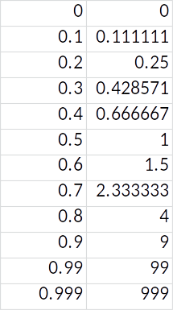
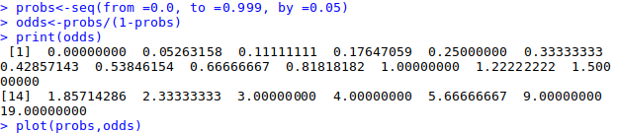
Let’s try it
Please create a table in Excel and calculate odds for probability from 0 to 1 by 0.1

Slide 6
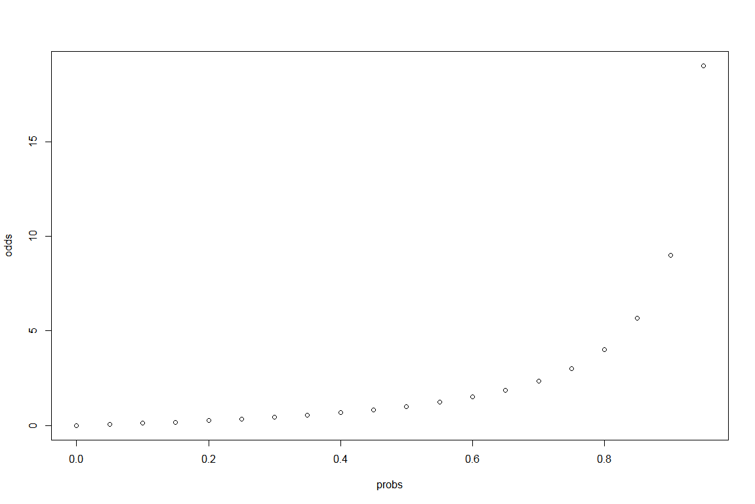
Plot the results

Slide 7
Log
The transformation from odds to log of odds is the log transformation. Again this is a monotonic transformation. That is to say, the greater the odds, the greater the log of odds and vice versa. The table below shows the relationship among the probability, odds and log of odds. We have also shown the plot of log odds against odds.
Prob | Odds | Logodds
0 | 0 | #NUM!
0.1 | 0.111111 | -2.19722
0.2 | 0.25 | -1.38629
0.3 | 0.428571 | -0.8473
0.4 | 0.666667 | -0.40547
0.5 | 1 | 0
0.6 | 1.5 | 0.405465
0.7 | 2.333333 | 0.847298
0.8 | 4 | 1.386294
0.9 | 9 | 2.197225
0.99 | 99 | 4.59512
0.999 | 999 | 6.906755

Slide 8
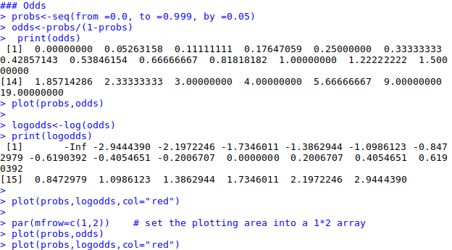
In R

Slide 9
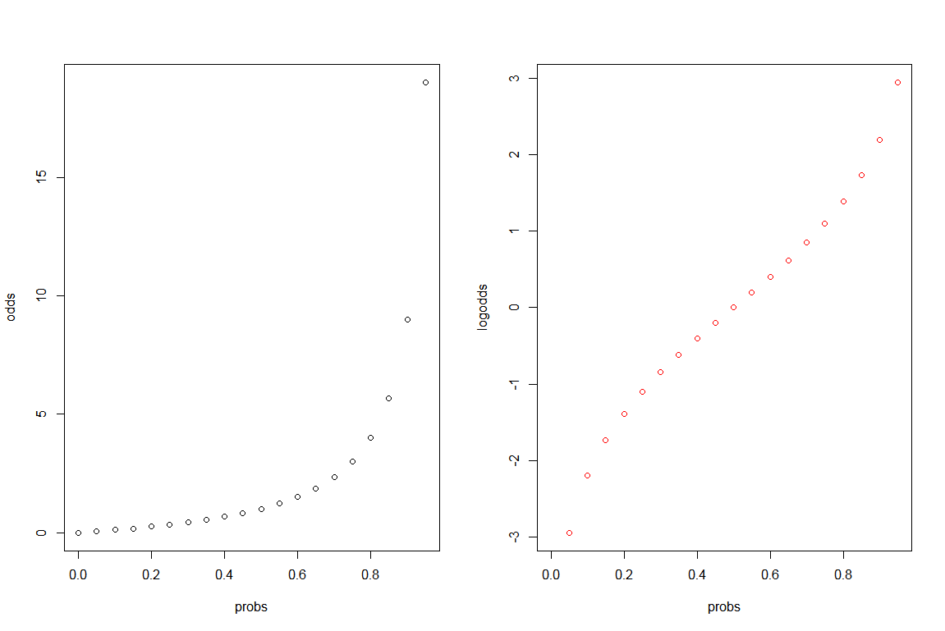
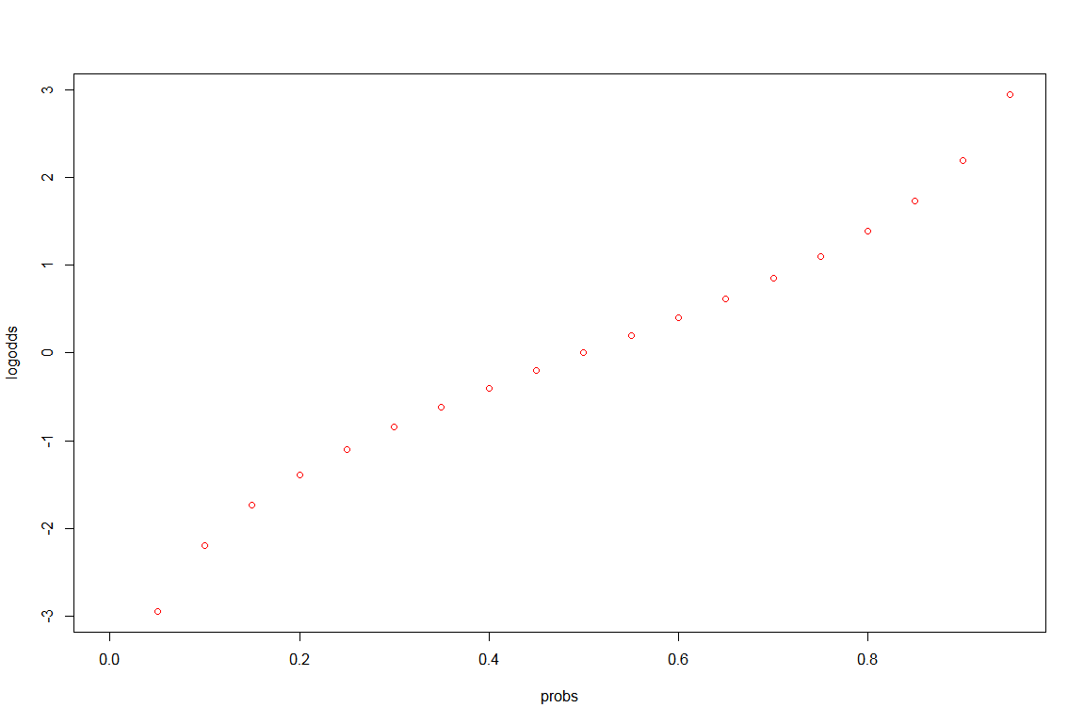
Plot log odds

Slide 10
Why all of these work?
It is usually difficult to model a variable which has restricted range, such as probability. This transformation is an attempt to get around the restricted range problem. It maps probability ranging between 0 and 1 to log odds ranging from negative infinity to positive infinity.
Among all of the infinitely many choices of transformation, the log of odds is one of the easiest to understand and interpret. This transformation is called logit transformation. The other common choice is the probit transformation, which will not be covered here.

Slide 11
Logistic regression
A logistic regression model allows us to establish a relationship between a binary outcome variable and a group of predictor variables. It models the logit-transformed probability as a linear relationship with the predictor variables. More formally, let y be the binary outcome variable indicating failure/success with 0/1 and p be the probability of y to be 1, p = prob(y=1). Let x1, .., xk be a set of predictor variables. Then the logistic regression of y on x1, …, xk estimates parameter values forβ0, β1, . . . , βk via maximum likelihood method of the following equation.
logit(p) = log(p/(1-p))= β₀ + β₁*x₁ + … + β_{k}*x_{k}

Slide 12
Back to probability
In terms of probabilities, the equation above is translated into
p= exp(β₀ + β₁*x1 + … + β_{k}*xk)/(1+exp(β₀ + β₁*x1 + … + β_{k}*xk)).

Slide 13
Why use logistic regression?
There are many important research topics for which the dependent variable is "limited."
For example: whether or not a person smokes, or drinks, or skips class, or takes advanced mathematics. For these the outcome is not continuous or distributed normally.
  Example: Are mother’s who have high school education less likely to have children with IEP’s (individualized plans, indicating cognitive or emotional disabilities)
Binary logistic regression is a type of regression analysis where the dependent variable is a dummy variable: coded 0 (no event) or 1(event)

Slide 14
The Linear Probability Model
In the OLS regression:
Y = β₀ + β₁X + e ; where Y = (0, 1)
The error terms are heteroskedastic
e is not normally distributed because Y takes on only two values
The predicted probabilities can be greater than 1 or less than 0

Slide 15
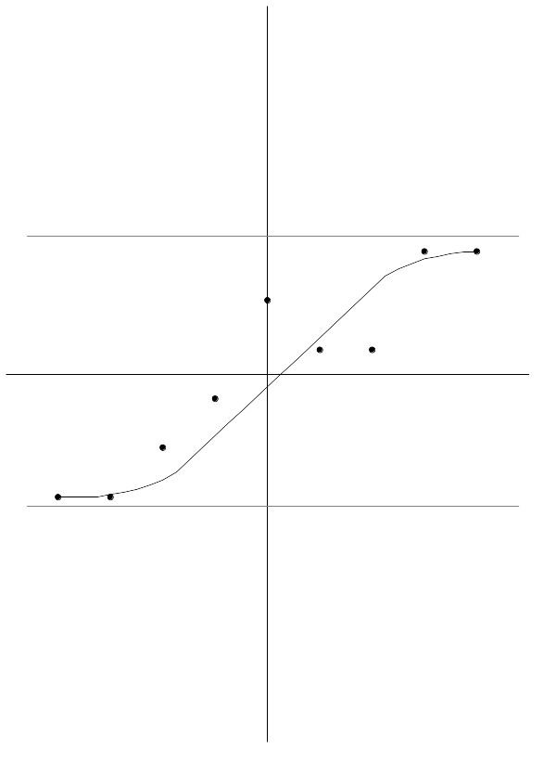
A Problem with Linear Regression
If you think about the shape of this distribution, you may posit that the function is a cumulative probability distribution. As stated previously, we can model the nonlinear relationship
between X and Y by transforming one of the variables. Two common transformations that result in sigmoid functions are probit and logit transformations. In short, a probit
transformation imposes a cumulative normal function on the data. But, probit functions are difficult to work with because they require integration. Logit transformations, on the other hand, give nearly identical values as a probit function, but they are much easier to work with because the function can be simplified to a linear equation.

Slide 16

Non-Linear Probability Models
To begin, assume the appropriate statistical experiment. The statistical experiment is draws from a Bernoulli distribution. The probability model from the Bernoulli distribution is given:
where p is a parameter reflecting the probability that y=1.
The issue then becomes how to specify the probability that y=1. We noted above that this probability often follows an S shaped distribution. In other words, the probability that y=1 remains small until some threshold is crossed, at which point it switches rapidly to remain large after the threshold. This suggests a cumulative density function.

Slide 17
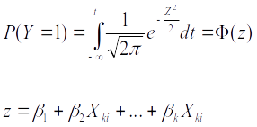
Two different cumulative density functions are commonly used in this situation: the cumulative standard normal distribution (probit) and the cumulative logistic distribution (logit).
Probit- The cumulative standard normal density is given:

Slide 18

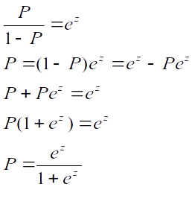
Logit- The cumulative logistic function for logit is grounded in the concept of an odds ratio. Let the log odds that y=1 be given:
Then solving for the probability that y=1 we have:

Slide 19
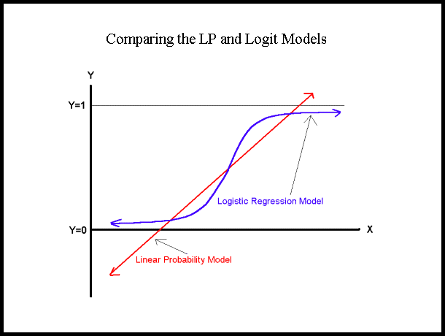


Slide 20
The Logistic Regression Model
The "logit" model solves these problems:
ln[p/(1-p)] = β₀ + β₁X
p is the probability that the event Y occurs, p(Y=1)
[range=0 to 1]
p/(1-p) is the "odds ratio"
[range=0 to ∞]
ln[p/(1-p)]: log odds ratio, or "logit“
[range=-∞ to +∞]

Slide 21


Odds & Odds Ratios
Definitions of an odds:
The odds has a range of 0 to ∞ with values greater than 1 associated with an event being more likely to occur than to not occur and values less than 1 associated with an event that is less likely to occur than not occur.
The logit is defined as the log of the odds:
This transformation is useful because it creates a variable with a range from -∞ to +∞. Hence, this transformation solves the problem we encountered in fitting a linear model to probabilities. Because probabilities (the dependent variable) only range from 0 to 1, we can get linear predictions that are outside of this range. If we transform our probabilities to logits, then we do not have this problem because the range of the logit is not restricted. In addition, the interpretation of logits is simple—take the exponential of the logit and you have the odds for the two groups in question.

Slide 22

Interpretation
The logistic distribution constrains the estimated probabilities to lie between 0 and 1.
The estimated probability is:
)
if you let β₀ + β₁X =0, then p = .50
as β₀ + β₁X gets really big, p approaches 1
as β₀ + β₁X gets really small, p approaches 0

Slide 23
Introducing the Odds Ratio for the Logistic Transformation
If there is a 75% chance that it will rain tomorrow, then 3 out of 4 times we say this it will rain. That means for every three times it rains once it will not. The odds of it raining tomorrow are 3 to 1. This can also be understood as (¾)/¼=3/1.
If the odds that my pony will win the race is 1 to 3, that means for every 4 races it runs, it will win 1 and lose 3. Therefore I should be paid $3 for every dollar I bet.

Slide 24
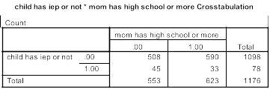
Example Interpretation of coefficient β₁
p/(1-p)=odds 5% / 95% =.5/.95=.056
Odds in IEP in with HS = (33/623)/(590/623)= 33/590=.056
8% / 92% =.8/.92 =.089
Odds in IEP, No HS = (45/553)/(508/553) =45/508=.089
Change in odds due to HS =.056/.089=.63
The odds that the child of a mother with high school education has an IEP is .63 that of other mothers – it is lower because they are less likely.
Logistic regression coefficient=LN(.63)= -.46
Change in odds =e ^{β0 + β1}/e ^{β0}=e^{β1 =} e^{-.46} =.63

Slide 25
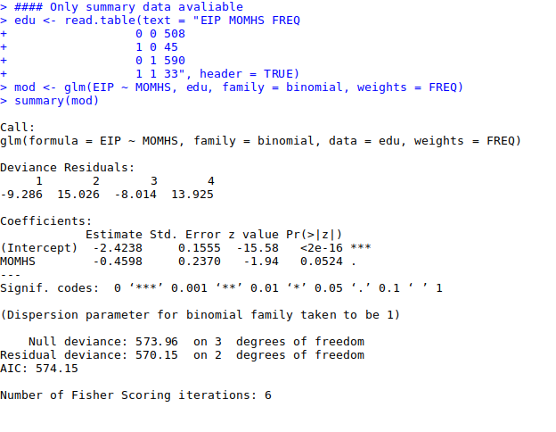
Running logistic in R

Slide 26
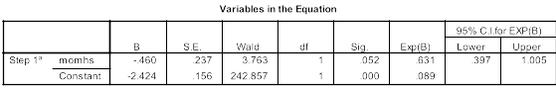
Results interpretation and post-processing
ln[p/(1-p)] = β₀ + β₁X= ln[p/(1-p)] = -2.424 -.46X
Change in odds =e ^{β0 + β1}/e ^{β0}=e^{β1} e^{-.46} =.63

Slide 27
Hypothesis Testing
The Wald statistic for the β coefficient is:
Wald = [β /s.e._{B}]²
which is distributed chi-square with 1 degree of freedom.

Slide 28

Multiple logistic regression
More than one independent variable
  Dichotomous, ordinal, nominal, continuous …
Interpretation of β_{i}
  Increase in log-odds for a one unit increase in x_{i} with all the other x_{i}s constant
  Measures association between x_{i} and log-odds adjusted for all other x_{i}

Slide 29



Transformation
α = log odds of x=0
β = log odds ratio associated
with x=1
e ^{β} = odds ratio
{
logit of P(y|x)

Slide 30

Fitting equation to the data
Linear regression: Least squares
Logistic regression: Maximum likelihood
Likelihood function
  Estimates parameters α and β
  Practically easier to work with log-likelihood

Slide 31
Maximum likelihood
Iterative computing
  Choice of an arbitrary value for the coefficients (usually 0)
  Computing of log-likelihood
  Variation of coefficients’ values
  Reiteration until maximisation (plateau)
Results
  Maximum Likelihood Estimates (MLE) for α and β
  Estimates of P(y) for a given value of x

Slide 32
Multiple logistic regression
More than one independent variable
  Dichotomous, ordinal, nominal, continuous …
Interpretation of β_{i}
  Increase in log-odds for a one unit increase in x_{i} with all the other x_{i}s constant
  Measures association between x_{i} and log-odds adjusted for all other x_{i}

Slide 33
Coding of variables
Nominal variables or ordinal with unequal classes:
  Ranking of school 1 to 4 from Institutions with a rank of 1 have the highest prestige, while those with a rank of 4 have the lowest.
  Use indicator variables (dummy variables)

Slide 34
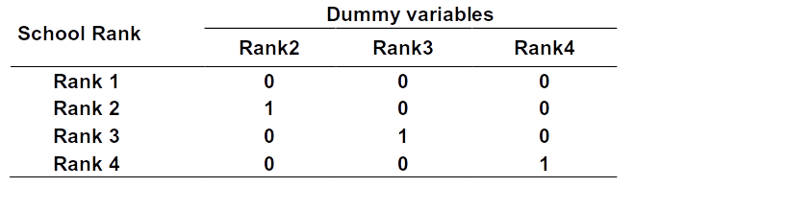
Indicator variables: Rank
Neutralises artificial hierarchy between classes in the variable “Rank"
No assumptions made
3 variables (3 df) in model using same reference
OR for each type of school rank adjusted for the others in reference to most prestigious (rank =1)

Slide 35
Example 2 –Graduate Admission
A researcher is interested in how variables, such as GRE (Graduate Record Exam scores), GPA (grade point average) and prestige of the undergraduate institution, effect admission into graduate school. The response variable, admit/don’t admit, is a binary variable.
Data description: This dataset has a binary response (outcome, dependent) variable called admit. There are three predictor variables: gre, gpa and rank. We will treat the variables gre and gpa as continuous. The variable rank takes on the values 1 through 4. Institutions with a rank of 1 have the highest prestige, while those with a rank of 4 have the lowest

Slide 36
What are the next steps?
1. Read the data (load data to R)
2. Get basic descriptive for the entire data set
Determine which model is applicable and run the model
4. Evaluate and interpret results
5. Evaluate model fit

Slide 37
Which model to apply?
Analysis methods you might consider:
Some of the methods listed are quite reasonable while others have either fallen out of favor or have limitations.
1. Logistic regression
2. Probit regression. Probit analysis will produce results similar logistic regression. The choice of probit versus logit depends largely on individual preferences.
3. OLS regression. When used with a binary response variable, this model is known as a linear probability model and can be used as a way to describe conditional probabilities. However, the errors (i.e., residuals) from the linear probability model violate the homoskedasticity and normality of errors assumptions of OLS regression, resulting in invalid standard errors and hypothesis tests.
4. Two-group discriminant function analysis. A multivariate method for dichotomous outcome variables. FYI only. The 0/1 outcome is turned into the grouping variable, and the former predictors are turned into outcome variables. This will produce an overall test of significance but will not give individual coefficients for each variable, and it is unclear the extent to which each "predictor" is adjusted for the impact of the other "predictors."

Slide 38
Simple example
Call: glm(formula = vomiting ~ age, family = binomial(link = logit))
Deviance Residuals:
Min 1Q Median 3Q Max
-1.0671 -1.0174 -0.9365 1.3395 1.9196
Coefficients:
Estimate Std. Error z value Pr(>|z|)
(Intercept) -0.141729 0.106206 -1.334 0.182
age -0.015437 0.003965 -3.893 9.89e-05 ***
---
Signif. codes: 0 '***' 0.001 '**' 0.01 '*' 0.05 '.' 0.1 ' ' 1
(Dispersion parameter for binomial family taken to be 1)
Null deviance: 1452.3 on 1093 degrees of freedom
Residual deviance: 1433.9 on 1092 degrees of freedom
AIC: 1437.9
Number of Fisher Scoring iterations: 4

Slide 39
To get the significance for the overall model we use the following command:
> 1-pchisq(1452.3-1433.9, 1093-1092)
[1] 1.79058e-05
The input to this test is:
deviance of "null" model minus deviance of current model (can be thought of as "likelihood") degrees of freedom of the null model minus df of current model
This is analogous to the global F test for the overall significance of the model that comes automatically when we run the lm() command.
This is testing the null hypothesis that the model is no better (in terms of likelihood) than a model fit with only the intercept term, i.e. that all beta terms are 0.
Thus the logistic model for these data is:
Log (E[ odds(vomiting) ]) = -0.14 – 0.02*age
This means that for a one-unit increase in age there is a 0.02 decrease in the log odds of vomiting. This can be translated to e^{-0.02} = 0.98. Groups of people in an age group one unit higher than a reference group have, on average, 0.98 times the odds of vomiting.

Slide 40
How do we test the association between vomiting and age?
H₀: There is no association between vomiting and age (the odds ratio is equal to 1)
H_{a}: There is an association between vomiting and age (the odds ratio is not equal to 1)
When testing the null hypothesis that there is no association between vomiting and age we reject the null hypothesis at the 0.05 alpha level (z = -3.89, p-value = 9.89e-05)
On average, the odds of vomiting is 0.98 times that of identical subjects in an age group one unit smaller.

Slide 41
Let’s work on this independently using R

Slide 42
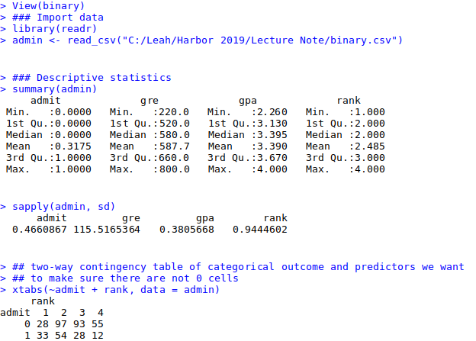
Read the data (load data to R)
Get basic descriptives for the entire data set
We can get basic descriptives for the entire data set by using summary
We can get basic descriptives for the entire data set by using summary
We can get basic descriptives for the entire data set by using summary
To get the standard deviations, we use sapply to apply the sd function to each variable in the dataset.

Slide 43
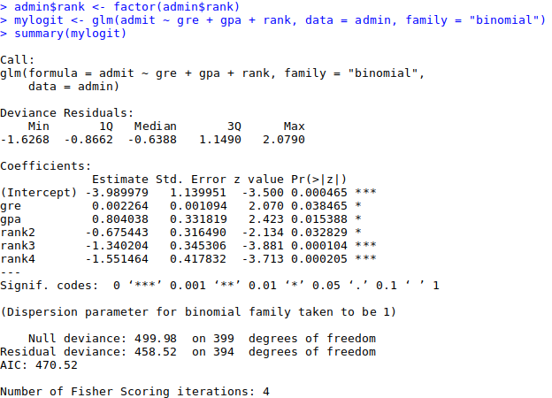
Determine which model is applicable and run the model
deviance residuals, which are a measure of model fit. This part of output shows the distribution of the deviance residuals for individual cases used in the model. Below we discuss how to use summaries of the deviance statistic to assess model fit.
The next part of the output shows the coefficients, their standard errors, the z-statistic (sometimes called a Wald z-statistic), and the associated p-values.
table of coefficients are fit indices, including the null and deviance residuals and the AIC. Later we show an example of how you can use these values to help assess model fit.

Slide 44
Fit logit model

Slide 45
Please write the equation
ln[p/(1-p)] = β₀ + β₁GRE+ β₂GPA + β₃R2 + β₄R3+ β₅R4 =
= 3.99+0.002264 GRE+0.804GPA -0.675 (Rank2=1) -1.34(Rank3=1)-1.55(Rank4=1)
Both GRE and GPA are statistically significant, as are the three terms for rank. The logistic regression coefficients give the change in the log odds of the outcome for a one unit increase in the predictor variable.
For every one unit change in GRE, the log odds of admission (versus non-admission) increases by 0.002.
For a one unit increase in GPA, the log odds of being admitted to graduate school increases by 0.804.
The indicator variables for rank have a slightly different interpretation. For example, having attended an undergraduate institution with rank of 2, versus an institution with a rank of 1, changes the log odds of admission by -0.675.

Slide 46
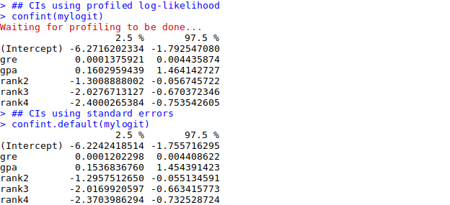
Some ‘extras’
We can use the confint function to obtain confidence intervals for the coefficient estimates. Note that for logistic models, confidence intervals are based on the profiled log-likelihood function. We can also get CIs based on just the standard errors by using the default method.

Slide 47
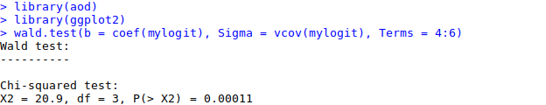
RANK – ‘dummy’ variable
We can test for an overall effect of rank using the wald.test function of the aod library. The order in which the coefficients are given in the table of coefficients is the same as the order of the terms in the model. This is important because the wald.test function refers to the coefficients by their order in the model. We use the wald.test function. b supplies the coefficients, while Sigma supplies the variance covariance matrix of the error terms, finally Terms tells R which terms in the model are to be tested, in this case, terms 4, 5, and 6, are the three terms for the levels of rank.
The chi-squared test statistic of 20.9, with three degrees of freedom is associated with a p-value of 0.00011 indicating that the overall effect of rank is statistically significant.

Slide 48
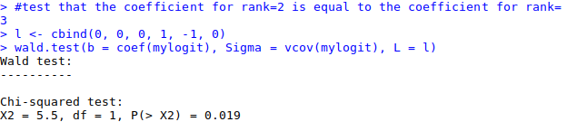
Testing ranks
We can also test additional hypotheses about the differences in the coefficients for the different levels of rank. Below we test that the coefficient for rank=2 is equal to the coefficient for rank=3. The first line of code below creates a vector l that defines the test we want to perform. In this case, we want to test the difference (subtraction) of the terms for rank=2 and rank=3 (i.e., the 4th and 5th terms in the model). To contrast these two terms, we multiply one of them by 1, and the other by -1. The other terms in the model are not involved in the test, so they are multiplied by 0. The second line of code below uses L=l to tell R that we wish to base the test on the vector l (rather than using the Terms option as we did above).
The chi-squared test statistic of 5.5 with 1 degree of freedom is associated with a p-value of 0.019, indicating that the difference between the coefficient for rank=2 and the coefficient for rank=3 is statistically significant.

Slide 49
Interpretation
We can exponentiate (in R or by hand) the coefficients and interpret them as odds-ratios. R will do this computation for you. To get the exponentiated coefficients, you tell R that you want to exponentiate (exp), and that the object you want to exponentiate is called coefficients and it is part of mylogit (coef(mylogit)). We can use the same logic to get odds ratios and their confidence intervals, by exponentiating the confidence intervals from before. To put it all in one table, we use cbind to bind the coefficients and confidence intervals column-wise.
Now we can say that for a one unit increase in gpa, the odds of being admitted to graduate school (versus not being admitted) increase by a factor of 2.23.
Note that while R produces it, the odds ratio for the intercept is not generally interpreted.

Slide 50
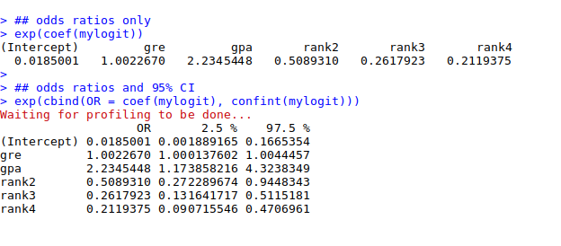



R to exponent
1.02267
2.2345
the odds of being admitted to graduate school (versus not being admitted) increase by a factor of 2.23.

Slide 51
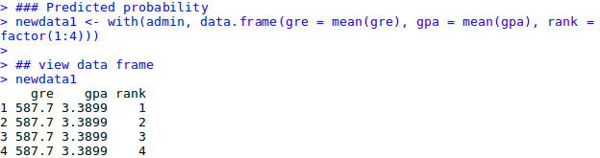
Predicted probability
You can also use predicted probabilities to help you understand the model. Predicted probabilities can be computed for both categorical and continuous predictor variables. In order to create predicted probabilities we first need to create a new data frame with the values we want the independent variables to take on to create our predictions.
We will start by calculating the predicted probability of admission at each value of rank, holding gre and gpa at their means. First we create and view the data frame.

Slide 52
> newdata2 <- with(admin, data.frame(gre = rep(seq(from = 200, to = 800, length.out = 100), + 4), gpa = mean(gpa), rank = factor(rep(1:4, each = 100)))) > > newdata3 <- cbind(newdata2, predict(mylogit, newdata = newdata2, type = "link", + se = TRUE)) > newdata3 <- within(newdata3, { + PredictedProb <- plogis(fit) + LL <- plogis(fit - (1.96 * se.fit)) + UL <- plogis(fit + (1.96 * se.fit)) + }) > > ## view first few rows of final dataset > head(newdata3) gre gpa rank fit se.fit residual.scale UL LL PredictedProb 1 200.0000 3.3899 1 -0.8114870 0.5147714 1 0.5492064 0.1393812 0.3075737 2 206.0606 3.3899 1 -0.7977632 0.5090986 1 0.5498513 0.1423880 0.3105042 3 212.1212 3.3899 1 -0.7840394 0.5034491 1 0.5505074 0.1454429 0.3134499 4 218.1818 3.3899 1 -0.7703156 0.4978239 1 0.5511750 0.1485460 0.3164108 5 224.2424 3.3899 1 -0.7565919 0.4922237 1 0.5518545 0.1516973 0.3193867 6 230.3030 3.3899 1 -0.7428681 0.4866494 1 0.5525464 0.1548966 0.3223773
>
> newdata2 <- with(admin, data.frame(gre = rep(seq(from = 200, to = 800, length.out = 100), + 4), gpa = mean(gpa), rank = factor(rep(1:4, each = 100)))) > > newdata3 <- cbind(newdata2, predict(mylogit, newdata = newdata2, type = "link", + se = TRUE)) > newdata3 <- within(newdata3, { + PredictedProb <- plogis(fit) + LL <- plogis(fit - (1.96 * se.fit)) + UL <- plogis(fit + (1.96 * se.fit)) + }) > > ## view first few rows of final dataset > head(newdata3) gre gpa rank fit se.fit residual.scale UL LL PredictedProb 1 200.0000 3.3899 1 -0.8114870 0.5147714 1 0.5492064 0.1393812 0.3075737 2 206.0606 3.3899 1 -0.7977632 0.5090986 1 0.5498513 0.1423880 0.3105042 3 212.1212 3.3899 1 -0.7840394 0.5034491 1 0.5505074 0.1454429 0.3134499 4 218.1818 3.3899 1 -0.7703156 0.4978239 1 0.5511750 0.1485460 0.3164108 5 224.2424 3.3899 1 -0.7565919 0.4922237 1 0.5518545 0.1516973 0.3193867 6 230.3030 3.3899 1 -0.7428681 0.4866494 1 0.5525464 0.1548966 0.3223773

Slide 53
Let’s plot it
In the on previous slide output we see that the predicted probability of being accepted into a graduate program is 0.52 for students from the highest prestige undergraduate institutions (rank=1), and 0.18 for students from the lowest ranked institutions (rank=4), holding gre and gpa at their means. We can do something very similar to create a table of predicted probabilities varying the value of gre and rank. We are going to plot these, so we will create 100 values of gre between 200 and 800, at each value of rank (i.e., 1, 2, 3, and 4). – Code in the previous slide as well
It can also be helpful to use graphs of predicted probabilities to understand and/or present the model. We will use the ggplot2 package for graphing. Below we make a plot with the predicted probabilities, and 95% confidence intervals.
ggplot(newdata3, aes(x = gre, y = PredictedProb)) + geom_ribbon(aes(ymin = LL,
ymax = UL, fill = rank), alpha = 0.2) + geom_line(aes(colour = rank), size = 1)

Slide 54
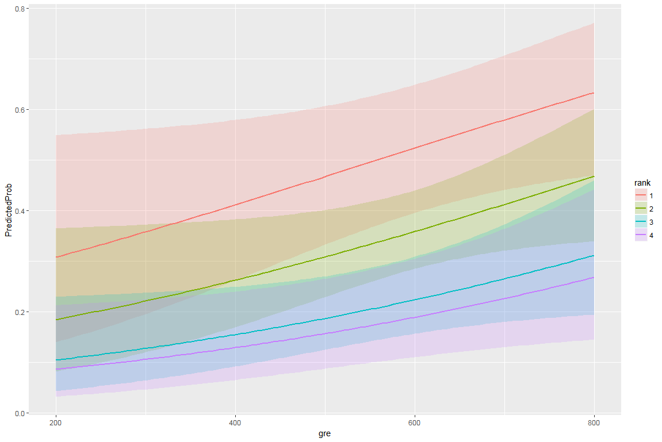

Slide 55
Interpretation
Applying such a model to our example dataset, each estimated coefficient is the expected change in the log odds of achieving success (in our example admission) for a unit increase in the corresponding predictor variable holding the other predictor variables constant at certain value. Each exponentiated coefficient is the ratio of two odds, or the change in odds in the multiplicative scale for a unit increase in the corresponding predictor variable holding other variables at certain value.

Slide 56
Assumptions
  Ratio of cases to variables – using discrete variables requires that there are enough responses in every given category
    If there are too many cells with no responses parameter estimates and standard errors will likely blow up
    Also can make groups perfectly separable (e.g. multicollinear) which will make maximum likelihood estimation impossible.

Slide 57
Assumptions
Linearity in the logit – the regression equation should have a linear relationship with the logit form of the DV. There is no assumption about the predictors being linearly related to each other.

Slide 58
Assumptions
Absence of multicollinearity
No outliers
Independence of errors – assumes a between subjects design. There are other forms if the design is within subjects.

Slide 59
Aims
When and Why do we Use Logistic Regression?
  Binary
  Multinomial
Theory Behind Logistic Regression
  Assessing the Model
  Assessing predictors
  Things that can go Wrong
Interpreting Logistic Regression

Slide 60
When And Why
To predict an outcome variable that is categorical from one or more categorical or continuous predictor variables.
Used because having a categorical outcome variable violates the assumption of linearity in normal regression.

Slide 61
With One Predictor
Outcome
  We predict the probability of the outcome occurring
b₀ and b₀
  Can be thought of in much the same way as multiple regression
  Note the normal regression equation forms part of the logistic regression equation

Slide 62
With Several Predictor
Outcome
  We still predict the probability of the outcome occurring
Differences
  Note the multiple regression equation forms part of the logistic regression equation
  This part of the equation expands to accommodate additional predictors

Slide 63

Assessing the Model
The Log-likelihood statistic
  Analogous to the residual sum of squares in multiple regression
  It is an indicator of how much unexplained information there is after the model has been fitted.
  Removing predictor variables from a model will almost always make the model fit less well (i.e., a model will have a lower log likelihood), but it is necessary to test whether the observed difference in model fit is statistically significant. The LR test does this by comparing the log likelihoods of the two models

Slide 64
Logistic Regression Overall Model Fit
The most common assessment of overall model fit in logistic regression is the goodness-of-fit test (G), which is simply the chi-square difference between the null model (i.e., with the constant only) and the model containing one or more predictors. This is one use of the likelihood ratio test between two nested models.
It is an assessment of the improvement of fit between the predicted and observed values on Y by adding the predictor(s) to the model.

Slide 65
Assessing Changes in Models
It’s possible to calculate a log-likelihood for different models and to compare these models by looking at the difference between their log-likelihoods.

Slide 66
Assessing Predictors: The Wald Statistic
Similar to t-statistic in Regression.
Tests the null hypothesis that b = 0.
Is biased when b is large.
Better to look at Likelihood-ratio statistics.

Slide 67
Assessing Predictors: The Odds Ratio or Exp(b)
Indicates the change in odds resulting from a unit change in the predictor.
  OR > 1: Predictor ↑, Probability of outcome occurring ↑.
  OR < 1: Predictor ↑, Probability of outcome occurring ↓.

Slide 68
Things That Can go Wrong
Assumptions from Linear Regression:
  Linearity
  Independence of Errors
  Multicollinearity
Unique Problems
  Incomplete Information
  Complete Separation
  Overdispersion

Slide 69
Incomplete Information From the Predictors
Categorical Predictors:
  Predicting cancer from smoking and eating tomatoes.
  We don’t know what happens when nonsmokers eat tomatoes because we have no data in this cell of the design.
Continuous variables
  Sample doesn’t include some information

Slide 70
Complete Separation
When the outcome variable can be perfectly predicted. A complete separation happens when the outcome variable separates a predictor variable or a combination of predictor variables completely. Albert and Anderson (1984) define this as, “there is a vector α that correctly allocates all observations to their group.” Below is a small example.
Y X1 X2
0 1 3
0 2 2
0 3 -1
0 3 -1
1 5 2
1 6 4
1 10 1
1 11 0
In this example, Y is the outcome variable, X1 and X2 are predictor variables. We can see that observations with Y = 0 all have values of X1<=3 and observations with Y = 1 all have values of X1>3. In other words, Y separates X1 perfectly. The other way to see it is that X1 predicts Y perfectly since X1<=3 corresponds to Y = 0 and X1 > 3 corresponds to Y = 1. By chance, we have found a perfect predictor X1 for the outcome variable Y. In terms of predicted probabilities, we have Prob(Y = 1 | X1<=3) = 0 and Prob(Y=1 X1>3) = 1, without the need for estimating a model.

Slide 71
Why complete separation is a problem
Mathematically the maximum likelihood estimate for X1 does not exist. In particular with this example, the larger the coefficient for X1, the larger the likelihood. In other words, the coefficient for X1 should be as large as it can be, which would be infinity! In terms of the behavior of statistical software packages as R do when we run the model on the sample data. We present these results here in the hope that some level of understanding of the behavior of logistic/probit regression when using our familiar software package might help us identify the problem of complete separation more efficiently.

Slide 72
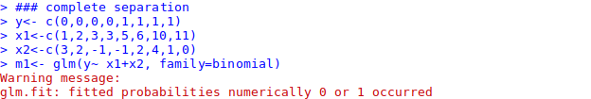
R illustration for complete separtaion

Slide 73
What to do
Depends on why (small sample size, coding of the variables)
1. Make sure that the outcome variable is not a dichotomous version of a variable in the model.
If it is quasi-complete separation, the easiest strategy is the "Do nothing" strategy. This is because that the maximum likelihood for other predictor variables are still valid. The drawback is that we don’t get any reasonable estimate for the variable X that actually predicts the outcome variable effectively. This strategy does not work well for the situation of complete separation.
2. Simple strategy is to not include X in the model. The problem is that this leads to biased estimates for the other predictor variables in the model. Thus, this is not a recommended strategy.
3. Possibly we might be able to collapse some categories of X if X is a categorical variable and if it makes substantive sense to do so.
4. Exact method is a good strategy when the data set is small and the model is not very large.

Slide 74
Overdispersion
Overdispersion is where the variance is larger than expected from the model.
This can be caused by violating the assumption of independence.
This problem makes the standard errors too small!

Slide 75
Summary
The overall fit of the final model is shown by the −2 log-likelihood statistic.
  If the significance of the chi-square statistic is less than .05, then the model is a significant fit of the data.
Check the table labelled Variables in the equation to see which variables significantly predict the outcome.
Use the odds ratio, Exp(B), for interpretation.
  OR > 1, then as the predictor increases, the odds of the outcome occurring increase.
  OR < 1, then as the predictor increases, the odds of the outcome occurring decrease.
  The confidence interval of the OR should not cross 1!
Check the table labelled Variables not in the equation to see which variables did not significantly predict the outcome.

Slide 76
Statistical testing
Question
  Does model including given independent variable provide more information about dependent variable than model without this variable?
Three tests
  Likelihood ratio statistic (LRS)
  Wald test
  Score test

Slide 77
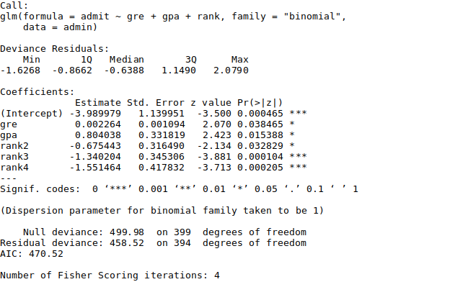
Model Diagnostic

Slide 78
The summary(logitMod) gives the beta coefficients, Standard error, z Value and p Value. If your model had categorical variables with multiple levels, you will find a row-entry for each category of that variable. That is because, each individual category is considered as an independent binary variable by the glm(). In this case it is ok if few of the categories in a multi-category variable don’t turn out to be significant in the model (i.e. p Value turns out greater than significance level of 0.5).

Slide 79
Deviance
Deviance is a measure of goodness of fit of a generalized linear model. Or rather, it’s a measure of badness of fit–higher numbers indicate worse fit.
R reports two forms of deviance – the null deviance and the residual deviance. The null deviance shows how well the response variable is predicted by a model that includes only the intercept (grand mean). The deviance has little intuitive meaning because it depends on the sample size and the number of parameters in the model as well as on the goodness of fit.
In our case n-1=400(total records)-1=399

Slide 80
Deviance or Likelihood ratio statistic (-2LL)
Compares two nested models
Log(odds) = α + β₁x₁ + β₂x₂ + β₃x₃ (model 1)
Log(odds) = α + β₁x₁ + β₂x₂ (model 2)
LR statistic
-2 log (likelihood model 2 / likelihood model 1) =
-2 log (likelihood model 2) minus -2log (likelihood model 1)
LR statistic is a χ² with DF = number of extra parameters in model

Slide 81
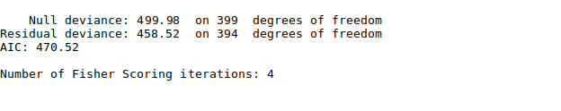
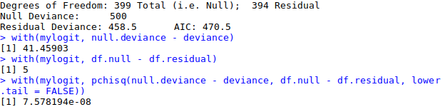
Deviance in our model
What is the improvement by adding predictors k=5
499.98-458.52=41.46
One measure of model fit is the significance of the overall model. This test asks whether the model with predictors fits significantly better than a model with just an intercept (i.e., a null model). The test statistic is the difference between the residual deviance for the model with predictors and the null model. The test statistic is distributed chi-squared with degrees of freedom equal to the differences in degrees of freedom between the current and the null model (i.e., the number of predictor variables in the model). To find the difference in deviance for the two models (by hand as above or using the following command)
The degrees of freedom for the difference between the two models is equal to the number of predictor variables in the mode,

Slide 82
Continue model fit
The chi-square of 41.46 with 5 degrees of freedom and an associated p-value of less than 0.001 tells us that our model as a whole fits significantly better than an empty model. This is sometimes called a likelihood ratio test (the deviance residual is -2*log likelihood). To see the model’s log likelihood, we type:

Slide 83
Information Criteria
The Akaike Information Criterion (AIC) provides a method for assessing the quality of your model through comparison of related models. It’s based on the Deviance, but penalizes you for making the model more complicated. Much like adjusted R-squared, it’s intent is to prevent you from including irrelevant predictors.
However, unlike adjusted R-squared, the number itself is not meaningful. If you have more than one similar candidate models (where all of the variables of the simpler model occur in the more complex models), then you should select the model that has the smallest AIC.
So it’s useful for comparing models, but isn’t interpretable on its own.

Slide 84
AIC and BIC
These are criteria that balance goodness of fit (as measured by RSS) against model complexity (as measured by the number of regression coefficients)
AIC (Akaike Information Criterion) is, up to a constant depending on n , AIC = n log(RMS_{p}) + 2p
Alternative version is AIC = RSS_{p}/RMS_{Full} + 2p, equivalent to Cp
BIC (Bayesian Information Criterion) is
RSS_{p}/RMS_{Full} + p log(n)
Small values = good model
AIC tends to favour more complex models than BIC
RMS = residual mean square

Slide 85
One more example
Data: Current Use of Contraception Among Married Women by Age, Education and Desire for More Children Fiji Fertility Survey, 1975

Slide 86
age education wants More
Kids notUsing using
<25 low yes 53 6
<25 low no 10 4
<25 high yes 212 52
<25 high no 50 10
25-29 low yes 60 14
25-29 low no 19 10
25-29 high yes 155 54
25-29 high no 65 27
30-39 low yes 112 33
30-39 low no 77 80
30-39 high yes 118 46
30-39 high no 68 78
40-49 low yes 35 6
40-49 low no 46 48
40-49 high yes 8 8
40-49 high no 12 31

Slide 87
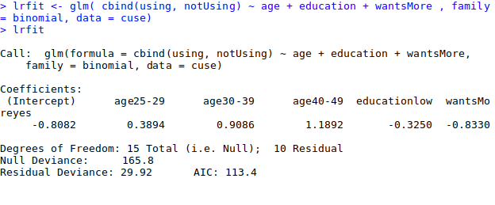
Run logistic regression
Let us first try a simple additive model where contraceptive use depends on age, education and wantsMore:
The residual deviance of 29.92 on 10 d.f. is highly significant:
The residual deviance of 29.92 on 10 d.f. is highly significant. Thus, we have evidence that there are significant net effects of age, education and desire for more children, considering each factor after controlling the other two. However, the three-factor additive model does not fit the data.

Slide 88
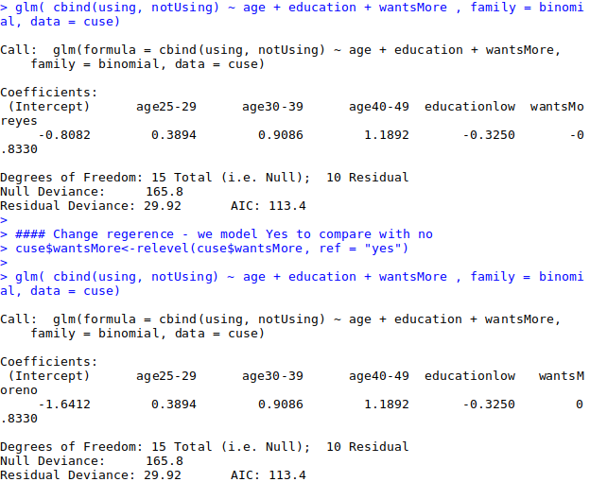
Changing reference point
Nothing else changed, only sing and intercept

Slide 89
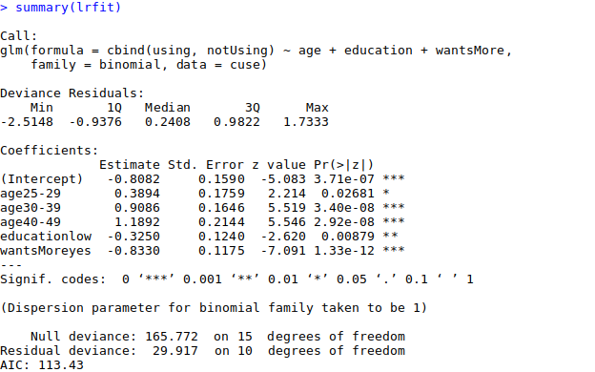
Summary of the model

Slide 90


Slide 91
How to change reference
(1) use relevel to change the base category
(2) define your own indicator variables.
In the example we used I the latter approach by defining indicators for women who want no more children:
R code:
use$wantsMore<-relevel(cuse$wantsMore, ref = "yes") or
noMore <- wantsMore == "no"

Slide 92
One more example
BLOWDOWN Data use it to model the probability that a tree in a forest is blown down during an unusually severe thunderstorm that occurred on July 4, 1999, and caused great damage over 477,000-acres of the Boundary Waters Canoe Area Wilderness in northeastern Minnesota. Data from a sample of 3666 trees were collected, including for each tree, whether it was blown down (Y = 1) or not (Y = 0), its trunk diameter D in centimeters, its species S, and the local intensity L of the storm, as measured by the fraction of damaged trees in its vicinity
The data frame blowdown includes nine species of trees, blowBF gives data for Balsam Fir only.
Format
This data frame contains the following columns:
D Tree diameter, in cm
S Proportion of basal area killed for the four species BF, C, PB, BS, a measure of local severity of the storm.
Y 1 of the tree died, 0 if it survived
SPP BF= balsam fir, BS= black spruce, C= cedar, JP= jackpine, PB= paper birch, RP= red pine, RM= red maple, BA = black ash, A= aspen.
Source: Roy Rich
References: S. Weisberg (2005). Applied Linear Regression, third edition. New York: Wiley.

Slide 93
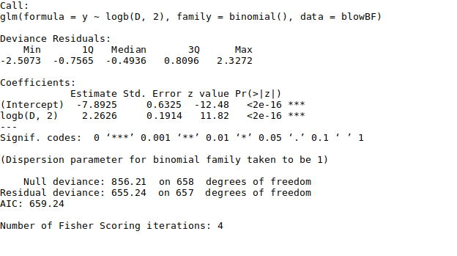
Fitting logistic regression-
One predictor
If log (D) increased by one unit (since this is a log of 2, means that the value of D doubles) the odds of fall down increase by 2.26 of exp(2.26)=9.6. Thus, three with diameter of 10 is 9.6 time likely to blow down as the tree of diameter of 5. The tree with diameter of 2 is 9.6 time likely to blow down as tree with diameter of 1 etc

Slide 94
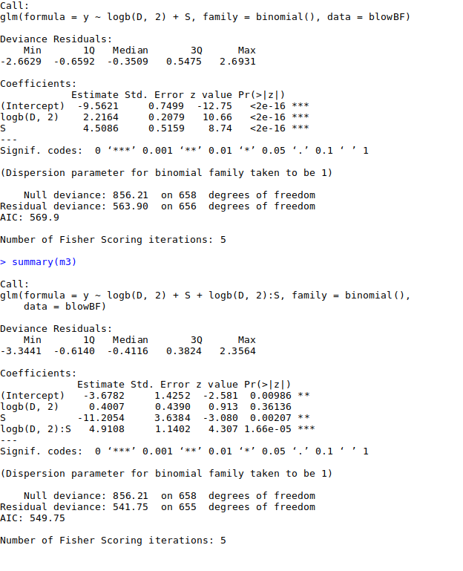
Model with additional term and interaction
Results are similar to previous model 2.2 vs 2.6 coefficient
Notice significant interaction term. Because interaction is significant we need to retain logD even it this term is not significant

Slide 95
Interpretation of interaction
Interpretation of estimates is complicated by interaction.
If log(D) is increased by one unit, what are the odds of blowdown?
exp(0.4009+4.9098S)
Depends on value of S, remember S is between 0 and 1 (score of local severity from 0- few trees affected to 1- almost all trees affected). We can’t increase S by one unit, but can summarize by 0.1
Odds multiplier for S
exp(0.1[-11.2026+4.9098log(D)]
Big trees much more likely to blow down in sever areas

Slide 96
Deviance
Analysis of Deviance for Balsam Fir Blowdown Data
Sequential Analysis of Deviance
Deviance used to provide goodness of fit test
Terms | df | Deviance | Change in DF | Change in Deviance | P(>Chi)
log(D) | 657 | 655.24
log(D), S, Sx log(D) | 655 | 541.75 | 2 | 113.49 | 0.000000
Terms | df | Deviance | Change in DF | Change in Deviance | P(>Chi)
Intercept | 658 | 856.21
Add log(D) | 657 | 655.24 | 1 | 200.97 | 0.000000
Add S | 656 | 563.9 | 1 | 91.34 | 0.000000
log(D), S, Sx log(D) | 655 | 541.75 | 1 | 22.15 | 0.000003

Slide 97
Multiple linear regression
Relation between a continuous variable and a set of
i continuous variables
Partial regression coefficients β_{i}
  Amount by which y changes on average
  when x_{i} changes by one unit
  and all the other x_{i}s remain constant
  Measures association between x_{i} and y adjusted for all other x_{i}
Example
  SBP versus age, weight, height, etc

Slide 98
> summary(glm.hyp1)
Call:
glm(formula = hyp.tbl ~ smoking + obesity + snoring, family = binomial("logit"))
Deviance Residuals:
1 2 3 4 5 6 7 8
-0.04344 0.54145 -0.25476 -0.80051 0.19759 -0.46602 -0.21262 0.56231
Coefficients:
Estimate Std. Error z value Pr(>|z|)
(Intercept) -2.37766 0.38018 -6.254 4e-10 ***
smokingYes -0.06777 0.27812 -0.244 0.8075
obesityYes 0.69531 0.28509 2.439 0.0147 *
snoringYes 0.87194 0.39757 2.193 0.0283 *
---
Signif. codes: 0 `***' 0.001 `**' 0.01 `*' 0.05 `.' 0.1 ` ' 1
(Dispersion parameter for binomial family taken to be 1)
Null deviance: 14.1259 on 7 degrees of freedom
Residual deviance: 1.6184 on 4 degrees of freedom
AIC: 34.537
Number of Fisher Scoring iterations: 4

Slide 99
Estimate Std. Error z value Pr(>|z|)
(Intercept) -2.37766 0.38018 -6.254 4e-10 ***
smokingYes -0.06777 0.27812 -0.244 0.8075
obesityYes 0.69531 0.28509 2.439 0.0147 *
snoringYes 0.87194 0.39757 2.193 0.0283 *
The coefficients of the linear predictor are on the log odds ratio scale. In this data set, only obesity and snoring are related to hypertension. For obesity, the coefficient is 0.69531. Since this is log odds ratio, we must exponentiate it to get the odds ratio of exp(0.6931) = 2.00, so obesity is estimated to double the odds of hypertension. Since this is a cross-sectional study, the actual probability cannot be determined. This depends on the intercept which is part of a measure of the average risk of the population, which we do not have access to.
A 95% CI for the coefficient is 0.69531 ± (1.960)(0.28509) or (0.13653,1.2541), which is on the log odds ratio scale, or (1.146, 3.505) on the odds ratio scale. So obesity raises the odds by 15% to a factor of 3.5.

Slide 100
References
http://personal.ecu.edu/whiteheadj/data/logit/
power points
  http://personal.ecu.edu/whiteheadj/data/logit/logit.ppt
  http://www.google.com/search?q=logistic+regression+ppt&ie=utf-8&oe=utf-8&aq=t&rls=org.mozilla:en-US:official&client=firefox-a
  http://www.google.com/search?q=logistic+regression+ppt&ie=utf-8&oe=utf-8&aq=t&rls=org.mozilla:en-US:official&client=firefox-a
  http://dmrocke.ucdavis.edu/Class/EPI204-Spring-2019/EPI204-Spring-2019.html
Homework carefully go through example:
https://www.machinelearningplus.com/machine-learning/logistic-regression-tutorial-examples-r/

Slide 101
GLM
Some final notes

Slide 102
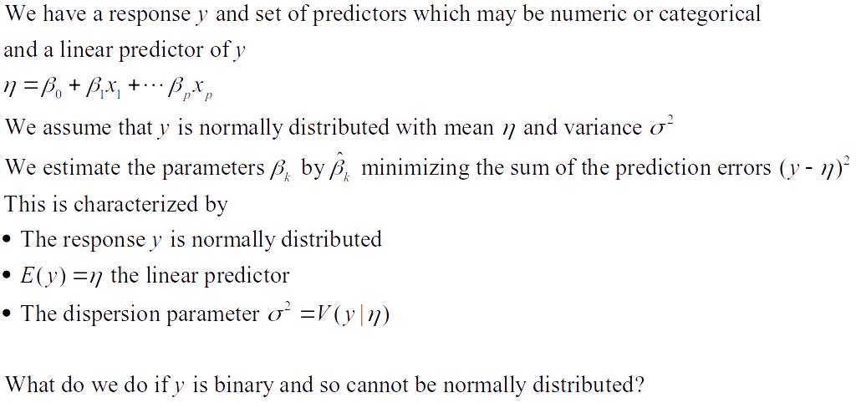
Linear Regression

Slide 103
Generalized Linear Models
The type of predictive model one uses depends on a number of issues; one is the type of response.
Measured values such as quantity of a protein, age, weight usually can be handled in an ordinary linear regression model, possibly after a log transformation.
Patient survival, which may be censored, calls for a different method (survival analysis, Cox regression).

Slide 104
If the response is binary, then can we use logistic regression models
If the response is a count, we can use Poisson regression
If the count has a higher variance than is consistent with the Poisson, we can use a negative binomial or over-dispersed Poisson
Other forms of response can generate other types of generalized linear models

Slide 105
Generalized Linear Models
We need a linear predictor of the same form as in linear regression βx
In theory, such a linear predictor can generate any type of number as a prediction, positive, negative, or zero
We choose a suitable distribution for the type of data we are predicting (normal for any number, gamma for positive numbers, binomial for binary responses, Poisson for counts)
We create a link function which maps the mean of the distribution onto the set of all possible linear prediction results, which is the whole real line (-∞, ∞).
The inverse of the link function takes the linear predictor to the actual prediction

Slide 106
Ordinary linear regression has identity link (no transformation by the link function) and uses the normal distribution
If one is predicting an inherently positive quantity, one may want to use the log link since e^{x} is always positive.
An alternative to using a generalized linear model with an log link, is to transform the data using the log. This is a device that works well with measurement data and may be usable in other cases, but it cannot be used for 0/1 data or count data that may be 0.

Slide 107
R glm() Families
Family | Links
gaussian | identity, log, inverse
binomial | logit, probit, cauchit, log, cloglog
Gamma | inverse, identity, log
inverse.gaussian | 1/mu^2, inverse, identity, log
poisson | log, identity, sqrt
quasi | identity, logit, probit, cloglog, inverse, log, 1/mu^2 and sqrt
quasibinomial | logit, probit, identity, cloglog, inverse, log, 1/mu^2 and sqrt
quasipoisson | log, identity, logit, probit, cloglog, inverse, 1/mu^2 and sqrt

Slide 108
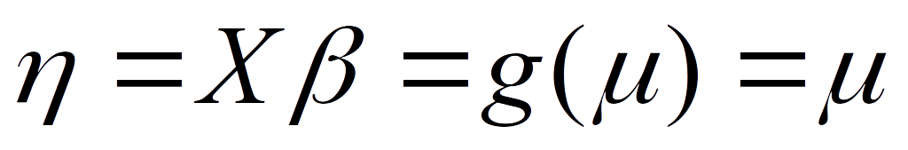
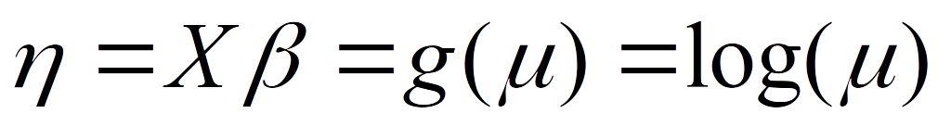
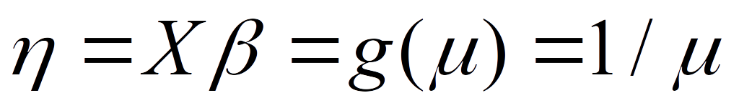
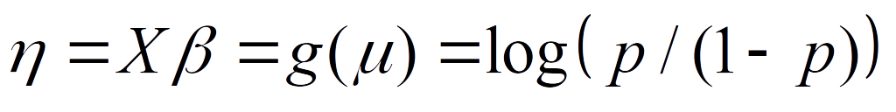
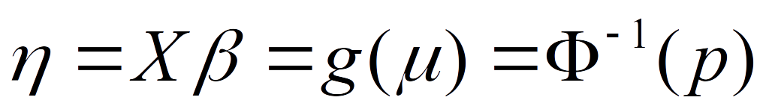
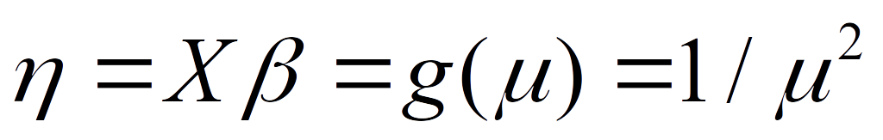
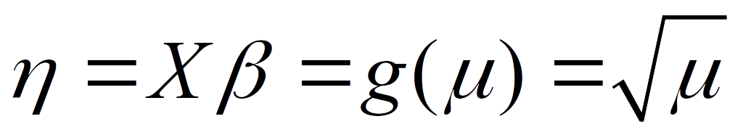
R glm() Link Functions
Links | Domain | Range
identity | (−∞, ∞) | (−∞, ∞)
log | (0, ∞) | (−∞, ∞)
inverse | (0, ∞) | (0, ∞)
logit | (0, 1) | (−∞, ∞)
probit | (0, 1) | (−∞, ∞)
cloglog | (0, 1) | (−∞, ∞)
1/mu^2 | (0, ∞) | (0, ∞)
sqrt | (0, ∞) | (0, ∞)

