Slide 1
Sign Test
Simple non-parametric procedure for testing hypothesis abound central tendency of a non-normal probability distribution.
Central tendency (η – median, µ -mean)
η – is the 50th percentile of the distribution, less effected by the skewness of the distribution and the presence of outliers (extreme observations)

Slide 2
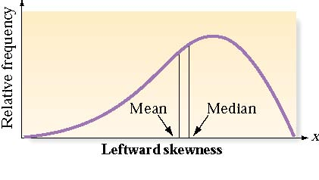
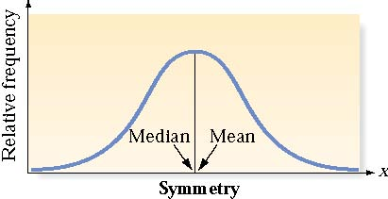
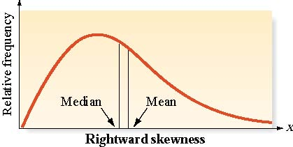
Numerical Measures of
Central Tendency
A data set is skewed if one tail of the distribution has more extreme observations that the other tail.

Slide 3
Sign Test for a Population Median
One-Tailed Test
Two-Tailed Test
H₀ : η = η₀
H_{a} : η> η₀ [η< η₀ ]
Test Statistic: S- number of sample measurements greater than η₀ [or S=number of measurements less than η_{0]}
Observed significance level
P-value=P(x≥S)
H₀ : η = η₀
H_{a} : η ≠ η₀
Test Statistic: Larger of S₁ and S₂, where S₁ is the number of measurements less than η₀ and S₂ is a number of measurements greater than η₀
Observed significance level
P-value=2P(x≥S)
Rejection Region: Reject H₀ if p-value ≤α
NOTE: Eliminate observation from the analysis that are exactly equal to the hypothesized
Median η₀

Slide 4

Large-sample Sign Test for a Population Median
One-Tailed Test
Two-Tailed Test
H₀ : η = η₀
H_{a} : η> η₀ [η< η₀]
H₀ : η = η₀
H_{a} : η ≠ η₀
Test Statistics:
S calculated as shown in previous slide. We subtract 0.5 from S as the ‘correction for continuity’. The null hypothesized value is np=0.5n and the standard deviation is
We use normal approximation for binomial probability
Rejection Region: | z | > z_{α}
Rejection Region: | z | > z_{α/2}

Slide 5
Sign Test
Tests One Population Median, η
2. Corresponds to t-Test for 1 Mean
3. Assumes Population Is Continuous
Small Sample Test Statistic: # Sample Values Above (or Below) Median

Slide 6
Test About a Population Median:
Step by Step (one-sided)
Establish hypotheses H_{o}: η=η_{o} and alternative H_{a}: η>η_{o}
Pick 
Set the decision rule for the test: if p-value≤  then reject the null hypothesis. No need to draw a picture.
Find test statistic: S=number of measurements less that null hypothesize median
Based on test statistic find p-value. To determined observed significance level, note that number of measurements S is a binomial random variable

Slide 7
One-sided sign test example
Test for substance abuse as part of employments screening.
Laboratory that conducts such testing has developed a system with normalized measurement scale in which values less than 1.00 indicate ‘normal’ ranges and values ≥ 1 indicative of potential substance abuse. The lab reports a normal result as long as the median level for an individual is less than 1.00
Eight independent measurements of each individual's sample are made. Let’s look at one individual results

Slide 8
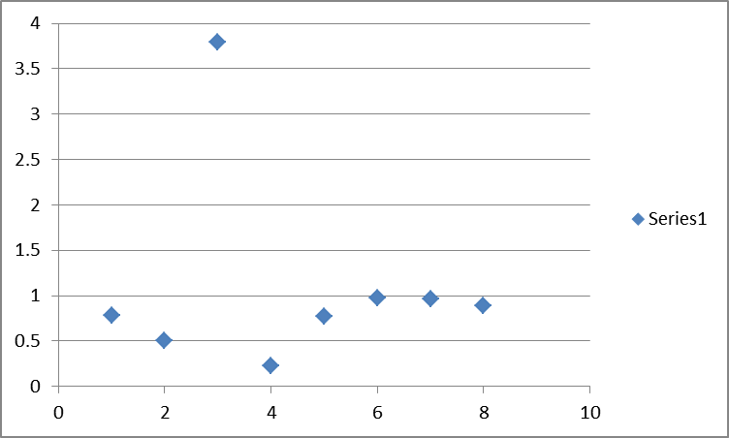
READING |  | Sign Test
0.78 |  | -
0.51 |  | -
3.79 |  | +
0.23 |  | -
0.77 |  | -
0.98 |  | -
0.96 |  | -
0.89 |  | -
Mean | 1.11
Std | 1.11
7 out of 8 values less than 1.00
One tailed test: H₀ : η = η₀
H_{a} : η< η₀
If Ho is true, the binomial probability p than a measurement lies below (or above the median) is 0.5
=BINOM.DIST(7,8,0.5,TRUE)
α=0.05
S=7
P(x≥7)=1-P(x≤7)=1-0.965=0.035
P=0.035<0.05 – reject Ho

Slide 9
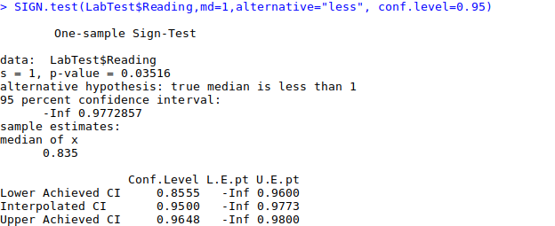
Sign Test in R
single number representing the value of the population median specified by the null hypothesis
indicating the specification of the alternative hypothesis. For one-sample tests, alternative refers to the true median

Slide 10
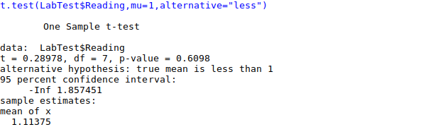
If we use t.test
Can’t reject Ho -> wrong test leads to wrong conclusions

Slide 11
Large Sample Sign Test Example
A manufacturer of MP3 players has established that the median time to failure for its players is 5,250 hours of utilization. A sample of 40 MP3 players from a competitor is obtain, and the players are tested continuously until each fails. The 40 failure times range from 5 hours (‘defective’ player) to 6,575 hours, and 24 out of 40 exceed 5,250 hours.
Is there evidence that the median failure time of the competitor’s product differs from 5,250 hours?
We will use alpha of 0.1

Slide 12

Standard deviation sqrt(npq)=sqrt(n*0.5*0.5)=0.5*sqrt(n), by definition of median probability 50% above and 50% below median
Correction for continuity

