Slide 1
Adaptive Peer Selection for
Hierarchical Federated Learning
A data-similarity approach to client–edge assignment under non-IID data
Ibrahim Aboelsouod · K12140435 · Bachelor's Programme Artificial Intelligence
Supervisor: Univ.-Prof. Dr. Alois Ferscha · Institute of Pervasive Computing
Notes:
Good morning. My thesis asks whether the client-to-edge assignment in hierarchical federated learning can be learned from the model updates themselves instead of being fixed in advance from network topology.

Slide 2
Overview
1
Motivation
Why federated learning struggles under non-IID data
2
Background
FedAvg, hierarchical FL, and the gap this work targets
3
Method
Adaptive peer selection from update similarity
4
Evaluation
Setup, metrics, and what the experiment can decide
5
Findings
Cluster recovery, a degeneracy, and a noise floor
6
Conclusion
Limitations and future work
Notes:
Six parts. I will spend most of the time on the method and on what the results do and do not support.

Slide 3
Federated learning: the promise and two problems
Train a shared model across many clients without ever centralising their raw data. Only parameter updates are exchanged.
Statistical heterogeneity
Client data is non-IID: one user, one hospital, one region. Local optima drift apart and their average serves no one well.
Accuracy degrades
Communication cost
One central aggregator must reach every client every round — a bandwidth bottleneck, a latency bottleneck, a single point of failure.
Does not scale
Hierarchical FL answers the second problem. This thesis asks whether the same structure can be made to answer the first.
Notes:
FedAvg trades communication rounds for local computation. Two structural problems have dominated the field since: statistical heterogeneity and communication cost.

Slide 4

Background: FedAvg and the non-IID problem
• FedAvg averages client parameters weighted by sample count.
• Under label skew, local optima are far from the global optimum — clients drift apart.
• Dirichlet partitioning with concentration α controls the skew; α = 0.1 is strong skew.
• Clustered FL (Sattler et al.) showed the cosine similarity of updates reveals which distribution a client belongs to.
Cosine, not Euclidean
Update magnitude reflects dataset size and training length. Only the direction carries the distributional signal.
Notes:
The key prior insight: clients from the same distribution produce positively aligned updates; clients from different ones produce near-orthogonal updates.

Slide 5
Hierarchical FL — and the gap
Abad et al., ICASSP 2020
Clients cluster around small-cell base stations; intra-cluster aggregation every round, global sync every H rounds.
5.6×–41.5× latency improvement, no accuracy penalty.
Assignment is spatial and static.
Evaluated on IID data — non-IID named as future work.
Rana et al.
Aggregator placement and user assignment framed as a dynamic optimisation problem — aggregator location need not be predetermined.
This thesis
Keep Abad et al.'s H-periodic schedule; replace the spatial rule with a similarity-driven one, in the non-IID regime they left open.
Notes:
Proximity is the right criterion for radio latency, but it says nothing about whether grouped clients have compatible data.

Slide 6
Research question and objectives
Can client-to-edge assignment be recovered at runtime from the similarity of model updates — and does it help?
1
Design
An assignment rule driven by update-delta cosine similarity, using no raw data
2
Integrate
Drop it into the H-periodic hierarchical loop without modifying the loop
3
Measure
Task accuracy and cluster recovery against a known latent grouping
4
Characterise
The accuracy–communication trade-off as the sync period H varies
Notes:
Note the third objective: because the latent grouping is planted by construction, clustering quality can be scored directly rather than inferred from accuracy.

Slide 7
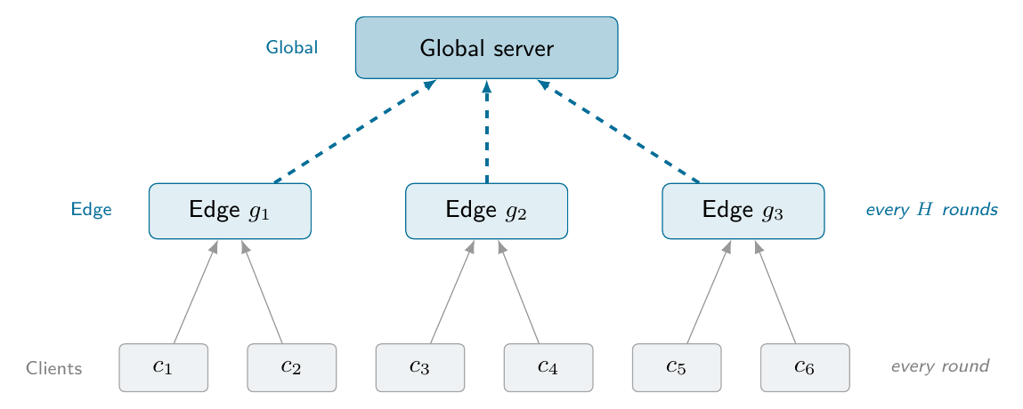
System model: three logical tiers
System A — flat
Standard FedAvg. One global model every round.
System B — static
Fixed round-robin assignment π(i) = i mod G.
System C — adaptive
π recomputed from update similarity at each sync.
Notes:
The hierarchy is logical, not physical — everything runs inside one Flower Strategy, so the three systems differ only in the assignment rule and share every other line of code.

Slide 8
Adaptive peer selection in four steps
1
Update deltas
Δᵢ = θᵢ − w_glob, restricted to the classifier layer, all measured against one common reference model
2
Similarity matrix
Pairwise cosine similarity of the deltas — direction only, magnitude discarded
3
Peer graph
Weighted graph, sparsified by a similarity threshold τ union the top-k nearest neighbours
4
Community detection
Louvain partitions the graph; each community becomes one edge aggregator — the number of groups is emergent, not a hyperparameter
Uses only the parameter updates FedAvg already transmits — no raw data, no label histograms, no extra communication.
Notes:
The classifier head carries the clearest signal about which labels a client has seen, and it cuts the vector length from 50,186 to 31,370.

Slide 9
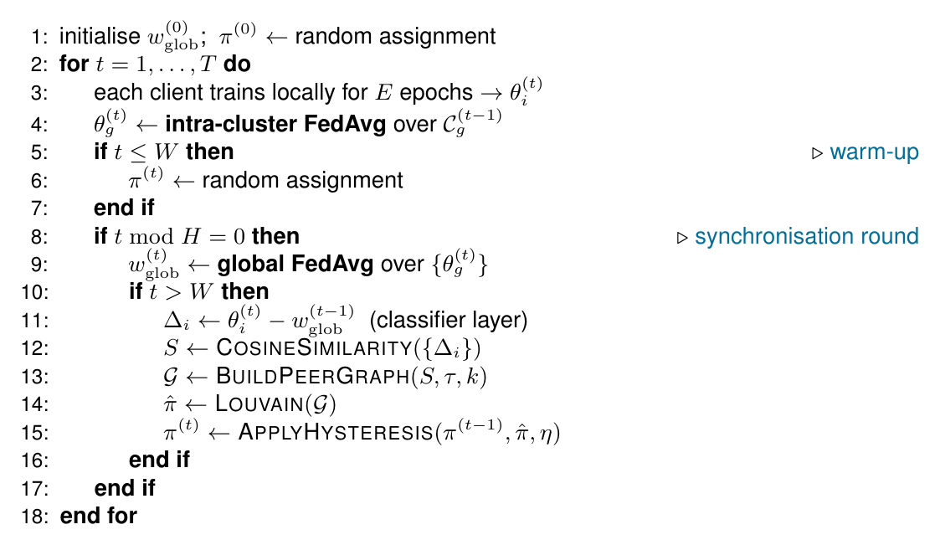
Stabilising it: warm-up, hysteresis, and the loop
Warm-up (W)
Early deltas are initialisation noise, not data signal. The first W rounds group clients randomly.
Hysteresis (η)
Community labels are arbitrary and permute between rounds. A community keeps its identity when a majority of members stayed together.
Notes:
Without hysteresis, cluster 2 in one round has no relation to cluster 2 in the next, which destroys the continuity of the edge-model state.

Slide 10
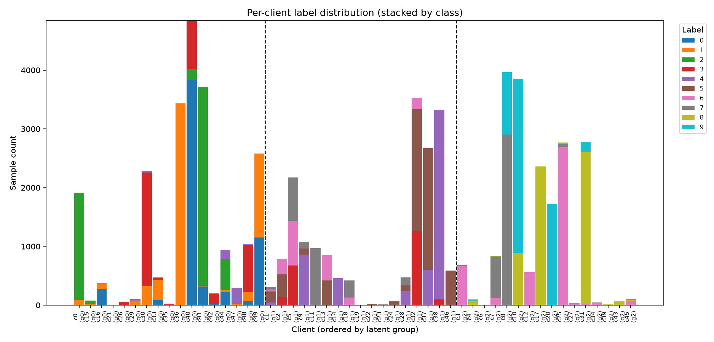
Experimental setup
Configuration
Dataset Fashion-MNIST, CNN (50,186 params)
Clients K = 50, full participation
Rounds T = 10, E = 2 local epochs
Non-IID Dirichlet α = 0.1, 3 latent groups
Sync period H ∈ {1, 2}
Seeds 42, 43
Per-client label composition at α = 0.1, ordered by latent group.
Three metrics
Top-1 accuracy of the global model · Adjusted Rand Index and NMI against the planted grouping · a weighted transfer-count proxy for communication (edge→global charged 10× client→edge)
Notes:
The latent groups are planted, so cluster recovery can be scored against ground truth. This makes the setting favourable to the method — a real structure exists to be found.

Slide 11
Results: the headline table
System | H | Final acc. | Final ARI | Comm. cost | Speed-up
A — Flat FedAvg | 1 | 0.743 ± 0.091 | — | 10000 | 1.00×
B — Static HFL | 1 | 0.789 ± 0.038 | −0.004 ± 0.012 | 2100 | 4.76×
C — Adaptive | 1 | 0.788 ± 0.062 | 0.358 ± 0.106 | 1990 ± 156 | 5.04×
A — Flat FedAvg | 2 | 0.779 ± 0.046 | — | 10000 | 1.00×
B — Static HFL | 2 | 0.766 ± 0.003 | −0.004 ± 0.012 | 1600 | 6.25×
C — Adaptive | 2 | 0.737 ± 0.056 | 0.255 ± 0.079 | 1420 ± 85 | 7.05×
Read uncritically, the H = 1 block flatters the method: adaptive reaches 0.788 against flat's 0.743, at a fifth of the communication cost, while recovering the planted structure.
The communication and cluster-recovery claims survive. The accuracy claim does not — for two independent reasons.
Notes:
I want to walk through why the accuracy claim fails, because finding that out was the most instructive part of the project.

Slide 12
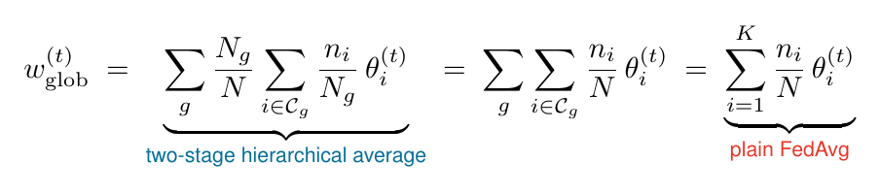
Finding 1: the H = 1 comparison is degenerate
At H = 1 every round is a synchronisation round, so the two-stage aggregation telescopes:
The cluster weights cancel. All three systems execute the same algorithm at H = 1 — the assignment is computed and logged, but never influences training.
Consequences
• Half the sweep compares three implementations of one algorithm — a design error, not a result.
• Only the H = 2 block compares the systems. There the order reverses: flat 0.779 > static 0.766 > adaptive 0.737.
• ARI stays valid throughout, since the assignment is scored whether or not it is used.
Notes:
This is a structural property of hierarchical FL, not an implementation bug: an HFL scheme that syncs every round simply is FedAvg. Abad et al. evaluate H of 2, 4 and 6 and never report H = 1.

Slide 13
Finding 2: the differences are below the noise floor
Flat FedAvg ignores H entirely — so the two flat rows of the table are the same experiment run twice, same seeds, same code path. Any difference is pure run-to-run variation.
Seed | Run 1 (H = 1 config) | Run 2 (H = 2 config) | Spread
42 | 0.679 | 0.747 | 6.8 pp
43 | 0.807 | 0.812 | 0.5 pp
6.8 pp
run-to-run noise floor, identical configuration
• Larger than every between-system accuracy difference measured, including the 4.2-point gap at H = 2.
• The between-seed gap is larger still — seed 42 lands near 0.68–0.75, seed 43 near 0.81.
• Flat FedAvg's last four rounds on seed 42: 0.755, 0.660, 0.761, 0.679 — final-round accuracy is itself a noisy estimator.
Honest reading: no accuracy difference between the three systems is statistically supported by this experiment.
Notes:
The cause is strong label skew interacting with the simulator's concurrent execution: the partition changes with the seed, and floating-point summation order varies with the order client actors return.

Slide 14
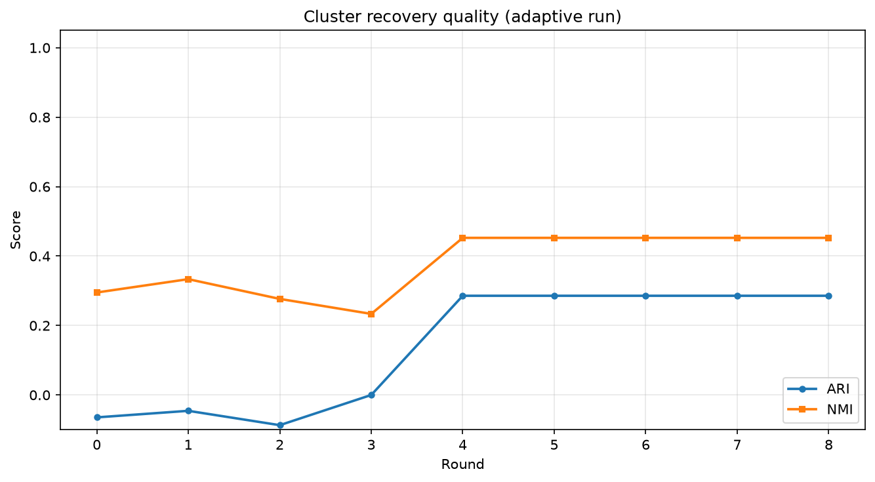
The result that does hold: cluster recovery
0.358
Adaptive (C) — final ARI
−0.004
Static round-robin (B) — final ARI
• ≈ 3 standard deviations apart; holds at both seeds and both values of H.
• Unaffected by the H = 1 degeneracy — the assignment is scored either way.
• Louvain finds 3–5 communities where 3 were planted; ARI punishes that over-segmentation.
• The signal weakens later in training as updates shrink toward stationarity.
ARI and NMI over training rounds; warm-up covers rounds 0–3.
Notes:
Static HFL scoring zero is exactly right — ARI is chance-corrected and a fixed round-robin partition is chance. So the adaptive system is extracting real information from update geometry alone, with no access to any client's labels.

Slide 15
Communication and the trade-off in H
5–7× cheaper than flat FedAvg
• Almost all of the saving comes from having a hierarchy at all, not from adaptivity (static 4.76× vs adaptive 5.04×).
• Raising H from 1 to 2 improves the speed-up to 7.05× but drops ARI from 0.358 to 0.255 — the assignment is refreshed from staler information.
• Abad et al. saw accuracy rise with H on IID data; under α = 0.1 each cluster optimises a genuinely different objective, so drift between syncs hurts.
Conditional on λ = 10 for the backhaul hop — an assumption, not a measurement.
Notes:
At K = 12 in the shorter figure run, the hierarchy actually loses: each edge aggregator averages only about four clients, too little data to train on. That suggests a practical lower bound on clients per aggregator.

Slide 16
Limitations and future work
Limitations
H = 1 is degenerate — the accuracy evidence rests on one non-degenerate setting.
Two seeds; the noise floor exceeds every effect measured.
50 clients, 10 rounds — early training only, asymptotics unobserved.
Simulation only: no real network, no stragglers or dropout.
One dataset, one shift type; the latent structure was planted, so the setting favours the method.
The server needs per-client updates in the clear — in tension with secure aggregation.
Future work
Drop H = 1, add H ∈ {4, 6}, raise the seed count and report confidence intervals.
Use a stable accuracy statistic — mean over the last k rounds, not a final-round snapshot.
A minimum-cluster-size constraint to prevent communities too small to train on.
An assignment-frozen ablation at H > 1 to explain the ARI decay.
Covariate shift (rotated-MNIST), CIFAR-10, and a sweep over α.
Privacy-compatible similarity: secure sketches or DP projections of the deltas.
Notes:
The most valuable next steps are the unglamorous ones — they would turn the accuracy question from undecidable into decidable.

Slide 17
Conclusion
Can client-to-edge assignment be recovered from update geometry? Yes for the recovery; undetermined for the downstream accuracy benefit.
0.358
ARI recovered (vs −0.004 for the control)
5–7×
communication saving over flat FedAvg
0
accuracy claims the experiment can support
• Latent client structure is recoverable from the updates a federation already exchanges — no raw data, no extra communication, negligible compute.
• Reaching the honest verdict on accuracy required deriving the aggregation symbolically and noticing that a parameter one baseline ignores had changed its result.
• The information needed to group clients sensibly is already there. Whether exploiting it improves the models is a question a better-powered experiment should now settle.
Code, configurations and all result logs: github.com/IAboelsouod/Adaptive-Peer-Selection
Notes:
Thank you — I am happy to take questions.

