Slide 1

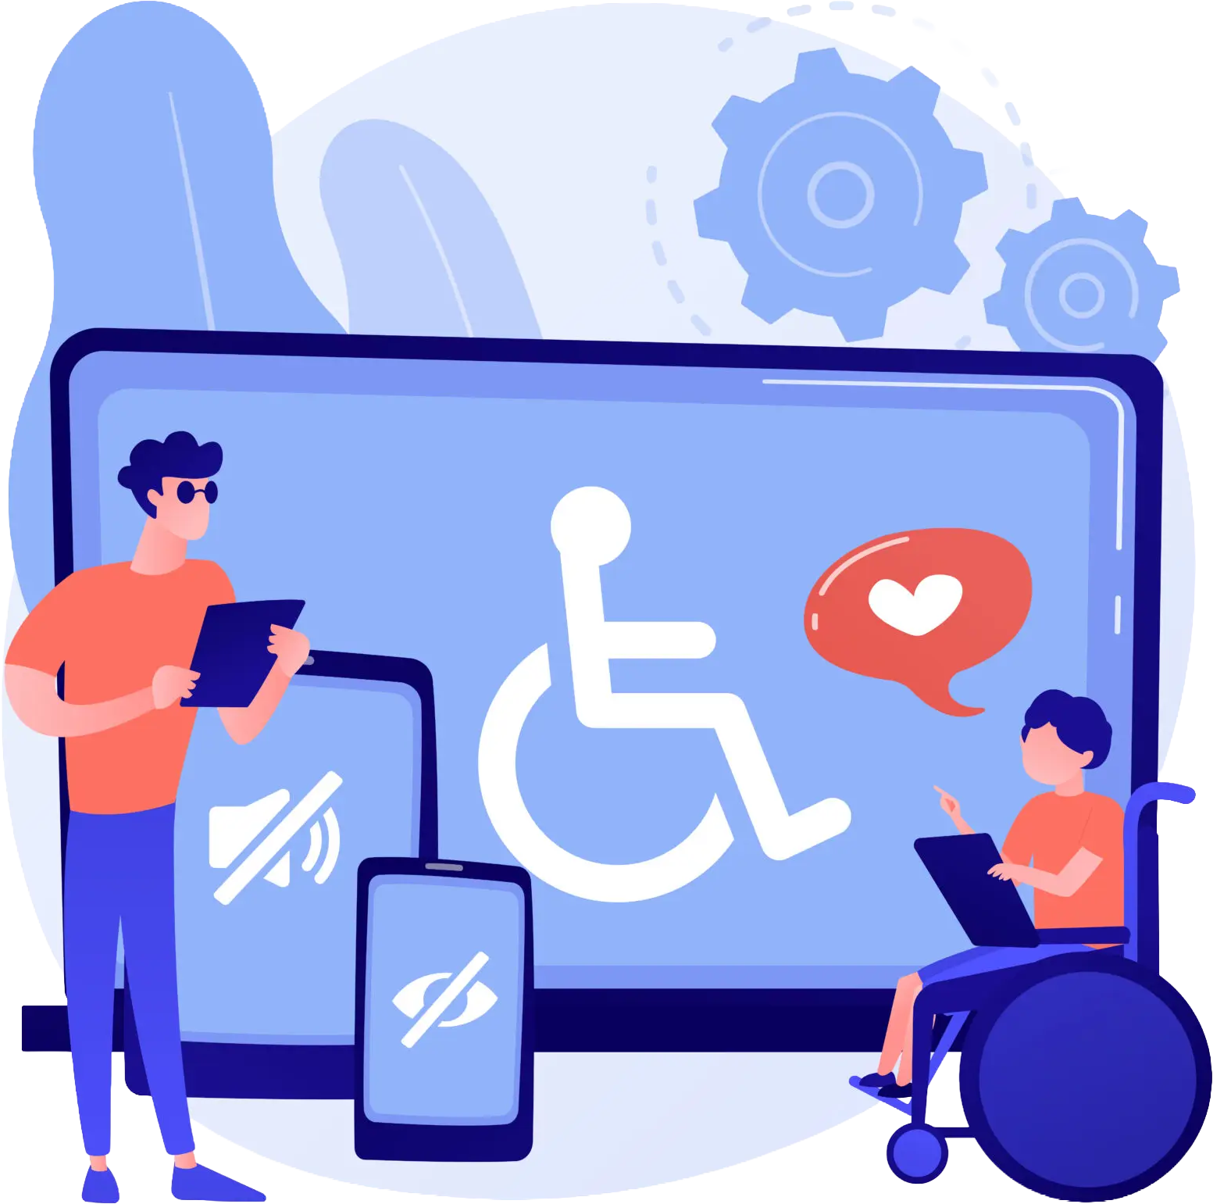


People with disabilities power accessibility in your products
https://iaccessible.net
info@iaccessible.net

Slide 2
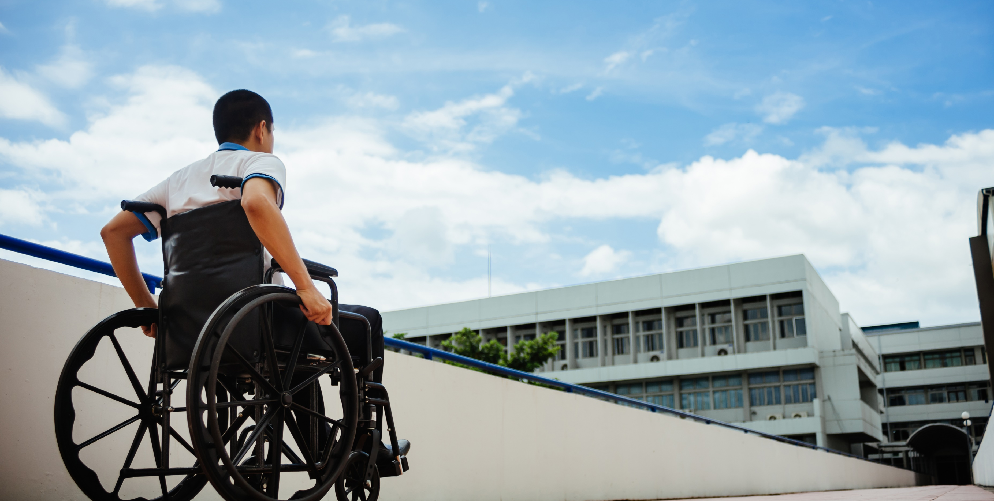
Accessibility is a growth strategy, not a checkbox
Over 1 billion people globally experience some form of disability.
$500 billion+ in annual spending power and rising digital dependency.
Companies leading in accessibility outperform peers in customer loyalty and brand trust.
Accessibility sparks innovations everyone uses — captions, voice input, dark mode.

Slide 3
Accessibility Drives Growth, Loyalty, and Product Innovation.
MINIMIZE
LEGAL RISK
YOUR UNTAPPED
MARKET IS MASSIVE
INNOVATION AND
COMPETITIVE ADVANTAGE
Digital accessibility lawsuits up 320% over 5 years (UsableNet)
DOJ & EEOC issuing updated rules aligning to WCAG 2.2
21% of companies sued multiple times
Global laws tightening simultaneously (ADA, Section 508, EN 301 549,AODA)
1.3B people globally with disabilities (WHO).
$500B–$1T in annual disposable income.
82% say they spend more with companies that offer accessible experiences.
Companies investing in accessibility see up to a 50% improvement in customer retention and brand perception -- Forester.
Companies lose $6.9B annually to accessible competitors (US DoC).
Up to 70% of accessibility-driven features become general-use features – Worldbank/Microsoft.

Slide 4
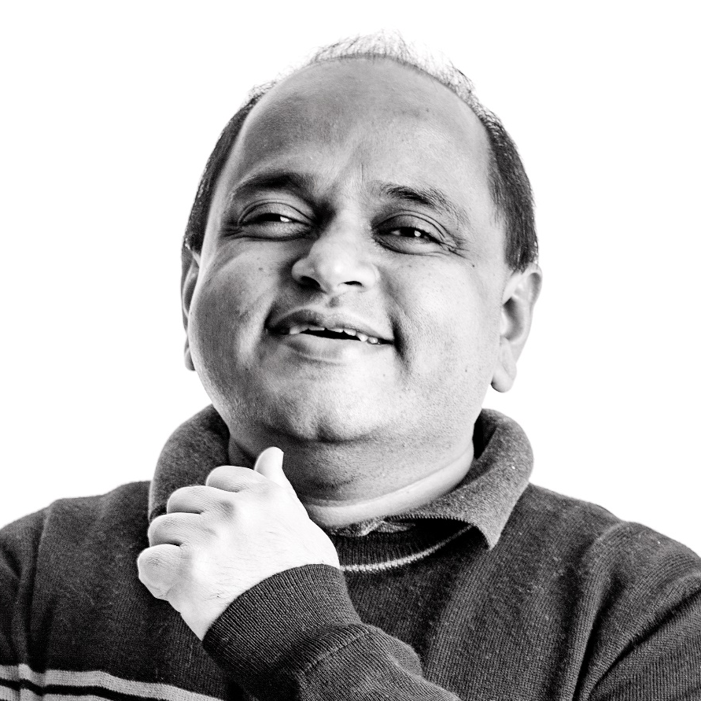
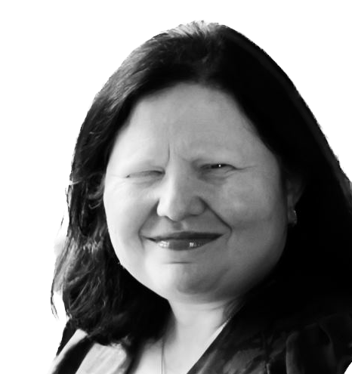
Our Lived Experience Powers Every Insight We Deliver
Accessibility designed and delivered by people who live it every day.
MANISH AGRAWAL
Blind technologist • 20+ years in accessibility
Led Microsoft Narrator & Responsible AI in Windows
NVDA contributor Patents in accessible design
AMAN SINGAL
Trusted Tester-certified leader with lived disability
Led inclusive design initiatives at Microsoft
Harvard LDT graduate

Slide 5
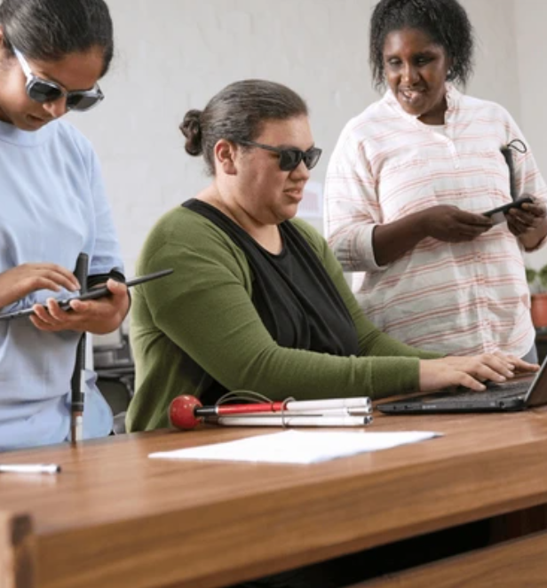
Teams Struggle to Build Accessible Products Without the Right Expertise
Hard to test effectively with real assistive technology workflows.
Difficult to prioritize: "Which issues actually matter to users?"
Uncertainty about legally defensible interpretations of WCAG.
Unsure how to remediate issues efficiently and correctly.
Automation alone cannot provide full compliance or coverage.
High remediation cost when issues are found late in development.
Difficult to scale accessibility consistently across teams and releases.

Slide 6
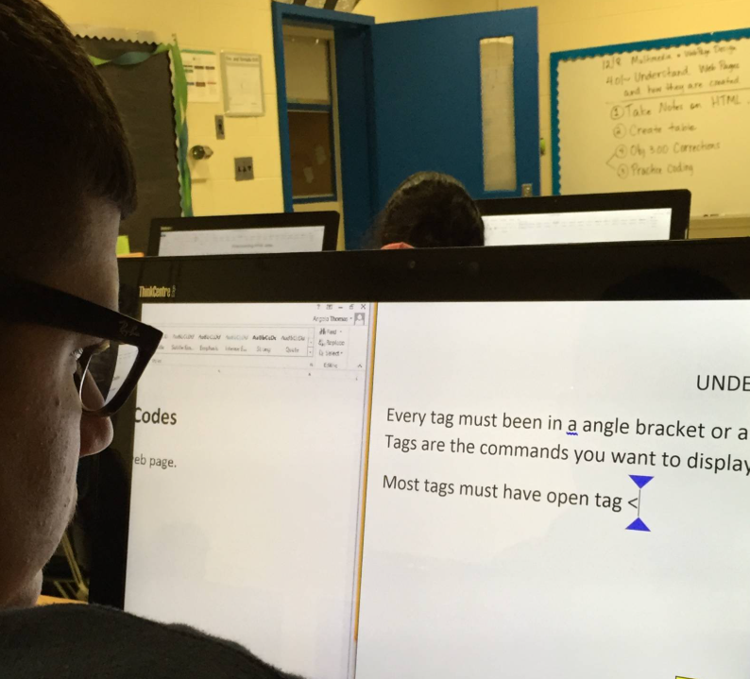
Lived Experience Reveals
Issues Checklists Cannot
Real-world assistive technology usage reveals issues compliance checklists miss.
Helps teams understand which bugs actually block users and why.
Ensures recommendations are accurate, actionable, and contextually correct.
Produces fixes that are legally defensible because they reflect authentic user impact.
Creates empathy-driven insights that improve UX for all users.

Slide 7
We Are a Disability-powered Team Built to Deliver Real Accessibility Impact
Disability-owned
small business headquartered in Redmond, WA
Every team member has lived experience of disability
Dual-shore delivery model across the U.S. and India
3,000+ self-identified people with disabilities in our research participant database
OUR CREDENTIALS & AFFILIATIONS
Certified:
CPACC, Trusted Tester
Professional Associations:
W3C, DAISY Consortium
Contributors to NVDA and inclusive design standards
Notes:
Add speaker notes and summarize granola notes

Slide 8
Our Mission
    Empower enterprises and product makers to build truly accessible products by connecting them to people with disabilities.

Slide 9
We Support Your Entire Accessibility Journey
We help organizations build accessible digital experiences through four core service pillars
1
2
3
4
ACCESSIBILITY
AUDITS
Comprehensive testing for WCAG 2.2 / 508 / EN 301 549 compliance, using real assistive-technology workflows.
USABILITY RESEARCH
& DESIGN REVIEWS
Shift-left studies and design evaluations with people with disabilities to prevent issues early.
ACCESSIBILITY TRAINING
& ENABLEMENT
Customized, role-based training and culture-building programs that embed accessibility across teams.
PDF TESTING & REMEDIATION
Large scale testing and remediation of
PDF and Office documents for
compliance with WCAG 2.2/ PDF U/A.

Slide 10
We Deliver Impactful, Developer-Ready Accessibility Findings - Not Noise
Comprehensive WCAG 2.2 / Section 508 / EN 301 549 audits.
Manual testing with screen readers, magnifiers, and voice-input tools.
Also use cutting edge tools like Accessibility Insights to find basic issues.
Conducted by experts with lived experience of disability.
Developer-ready, prioritized issues with clear severity and remediation guidance.
We focus on what blocks users, not on flooding teams with false positives.
Industry Typical vs IAccessible Approach
Industry Typical
60% invalid bugs / compliance noise.
VS
IAccessible
Actionable issues / measurable user impact.

Slide 11
We Catch Accessibility Issues Early –
Before They Become Expensive
Research with real users with disabilities drawn from our 3,000+ self-identified research participant panel.
Early design reviews and prototype testing catch 40–60% of issues before code.
Early findings save 4× remediation cost compared to post-release fixes.
Contextual usability studies ensure inclusive, intuitive experiences.
Where We Intervene — Shift Left to Design Phase
Idea
Design
Build
Launch
IAccessible intervenes here to catch issues early

Slide 12
We Build Accessibility Skills That Stay With Your Teams
Customized, role-specific training for designers, developers, QA, and leadership.
Hands-on sessions with assistive technologies (screen readers, magnifiers, speech input).
Accessibility Champions program to build internal ownership.
Integrated training modules aligned with your SDLC for sustained maturity.
Training Audiences
Designers
Developers
QA/Testers
Product Managers
Executives

Slide 13
Our Engagement Models Scale With Your Needs
Our flexible engagement models fit your accessibility journey and scale with your needs.
Fixed-Price Audits
Well-defined scopes with predictable cost and timeline.
1
Fixed-Price Audits
Ongoing design, development, and accessibility consulting.
2
Multi-Site Programs
Coordinated audits and retests with cadence, SLAs, and governance.
3
Embedded Accessibility Teams
Accessibility experts integrated into agile squads for day-to-day guidance.
4

Slide 14

We Integrate Accessibility Into Every Step of Your Product Lifecycle
Discover
Define accessibility goals and personas.
Evolve Training, analytics, and usability studies.
Design
Inclusive design reviews and prototype testing.
PRODUCT
Lifecycle
IAccessible integrates accessibility activities at every step of your SDLC.
Develop Continuous audits and code reviews.
Launch VPAT / ACR document-tation.
Test
Assistive-tech validation and fix verification.

Slide 15
Our Dual-Shore Model Delivers Quality, Speed, and Scalability
Dual-shore delivery from the U.S. and India for 24 × 5 coverage.
One lead per four testers ensures quality, speed, and accountability.
Dedicated delivery managers for governance and reporting.
Scalable reach through partnerships (e.g., Sutherland) and our 3,000+ participant research panel.
Efficiency focus: high-impact expertise over headcount volume.
Delivery
Partners
Research
Panel
IAccessible
Core Team
Clients

Slide 16
We Deliver Clear, Actionable, Impactful Results That Others Miss
Impact-Driven
Findings
Clear, prioritized findings grounded in real user impact.
Actionable issues delivered in developer-ready format.
Enables faster, more meaningful product improvements.
Lived-Experience
Insights
Every issue informed by real assistive-technology usage.
We catch what automation and checklist audits miss.
Authentic insights that improve UX for all users.
Shift-Left &
Cost Efficiency
Prevent 40–60% of issues early in design.
Reduce late-stage remediation costs by 10–100x.
Practical guidance for designers and developers.
Proven Track
Record
Trusted by Microsoft, Adobe, Compass, and leading enterprises.
High client satisfaction and low reopened-defect rates.
Consistent delivery at scale across industries.

Slide 17







Leading Companies Trust Us to Deliver Inclusive Digital Experiences
We've partnered with organizations across industries
to build more inclusive digital experiences.

Slide 18
See How We Help Organizations Achieve Real Accessibility Outcomes
Enterprise Apps
WCAG 2.2 A and AA
Copilot
Usability not just compliance
Microsoft Cafés
Inclusive ordering
Digital Platforms
User-tested
Procurement
WCAG 2.2 AA
Travel & Ticketing
Global standards
HR Upskilling
Accessible learning

Slide 19
CASE STUDY: MICROSOFT
We Helped Microsoft Build Accessible
Enterprise Applications at Scale
Challenge
Solution
Outcome
Microsoft needed comprehensive accessibility evaluations across multiple enterprise applications to meet WCAG 2.2 Level A and AA and support diverse user needs.
IAccessible conducted in-depth audits, usability testing with assistive technology users, and provided detailed remediation guidance for development teams.
Achieved WCAG AA compliance across key applications. Improved user satisfaction scores among employees with disabilities by 40%.

Slide 20
CASE STUDY: MICROSOFT
We Helped Microsoft Build Accessible
Enterprise Applications at Scale
Challenge
Solution
Outcome
As Microsoft developed Copilot AI features, ensuring accessibility from day one was critical to inclusive AI experiences.
IAccessible partnered with product teams during design and development, testing with screen reader users and providing real-time accessibility guidance.
100% of Copilot features launched with full accessibility support. Set new standard for accessible AI interactions.

Slide 21
CASE STUDY: Compass
We Helped Compass Launch Accessible
Ordering Experiences
Challenge
Solution
Outcome
Compass needed to make vending machine ordering apps at Microsoft campuses accessible to all employees, including those using assistive technologies.
IAccessible conducted usability testing with blind and low-vision users, and trained Compass staff on accessibility best practices.
Fully accessible ordering apps deployed across Microsoft cafés. Positive feedback from employees with disabilities.

Slide 22
CASE STUDY: Adobe
We Helped Adobe Bring Inclusive
Design to Flagship Platforms
Challenge
Solution
Outcome
Adobe sought to enhance accessibility of key digital platforms, ensuring creative professionals with disabilities could fully utilize their tools.
IAccessible conducted accessibility audits, usability research with disabled creators, and provided design recommendations integrated into product roadmaps.
User-tested features launched with significantly improved accessibility. Strengthened Adobe's commitment to inclusive design.

Slide 23
CASE STUDY: ZipHQ
We Helped ZipHQ Achieve WCAG 2.2 AA and Win Enterprise Deals
Challenge
Solution
Outcome
ZipHQ needed to achieve WCAG 2.2 AA certification for their procurement SaaS platform to meet enterprise client requirements.
IAccessible performed comprehensive WCAG audits, prioritized issues by impact, and guided development team through remediation process.
Achieved WCAG 2.2 AA compliance, published an Accessibility Conformance Report (ACR) in VPAT 2.1 format. Unlocked new enterprise contracts requiring accessibility compliance.

Slide 24
CASE STUDY: Indigo Airlines
We Helped Indigo Create Accessible
Booking and Travel Experiences
Challenge
Solution
Outcome
Indigo needed to make their travel booking and ticketing platforms accessible to meet global accessibility standards and serve all customers.
IAccessible audited booking flows, tested with assistive technology users, and provided detailed recommendations for accessible travel experiences.
Met global accessibility standards. Improved booking experience for customers with disabilities across web and mobile.

Slide 25
CASE STUDY: Eskalera
We Helped Eskalera Deliver Inclusive
Learning for All Employees
Challenge
Solution
Outcome
Eskalera's HR upskilling platform needed to be accessible to ensure all employees could benefit from professional development opportunities.
IAccessible evaluated learning interfaces, tested with users who rely on assistive technologies, and recommended accessible design patterns for educational content.
Launched accessible learning platform. Enabled equitable professional development for all employees.

Slide 26

CONTACT US
https://iaccessible.net
info@iaccessible.net
www.iaccessible.net | © 2026 IAccessible Inc. All Rights Reserved.

