Slide 1




People with disabilities power accessibility in your products
https://iaccessible.net
info@iaccessible.net

Slide 2






We are a disability owned social enterprise with a mission to bridge the #DisabilityDivide
Redmond based small business with a globally distributed team.
Innovate with experts
Our accessibility specialists are people with a lived experience of disabilities.
We have decades of expertise in technology delivery and accessibility.
Certified in WCAG Web and mobile accessibility
We partner with nonprofits in India and can reach a network of over 3000 users with disabilities.
Achieve your inclusion goals
We help you do user research, conduct accessibility design reviews and audits, and train your teams on accessibility.
We partner with leading organisations to achieve their inclusion goals.

Slide 3
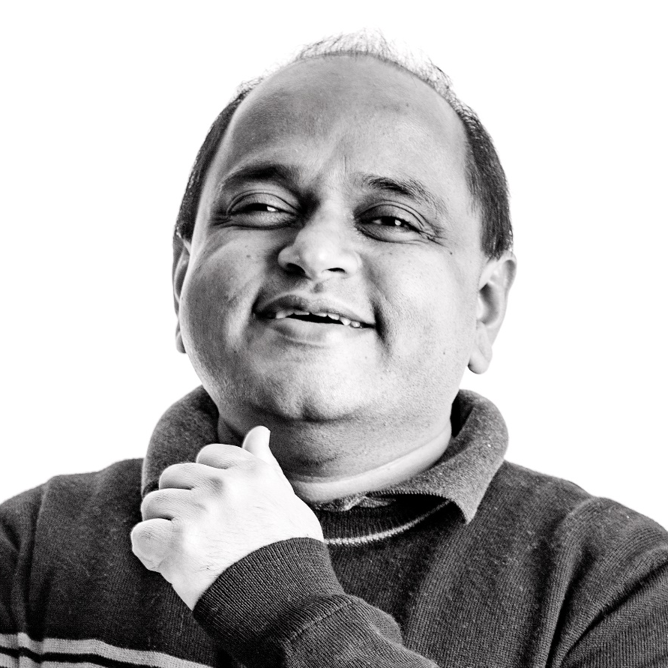
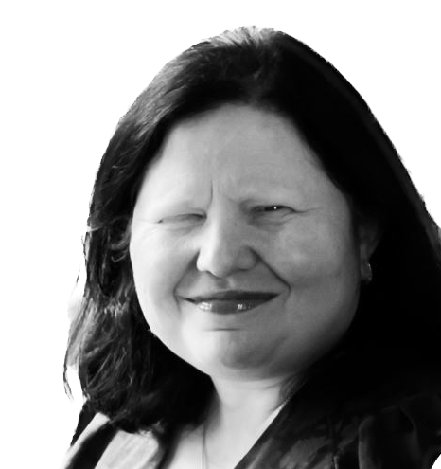
Founders
Manish Agrawal
Blind technology leader with 20+ years in accessibility
Led Microsoft Narrator and advanced responsible AI in Windows
Contributor to NVDA open-source screen reader
Patent holder in accessible design
Aman Singal
Accessibility leader with lived experience of disability
Trusted Tester certified at Microsoft
Proven track record leading accessibility programs.

Slide 4
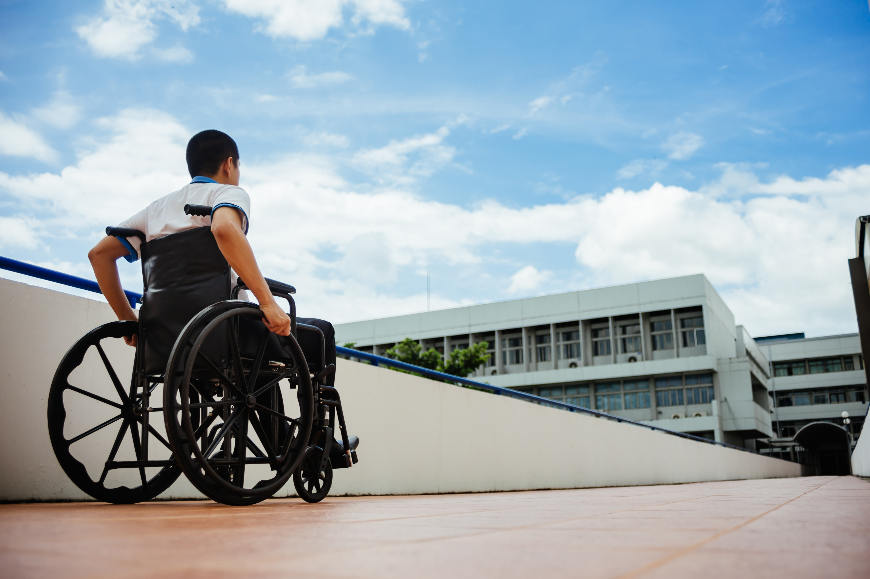
Accessibility is fundamental to your products!
MINIMIZE LEGAL RISK
ACCESS TO UNTAPPED MARKET
INNOVATION AND COMPETITIVE ADVANTAGE
Annual number of high-profile accessibility cases grew from 262 in 2016 to 2,352 in 2021
21% of all companies were sued multiple times
Companies of all sizes globally are at risk
1 Billion people live with some kind of disability
59.6% of the U.S. population with disabilities are living in a household with internet access (Statista)
People with disabilities spend a half trillion dollars annually (UsableNet)
82% say they would often return and spend more with a company that provides an accessible online experience (Click Away Pound)
Companies without accessible sites loose $6.9 billion to accessible competitors (US Department of Commerce)
Cost of compliance is very high when accessibility is done late in the product lifecycle

Slide 5





Our Services
User
Research
Accessible
Design
Accessibility
Testing
Print material
digitization platform
Training
Conduct research with users with disabilities to get actionable data.
Get experts to review designs for accessibility
Test your applications for accessibility compliance
Train your teams on accessibility design and standards
Use our Accessital platform to create accessible eBooks at scale

Slide 6
User Research:
Conduct research with users with disabilities to get actionable data
360 DEGREE RESEARCH
recruit participants and manage studies
RESEARCH TOOLS AND SERVICES
Conduct user interviews, moderated and unmoderated studies, usability feedback, heuristic evaluation, study design, data analysis and report readouts for insights.
Focus on building high quality products while we handle the process to recruit participants, compensation, and provide technical support.
Get the tools and services you need to easily conduct user research for your products by people with disabilities.

Slide 7
Accessible Design:
Get experts to review designs for accessibility
Teams of Experts
WIREFRAME REVIEWS
Accessibility during design
We review your designs with our integrated team of certified design experts consisting of people with a variety of disabilities.
We review wireframes and prototypes for accessibility patterns and anti-patterns
We help catch upto 60% of accessibility problems during design saving you costly changes later.

Slide 8
Accessibility Testing:
Test your applications for accessibility compliance
DOCUMENT ACCESSIBILITY
ASSESSMENT
Reports
Our certified "Trusted Testers" assess for WCAG 2.1, section 508, and European EN 301549 standards.
We do automated and manual testing of websites and apps on mobile and desktop.
Inputs from our experts with disabilities help prioritise and remediate bugs.
We do bug reporting in github, Jira, ADO or other tools you use. We help create Voluntary Product Accessibility Template (VPAT) Report Or Accessibility Conformance Report (ACR)
We do accessibility testing and remediation for Word, PPT, PDF, and Outlook.

Slide 9
Training:
Train your teams on accessibility design and standards
ASSISTIVE TECHNOLOGIES Demos
CERTIFICATIONS
Design Workshops
Hands on sessions that include W3C’s WCAG 2.1, ADA, Section 508 and many other accessibility regulations.
Screen readers: JAWS, NVDA, Voiceover, Narrator, Talkback
Magnifiers and high contrast: ZoomText, windows magnifier
Other AT: Dragon NaturallySpeaking, switch controls
Deep dive workshops on WAI ARIA (Web Accessibility Initiative Accessible Rich Internet Applications) in implementation of advanced controls

Slide 10
Print Material digitization Platform:
Use our Accessital platform to create accessible Ebooks at scale
Focus on your content
Manage large volumes
Easy onboarding
Hosted SAS offering at https://accessital.com/
Allows organisations like higher education institutions to provide accessible materials to students on time.
Allows nonprofits to manage thousands of volunteers and create ebooks at scale.

Slide 11
Partner with us at every step to build inclusive products
SOFTWARE DEVELOPMENT LIFECYCLE
1
Requirements
2
Design
3
Develop & Test
4
Deploy
5
Review
a. User research
a. User research
a. Accessibility assessment
a. VPAT/ACR creation
a. Usability studies
b. User interviews
b. Design review
b. User interviews

Slide 12
Case Studies Leading companies partner with IAccessible to achieve their inclusion goals!

Slide 13

Case Study: Design partnership with Adobe
Adobe selected IAccessible to create a more inclusive Universal Editor for Adobe Experience Manager
Providing feedback from real users with disabilities throughout design and development
Conducting industry research and prototyping designs to address challenges with Selection Tool and other aspects of Universal Editor
Goal is to build an accessible and usable product “right” the first time

Slide 14
Case Study: Microsoft – Copilot Accessibility Research
Usability research with people with disabilities for Microsoft Office AI Copilot across Web, desktop, and mobile.
Conducted 15 in-person research sessions observing users with low vision, blindness, dyslexia, and motor disabilities.
Identified 20+ usability gaps.
Concrete recommendations for product design and engineering improvements.

Slide 15
Case Study: Mobile app review for Microsoft Cafes
Compass Group partnered with IAccessible to improve Accessibility in Microsoft Cafes
Ensuring innovations with vending machines, such as a Rammon vending car, are accessible
Gathering feedback from real users with disabilities to ensure innovations are ready for deployment
Streamlined lightweight process provided by Iaccessible

Slide 16
Case Study: ZipHQ – Procurement Platform Accessibility
Accessibility testing on procurement platform across browsers and OS.
700+ bugs logged, 250 verified after fixes.
ACR published.
Continued accessibility guidance for engineering and design teams.

Slide 17
Case Study: Indigo Airlines – Accessible Travel Platforms
Accessibility testing for travel site, booking and payment tools, native apps.
1200+ issues identified. 450 bugs verified post-remediation.
50+ documents fixed.
Significant reduction in new bugs via design workshops.

Slide 18
Case Study Accessibility audits for Eskalera and Racloop
CLIENTS
TASKS
DELIVERABLES
Eskalera enables large and medium sized companies to transform their HR operations by improving employee engagement, productivity, and growth
Racloopis B2B aggregation platform that enables pharmacies and distributor to perform ecommerce transactions.
Accessibility test team included trusted testers and people with legal blindness
Entire Web and mobile applications tested for WCAG 2.1 Level A and AA.
Platforms tested: Google Chrome + JAWS and Firefox + NVDA on Windows, Android + talkback and IOS + voice over.
Test scenarios created by test team after walkthrough with product engineering.
Bugs logged in Jira and triaged with engineering teams for severity.
Evidence provided as screenshots and videos for software behavior.
Design and development support provided to engineering team to fix complex bugs.
Created Accessibility Conformance report (ACR) as a Voluntary Product Assessment template (VPAT) for the product after remediation of high severity bugs.

Slide 19
Case Study Accessibility training for NIC (Indian Government)
CLIENTS
TOPICS
METHODOLOGY
Accessibility workshop conducted for 40 senior engineers
Accessibility fundamentals: What, why, and how
Common problems faced by users because of accessibility barriers
WCAG 2.1 guidelines and section 508
POUR principles
Automated testing tools, like the WebAIM toolbar
ARIA basics and custom controls vs native HTML
Instructor lead in person sessions with experts
Workshop style hand on exercises for participants
Post workshop follow up on email groups

Slide 20
Case Study Product development for Saksham
ACCESSITAL
CONTRIBUTION TO NVDA
Cloud based SAS platform created to enable the creation of accessible daisy and Epub books.
Use of Google Vision APIs and google cloud for Optical Character Recognition (OCR) for Indian languages.
Highly scalable platform to onboard 100s of volunteers and manage book creation workflow.
Currently used by many organizations, including Saksham, Enable India, and Mitra Jyoti.
Hosted SAS offering at https://www.accessital.org
Epub and Daisy accessible book creation platform
Created NVDA drivers for Nuance Text to speech engines for Indian Languages.
Created a licensing and install system for NVDA with Indian voices from Nuance.
Contributed many improvements to the Core NVDA screen reader.
Managed a program to create many new Indian language TTS voices using the Espeak TTS engine.

Slide 21
CONTACT US
https://iaccessible.net
info@iaccessible.net
www.iaccessible.net | © 2022 IAccessible Inc. All Rights Reserved.

