Slide 1
Swerve Drive Software Design

Slide 2
Software Layers
Joystick Axis Correction
Joystick Response Calculation
Motor/Wheel Orientation Adjustments
Field-oriented Angle Adjustment
Swerve Drive Steer Angle / Drive Speed Calculation
Steer Motor PID
Controllers
Drive Motor PID
Controllers
L F
R F
L F
R F
L B
R B
L B
R B

Slide 3
Software Tuning
Motor/Wheel Orientation Settings
Joystick Response Tuning
Steering Angle Sensor Offsets
Steer PID
Tuning
Drive PID
Tuning
P
I
P
I
D
D
F

Slide 4


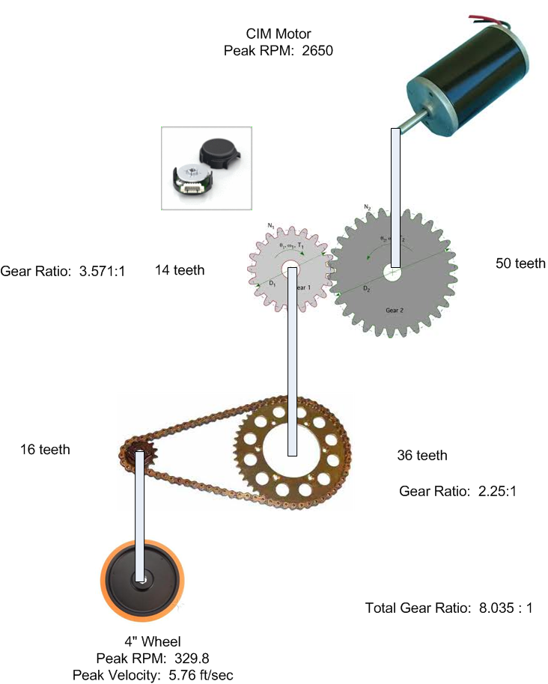
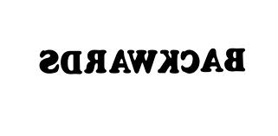
Motor/Wheel Orientation Normalization
Steering Motors are mounted upside-down, Angle Sensors are mounted rightside-up.
Setpoint angles need to be inverted
Drive Motors are inverted on the left and right-side of the robot.
Some motors rotate “backwards”
Drive Motor Gear Ratios are not 1:1

Slide 5
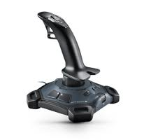
Joystick Axis Correction
Flight Joysticks have Y forward as “dive”, so Y forward is NEGATIVE.
Drive Joysticks need to invert the Y axis.

Slide 6
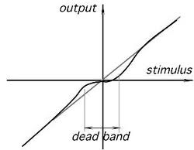
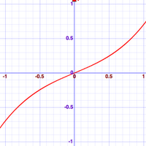
Joystick Response Calculation
When Joysticks are at rest, they don’t read exactly 0 (in X, Y and Twist Axes).
A “deadband” is needed, otherwise the Robot will “twitch” when the joystick is centered.
Humans find non-linear joystick response (less-sensitive near the middle) easier to use.
X/Y -> .4x^3+.6x
Rot -> .7 * (.4x^3+.6x)

Slide 7
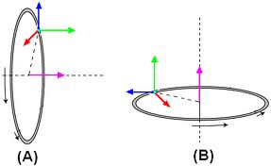
Field-Oriented Angle Adjustment
It’s simpler to drive an omniwheel system if joystick straight ahead is ALWAYS aligned with the field – even if the robot body is rotated.
It’s much simpler if rotating the robot doesn’t change the direction the joystick will move the robot.
Field-oriented drive reads the angular offset between robot’s current rotation and “north” on the field – using data from the IMU.
Then, software rotates the X/Y joystick directions by this difference.

Slide 8
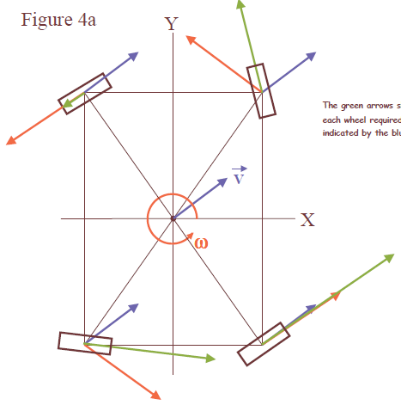
Swerve-Drive Steer Angle/Drive Speed Calculation
Translates X, Y and Rotation Values into Steering Motor Angles and Drive Motor Velocities.
Steering Motor Angles are a “mix” of the X/Y angle, and a rotation angle (which is only present if Rotation != 0)

Slide 9
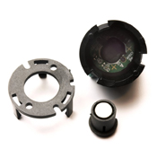
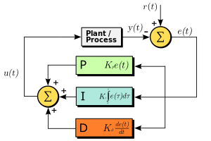
Steer Motor PID Controllers
Uses Angle Sensor (-180 to 180 degrees) as Input.
Outputs to Motors (-1 to 1).
Uses Proportional (P), Integral (I) and D (Differential) coefficients, which require tuning.
Operates 50 times per second.
Each steering motor has it’s own PID controller.
Fast, accurate operation is crucial to smooth performance.

Slide 10
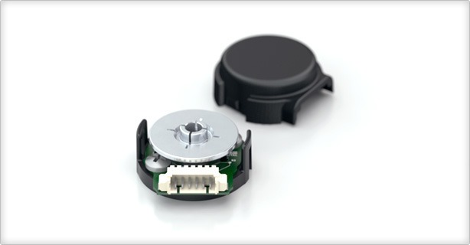
Drive Motor PID Controllers
Uses RPM Sensor (360 ticks per revolution) as Input.
Outputs to Motors (-1 to 1).
Uses Proportional (P), Integral (I) and D (Differential) coefficients, which require tuning.
Operates 50 times per second.
Each drive motor has it’s own PID controller.
Required for high-accuracy autonomous “drive this far” commands, to ensure similar behavior at different battery levels, and to account for differing amount of wheel slip.

Slide 11
Joystick Response Tuning
Software adjusts the magnitude of the X, Y and Rotation values so it “feels” responsive to a human.
Autonomous code has no need for this correction.
This is an interactive process; here’s the curve that Lexa developed in the 2012 season for the mecanum robot.
We later adjusted this to slow down the robot we finally built, but unfortunately didn’t create a graph of this curve.

Slide 12
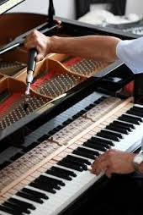
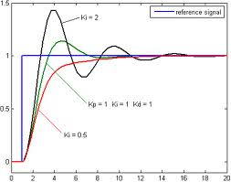
PID Coefficient Tuning
Simplest thing is P only.
If P doesn’t quite get there, we add an I.
If P overshoots, we can decrease P and increase D.
It’s not as easy as it sounds, and takes some time.

