Slide 1
length = 4
'trek' | 'cannondale' | 'redline' | 'specialized'
index
0 | 1 | 2 | 3
-4 | -3 | -2 | -1
Negative index

Slide 2
bicycles[0]
bicycles[1]
bicycles[2]
bicycles[3]
T
r
e
k
bicycles[0]
r
e
k
Trek
t
r
e
k
.title()
bicycles[0].title()

Slide 3
motorcycles
honda
yamaha
suzuki
0 1 2
motorcycles.insert(0, 'ducati')
ducati
motorcycles
honda
yamaha
suzuki
motorcycles
ducati
honda
yamaha
suzuki

Slide 4
magicians
alice
david
carolina
for tells Python a loop starting
for magician in magicians:
print(magician)
magician represent each item one by one, from the list
keyword in comes before the list
Indent loop processing code
Fig. 4.1 shows how each part of for loop works

Slide 5
print(magician)
keyword in comes before the list
magicians = ['alice', 'david', 'carolina']
for magician in magicians:
print(magician)
magician
alice
magician
david
magician
carolina
Fig. 4.2 shows how each item is printed

Slide 6
print(magician)
keyword in comes before the list
magicians = ['alice', 'david', 'carolina']
for magician in magicians:
print(f"{magician.title()}, that was a great trick!")
print(“I can’t wait to see your next trick {magician.title()}")
# add more instructions ..
..
Fig. 4.3 shows how to add set of instructions under a loop

Slide 7
bicycles[3]
for value in range(1, 5):
print(value)
1
1
2
3
4
5
starts
stop
Fig. 4.4 shows how to use range to generate a series of numbers

Slide 8
range([start,] stop, [,step]):
Optional. An integer number specifying the incrementation. Default is 1
Required. An integer number specifying at which position to stop (not included).
Optional. An integer number specifying at which position to start. Default is 0
for value in range(1, 9, 2):
1
1
2
3
4
5
6
7
8
9
starts:1
stop: 9
1+2=3
3+2=5
5+2=7
step/increment:2
Fig. 4.5 shows the syntax of range function

Slide 9
syntax
[output for value in iterable]
example
[value**2 for value in range(1, 11)]
generalsyntax
[ output for value in iterable if condition ]
do this
for this collection
In this situation
Fig. 4.6 shows the syntax of list comprehensions

Slide 10
players = ['charles', 'martina', 'michael', 'florence', 'eli']
players[0]
players[1]
players[2]
players[3]
players[4]
players[:3]
['charles', 'martina', 'michael']
players[1:4]
['martina', 'michael', 'florence']
Fig. 4.7 shows how to slice a list in Python

Slide 11
my_foods
Address: 0xefadfe13
[ 'pizza’ , 'falafel’ , 'carrot cake’ , 'cannoli’ , 'ice cream’ ]
friend_foods
friend_foods = my_foods
my_foods
Address: 0xefadfe13
[ 'pizza’ , 'falafel’ , 'carrot cake’ , 'cannoli’ , 'ice cream’ ]
Address: 0xefabff17
[ 'pizza’ , 'falafel’ , 'carrot cake’ , 'cannoli’ , 'ice cream’ ]
friend_foods
friend_foods = my_foods[:]
Fig. 4.8 copying a list in Python

Slide 12
cars = ['audi', 'bmw', 'subaru', 'toyota’]
for car in cars:
if car == 'bmw’ :
print(car.upper())
else:
print(car.title())
Condition is True
Execute if True
Condition is False
Execute if False
Fig. 5.1 shows how if simple if-else statement

Slide 13
conditional_test
True
if conditional_test:
code inside if body
Code outside if body
Code inside
if body
Code outside
if body
Fig. 5.2 shows simple if statement Flow Chart and Pseudo code

Slide 14
False
conditional_test
True
if conditional_test:
code inside if body
else:
code inside else body
Code outside if-else body
Code inside
else body
Code inside
if body
Code outside
if-else body
Fig. 5.3 shows simple if-else statement Flow Chart and Pseudo code

Slide 15
age = 12
is age < 4 ?
False
False
is age < 18 ?
True
True
"Your admission cost is $0."
"Your admission cost is $25."
"Your admission cost is $40."
Fig. 5.4 shows if-elif-else chain statement Flow Chart

Slide 16
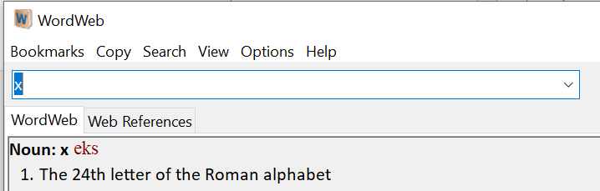
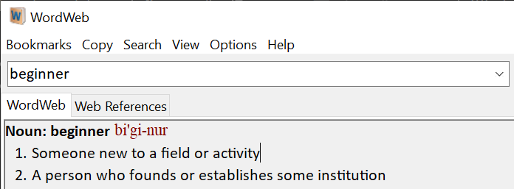
key
value
Fig. 6.1 shows definition of key (words) from a dictionary

Slide 17
current_number = 1
current_number
<= 5
True
current_number = 1
while current_number <= 5:
print(current_number)
current_number += 1
DISPLAY
current_number
current_number += 1
Fig. 7.2 shows while loop statement Flow Chart and Python code equivalent

Slide 18
active = True
while True:
city = input(prompt)
if city == 'quit':
break
else:
print(f"I'd love to go to {city.title()}!")
Exit Loop
# outside loop
Fig. 7.3 shows the use of break to exit loop

Slide 19
current_number = 1
active = True
while active:
while True:
city = input(prompt)
if city == 'quit':
break
else:
print(f"I'd love to go to {city.title()}!")
True
while active
GET input as
message
message ==
‘quit’?
current_number += 1
Fig. 7.2 shows while loop statement Flow Chart and Python code equivalent

Slide 20
# Define a function
def greet_user():
"""Display a simple greeting."""
print("Hello!")
# calling the function
greet_user()
print("Outside the function")
2
1
3
Fig. 8.1 shows Python function definition and function call

Slide 21
def greet_user(username):
"""Display a simple greeting."""
print(f"Hello, {username.title()}!")
greet_user('jesse')
Fig. 8.2 Passing Information to a Function

Slide 22



Slide 23
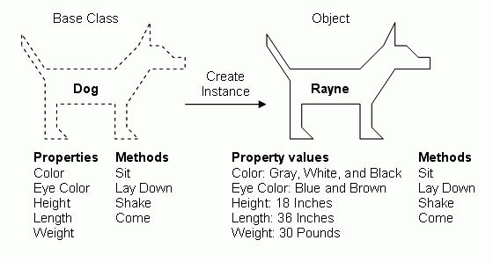

Slide 26
Car
+make: str
+model: str
+year: str
+odometer_reading: int
super/base/parent
+__init__(make,model,year)
+get_descriptive_name()
+read_odometer()
+update_odometer()
+increment_odometer()
ElectricCar
+inherit from Car
+……
- ……
subclass/derived/child
+inherits from Car
+…….

Slide 27
Dog
+name: str
+age: int
………
+sit()
+roll_over()
…………
ElectricCar
+inherit from Car
+……
- ……
subclass/derived/child
+inherits from Car
+…….

