Slide 1


FOREST FIRE DETECTION USING DEEP LEARNING
Name: MARTHI HEMALATHA YADAV
AICTE Student ID: STU66c05b192adaa1723882265

Slide 2

Learning Objectives
🗸 Understand the
use of CNN for
FFD
🗸 Learn how
Conv2D works
🗸 Analyse
the accuracy
of model
🗸 Explore & build the
Build 2-Class Model
Learn how CNNs can automatically extract features from images to detect fire patterns.
Understand the internal working of convolutional layers in identifying edges, textures, and fire signatures.
Implement a CNN classifier to categorize images into “fire” or “no fire” classes.
Visualize training and validation accuracy/loss curves to assess model efficiency.
Use image generators for efficient loading and preprocessing of training data.
Use Dropout and validation data to reduce overfitting and improve generalization.
GOAL
🗸 Achieve Forest
Fire Detection
Model with
High Accuracy
Source :
www.freepik.com/

Slide 3





Tools and Technology used
(Libraries)
Programming Language: Python
Frameworks: TensorFlow & Keras
Model Used: CNN (Convolutional Neural Network)
Development Environment: Google Colab (GPU Enabled)
Dataset Source: Kaggle
Other Tools:
Matplotlib
Pandas
Seaborn
Kaggle
(dataset)
Python
(Programming
Language)

Slide 4
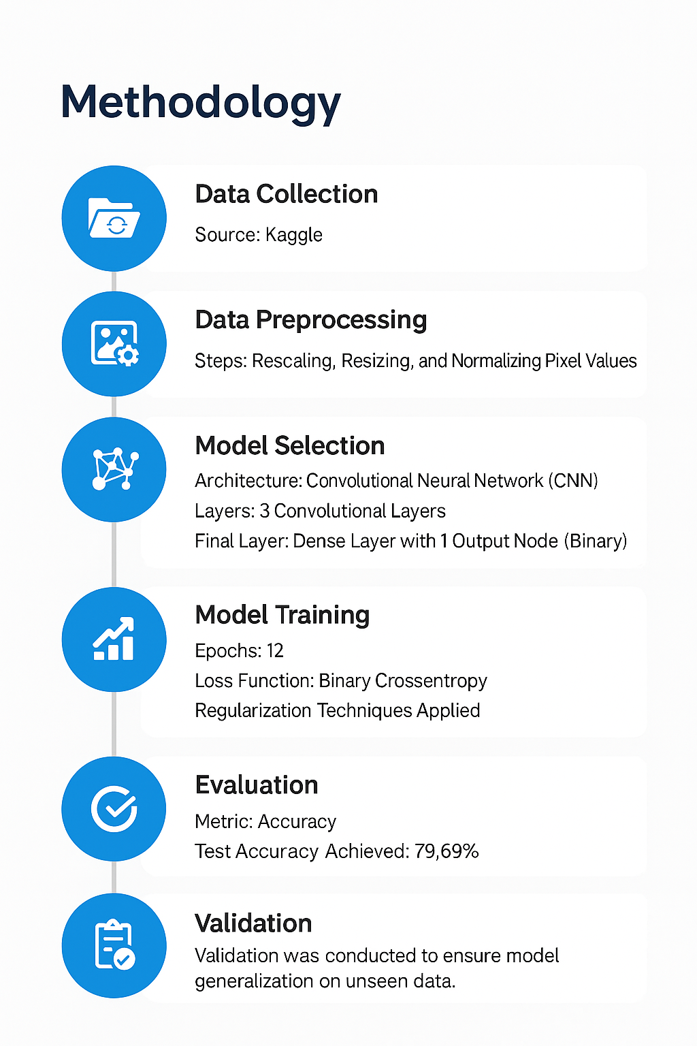
Methodology
Data Collection
Source: Kaggle
Steps: Rescalling, Resizing, and Normalization Pixel Values
Architecture: Convolutional Neural Network(CNN)
Layers: 3 Convolutional Layers’
Final Layer: Dense Layer with 1 Output Node(Binary)
Epochs: 12
Loss Function: Binary Crossentropy
Regularization Techniques Applied
Metric: Accuracy
Test Accuracy Achieved: 80.99%
Validation was conducted to ensure model generalization on unseen data.
Data Preprocessing
Model Selection
Model Training
Evaluation
Validation

Slide 5
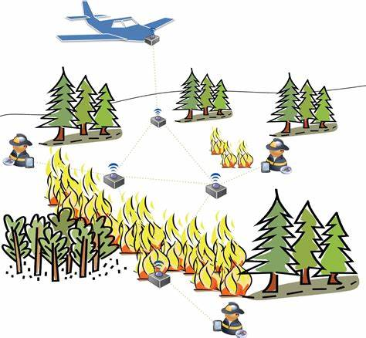
Problem Statement:
Forest fires cause significant environmental degradation and economic damage by destroying natural resources, threatening wildlife habitats, and endangering human lives. Traditional methods of fire detection often rely on manual monitoring, which can be slow, inefficient, and prone to delays. To overcome these limitations, this project proposes an automated solution using Deep Learning techniques, specifically Convolutional Neural Networks (CNNs), to accurately identify and classify images as either "Fire" or "No Fire." The aim is to develop a real-time, scalable, and reliable system that can detect forest fires at an early stage using satellite or camera images, thereby enabling quicker response times and minimizing potential damage.

Slide 6
Solution:
Deep Learning Model trained to accurately detect and classify fire/smoke in real-time.
Achieved 80%+ accuracy on diverse test data, showing strong generalization across regions.
Enables real-time alert system, critical for early fire detection and quick response
Deployed model can be integrated with CCTV, drones, or satellite feeds for continuous monitoring.
Scalable and lightweight can run on edge devices for remote forest areas.
Potential to save lives, wildlife, and resources by minimizing fire spread through early action.
Source code : ForestFireDitection_Using_DeepLearning/Forest_Fire_Detection_using_DL (2).ipynb at main · IAmHemalathaYadav/ForestFireDitection_Using_DeepLearning

Slide 7

Screenshot of Output:
CNN Model Architecture

Slide 8
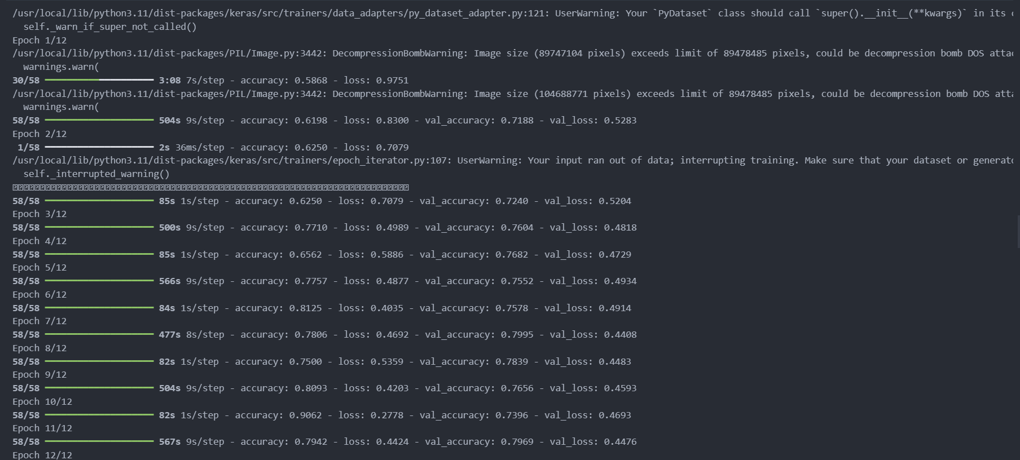
Screenshot of Output:
Code Execution

Slide 9
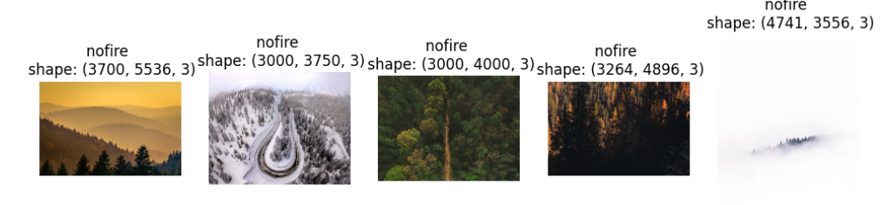
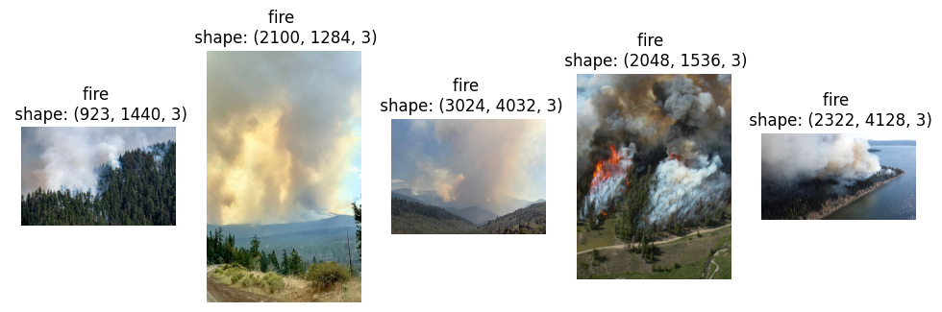
Screenshot of Output:
Training Progress

Slide 10
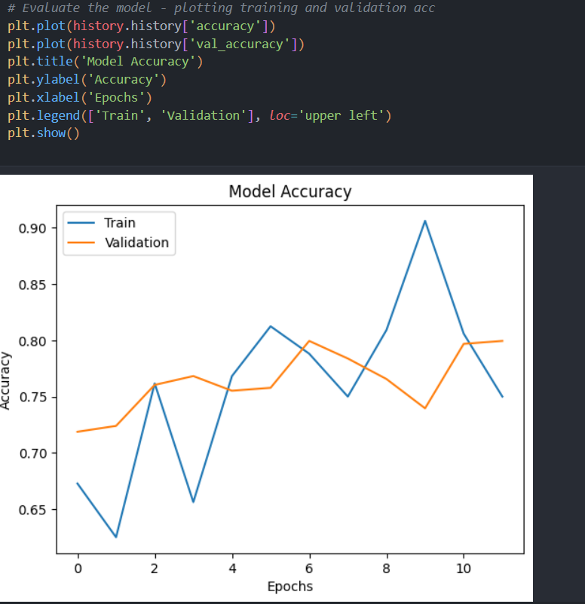
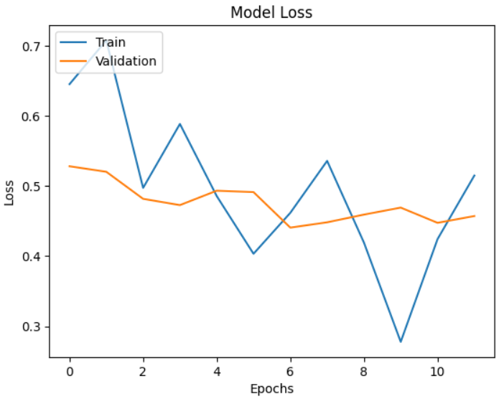
Screenshot of Output:
Model Accuracy & Model Loss

Slide 11
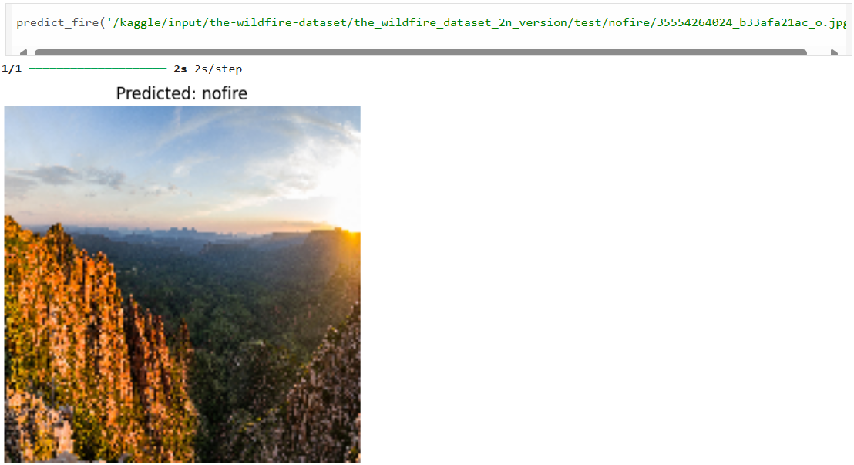
Screenshot of Output:
Prediction Output

Slide 12
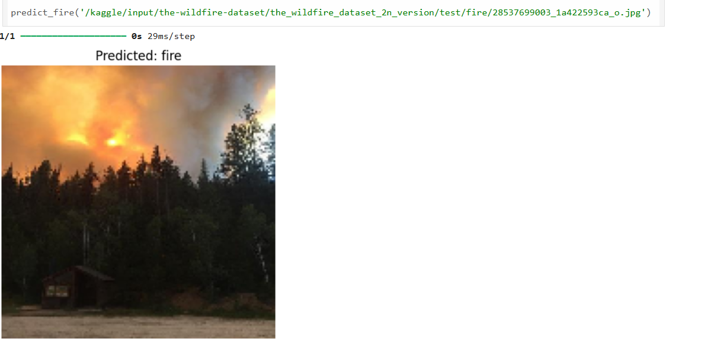
Screenshot of Output:
Prediction Output

Slide 13
Conclusion:
In conclusion, this project demonstrates the effective use of Deep Learning, particularly Convolutional Neural Networks (CNNs), for the early detection of forest fires through image classification. By accurately identifying images as "Fire" or "No Fire," the system provides a reliable and automated alternative to manual monitoring. This not only improves detection speed but also enhances scalability and real-time responsiveness. The proposed solution holds strong potential for integration with satellite and surveillance camera systems, ultimately supporting faster emergency response, reducing environmental damage, and protecting both wildlife and human life.

