Slide 1

Notes:
Purpose of this presentation: Power BI Modeling
Target audience: Analysts, Report Builders
Updated slide 12 to show Actuals_File instead of Actual_File
Updated images on slide 2, 12, 13, and 15

Slide 2
Mod 2 Lab

Slide 3
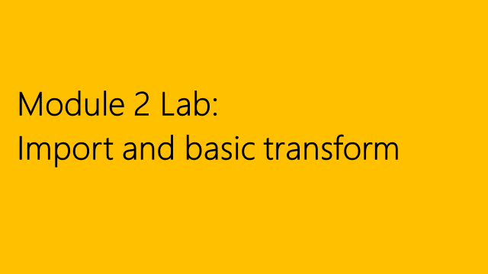
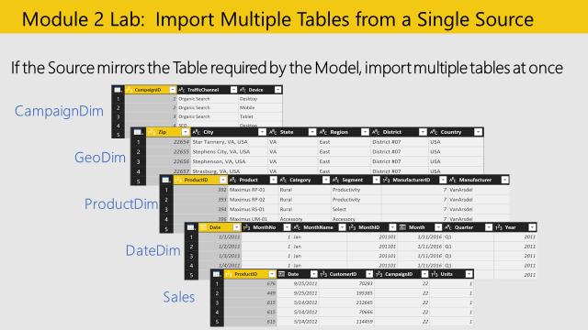
Student Notes
Step by Step
VERSION CHECK!!
Objective: Import multiple worksheets from an Excel file in one step
Get Data > from Excel
Navigate to where you downloaded VanArsdel_Actuals
Select the following Tables (All but CustomerDim):
CampaignDim
GeoDim
ProductDim
DateDim
Sales
Click ‘Transform Data’
In GeoDim, change the [ZIP] Data Type to Text

Slide 4
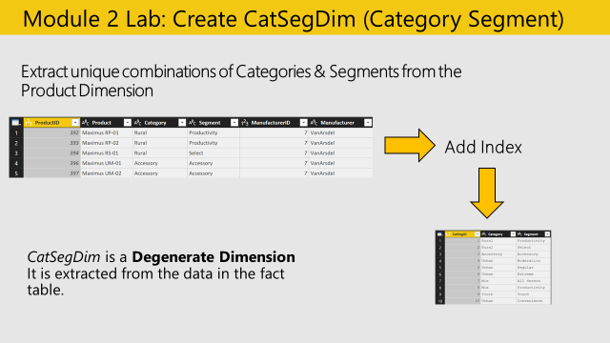
Step by Step
Objective: Create the Product Category Dimension by extracting Categories from the ProductDim
From the View ribbon check “Always Allow”
Duplicate the ProductDim query
Highlight [Category] and [Segment], and Remove other columns
Highlight [Category] and [Segment], and Remove Duplicates
Add Column > Add Index Column starting at 1, with column name [CatSegID]
Reorder Columns: [CatSegID], [Category], [Segment]
Rename the query “CatSegDim”
Student Notes

Slide 5
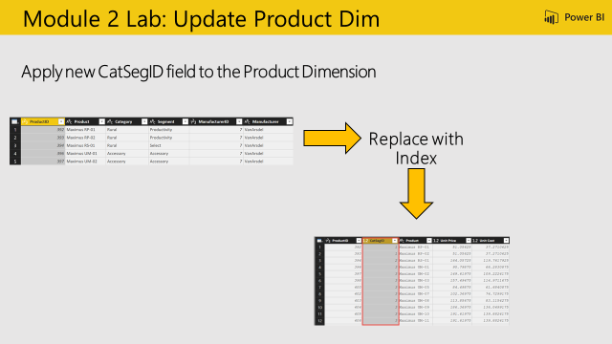
Step by Step
Objective: Update the Product Category ID in the ProductDim
Select the ProductDim query
From Home Ribbon > Merge Queries > Select ProductDim
From ProductDim, highlight [Category] and [Segment]
From CatSegDim, highlight [Category] and [Segment]
Note the Join Kinds available, and leave Left Outer
Expand the [NewColumn] > Select [CatSegID] and deselect “Use Original column name as prefix”
Remove columns: [Category], [Segment], [Manufacturer ID],and [Manufacturer].
Hint: There is only one manufacturer name and one manufacturer ID, so we don’t need this information!
Reorder columns: [ProductID], [CatSegID], [Product], [Unit Price], [Unit Cost]
Student Notes

Slide 6
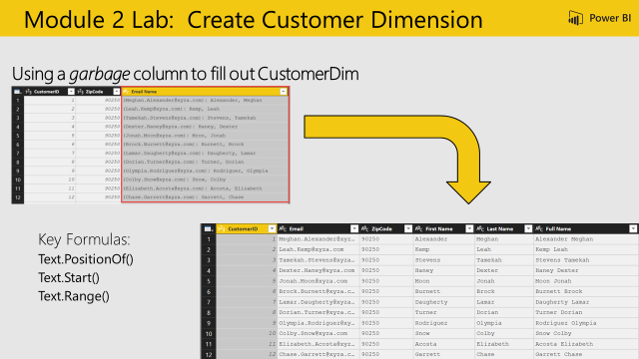
Step by Step
Objective: Create a First, Last, and Full Name columns based on the Email Name column.
Use Recent Sources to get CustomerDim from Excel
Change the ZipCode column data type to TEXT
Split by Delimiter Custom “: “ colon space
Replace to Remove ( and )
Add Column to find Text.PositionOf() the comma
Add Column > Custom Column
Name = “Separator”
Formula = Text.PositionOf([Email Name.2],",")
Use position of comma to split Last Name and First Name Add Columns for First Name, Last Name and Full Name Last Name = Text.Start([Email Name.2],[Separator]) First Name = Text.Range([Email Name.2],[Separator]+2) Full Name = [First Name] & " " & [Last Name]
Student Notes

Slide 7
Mod 3 Lab

Slide 8
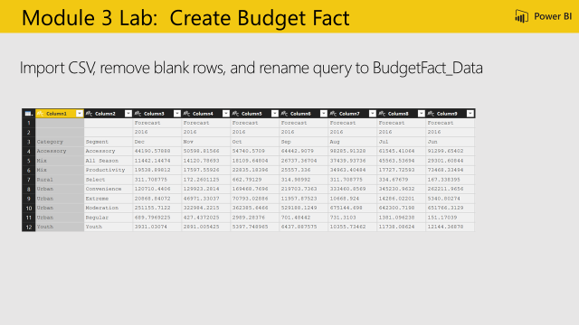
Step by Step
Objective: Create the Budget Fact
Import CSV document
Navigate to where you saved VanArsdel_Budget.csv
Rename query from VanArsdel_Budget to BudgetFact_Data
Remove Rows > Remove Top Rows, enter 3 (to remove the first 3 rows)
Student Notes

Slide 9
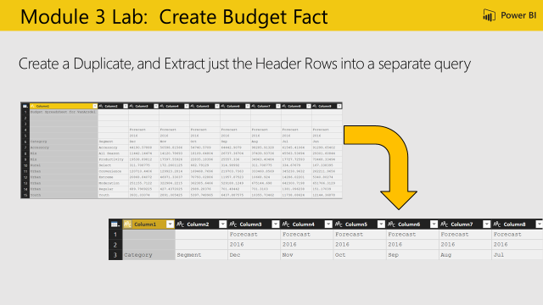
Step by Step
Objective: To Create a Header which combines the first three rows
Duplicate query BudgetFact_Data rename to “BudgetFact”
Keep Rows > Keep Top Rows, enter 3 (to keep the first three rows)
Student Notes

Slide 10
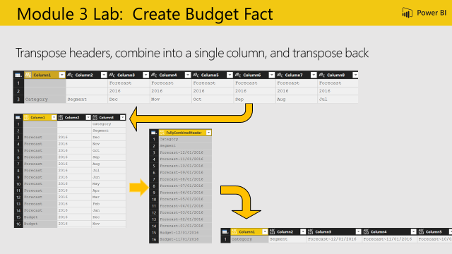
Step by Step
Objective: To Create a Header which combines the first three rows
Transform > Transpose
Add Column > Custom Column
Add Column to combine month and year into a date
Add Column > Custom Column
Name = “Budget Month”
Formula = try Date.From ([Column3] & [Column2]) otherwise null
Add Column to combine Month and Scenario
Add Column > Custom Column
Name = “FullyCombinedHeader”
Formula = if Text.Length([Column3]) > 3 then [Column3] else [Column1] & "~" & Date.ToText([Budget Month], "M/D/YYYY")
Hint: Day did not come through correctly, as it is case sensitive. Update to “MM/dd/yy”
Remove all columns except for [FullyCombinedHeader]
Transform > Transpose to transpose back to wide
Student Notes

Slide 11
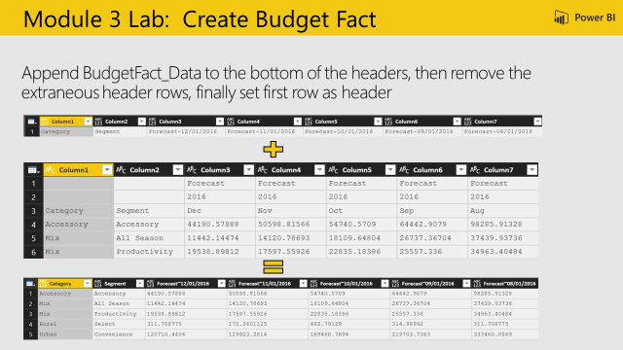
Step by Step
Objective: To Append the new header row to the data to create the new wide data table with a single header row
Append query BudgetFact_Data
Use First Row as Header to promote the newly fixed header row
Remove Rows > Remove Top Rows, enter 3 (to remove the first 3 rows – the old header rows)
Student Notes

Slide 12
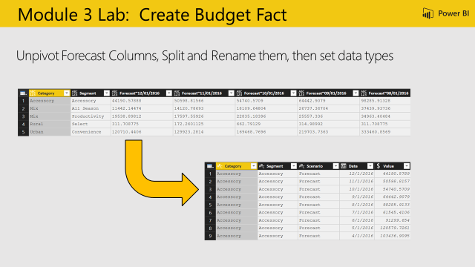
Step by Step
Objective: Create the Budget Fact
Highlight [Category] and [Segment] and Transform > Unpivot Other Columns
Highlight [Attribute] and navigate to Home > Split Column > By Delimiter > “~”
Rename: [Attribute.1] = “Scenario”, [Attribute.2] = “Date”, [Value] = “Budget Amount”
Change the Data Types: [Budget Amount] = Fixed Decimal, [Date] = Date
Student Notes

Slide 13
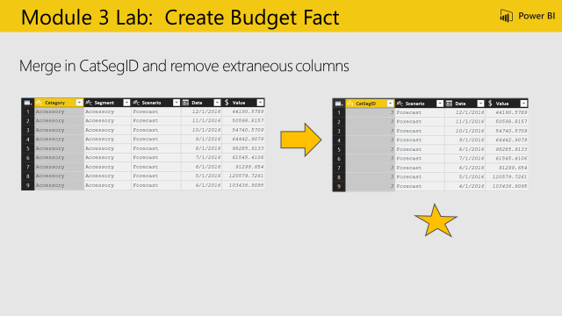
Step by Step
Objective: Merge the queries together to create the final Budget Fact table
Home > Merge Queries > Select CatSegDim
From the CatSegDim highlight both [Category] and [Segment]
Go back up to BudgetFact, highlight both [Category] and [Segment]
Show the Join Kinds available, and leave “Left Outer”
Expand [NewColumn] > Select “CatSegID” and deselect “Use Original column name as prefix”
Remove: [Category], [Segment]
Reorder: [CatSegID], [Scenario], [Date], [Budget Amount]
Disable the load of BudgetFact_Data
Student Notes

Slide 14
Mod 4 Lab

Slide 15
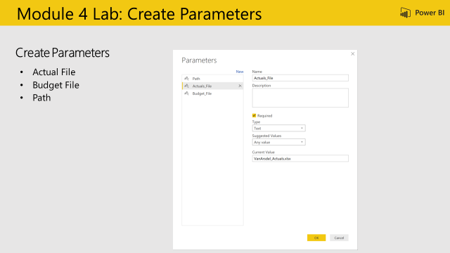
Step by Step
Objective: Update file paths to use dynamic variables
From the Home Ribbon > Manage Parameters
Create a new Parameter
Parameter Name: Path
Type: Text
Current Value = Where you have your data file, i.e. C:\Power BI_Adv_M\
Create a new Parameter
Parameter Name: Actuals_File
Type: Text
Current Value = VanArsdel_Actuals.xlsx
Create a new Parameter
Parameter Name: Budget_File
Type: Text
Current Value = VanArsdel_Budget.csv
Update the text files to ensure the parameter names are consistent
Student Notes

Slide 16
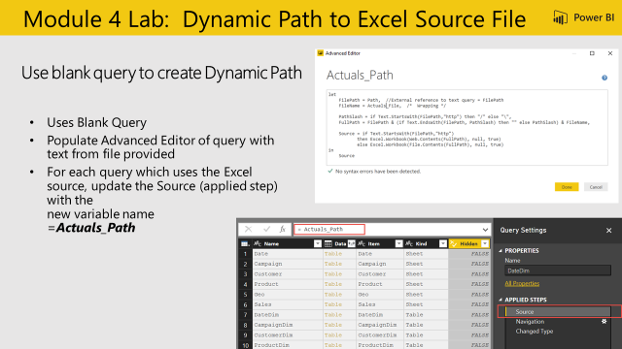
Step by Step
Objective: Create a query to validate if source is Web or Local and resolve path
Create a new blank query
Query Name: “Actuals_Path”
Text as shown in slide (white box)
Update Source Applied Step to use Resolved Path = “Actuals_Path” to the following Queries:
CampaignDim
CustomerDim
ProductDim
CatSegDim
DateDim
GeoDim
SalesFact
Student Notes

Slide 17
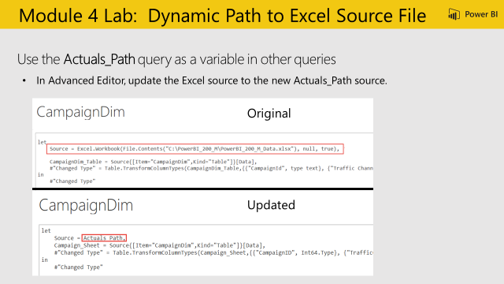
Step by Step
Student Notes

Slide 18
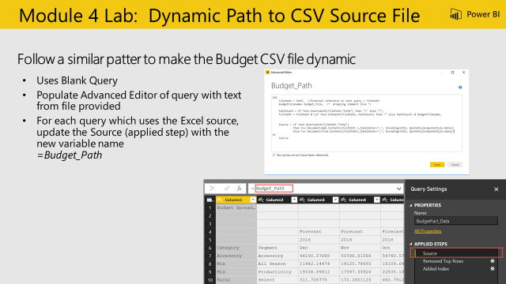
Step by Step
Objective: Update CSV file paths to use dynamic variables
Create a new blank query
Query Name: “Budget_Path”
Copy in text from Budget_Path.txt
Update Source Applied Step to use ResolvedBudgetPath = “Budget_Path” to the following Queries:
BudgetFact
BudgetFact_Data
Student Notes

Slide 19
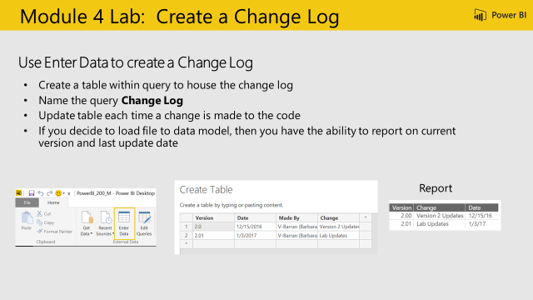
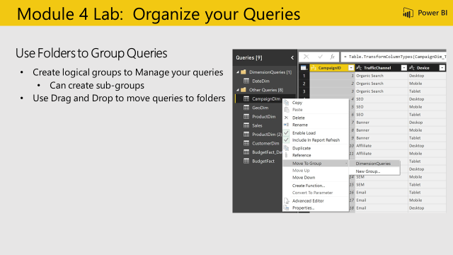
Student Notes
Student Notes

