Slide 1
NilamHut
First auction website in bangladesh

Slide 2

What is NilamHut ?
NilamHut is a place where products are sold through Auction. Auctions can be done on previously posted product and also live auction is a part where buyers can attend the auction online.
Government and other organizations like charity organization can use NilamHut for auction.
General people can also sell their valuable and rare products.
People can bid online regardless of the place.

Slide 3

Scope of the project
The scope of the project is to build an online platform specifically for auction purpose in Bangladesh. NilamHut will be the first auction website in Bangladesh.
It also serves as an E-Commerce platform.

Slide 4
Core Objective
Auctions can be done on previously posted products.
Audio and video broadcasting can be performed.
Real time communication between buyer and seller.
The application will learn user actions based on the interest they have expressed in the past and judgment they have made by monitoring the choices user makes.
Secure transaction via NilamHut.

Slide 5
Background Study
Local Market
International Market
There are no auction sites in Bangladesh.
Selling products on international auction sites is not practical.
International auctions platforms like beezid[1], wellbid[2] is not available in Bangladesh.
International auctions platforms like beezid[1], wellbid[2] does not support real time communication between buyer and seller.
International auctions platforms like beezid[1], wellbid[2] have not implemented live auction broadcasting yet.
Most of them do not have preference tracking integrated in their platform.

Slide 6
Feasibility Study
Technical
We have experience in ASP.NET Core on backend and Angular on front end.
We have also experience on web RTC for real time communication.
User can use the browser from mobile, tablet or pc to browse our web site. All modern browsers are capable of running this site.
Economical
There are no competitor site. So benefits are expected to come shortly.
NilamHut will charge 5% for each sale. So it is profitable.
User can attend or bid on products from anywhere. User don’t have to be there physically.
Environmental
NilamHut will provide secure transaction.
NilamHut will prevent frauds.

Slide 7

Technology To Be Used
Server Side
Language
C#
Framework
ASP.Net Core
Database
Sql Server
Client Side
HTML
CSS
Bootstrap 4
Angular (Angular 4)
WebRTC for real time communication.

Slide 8
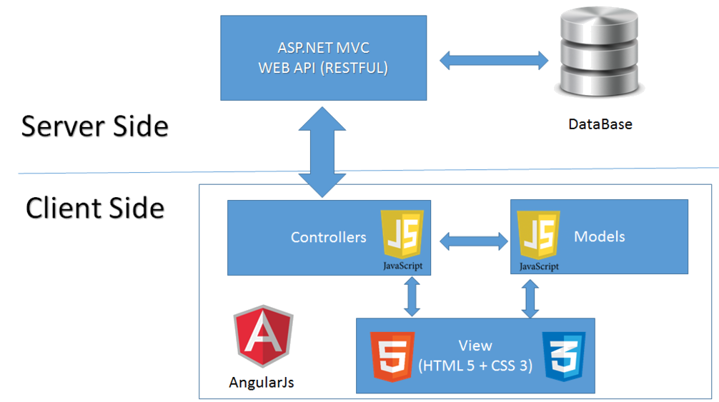
Implementation Plan
Asp.net Core

Slide 9
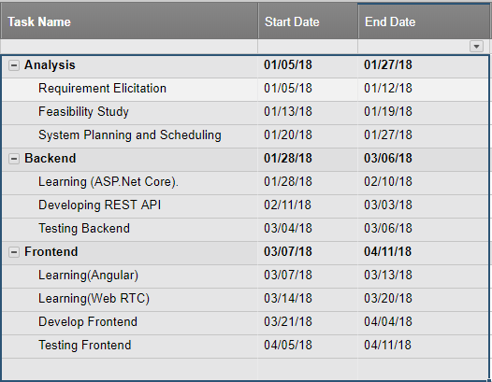
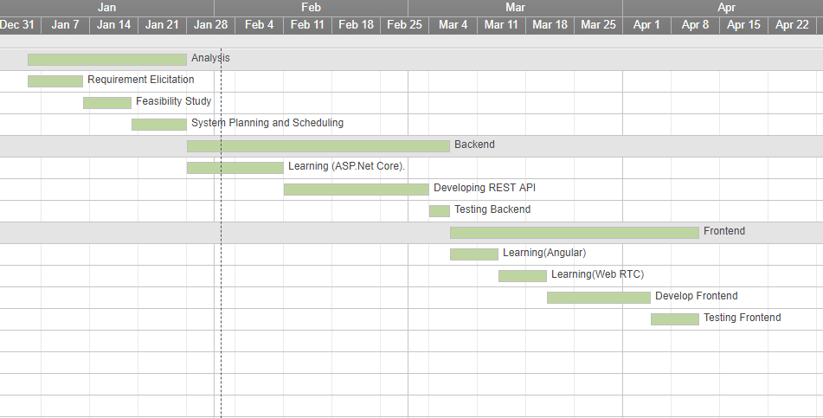
Task List And Gantt Chart

Slide 10
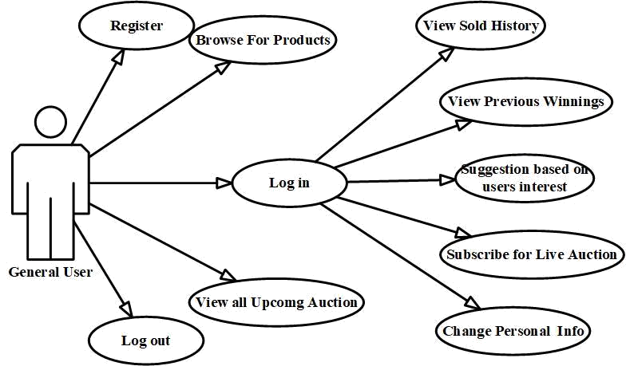
UML Diagram (Use Case) For General User

Slide 11
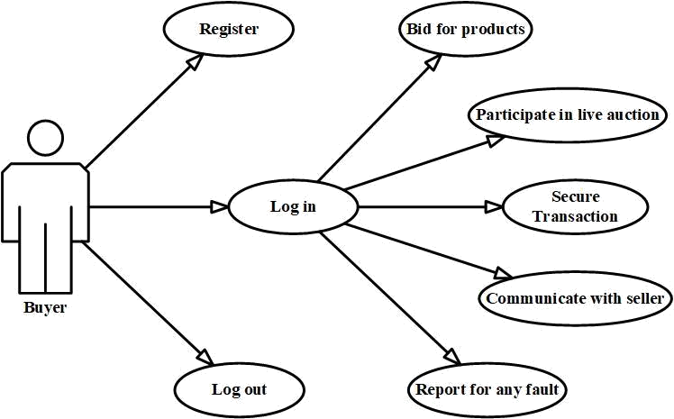
UML Diagram (Use Case) For Buyer

Slide 12
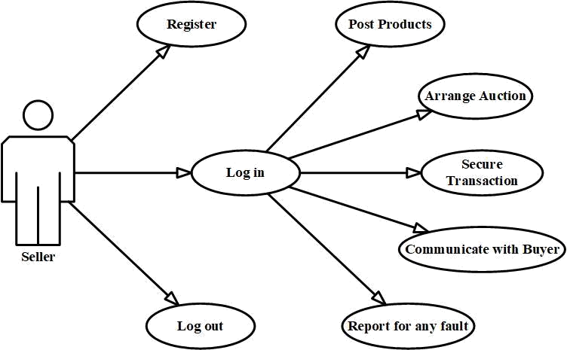
UML Diagram (Use Case) For Seller

Slide 13
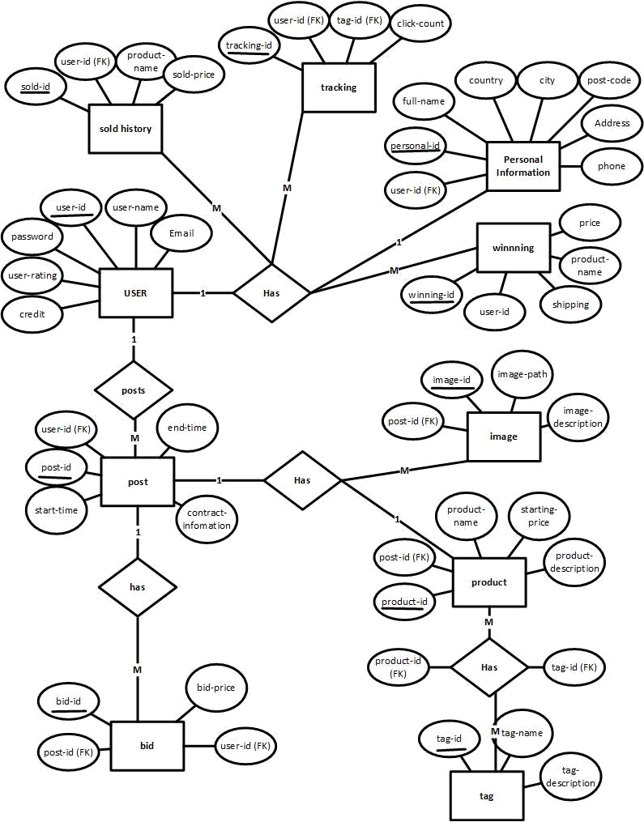
Relational Database (ER Diagram)

Slide 14

Expected Outcome
Complete business platform.
A trustworthy web platform for auctioning rare goods.
Government and other organizations like charity organization can use NilamHut for auction easily.

Slide 15
Risk Factor & Management
Asp.net core is very recent technology. So community help is limited
Implementing secure transaction is challenging
Implementing WebRTC in challenging
Risk Management
Microsoft has very good support for developers.
WebRTC has very good community support.
Now a days we have mobile banking services like Bkash, Roket. These are practical and easy to implement for Bangladesh.

Slide 16

Thank You

