Slide 1
BCSE308P COMPUTER NETWORKS LAB · INNOVATIVE EVALUATION PROJECT
Contender-Estimation Adaptive Backoff
Teaching Wi-Fi stations how long to wait
A comparative study of nine CSMA/CA backoff strategies in IEEE 802.11, and a new scheme that sets the contention window from the number of stations it overhears
SAHIL BARNWAL
Ssunvya jain
Rishika Singal
24BDS0256
23BCE0298
24BDS0233
School of Computer Science and Engineering · VIT · October 2026
Notes:
Introduce the team and the one-line idea: the 802.11 backoff rule forgets how crowded the channel is after every frame; CEAB measures the crowd and waits accordingly.

Slide 2
Crowded Wi-Fi loses a quarter of its capacity
Standard 802.11 binary exponential backoff (BEB), 50 saturated stations, 802.11g 54 Mb/s
−25 %
0.59
304 ms
throughput lost against the best backoff at N = 50 (22.3 vs 29.8 Mb/s)
probability that a transmission attempt collides
99th-percentile access delay: one frame in a hundred waits a third of a second
Why it happens
Why it matters
After every success BEB resets the window to 16 slots, regardless of how many stations compete
The next frame collides, doubles, collides again: contention is re-learned for every frame
The winner keeps the smallest window and tends to win again (capture effect)
Lecture halls, hostels and IoT deployments put dozens of active stations on one access point
Short-term fairness at N = 50 is only 0.40 (Jain index; 1.0 = perfectly fair)
Tail delay, not the mean, is what breaks calls, games and video
CEAB · BCSE308P Computer Networks Lab · Fall 2026-27
2
Notes:
All numbers are from our simulator, 10 seeds each. Emphasise that the problem grows with the number of stations, which is the trend in real deployments.

Slide 3
Existing waiting strategies either forget or assume
Baseline: IEEE 802.11 DCF with binary exponential backoff
Baseline: BEB
History-based rules
Estimation-based
1
Linear · Fibonacci · Quadratic · MILD · EIED · Constant
Calì et al. 2000 · Bianchi & Tinnirello 2003 · Idle Sense 2005
Draw backoff b ~ U[0, W−1]
Change W by a fixed rule after each outcome
Never learn how many stations compete
Linear/Fibonacci collide even more than BEB; MILD can lock at CWmax
Aim for the optimal window, but model the other stations
Model inversion is fragile: real counters are correlated
Idle Sense next to legacy stations gets 0.9 Mb/s vs 27 Mb/s
2
Count down idle 9 µs slots, freeze while busy
3
Transmit at b = 0; wait for the ACK
4
No ACK → W ← min(2W, 1024), retry ≤ 7
5
ACK → W ← 16 (forget everything)
CEAB · BCSE308P Computer Networks Lab · Fall 2026-27
3
Notes:
Gap: we need an estimate of contention that is model-free, passive, and independent of what backoff the other stations run.

Slide 4
CEAB counts who is talking, then waits
Contender-Estimation Adaptive Backoff: four steps, run independently by every station
1
2
3
4
Overhear
Estimate
Correct for load
Set the window
Log the sender address (TA) of the last M = 200 decoded frames
n_eff = M(M−1) / Σ c_j(c_j−1)
ρ = min(1, I* / I_obs); n_c = ρ · n_eff
W* = 2 / τ*(n_c) − 1
information every 802.11 header already carries
inverse Simpson index: equals n for n equal senders
long idle gaps → fewer backlogged stations
τ* = throughput-optimal attempt probability (Bianchi)
What exactly differs from the baseline
After success: W stays at the optimum, never back to 16
After collision: W unchanged (K = 0), not doubled
Estimator: model-free; valid whatever the others run
Same input for all: all stations hold the same window → fairness
CEAB · BCSE308P Computer Networks Lab · Fall 2026-27
4
Notes:
Novelty: the inverse Simpson index from ecology has not been used for 802.11 backoff tuning as far as we found. Unlike Calì/Bianchi-Tinnirello, no model of the other stations; unlike Idle Sense, no fixed idle-slot target, so it does not starve next to legacy stations.

Slide 5
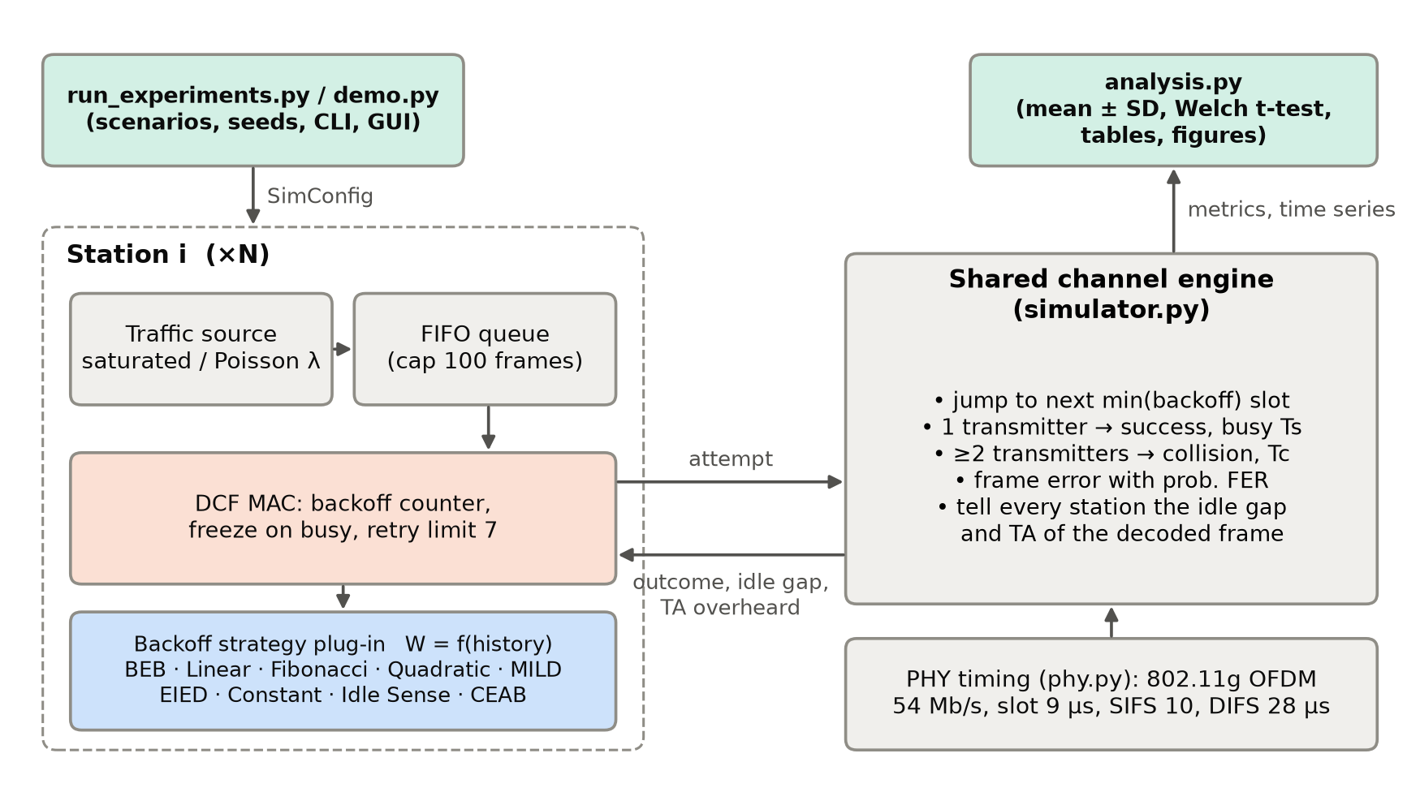
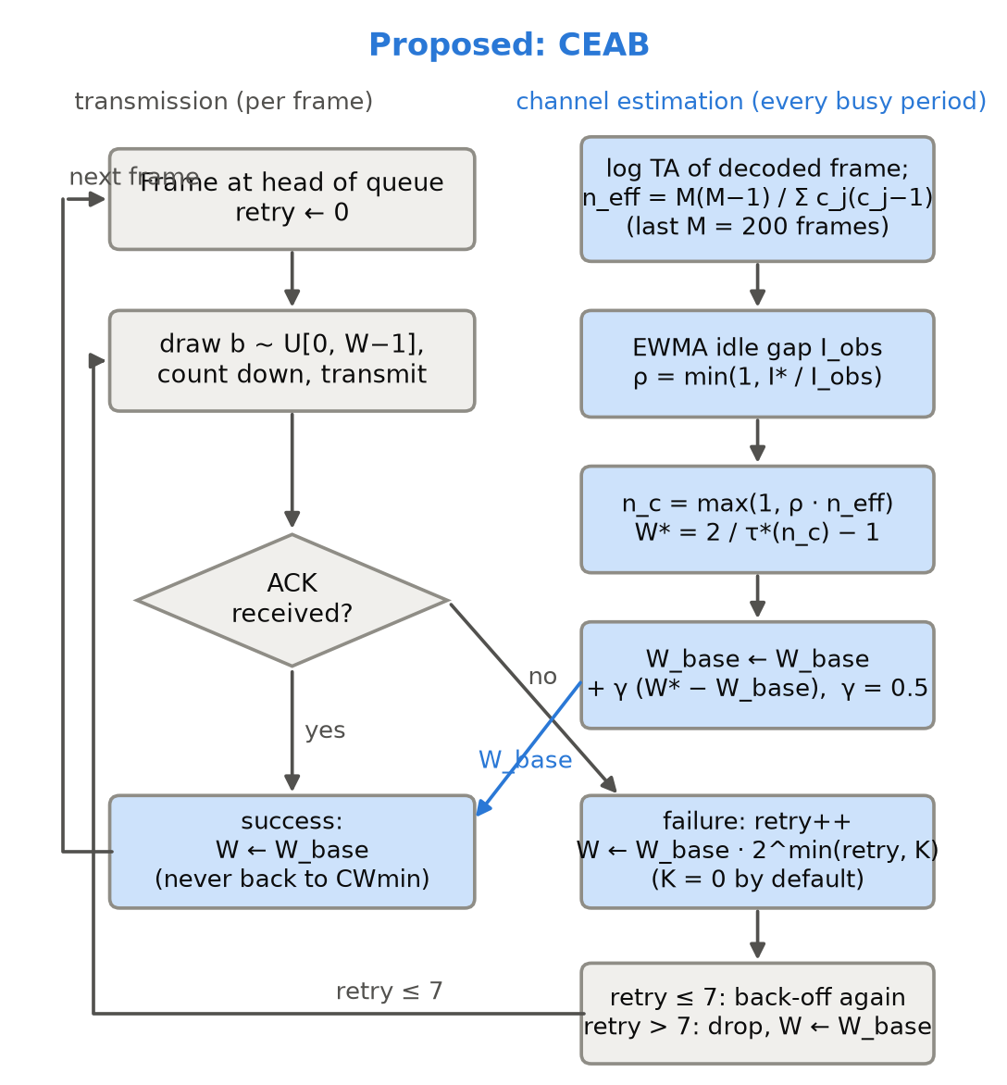
Architecture and algorithm
Event-driven 802.11 DCF simulator with pluggable backoff strategies
Engine: jumps straight to the next slot in which a backoff counter hits zero, so 2170 ten-second runs take about 6 minutes on 16 cores
CEAB · BCSE308P Computer Networks Lab · Fall 2026-27
5
Notes:
Left: each station = traffic source + queue + DCF state machine + strategy object. The channel engine decides success/collision/error and broadcasts idle gap and TA. Right: CEAB flowchart; estimation runs every busy period, window update on own outcomes.

Slide 6
Implementation setup
Python 3.14 · NumPy · SciPy · Matplotlib · 9 unit tests incl. Bianchi validation
Parameter | Value
PHY | 802.11g ERP-OFDM, 54 Mb/s data, 24 Mb/s ACK
Slot / SIFS / DIFS | 9 / 10 / 28 µs
Payload | 1500 B (256–2304 B sweep)
Ts / Tc (basic) | 314 / 323 µs
CWmin / CWmax / retries | 15 / 1023 / 7
Stations N | 2 – 100
Traffic | saturated, or Poisson 2 – 40 Mb/s
Runs | 10 seeds × 10 s, 1 s warm-up
CEAB | M = 200, γ = 0.5, β = 0.05, K = 0
Code structure
phy.py
frame timing, Ts and Tc
analytical.py
Bianchi model, τ*(n) table
strategies.py
9 strategies incl. CEAB
simulator.py
event-driven DCF engine
experiments.py
2170 parallel runs
analysis.py
mean ± SD, t-tests, plots
demo.py
live CLI, trace, GUI
CEAB · BCSE308P Computer Networks Lab · Fall 2026-27
6
Notes:
Validation: simulated BEB matches Bianchi's analytical throughput within 1.7 % for 2–100 stations, and an independent slot-by-slot Monte Carlo in the tests.

Slide 7
Scenarios and metrics
2170 independent simulation runs, every point = mean ± SD of 10 seeds
1
S1 · S2 · S3
saturated, N = 5 / 20 / 50 (low / medium / high)
Metrics and why
2
Station sweep
N = 2 … 100, all nine strategies
Throughput — capacity; what the optimal window maximises
Collision probability — direct sign of a window that is too small
99th-pct access delay — the tail is what real-time traffic feels
Short-term Jain fairness — 100 ms windows expose the capture effect
Drop rate, end-to-end delay — losses and queueing seen by upper layers
Welch t-test — is the difference real, not noise?
3
Offered load
Poisson traffic, 30 stations, 2 – 40 Mb/s
4
Robustness
frame errors 0 – 30 %, RTS/CTS, payload 256 – 2304 B
5
Churn
5 → 50 → 15 stations during a run
6
Coexistence
10 legacy BEB + 10 new-scheme stations
7
Ablation
CEAB escalation cap K and window M
CEAB · BCSE308P Computer Networks Lab · Fall 2026-27
7
Notes:
Mention that every scenario can be re-run live with demo.py by changing a flag or slider.

Slide 8
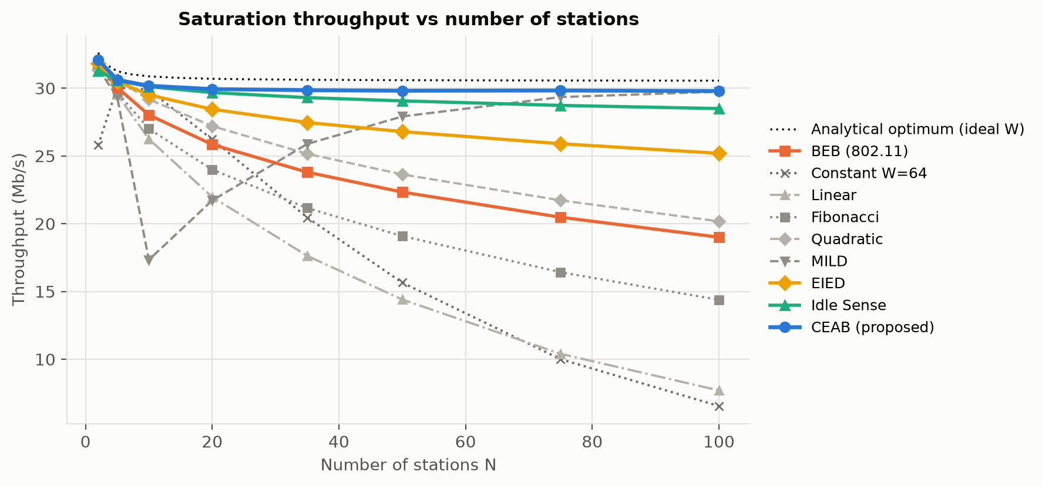
CEAB stays near capacity as the network grows
Saturation throughput, all nine strategies, N = 2 … 100 (10 runs per point)
+33.5 %
throughput at N = 50 (22.3 → 29.8 Mb/s), +57 % at N = 100
−79 %
99th-pct delay at N = 50 (304 → 65 ms)
0.40 → 0.91
short-term fairness at N = 50; collisions 0.59 → 0.20
CEAB · BCSE308P Computer Networks Lab · Fall 2026-27
8
Notes:
All BEB vs CEAB differences in S1–S3 are significant (Welch p < 0.01) except mean access delay at N = 50, which is fixed by the frame rate in saturation. S1 gain is small (+1.9 %) because BEB is already near-optimal with 5 stations; S2 +15.8 %.

Slide 9
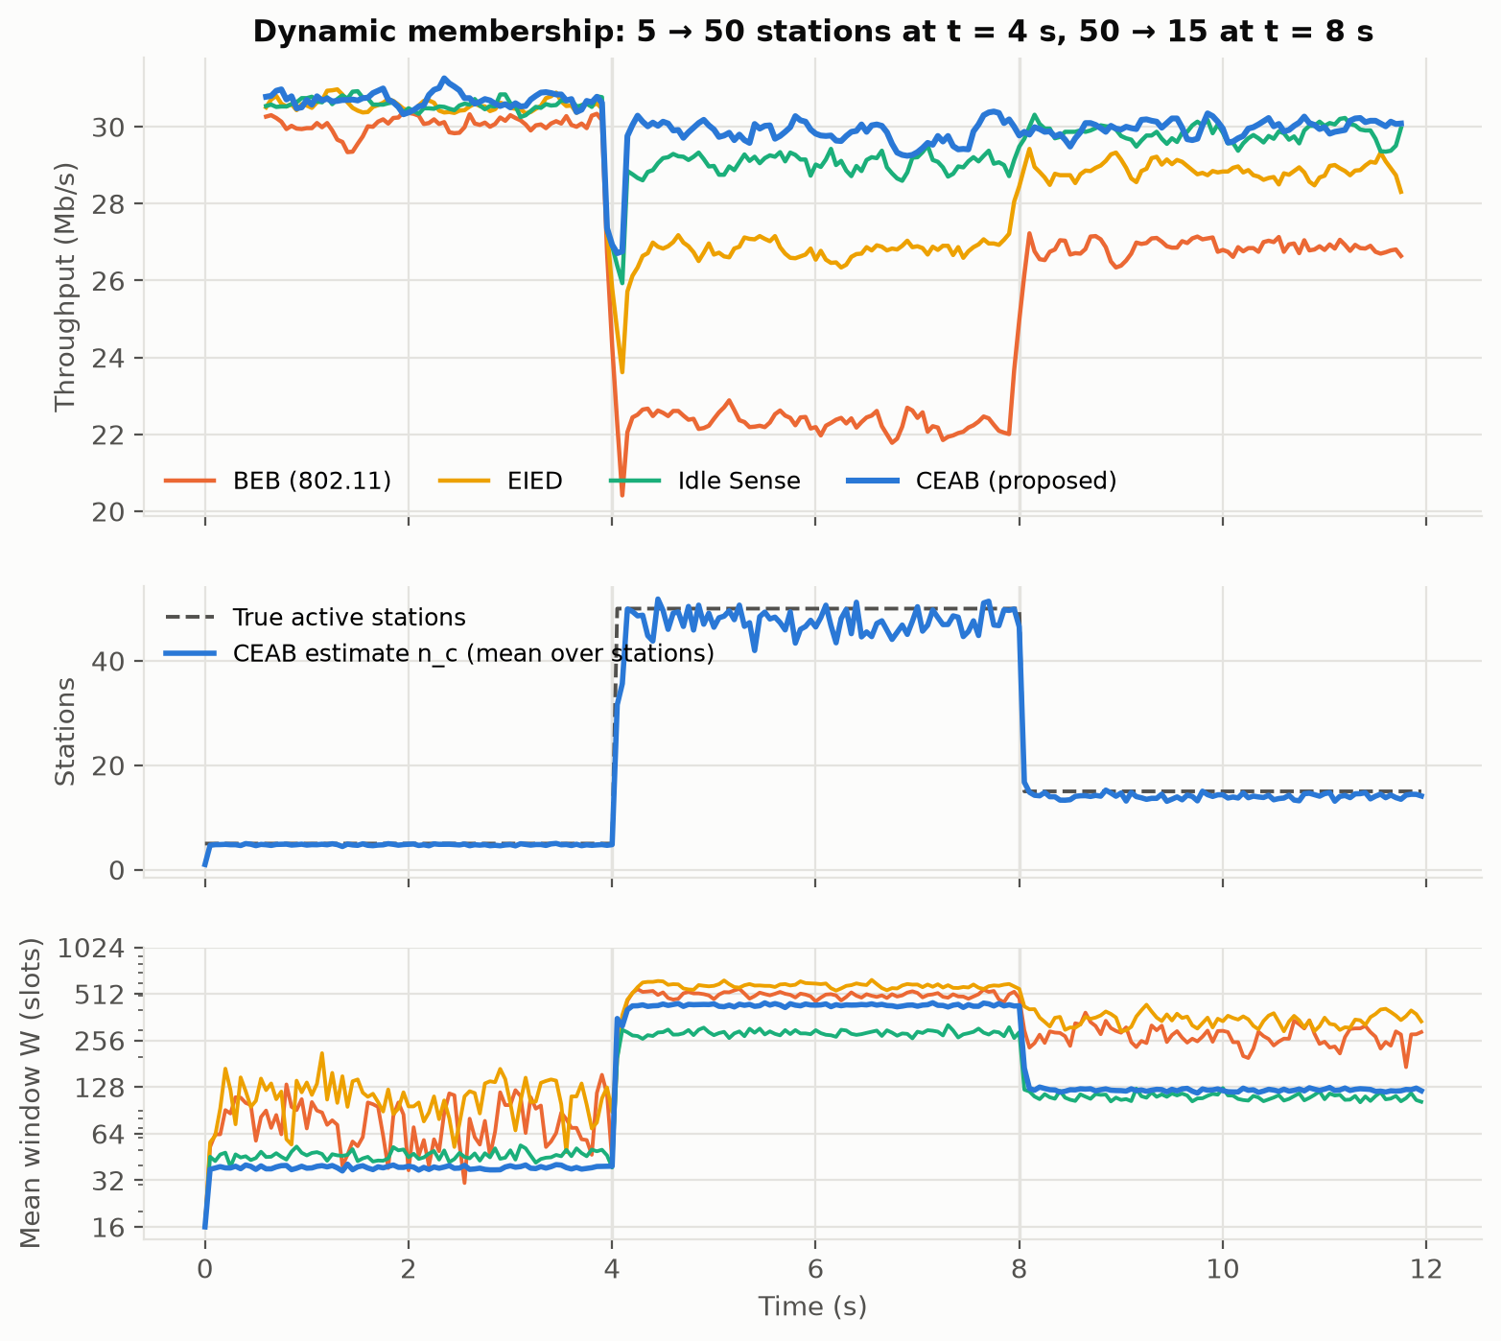
Where it helps, and where it does not
Dynamic membership trace (left) and critical evaluation (right)
Strengths
Tracks 5 → 50 → 15 stations within ~0.1 s
Carries 29.9 Mb/s of Poisson traffic vs 24.4 for BEB; light-load delay unchanged
Adopters are better off even beside legacy BEB (Idle Sense starves)
Limitations and failure cases
RTS/CTS, N = 5: no gain (-0.3 %) — collisions are cheap
FER 30 %: gains vanish, EIED marginally better
Medium Poisson load: mean delay 0.94 vs 0.77 ms
Hidden terminals not modelled; legacy BEB keeps a 2.6 : 1 share
CEAB · BCSE308P Computer Networks Lab · Fall 2026-27
9
Notes:
Be upfront about the failure cases: this is what the rubric's critical-evaluation criterion looks for. Ablation: per-retry doubling (K = 1, 2) raised the tail delay, so K = 0.

Slide 10
Conclusion, future work and references
Conclusion
Key references
Waiting well = remembering how crowded the channel is
CEAB: +16 % / +33 % throughput at N = 20 / 50, −79 % tail delay, fairness 0.91
Within 2.5 % of the theoretical limit for 5 – 100 stations
Uses only what every 802.11 receiver already decodes
[1] IEEE Std 802.11-2020
[2] G. Bianchi, IEEE JSAC 18(3), 2000
[3] F. Calì et al., IEEE/ACM ToN 8(6), 2000
[4] V. Bharghavan et al., MACAW, SIGCOMM 1994
[5] N.-O. Song et al., EIED, IEEE VTC 2003
[6] M. Heusse et al., Idle Sense, SIGCOMM 2005
[7] G. Bianchi, I. Tinnirello, INFOCOM 2003
[16] E. H. Simpson, Nature 163, 1949
Full IEEE-style list: project report, Ch. 7
Future work
Hidden terminals and multi-cell; airtime-aware estimate for multi-rate
ns-3 port and an OpenWiFi / ath9k testbed; 802.11ah IoT scale
CEAB · BCSE308P Computer Networks Lab · Fall 2026-27
10
Notes:
Close with the demo offer: python demo.py gui — change N, load, error rate or access mode live and compare BEB with CEAB.

