Slide 1
Neuro-Symbolic Automated Essay/Answer Grading
with Rule-Based Justification

Slide 2
The Problem
Hand grading long answers is slow and inconsistent.
The parent paper (Agrawal et al., 2024) grades well but fuses its three NLP modules with a black-box DNN.
The mark has no trace back to the evidence.
When a student contests a grade, there is nothing auditable to show.
A mark we cannot defend is not usable.

Slide 3
The Idea
Keep the parent paper’s three modules as the evidence.
Replace the opaque DNN with a fuzzy IF-THEN rule base.
The rule base is the justification — the rules that fired are the explanation.
Neural part = offline sentence embeddings (a sensor, not the judge).
Output: a grade plus the rules and evidence behind it.

Slide 4
Extends the Parent Paper, Point for Point
Parent paper (ESWA 2024) | This project
Keyword: YAKE + KeyBERT + WordNet | Reused (symbolic)
Similarity: SBERT / SimCSE | Reused (neural, offline)
NER: spaCy / CamemBERT | Reused (symbolic)
Fuse 3 scores with 4-layer DNN | Fuzzy rule base
Output: one number | Output: number + scorecard
Evaluation: RMSE only | + QWK, Pearson, stability

Slide 5
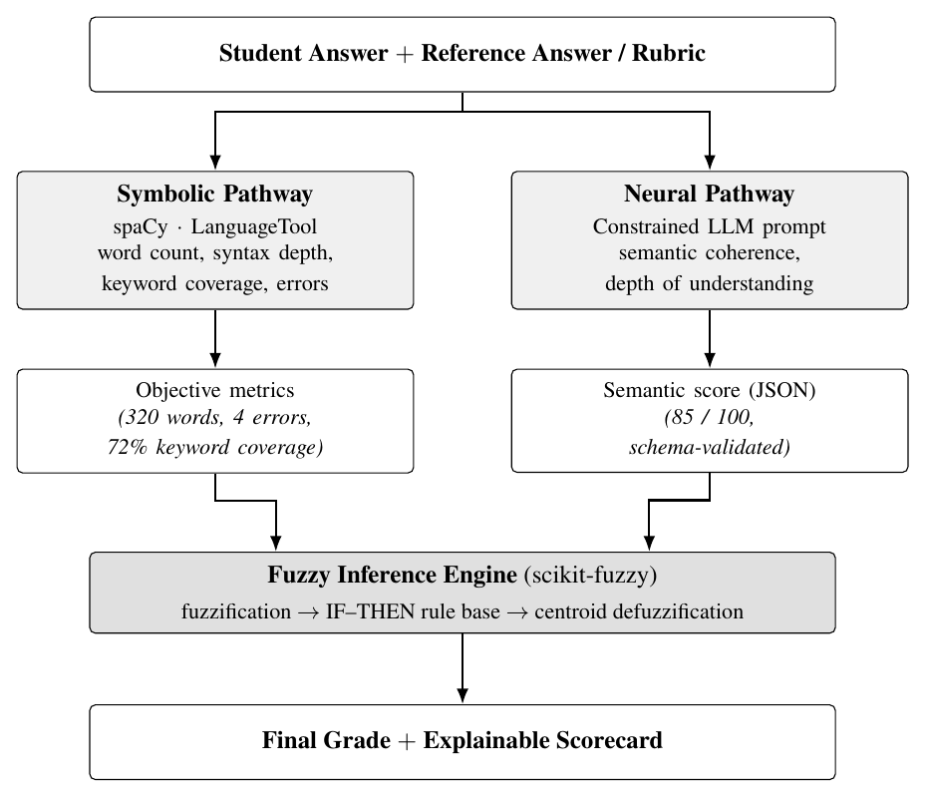
System Architecture

Slide 6
Step 1 - Data
Public Mohler (2011) UNT CS short-answer corpus.
2,273 student answers, 79 questions, reference answer each.
Human grades 0-5 (two annotators), rescaled to 0-100.
Matches the parent paper’s computer-science domain.

Slide 7
Step 2 - Symbolic Pathway (reused modules)
Keyword: YAKE + KeyBERT on the reference, WordNet synonym expansion, coverage of reference keywords.
NER: spaCy entities + numbers/big-O, Jaccard overlap.
Mechanics: length adequacy, grammar errors, syntactic depth (advisory penalty only — the axis the parent paper lacked).
Every metric normalised to 0-100, fully reproducible.

Slide 8
Step 3 - Neural Pathway (offline)
Sentence-BERT (all-MiniLM-L6-v2), runs locally — no API.
Encodes student and reference, cosine similarity.
Per-sentence coverage against the reference (0.75 threshold).
One deterministic number → nothing to hallucinate.
This is the only neural component: a semantic sensor.

Slide 9
Step 4 - Fuzzy Engine: Setup
Inputs: keyword, similarity, NER scores (the 3 parent modules).
Output: final grade.
Triangular / trapezoidal membership functions: Low, Medium, High.
Each score gets a degree of membership in each set.

Slide 10
Step 4 - Fuzzy Engine: Rules
IF similarity High AND keyword High THEN Excellent.
IF keyword High AND similarity Low THEN Average.
  the right terms, no real understanding
IF similarity High AND keyword Low THEN Good.
  weak wording, strong ideas
Mamdani inference, then centroid defuzzification.
Strict / lenient policy = just a different rule set (no code change).

Slide 11
Step 5 - Scorecard and UI
Streamlit page: paste both answers, press Grade.
Show raw metrics: keyword coverage, cosine, entities, errors.
Show the semantic score separately.
List which rules fired and how strongly.
Plot the membership functions and the aggregated output.

Slide 12
Step 6 - Evaluation
Compare system marks against human marks on all 2,273 answers.
Metrics: Quadratic Weighted Kappa, Pearson, RMSE.
Ablation: each module alone vs linear mean vs full fuzzy.
Paraphrase test: does the grade stay stable?
Padding test: does filler text raise the grade?

Slide 13
Results — Fuzzy Combiner Wins on Agreement
System | RMSE | Pearson | QWK
mean-baseline | 21.9 | 0.00 | 0.00
similarity-only | 34.9 | 0.50 | 0.26
mean-of-modules | 33.1 | 0.44 | 0.25
full-fuzzy (lenient) | 34.2 | 0.48 | 0.31

Slide 14
Best QWK of any configuration — beats every single module and the linear average.
After one affine calibration: held-out RMSE 19.9 < baseline 21.9.

Slide 15
Results — Stability (what the DNN was never tested for)
Paraphrase: grade moves only 0.72 pts on average.
Padding: appending filler changes the grade by -1.1 pts.
  the system does not reward verbosity — resists length-gaming.
Stability follows from the architecture: a centroid over a small rule base changes smoothly with its inputs.

Slide 16
Tech Stack
Part | Tool
Parsing, POS, NER | spaCy
Keywords | YAKE + KeyBERT + WordNet
Semantic judgement | Sentence-BERT (offline)
Fuzzy inference | from-scratch Mamdani (NumPy)
Interface | Streamlit
Plots | matplotlib

Slide 17
Why This Is Neuro-Symbolic
Neural: the SBERT transformer handles meaning.
Symbolic: keyword, NER and mechanics give checkable facts.
Fuzzy rules make the actual decision.
The neural model is a sensor, not the judge.
A single weak/wrong input cannot move the mark on its own.

Slide 18
Why a Fuzzy Engine Instead of the DNN?
The rule base is readable and editable by the examiner.
It encodes non-linear policies a weighted sum cannot (e.g. right terms + no understanding → Average).
Every rule’s firing strength is exposed → the explanation is the computation, not a story about it.
No training, no black box, no hallucinated justification.

Slide 19
Deliverables
Streamlit demo, graded live during the review.
Documented rule base the examiner can edit (strict / lenient).
Benchmark: our system vs each module vs linear mean vs human.
Full project report (17 pp) extending the parent paper, with real results and figures.

