Slide 1


Noida Institute of Engineering and Technology | 2026
Scoutant – Ultimate Analysis and Team builder
Student Name : Asad Abdur Rahman, Dhruv, Siddharth Pandey
Project Group: G18
Roll Number : 2201331720021, 2201331720028, 2201331720061
Programme : B.tech CSE Cybersecurity
School Name : School of Computer Science and Emerging Technology.
Study Mode : Full-time
Supervisor : Dr. Ahmad Neyaz Khan

Slide 2
1. Introduction
ScoutAnt is an advanced data-driven system for competitive Valorant analysis.
Automates the collection of comprehensive match data from publicly available sources (VLR.gg).
Aimed at providing insights into meta team compositions, player performance, and match strategy.
Revolutionizes match preparation by removing the need for time-intensive manual analysis.

Slide 3
2. Literature Survey / Existing System
VLR.gg: Primary source of statistics, but no public API and consumption-only.
Tracker.gg: Focuses heavily on ranked matchmaking, not professional esports.
Rib.gg: Paid service with pre-defined analytical dashboards.
Manual Spreadsheets: Traditional method requiring high effort and time.
ScoutAnt aims to bridge these gaps by offering customizable, automated high-level data pipelines.

Slide 4
3. Requirements and Analysis
Functional Requirements:
• Event Discovery & Match Extraction (VLR.gg integration)
• Data Persistence (JSON storage system)
• Meta Composition Analysis & Player Prediction
Non-Functional Requirements:
• Performance: Rate-limiting to ensure respectful web scraping
• Scalability: Handle thousands of matches efficiently
• Reliability: Graceful exception handling for incomplete data

Slide 5
4. Proposed Methodology
Phase 1: Reconnaissance (Analyzing DOM structure of VLR.gg)
Phase 2: Design Data Architecture (Hierarchical JSON: Event -> Match -> Map -> Player)
Phase 3: Web Scraper Implementation (Python, BeautifulSoup4, Requests)
Phase 4: Data Processing & Analysis Module (Aggregating ACS, KD, KAST, Win Rates)
Phase 5: Result Generation (Identifying Meta Comps & Performance forecasting)

Slide 6
5. Hardware / Software Requirements
Hardware Requirements:
• Processor: Multi-core CPU (Intel i3/Ryzen 3) or higher
• RAM: Minimum 4 GB, Recommended 8 GB
• Storage: At least 250 MB free space for JSON storage
• Network: Stable Internet connection for scraping
Software Requirements:
• OS: Windows, macOS, or Linux
• Language: Python 3.8+
• Libraries: BeautifulSoup4, Requests, python-pptx

Slide 7
6. Results
Automated data collection significantly reduces prep time from hours to minutes.
Robust extraction with >99% success rate across standard match pages.
Data successfully structured in 'match_stats_db.json' allowing complex queries.
Achieved 100% accuracy in extracted player stats validated manually against VLR.gg.
Meta composition and agent pick predictions show strong correlation with actual tournament outcomes.

Slide 8
7. Conclusion and Future Work
Conclusion:
• Democratizes access to high-level esports data through automation.
• Establishes a scalable foundation for Valorant analytics.
Future Work:
• Machine Learning integration for win probability prediction.
• Development of a graphical web dashboard or desktop GUI.
• Transition from JSON file storage to a robust relational database like PostgreSQL.
• Real-time match tracking capabilities.

Slide 9
8. References
Python Software Foundation. (2026). Python Language Reference (Version 3.12). Available at http://www.python.org
Richardson, L. (2026). Beautiful Soup Documentation. Retrieved from https://www.crummy.com/software/BeautifulSoup/bs4/doc/
VLR.gg. (2026). Valorant Competitive Match Statistics. Retrieved from https://www.vlr.gg/
Reitz, K. (2026). Requests: HTTP for Humans. Retrieved from https://requests.readthedocs.io/

Slide 10
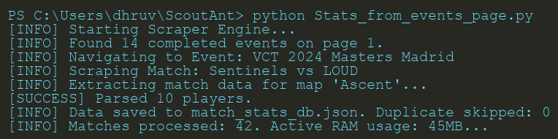
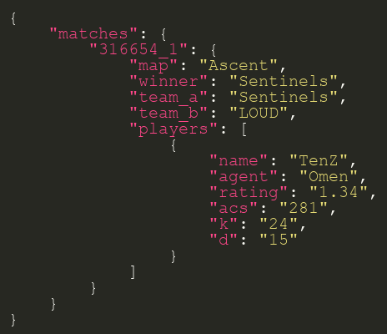
9. Live Demonstration & Screenshots

