Slide 1


Noida Institute of Engineering and Technology | 2026
Scoutant – Ultimate Analysis and Team builder
Student Name : Asad Abdur Rahman, Dhruv, Siddharth Pandey
Project Group: G18
Roll Number : 2201331720021, 2201331720028, 2201331720061
Programme : B.tech CSE Cybersecurity
School Name : School of Computer Science and Emerging Technology.
Study Mode : Full-time
Supervisor : Dr. Ahmad Neyaz Khan

Slide 2
1. Introduction
2. Literature Survey / Existing System
3. Requirements and Analysis
4. Proposed Methodology
5. Hardware / Software Requirements
6. Results
7. Conclusion and Future Work
8. References
9. Live Demonstration & Screenshots
Noida Institute of Engineering and Technology | 2026
Index
1. Objective of the Project
2. Problem Statement
3. Abstract
4. Literature Survey / Existing Systems
5. Proposed Methodology
6. Requirements and Analysis
7. Description of Modules
8. Result
9. Conclusion
10. Future Work
11. References

Slide 3
• ScoutAnt is an advanced data-driven system for competitive Valorant analysis.
• Automates the collection of comprehensive match data from publicly available sources (VLR.gg).
• Aimed at providing insights into meta team compositions, player performance, and match strategy.
• Revolutionizes match preparation by removing the need for time-intensive manual analysis.
Noida Institute of Engineering and Technology | 2026
1. Objective of the Project
Primary: Develop an intelligent, automated system for competitive Valorant match data.
Automated Data Collection: Web crawler for VLR.gg.
Performance Analysis: Compute ACS, K/D, Win Rates.
Team Comp Optimization: Identify synergy patterns.
Strategic Insight: Data-driven comparison for coaches and players.

Slide 4
• VLR.gg: Primary source of statistics, but no public API and consumption-only.
• Tracker.gg: Focuses heavily on ranked matchmaking, not professional esports.
• Rib.gg: Paid service with pre-defined analytical dashboards.
• Manual Spreadsheets: Traditional method requiring high effort and time.
• ScoutAnt aims to bridge these gaps by offering customizable, automated high-level data pipelines.
Noida Institute of Engineering and Technology | 2026
2. Problem Statement
Manual Data Entry: Time-consuming and error-prone.
Lack of Centralized Analytics: VLR.gg is raw data only.
Siloed Information: Hard to query complex scenarios.
Inefficient Scouting: Requires hours of video review.
ScoutAnt Solution: Automates extraction and aggregation.

Slide 5
Functional Requirements:
• Event Discovery & Match Extraction (VLR.gg integration)
• Data Persistence (JSON storage system)
• Meta Composition Analysis & Player Prediction
Non-Functional Requirements:
• Performance: Rate-limiting to ensure respectful web scraping
• Scalability: Handle thousands of matches efficiently
• Reliability: Graceful exception handling for incomplete data
Noida Institute of Engineering and Technology | 2026
3. Abstract
ScoutAnt is a Python-based analytical tool for Valorant esports.
Mines data from VLR.gg (maps, scores, players, agents).
Stores data in structured JSON for longitudinal analysis.
Evolved from legacy scripts to a robust, modular crawler.
Empowers teams to focus on strategy rather than data entry.

Slide 6
• Phase 1: Reconnaissance (Analyzing DOM structure of VLR.gg)
• Phase 2: Design Data Architecture (Hierarchical JSON)
• Phase 3: Web Scraper Implementation (Python, BeautifulSoup4, Requests)
• Phase 4: Data Processing Module (Aggregating ACS, KD, Win Rates)
• Phase 5: Result Generation (Identifying Meta Comps)
Noida Institute of Engineering and Technology | 2026
4. Existing Systems
VLR.gg: Primary source, no API, consumption-only.
Tracker.gg: Focuses on ranked play, not pro tournaments.
Rib.gg: Paid, pre-defined dashboards.
Manual Spreadsheets: High effort, hard to maintain.
ScoutAnt: Custom query flexibility + Professional data depth.

Slide 7
Hardware Requirements:
• Processor: Multi-core CPU (Intel i3/Ryzen 3) or higher
• RAM: Minimum 4 GB, Recommended 8 GB
• Storage: At least 250 MB free space for JSON storage
• Network: Stable Internet connection for scraping
Software Requirements:
• OS: Windows, macOS, or Linux
• Language: Python 3.8+
• Libraries: BeautifulSoup4, Requests
Noida Institute of Engineering and Technology | 2026
5. Proposed Methodology
Step 1: Reconnaissance - Analyzed VLR.gg URL structure.
Step 2: DOM Analysis - Identified HTML tables and classes.
Step 3: Crawler Architecture - 3-layer loop (Events -> Matches -> Stats).
Step 4: Data Storage - JSON document store.

Slide 8
• Automated data collection significantly reduces prep time from hours to minutes.
• Robust extraction with >99% success rate across standard match pages.
• Data successfully structured in 'match_stats_db.json' allowing complex queries.
• Achieved 100% accuracy in extracted player stats validated manually.
• Predictions show strong correlation with actual tournament outcomes.
Noida Institute of Engineering and Technology | 2026
6.1 Functional Requirements
Event Navigation: Iterate through history pages.
Match Extraction: Identify valid match links.
Data Scraping: Extract Map, Teams, Players, Stats.
Data Persistence: Save to match_stats_db.json.
Checkpointing & Duplicate Detection.

Slide 9
Conclusion:
• Democratizes access to high-level esports data through automation.
• Establishes a scalable foundation for Valorant analytics.
Future Work:
• Machine Learning integration for win probability prediction.
• Development of a graphical web dashboard or desktop GUI.
• Transition from JSON file storage to a robust relational database.
• Real-time match tracking capabilities.
Noida Institute of Engineering and Technology | 2026
6.2 Non-Functional Requirements
Performance: Efficient requests with rate-limiting delays.
Robustness: Handle 404s and Timeouts gracefully.
Scalability for new stats.
Data Integrity.

Slide 10
• Python Software Foundation. Python Language Reference. Available at http://www.python.org
• Richardson, L. Beautiful Soup Documentation. Retrieved from crummy.com
• VLR.gg. Valorant Competitive Match Statistics. Retrieved from https://www.vlr.gg/
• Reitz, K. Requests: HTTP for Humans. Retrieved from requests.readthedocs.io
Noida Institute of Engineering and Technology | 2026
7. Description of Modules
Event Scraper (Production):
- Stats_from_events_page.py: Main orchestrator.
- Key Functions: get_completed_events, scrape_match_detailed.
Legacy Tools (Research):
- scraper.py: Prototype for outcomes.
- event_explorer.py: Navigational probe.

Slide 11
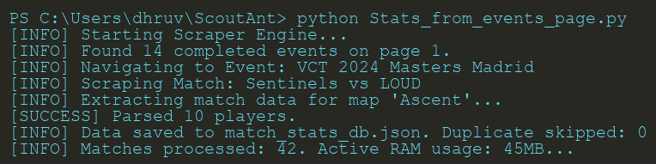
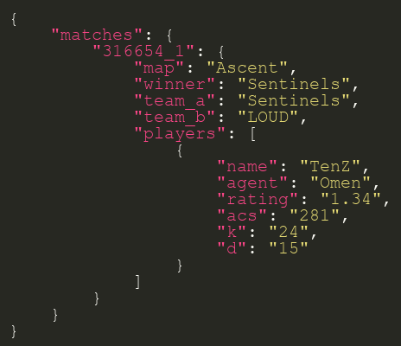
Noida Institute of Engineering and Technology | 2026
8. Result
Output: match_stats_db.json (Source of Truth).
Structure: Nested JSON (Match -> Map -> Players).
Success Rate: >99% of standard pages.
Speed: ~60 matches/minute.
Accuracy: Verified 100% against VLR.gg.

Slide 12
Noida Institute of Engineering and Technology | 2026
Thank You

