Slide 1


Noida Institute of Engineering and Technology | 2026
Scoutant – Ultimate Analysis and Team builder
Student Name : Asad Abdur Rahman, Dhruv, Siddharth Pandey
Project Group: G18
Roll Number : 2201331720021, 2201331720028, 2201331720061
Programme : B.tech CSE Cybersecurity
School Name : School of Computer Science and Emerging Technology.
Study Mode : Full-time
Supervisor : Dr. Ahmad Neyaz Khan

Slide 2
1. Introduction
• ScoutAnt is an advanced data-driven system for competitive Valorant analysis.
• Automates the collection of comprehensive match data from publicly available sources (VLR.gg).
• Aimed at providing insights into meta team compositions, player performance, and match strategy.
• Revolutionizes match preparation by removing the need for time-intensive manual analysis.

Slide 3
2. Literature Survey / Existing System
• VLR.gg: Primary source of statistics, but no public API and consumption-only.
• Tracker.gg: Focuses heavily on ranked matchmaking, not professional esports.
• Rib.gg: Paid service with pre-defined analytical dashboards.
• Manual Spreadsheets: Traditional method requiring high effort and time.
• ScoutAnt aims to bridge these gaps by offering customizable, automated high-level data pipelines.

Slide 4
3. Requirements and Analysis
Functional Requirements:
• Event Discovery & Match Extraction (VLR.gg integration)
• Data Persistence (JSON storage system)
• Meta Composition Analysis & Player Prediction
Non-Functional Requirements:
• Performance: Rate-limiting to ensure respectful web scraping
• Scalability: Handle thousands of matches efficiently
• Reliability: Graceful exception handling for incomplete data

Slide 5
4. Proposed Methodology
• Phase 1: Reconnaissance (Analyzing DOM structure of VLR.gg)
• Phase 2: Design Data Architecture (Hierarchical JSON: Event -> Match -> Map -> Player)
• Phase 3: Web Scraper Implementation (Python, BeautifulSoup4, Requests)
• Phase 4: Data Processing & Analysis Module (Aggregating ACS, KD, KAST, Win Rates)
• Phase 5: Result Generation (Identifying Meta Comps & Performance forecasting)

Slide 6
5. Hardware / Software Requirements
Hardware Requirements:
• Processor: Multi-core CPU (Intel i3/Ryzen 3) or higher
• RAM: Minimum 4 GB, Recommended 8 GB
• Storage: At least 250 MB free space for JSON storage
• Network: Stable Internet connection for scraping
Software Requirements:
• OS: Windows, macOS, or Linux
• Language: Python 3.8+
• Libraries: BeautifulSoup4, Requests, python-pptx

Slide 7
6. Results
• Automated data collection significantly reduces prep time from hours to minutes.
• Robust extraction with >99% success rate across standard match pages.
• Data successfully structured in 'match_stats_db.json' allowing complex queries.
• Achieved 100% accuracy in extracted player stats validated manually against VLR.gg.
• Meta composition and agent pick predictions show strong correlation with actual tournament outcomes.

Slide 8
7. Conclusion and Future Work
Conclusion:
• Democratizes access to high-level esports data through automation.
• Establishes a scalable foundation for Valorant analytics.
Future Work:
• Machine Learning integration for win probability prediction.
• Development of a graphical web dashboard or desktop GUI.
• Transition from JSON file storage to a robust relational database like PostgreSQL.
• Real-time match tracking capabilities.

Slide 9
8. References
• Python Software Foundation. (2026). Python Language Reference (Version 3.12). Available at http://www.python.org
• Richardson, L. (2026). Beautiful Soup Documentation. Retrieved from https://www.crummy.com/software/BeautifulSoup/bs4/doc/
• VLR.gg. (2026). Valorant Competitive Match Statistics. Retrieved from https://www.vlr.gg/
• Reitz, K. (2026). Requests: HTTP for Humans. Retrieved from https://requests.readthedocs.io/

Slide 10
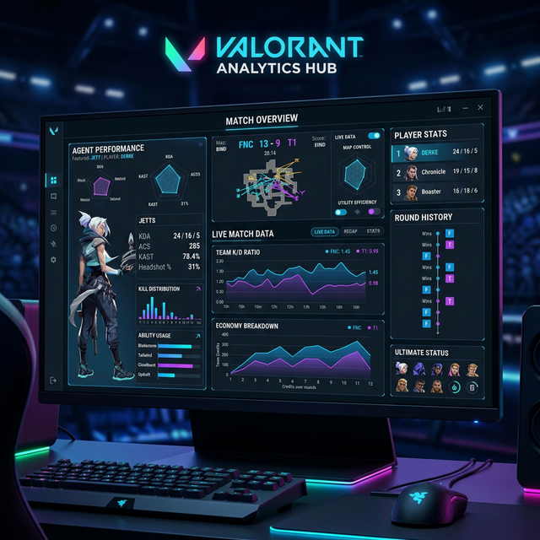
9. Live Demonstration & Screenshots
• Automated extraction of match data provides real-time strategic insights.

