Slide 1
ORACLE TRAINING
🎓 FREE WEBINAR
Oracle Database 19c
SQL · PL/SQL · Oracle APEX
A Complete Beginner-to-Intermediate Corporate Training
Duration
Schedule
Mode
Level
40 + 8 Bonus Hrs
3 Days / Week
80% Practical
Beginner → Intermediate
Ayub Miaze | Oracle Database Professional & Software Engineer at ERA | 2022–2026

Slide 2
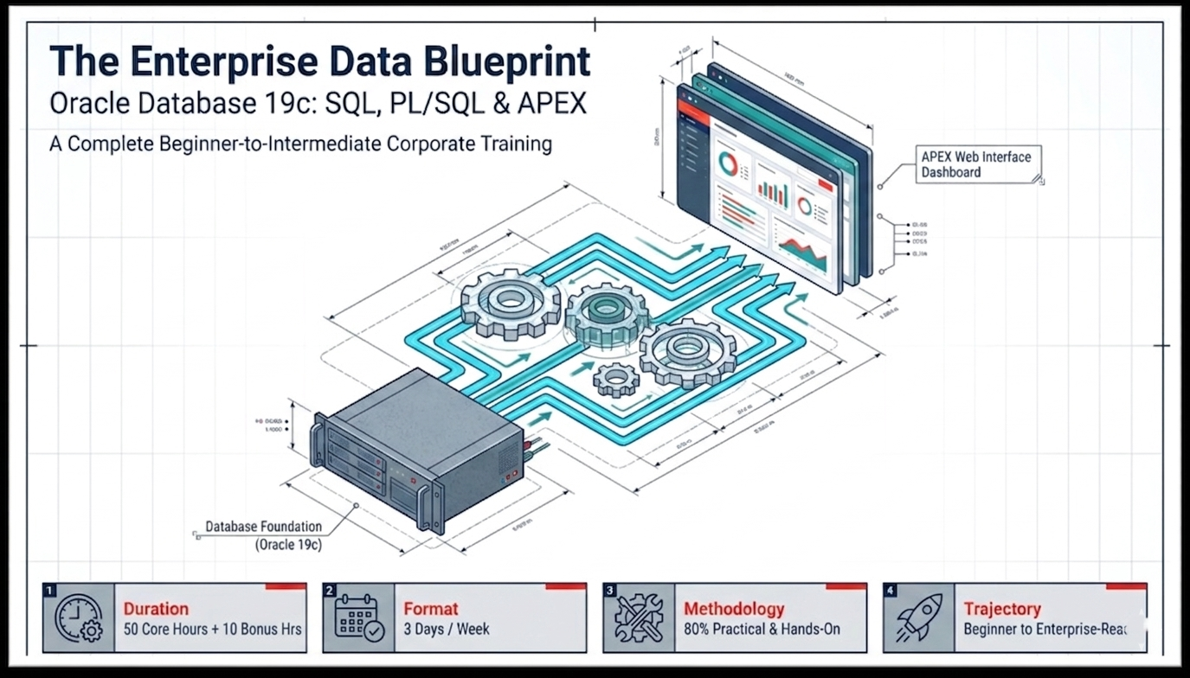

Slide 3
ToD's Webinar Agenda
What we'll cover in the next 60–90 minutes
👋
0–5 min
🌐
45–55 min
Welcome & Trainer Introduction
Oracle APEX — Build a Web App in Minutes
🗄️
5–15 min
🏆
55–65 min
What is Oracle Database 19c? Why Learn It?
Career Paths, Certifications & Job Scope
💻
15–30 min
📋
65–75 min
SQL Live Demo — Queries on a Real Database
Full Course Overview & What You Will Learn
📦
30–45 min
❓
75–90 min
PL/SQL Live Demo — Write Your First Package
Live Q&A — Ask Me Anything!

Slide 4

Meet Your Trainer
🗄️
Oracle Professional
6+ years designing enterprise Oracle solutions
🎓
Corporate Trainer
Trained students and professionals
Ayub Miaze
💼
Industry Experience
Banking, Finance, HR, POS, ERP systems
Software Engineer ERA
& Oracle Certified Professional
📜
Certifications
Oracle SQL 1Z0-071 · PL/SQL 1Z0-149 · APEX
6+ Years Experience
🌐
Teaching Style
80% hands-on, real-world examples, live coding

Slide 5
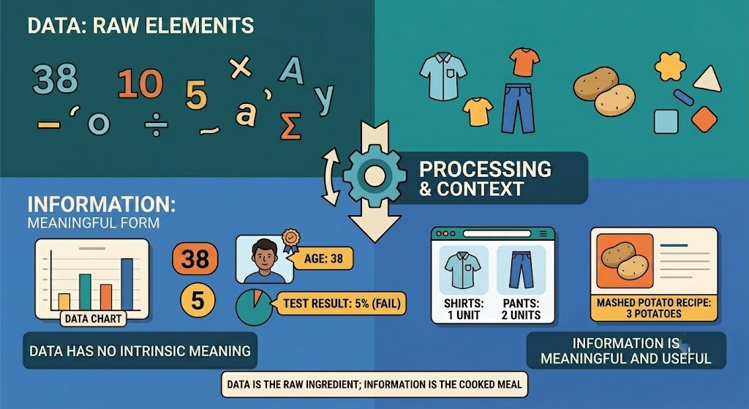


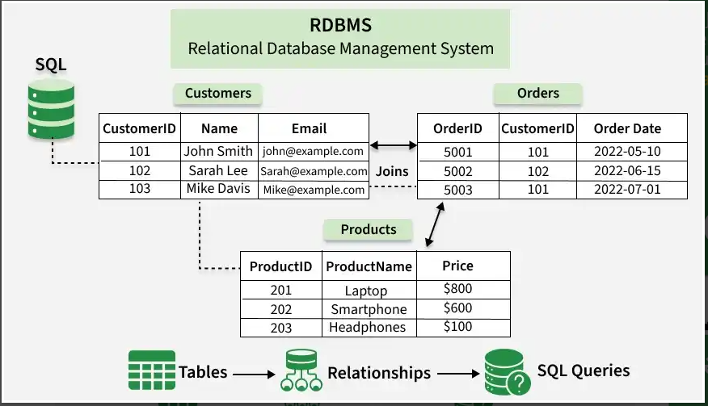

What Is the Definition of Data?
Data represents raw elements or unprocessed facts, from numerical values and symbolic representations to textual content and visual imagery.
What is Database?
A database is an organized collection of data stored electronically in a computer system.
What is RDBMS?
A relational database management system (RDBMS) is a type of database that stores and provides access to data points that are related to one another.

Slide 6
History of SQL , PL-SQL
Language | Era/Year | Key Pioneer | Core Purpose | Major Milestone
SQL (Structured Query Language) | 1970s (1974) | E.F. Codd (IBM) / Larry Ellison (Oracle) | To read, insert, and update data stored in relational tables using simple declarative statements. | Became the ANSI/ISO global standard in 1986/1987, turning into the universal language for data.
PL/SQL (Procedural Language/SQL) | 1990s (1991) | Oracle Corporation | To add programming logic (loops, conditions, variables) directly inside the database to process data faster. | Introduced Stored Procedures in 1993 (Oracle 7), eliminating massive network lag between apps and databases.

Slide 7
Why Oracle Database?
The world's most trusted enterprise database — powering banks, hospitals, governments & Fortune 500 companies
#1
40+
98%
175K+
Enterprise Database
in the World
Years Powering
Mission-Critical Systems
Fortune 100 Companies
Use Oracle
Oracle Certifications
Issued Globally/Year
🏦
💰
📈
🎓
Used in 90% of Bangladesh's banking and financial systems
Oracle Developers earn top salaries in BD, ME & Southeast Asia
Massive job demand — Oracle skills appear in 40% of IT job ads
Industry-recognized certifications: 1Z0-071, 1Z0-149, 1Z0-082

Slide 8
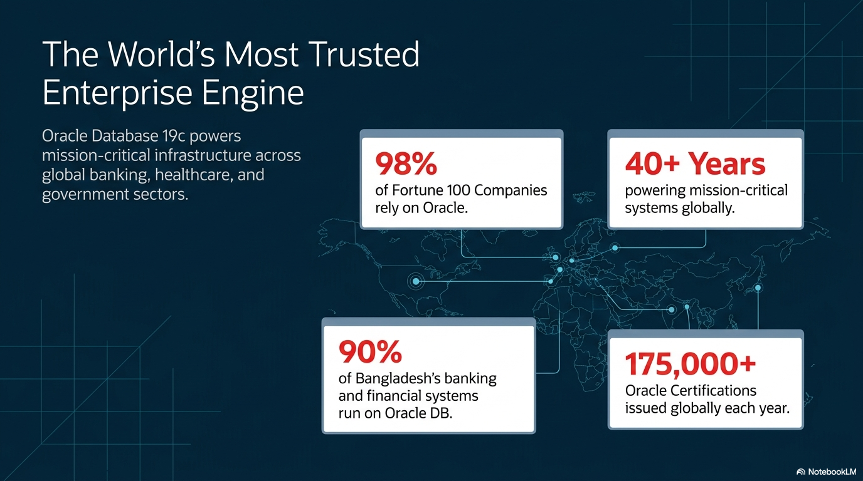

Slide 9
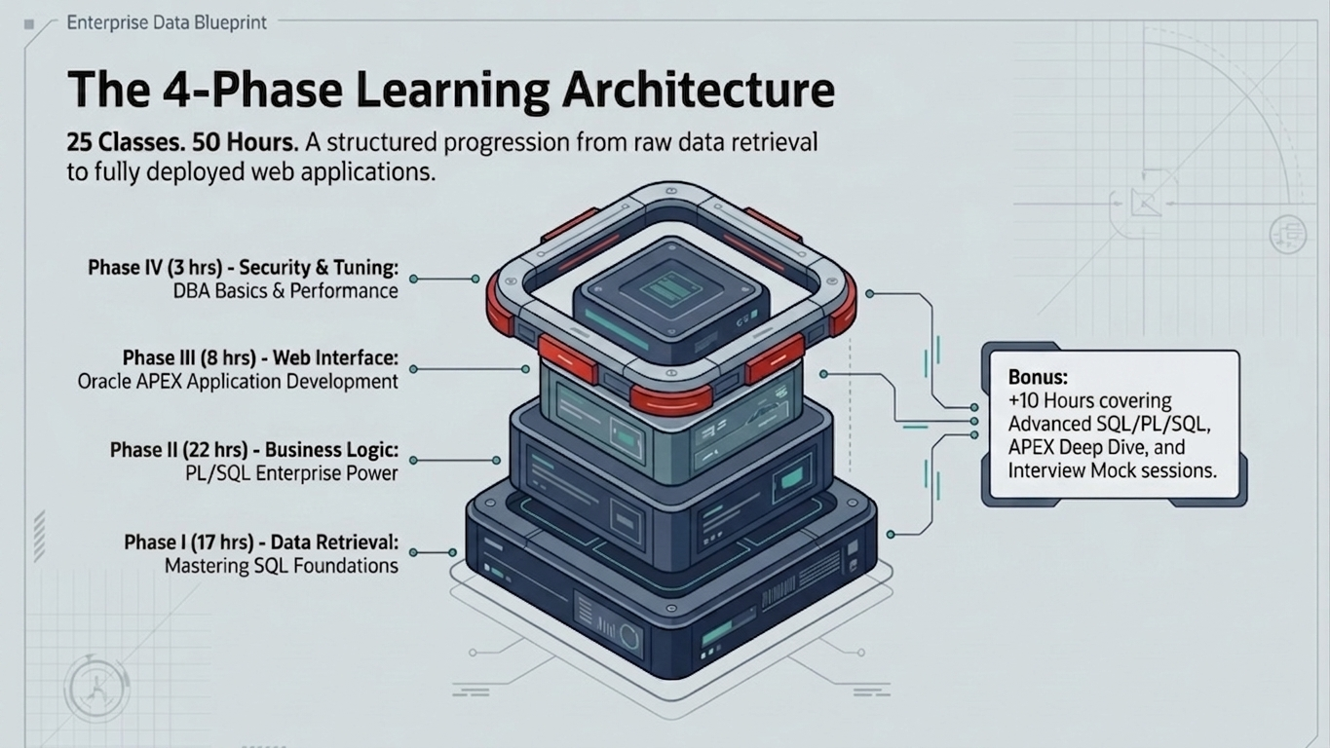

Slide 10
Course Structure at a Glance
💻
📦
🌐
🛡️
PART I
PART II
PART III
PART IV
SQL
PL/SQL
APEX
DBA Basics
17 hrs
22 hrs
8 hrs
3 hrs
▸ SELECT, WHERE, ORDER BY
▸ Blocks, Variables, Loops
▸ APEX Architecture
▸ Users & Roles
▸ JOINs & Subqueries
▸ Procedures & Functions
▸ App Builder & Page Designer
▸ Tablespaces
▸ Analytics & CTEs
▸ Packages (Industry Std)
▸ Interactive Reports & Grid
▸ Scheduler Jobs
▸ DDL/DML/TCL/DCL
▸ Cursors & Collections
▸ Dynamic Actions
▸ V$ Views & Monitoring
▸ Views, Sequences, Indexes
▸ BULK, Triggers, Dynamic SQL
▸ Authentication & REST
⭐ BONUS: +8 Hours — Advanced SQL · Advanced PL/SQL · APEX Deep Dive · Performance Tuning & Interview Mock

Slide 11
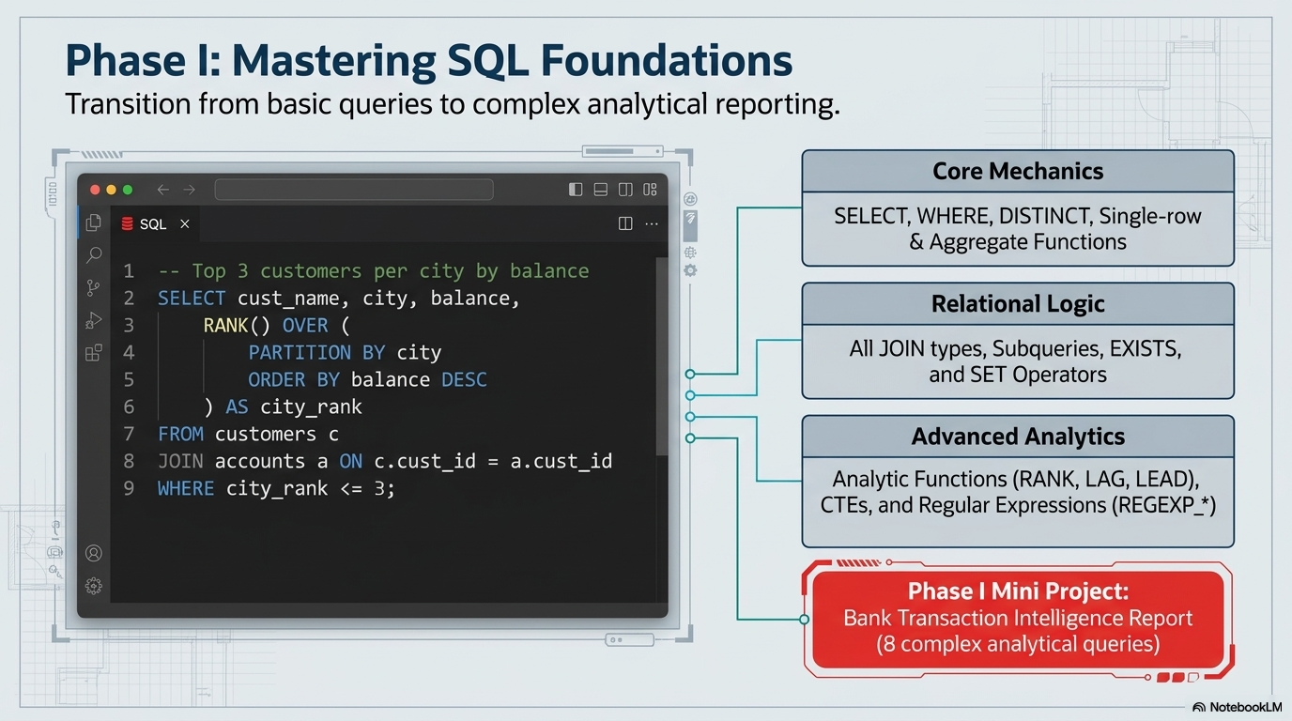

Slide 12
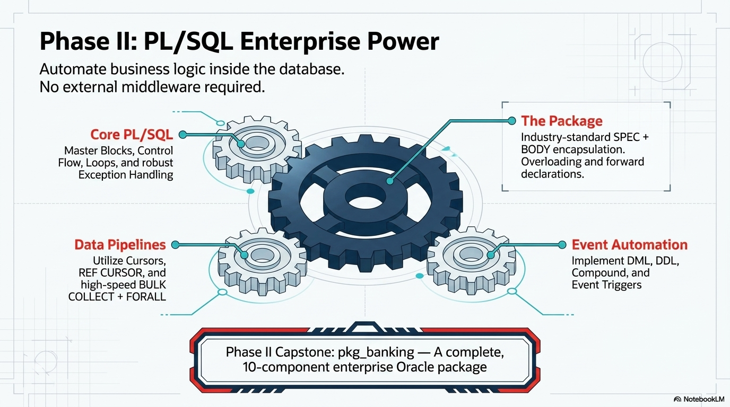

Slide 13
PL/SQL — Enterprise Programming Power
PART II · 22 Hours
● ● ● pkg_banking — Transfer Funds Procedure
Core PL/SQL
✓ Blocks, Variables (%TYPE, %ROWTYPE)
PROCEDURE transfer(
✓ Control Flow, Loops, CONTINUE
p_from IN NUMBER,
✓ Exception Handling (Custom + Built-in)
p_to IN NUMBER,
Stored Programs
p_amt IN NUMBER) AS
v_bal accounts.balance%TYPE;
✓ Procedures & Functions (IN/OUT/IN OUT)
✓ Packages — SPEC + BODY (Industry Std)
e_no_funds EXCEPTION;
✓ Overloading, Forward Declarations
BEGIN
SELECT balance INTO v_bal
Advanced
FROM accounts WHERE...
✓ Cursors, REF CURSOR, BULK COLLECT + FORALL
✓ Triggers (DML, DDL, Compound, Event)
IF v_bal < p_amt THEN
✓ Dynamic SQL + DBMS_SQL
RAISE e_no_funds; END IF;
🏆 Capstone Project: pkg_banking — 10-component complete Oracle package
✓ Oracle Packages: UTL_FILE, UTL_MAIL, DBMS_CRYPTO

Slide 14
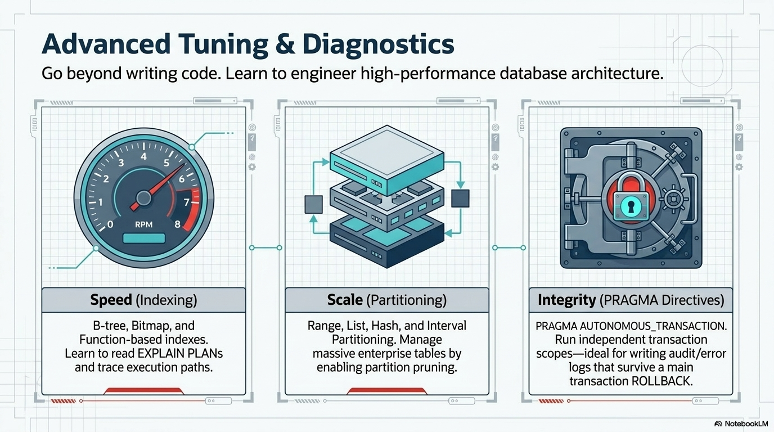

Slide 15
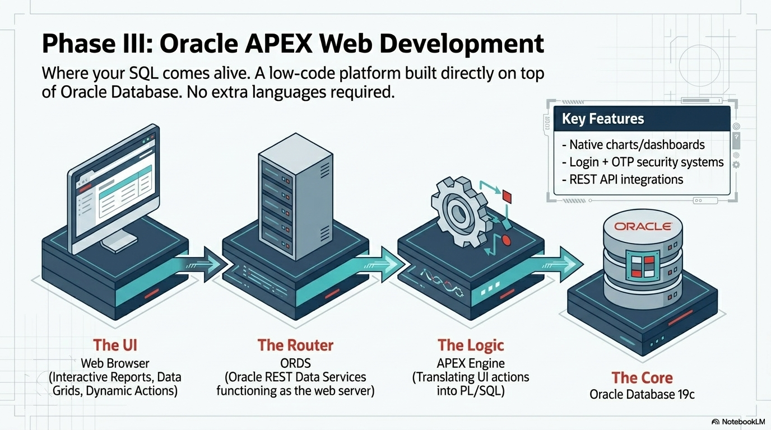

Slide 16
Oracle APEX — Your SQL Comes Alive!
Oracle APEX is a low-code web development platform built directly on top of Oracle Database.
Browser
ORDS
(Web Server)
APEX Engine
(PL/SQL)
Oracle Database
19c
→
→
→
📊
Interactive Reports
⚡
Dynamic Actions
🔐
Authentication
SQL-powered filterable data grids
Real-time UI updates, no code
Login + Authentication
📱
Responsive Apps
🔗
REST API Integration
📈
Charts & Dashboards
Works on desktop & mobile
Connect to external services
Native charts, visual analytics

Slide 17
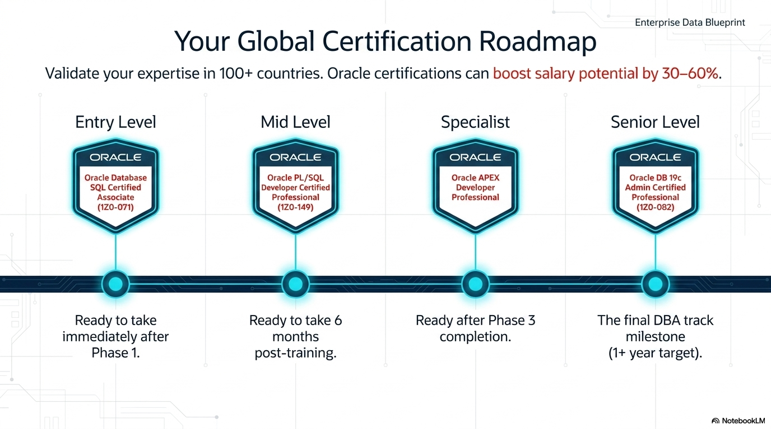

Slide 18
Career Path & Certifications
Oracle skills open global doors — Bangladesh · Middle East · Southeast Asia · Europe
1
Junior Oracle Developer
0–1 yr
SQL · Basic PL/SQL · SQL Developer
2
Oracle Developer
1–3 yrs
SQL Advanced · PL/SQL Packages · APEX
3
Senior Oracle Developer
3–6 yrs
Performance · Architecture · REST · DBA Basics
4
Oracle Technical Lead
6–10 yrs
Full Stack · Code Review · Mentoring
5
Oracle DBA / Architect
10+ yrs
RAC · Data Guard · Exadata · Cloud

Slide 19
Class & Timeline | Core Topics, Concepts & Milestones | Class & Timeline | Core Topics, Concepts & Milestones
CLASS 1 W1D1 | Course Setup, Oracle 19c Architecture, SQL SELECT, WHERE, ORDER BY | CLASS 14 W5D2 | Control Flow, Loops, CONTINUE, and Native DML in PL/SQL
CLASS 2 W1D2 | String, Number, and Date Functions | CLASS 15 W5D3 | Records & Collections (Part 1): Explicit Cursors, REF CURSOR, and Record Types
CLASS 3 W1D3 | Conversion Functions, NVL, NULLIF, CASE, DECODE | CLASS 16 W6D1 | Records & Collections (Part 2): Nested Tables, Varrays, and Index-by Tables
CLASS 4 W2D1 | Aggregates, GROUP BY, HAVING, and Regular Expressions — Quiz 1 | CLASS 17 W6D2 | Exceptions Management & Named Procedures — PL/SQL Quiz 1
CLASS 5 W2D2 | JOINS (Part 1): Inner, Outer, Self Joins, and MERGE | CLASS 18 W6D3 | Functions & Corporate Packages (Spec+Body, Overloading) — PL/SQL Quiz 2
CLASS 6 W2D3 | JOINS (Part 2): Advanced Join Patterns, Complex Conditions, and Time Zones | CLASS 19 W7D1 | Bulk Processing Engine: BULK COLLECT + FORALL Optimization & Built-in Packages (UTL_*)
CLASS 7 W3D1 | Subqueries (Part 1): Scalar, Correlated, EXISTS, and CTE Foundations — Quiz 2 | CLASS 20 W7D2 | Database Triggers (DML/DDL/Compound/Event) & Dynamic SQL Execution
CLASS 8 W3D2 | Subqueries (Part 2): Hierarchical Queries using Recursive WITH | CLASS 21 W7D3 | Architecture Design, PL/SQL Compiler, Dependencies, and pkg_banking Project — Capstone PL/SQL Project
CLASS 9 W3D3 | SET Operations and Analytic/Window Functions | CLASS 22 W8D1 | Oracle APEX Architecture, App Builder Workspace, and Page Flow Foundations
CLASS 10 W4D1 | DDL, Integrity Constraints, Flashback, and External Tables | CLASS 23 W8D2 | Form Components, Interactive Grids, Faceted Search, and UI Customization
CLASS 11 W4D2 | DML, TCL, DCL, Views, Sequences, Synonyms, and Indexes | CLASS 24 W8D3 | State Management, Dynamic Actions, JSON Integration & Web REST APIs
CLASS 12 W4D3 | Performance Basics — SQL Mini Project Due | CLASS 25 W9D1 | DBA Basics, Memory Architecture (SGA/PGA), Instance Structures, and User Security Profiles
CLASS 13 W5D1 | PL/SQL Core: Blocks, Variables, Nested Blocks, and Bind Variables | CLASS 26 W9D2 | Application Performance Tuning, Reading Execution Plans — Final Comprehensive Exam
Classes 27 through 30 are intentionally omitted from this core table to form your dedicated 8-Hour Bonus Boot Camp

Slide 20
Real-World Projects You Will Build
🏦
Banking Operations System
👥
HR & Payroll System
📦
Inventory & Stock System
⭐⭐⭐⭐
⭐⭐⭐
⭐⭐⭐
• pkg_banking — 10 procedures & functions
• pkg_payroll for payslip generation
• Stock in/out transaction tracking
• Fund transfer with rollback on failure
• Salary increment processing
• Low-stock alert trigger
• Bulk interest via BULK COLLECT + FORALL
• Department aggregate reports
• Reorder scheduler (DBMS_SCHEDULER)
• Audit triggers + APEX web interface
• Compound trigger for change log
• Dynamic SQL for flexible reporting
🔐
Login System (APEX)
✅
Approval Workflow System
🎓
Student Management System
⭐⭐⭐⭐
⭐⭐⭐⭐
⭐⭐
• DBMS_CRYPTO SHA-256 hashing
• Multi-step status state machine
• Enrollment & course tracking
• Custom APEX authentication scheme
• pkg_workflow with role-based logic
• GPA calculation function
• Session management & audit log
• Email notifications via UTL_MAIL
• Grade analytics with window funcs
• Full approval history audit trail

Slide 21

Who Should Join & What You Get
Who Should Join?
What You Will Receive
👨‍💻
Fresh graduates & CS students — start your Oracle career
📁
All SQL & PL/SQL script files for every topic
💼
🗄️
BankDB + HR schema — ready to run on D 1
Junior developers wanting to specialize in Oracle
📝
Quiz sheets, assignments & answer keys
📊
Business analysts needing SQL for data querying
🎤
Interview prep guide: top SQL & PL/SQL questions
🏢
IT professionals in banking, finance, ERP sectors
Sample projects with Only SQL, PL-SQL and Oracle Apex
🎯
Anyone preparing for Oracle 1Z0-071 certification exam
📜
Oracle certification roadmap & exam guidance

Slide 22
Ready to Start Your Oracle Journey?
Join the full 40-hour Oracle 19c SQL · PL/SQL · APEX training
📅
⏱️
💻
🎯
Schedule
Duration
Platform
Outcome
3 Ds/W
2.5 Hrs per Class
40 Core Hours
+ 8 Bonus Hours
SQL Developer
+ Oracle LiveSQL
Job-Ready Skills
+ Certification
❓ Q&A Session — Ask Me Anything!
Chat your questions now · I will answer every single one
📧 ayubmiazeraju@gmail.com | 📱 +880-1826-315564 | 🌐 linkdien.com/miaze
Thank you for attending! — Oracle Database 19c Corporate Training 2025–2026

