Slide 1
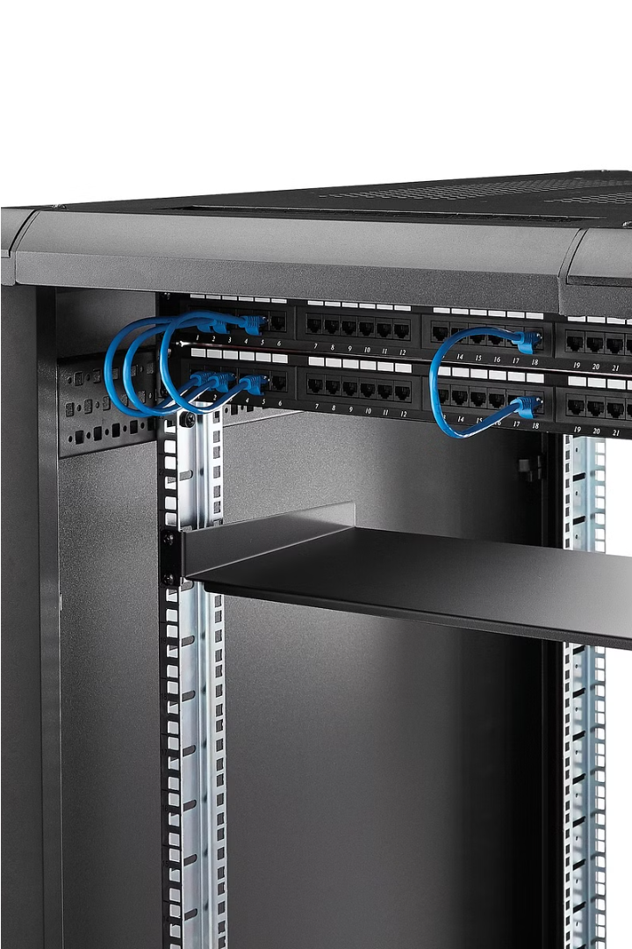
Introduction to XML Servers
XML servers are specialized software platforms that manage and process XML data. They provide a robust infrastructure for storing, querying, and transforming XML documents, enabling efficient data exchange and integration across various systems and applications.

Slide 2
What is an XML Server?
1
XML Data Management
2
Application Integration
3
Scalable Performance
XML servers offer advanced capabilities for managing and manipulating XML data, including storage, indexing, and querying.
They facilitate seamless integration between different applications and systems by providing a common XML-based interface.
XML servers are designed to handle large volumes of XML data and support high-throughput, low-latency processing requirements.

Slide 3
Key Features of XML Servers
XML Schema Support
Transactions and Concurrency
Security and Access Control
XML servers validate and enforce XML schema definitions, ensuring data integrity and consistency.
They provide ACID (Atomicity, Consistency, Isolation, Durability) properties to guarantee data reliability and consistency.
XML servers offer advanced security features, such as user authentication, authorization, and encryption, to protect sensitive data.

Slide 4
Advantages of Using XML Servers
Data Interoperability
Scalability and Performance
XML servers enable seamless data exchange and integration across heterogeneous systems and platforms.
They are designed to handle large volumes of XML data with high throughput and low latency.
Flexibility and Extensibility
Improved Data Management
XML servers can be easily integrated into various applications and can be extended to meet evolving requirements.
They provide advanced features for storing, indexing, querying, and transforming XML data efficiently.

Slide 5
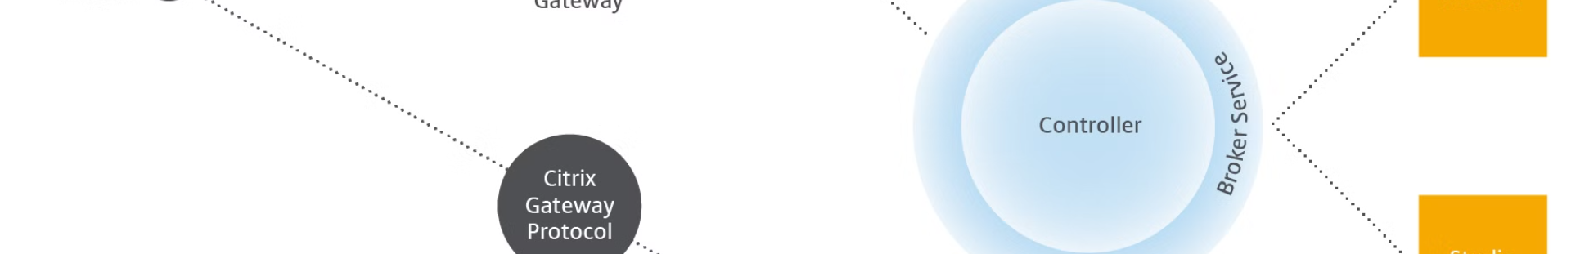
XML Server Architecture
Storage Layer
Query Layer
The storage layer manages the persistent storage of XML documents and related metadata.
The query layer provides powerful XML querying capabilities, supporting languages like XPath and XQuery.
1
2
3
Processing Layer
The processing layer handles the parsing, validation, and transformation of XML data.

Slide 6




XML Server Protocols and Standards
HTTP/HTTPS
SOAP
REST
XPath and XQuery
Widely used protocols for web-based XML data exchange and service access.
An XML-based protocol for exchanging structured information in web services.
An architectural style for building web services that leverage the HTTP protocol.
Query languages used for navigating and querying XML data structures.

Slide 7
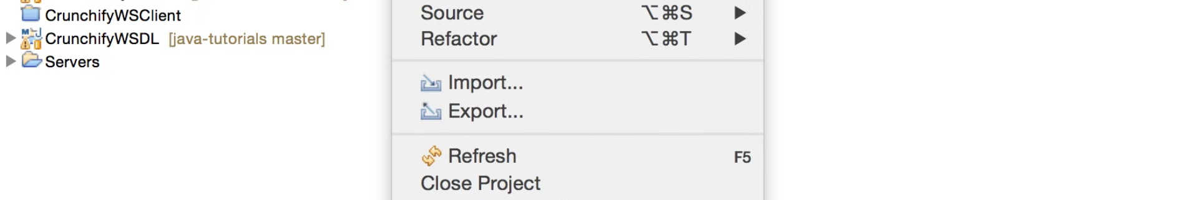



Deploying and Configuring XML Servers
Installation
Configuration
Integration
Download and install the XML server software on the designated hardware or virtual infrastructure.
Set up the server's network, security, and storage parameters to ensure optimal performance and security.
Integrate the XML server with existing applications and systems to enable seamless data exchange and processing.

Slide 8
Troubleshooting and Maintenance of XML Servers
Performance Monitoring
Regularly monitor server performance metrics to identify and address bottlenecks.
Security Auditing
Conduct periodic security audits to ensure the server's access controls and encryption are up-to-date.
Backup and Restore
Implement robust backup and disaster recovery strategies to protect against data loss and system failures.
Software Updates
Apply security patches and software updates to keep the XML server secure and up-to-date.

