Slide 1
Life Expectancy Data by WHO
INSTITUTE
Institute of Emerging Careers
PROGRAM
Data Analytics
Presented To
Syed Afroz Pasha
PRESENTED BY
Atta Ur Rehman

Slide 2
AGENDA
WHY THIS DATASET?
INTRODUCTION
DASHBOARD DESIGN & COMPONENTS
OBJECTIVES
DASHBOARD VISUALIZATION
KEY INSIGHTS
CONCLUSION & RECOMMENDATIONS

Slide 3
WHY THIS DATASET?
Importance
I chose this data set because Life is the most important thing and having insights about things affecting life will help humanity.
World Wide Data
This dataset is valuable as it has data about whole world and we can derive decisions about what we(Pakistan) should do to increase life.
Data By WHO
This data was gather by World Health Organization so there’s no issue about the integrity of Data.

Slide 4
INTRODUCTION
The dataset represents the life expectancy of all the countries in the world. And also includes different things like Drugs, GDP, Diseases and other different aspects.
It provides a detailed view of How change in different things like living in different Continent and in different Country Affects your life Expectancy and also describes what are key differences in those Continents.
By analyzing this dataset, we can gain valuable insights into the change of Life Expectancy w.r.t Different Factors

Slide 5
KEY TERMS & CONCEPTS
GDP: Gross Domestic Products
BMI: Body Mass Index
Alcohol : Alcohol, recorded per capita (15+) consumption (in liters of pure alcohol)
HIV/AIDS : Deaths per 1 000 live births HIV/AIDS (0-4 years)

Slide 6
DASHBOARD DESIGN & COMPONENTS
DESIGN APPROACH
The design is crafted to be clear and communicative, incorporating elements that support strategic decision-making.
VISUAL ELEMENTS
Area Chart, Funnel, Line Chart, Stacked Area Chart, Slicer, Card, Guage
TOOLS USED
Power BI and SQL
ANALYTICAL FOCUS AREAS
Effect Of Drugs, Continent, Diseases on Life Expectancy
DASHBOARD TYPE
Analytical Dashboard

Slide 7
OBJECTIVES
1
2
EVALUATE life Expectancy w.r.t Time
EVALUATE life Expectancy in different Continent
Analyze overall change in Life Expectancy When we Move from 2000 to 2015
Check How Living In Different Continent Effects Your Life Expectancy
3
4
Effect Of Drugs On Life
Effect Of HIV/Aids
Analyze how Drinking More or Less Alcohol Effects Your Life
Analyze How Hiv/Aids Affected The Life Expectancy
5
Life Expectancy In Different Countries
Check Life Expectancy In Different Countries Around the Globe

Slide 8
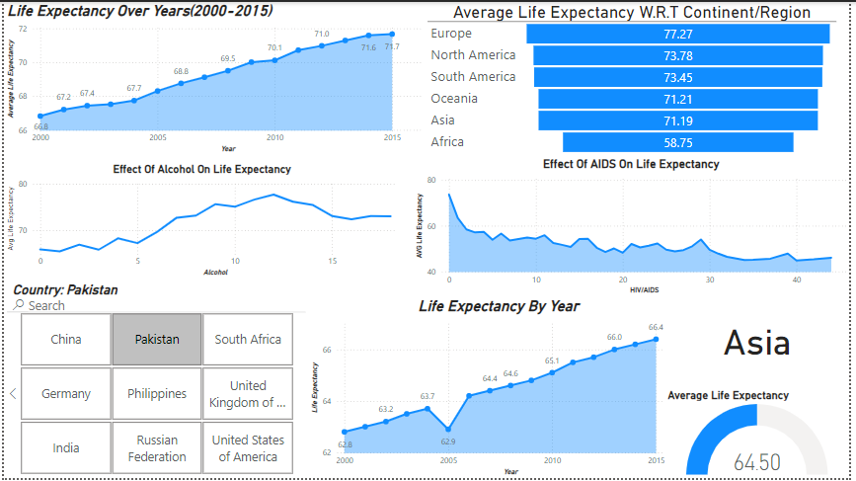
DASHBOARD VISUALIZATION

Slide 9
KEY INSIGHTS
Life Expectancy Has Increases From 2020 to 2015 i.e from 67 to 72
Aids Decreases Life Expectancy Heavily
Pakistan’s Life Expectancy has also increased from 63 to 67
Europe Has The Most Life Expectancy While Africa Has The Least.
Alcohol Directly Affects You Life Expectancy.

Slide 10
RECOMMENDATION
Overall Life Expectancy of the world has increased over the time so we should keep doing things to get healthy and get Life Expectancy even more higher.
Europe Has the highest life expectancy because they are most developed so countries should try to get high GDP as it effects life expectancy
AIDS/HIV should be considered as serious threat to life and awareness campaigns should be run to preserve peoples from this deadly diseases
Increases in alcohol consumption increases threat to your life
Some countries has higher life expectancy while some has low.

Slide 11
THANK YOU

