Slide 1

Multi-Agent Reinforcement Learning
Prepared By: Hadi Atwi & Mohammad Ali Al-Asbat Presented To: Dr. Ibrahim Sammour
01

Slide 2
Common RL Algorithms
Proximal Policy Optimization
PPO
Parametrized Off-Policy Centralized Actor-Critic
POCA
02

Slide 3
MARL Types
Agents work together
Passing the ball to each other
Cooperative
Agents work against each other
Teams fighting to score more goals
Competitive
03

Slide 4
SoccerFours
Based on SoccerTwos
from Unity ML-Agents
04

Slide 5
Environment
90:00
Team 1
Blue
Team 2
Purple
0:0
05

Slide 6
Quality of Life Improvements
1
Scoreboard
Added a scoreboard for each field to keep track of goals
2
Flashing Walls
Whenever a team scores, their goal flashes on the wall of the field
3
Moving Camera & Music
To always follow the ball where the action is going
06

Slide 7
Environment Changes
Duplicated Players
Increased Vision
Increased the size of the team to 4 from 2 for more teamwork potential
Increased number and length of cast rays to give the players better vision for better decisions
07

Slide 8
Rewards
Spacing out
For better formation
Passing to Teammates
To promote teamwork
Scoring a goal
The main objective, of course
08

Slide 9
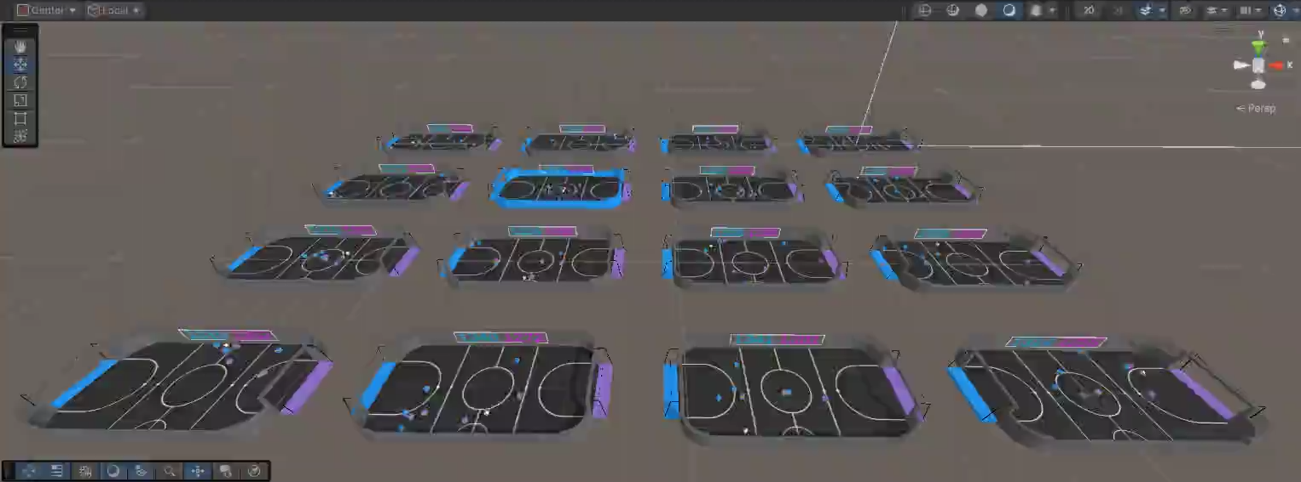
Training
09

Slide 10
Training Timeline
It’s composed of hydrogen and helium
Has a very poisonous atmosphere
SoccerFours0.1
SoccerThrees0.1
Started with 8 agents and increased rays
A 3v3 version for comparison purposes
SoccerFours0.4
SoccerFours0.6
Improved rewards and increased training time
Professional Gameplay 👌
10

Slide 11
Planned Improvements
Power-Ups
Assigned Roles & Better Rewards
A big change to the environment: adding powerups that increase team speed, adds a temporary wall to own goal, etc
Assigning roles for agents, such as midfielder, striker, goalkeeper
Adding rewards for blocking an incoming shot at goal
11

Slide 12
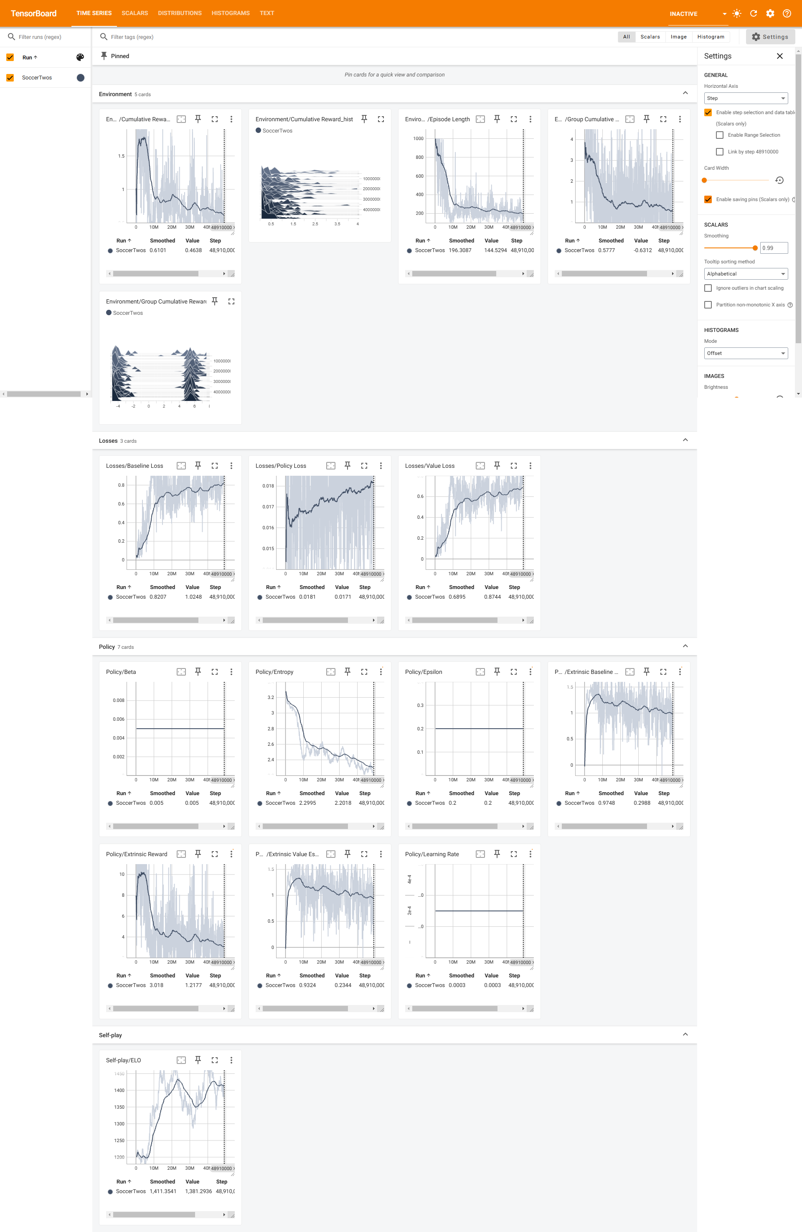
TensorBoard Metrics
12

Slide 13
TensorBoard Metrics
13

Slide 14
TensorBoard Metrics
14

Slide 15
TensorBoard Metrics
15

Slide 16
TensorBoard Metrics
16

