Slide 1
Beer Game Debriefing
Beergame
Dr. Kai Riemer

Slide 2
Experiencing the effects of systems dynamics
Did you feel yourself controlled by forces in the system from time to time? Or did you feel in control?
Did you find yourself "blaming" the groups next to you for your problems?
Did you feel desperation at any time?
Beergame Debriefing, by Kai Riemer, http://www.beergame.org

Slide 3
Some questions for discussion
What, if anything, is unrealistic about this game?
Why are there order delays?
Why are there production delays? Shipping delays?
Why have both distributor and wholesalers? Why not ship beer directly from the factory to the retailer?
Must the brewer be concerned with the management of the raw materials suppliers?
Beergame Debriefing, by Kai Riemer, http://www.beergame.org

Slide 4
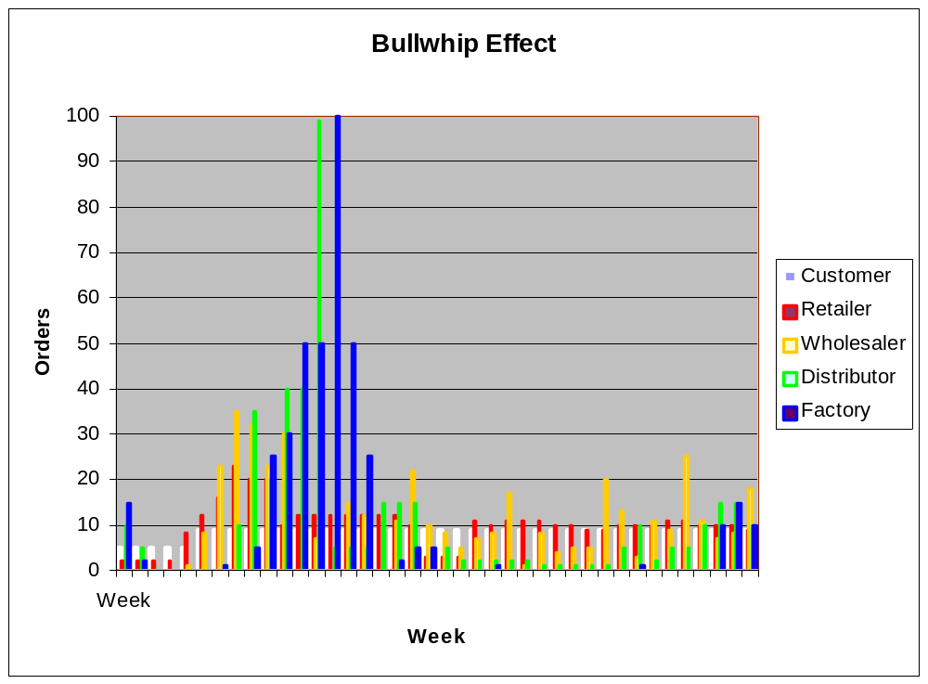
Beergame Debriefing, by Kai Riemer, http://www.beergame.org

Slide 5
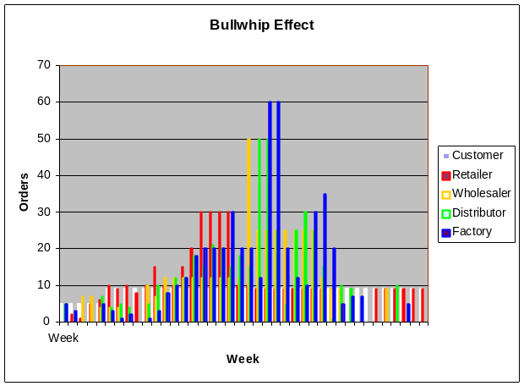
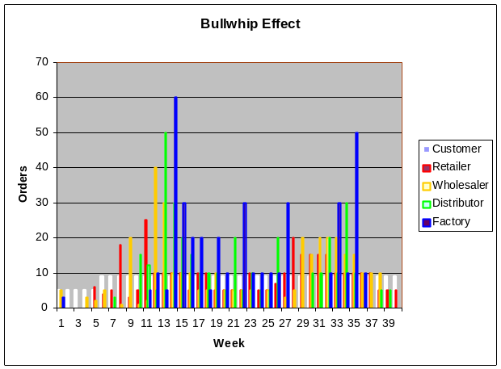
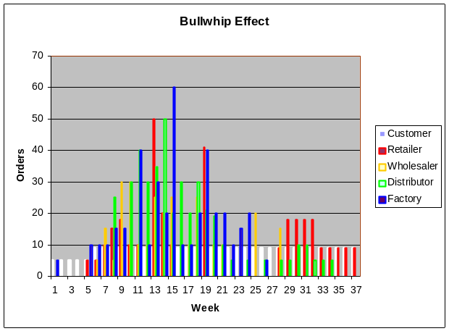
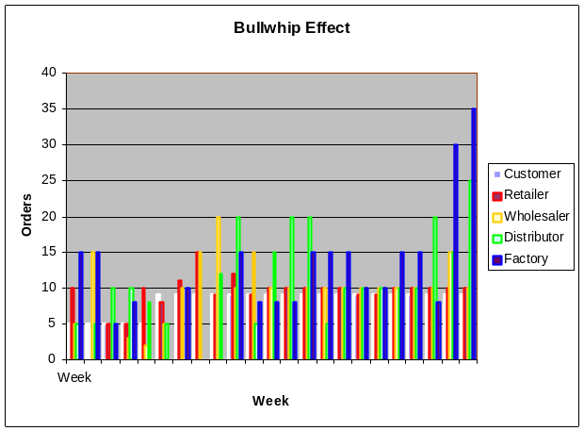
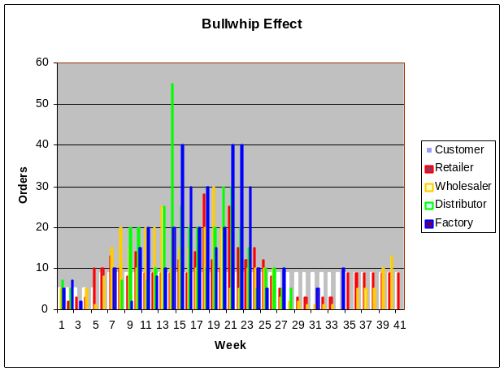
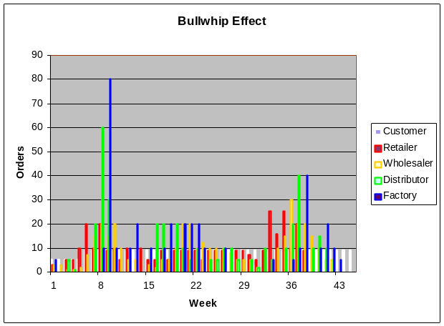
Other groups
Beergame Debriefing, by Kai Riemer, http://www.beergame.org

Slide 6
What happened here?
Average order size
Maximum order size
Numbers of small orders (0-2 items)
ohne
10,075 | 10,55 | 10,4 | 10,05
mit
7,7 | 7,9 | 8 | 8,325
ohne
23 | 35 | 99 | 100
mit
20 | 13 | 23 | 20
ohne
4 | 9 | 16 | 26
mit
6 | 5 | 3 | 4
Beergame Debriefing, by Kai Riemer, http://www.beergame.org

Slide 7
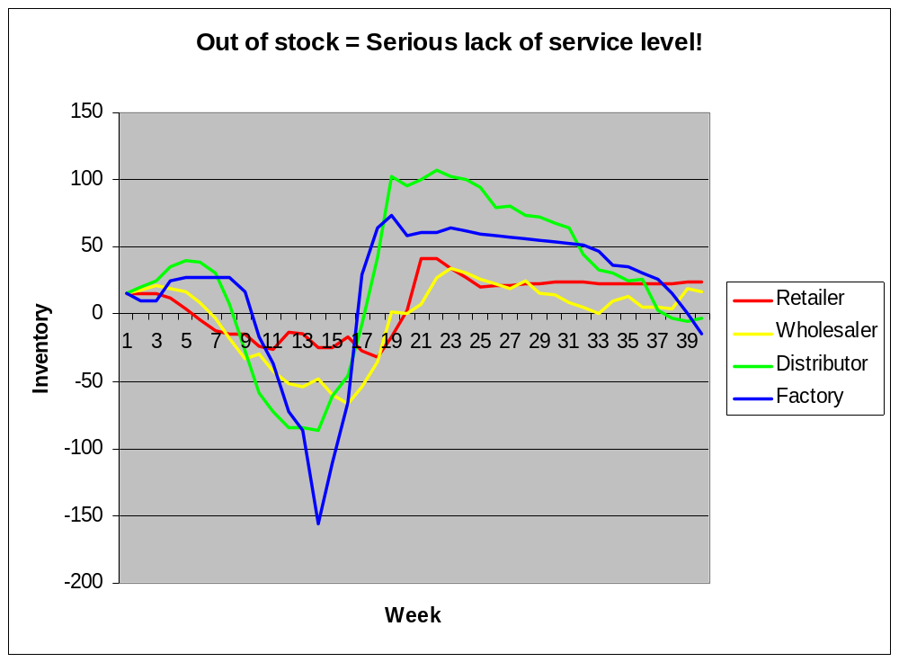
Beergame Debriefing, by Kai Riemer, http://www.beergame.org

Slide 8
What happened here?
Inventory oscillation: maximum amplitude
ohne
73 | 101 | 193 | 230
mit
38 | 59 | 32 | 48
Beergame Debriefing, by Kai Riemer, http://www.beergame.org

Slide 9
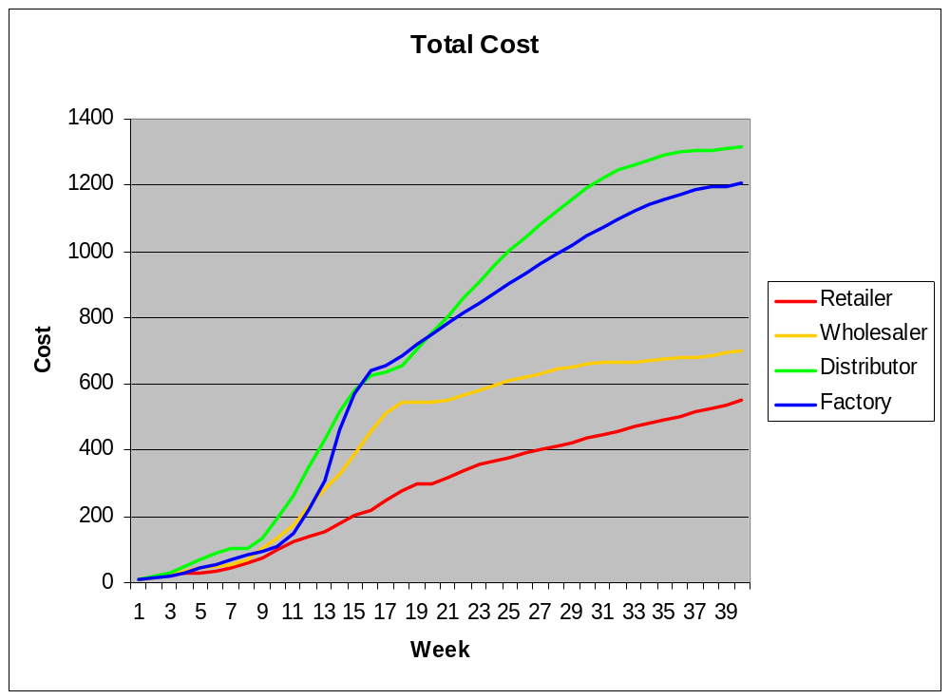
Beergame Debriefing, by Kai Riemer, http://www.beergame.org

Slide 10
Bullwhip effect → problems
High inventory levels
Low service level (back orders)
High cost
High demand fluctuation causes more problems…
Beergame Debriefing, by Kai Riemer, http://www.beergame.org

Slide 11
Bullwhip effect → problems
Variation in demand along the supply chain requires
  Shipment capacity
  Production capacity
  Inventory capacity
to cope with peaks.
Most of the time this capacity will be idle.
  There’s significant cost and investments attached!
In the end: high overall cost in the supply chain
  But competition between supply chains and networks, not just between individual companies!
Beergame Debriefing, by Kai Riemer, http://www.beergame.org

Slide 12
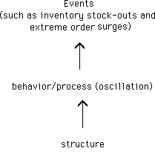
Structure creates behaviour
different people in the same organizational structure produce the same (or at least similar) results.
Beergame Debriefing, by Kai Riemer, http://www.beergame.org

Slide 13
Real world reactions
A typical organizational response would be to find the "person responsible" (the guy placing the orders or the inventory manager) and blame him.
But the game clearly demonstrates how inappropriate this response is
  different people following different decision rules for ordering create similar oscillations.
We have to change the structural setup!
Beergame Debriefing, by Kai Riemer, http://www.beergame.org

Slide 14
Factors contributing to bullwhip effect
Demand forecasting
  Usage of aggregate and thus inaccurate data does not allow for good predictions
  High variability leads to continuous adaptations of order policies and thus increases variability upstream
Lead time
  High lead time creates uncertainty
  Requires high safety stock levels
  Reduces flexibility and adaptability to unforeseen changes in demand
Beergame Debriefing, by Kai Riemer, http://www.beergame.org

Slide 15
Factors contributing to bullwhip effect
Batch ordering
  Batch ordering at one stage in SC leads to observing high variability at next stage upstream:
    one week large order followed by weeks with no order
    Contributors: fixed ordering costs, transportation and price discounts
Price fluctuation
  Stock up when prices are lower → large orders
  Promotions and discounts
Inflated orders
  In time of shortages, suppliers place big orders when expecting to be allocated proportionally
Beergame Debriefing, by Kai Riemer, http://www.beergame.org

Slide 16
Lesson
In traditional supply chains information about consumer demand is only passed up the supply chain through the orders that are placed
  Or using aggregated figure
Information is therefore lost
High Buffer stocks result
Even if each party acts “optimally” individually the result is less than optimal for the whole supply chain
Result is higher prices, less sales.
BUT:
Competition is now supply chain against supply chain and
Network against network
Beergame Debriefing, by Kai Riemer, http://www.beergame.org

Slide 17
Contact
Dr. Kai Riemer
http://www.beergame.org
Beergame Debriefing, by Kai Riemer, http://www.beergame.org

