Slide 1
Introduction To Data Analysis Using Pandas on Watson Studio
Kunal Malhotra
kunal.malhotra1@ibm.com
@kunal_forever

Slide 2
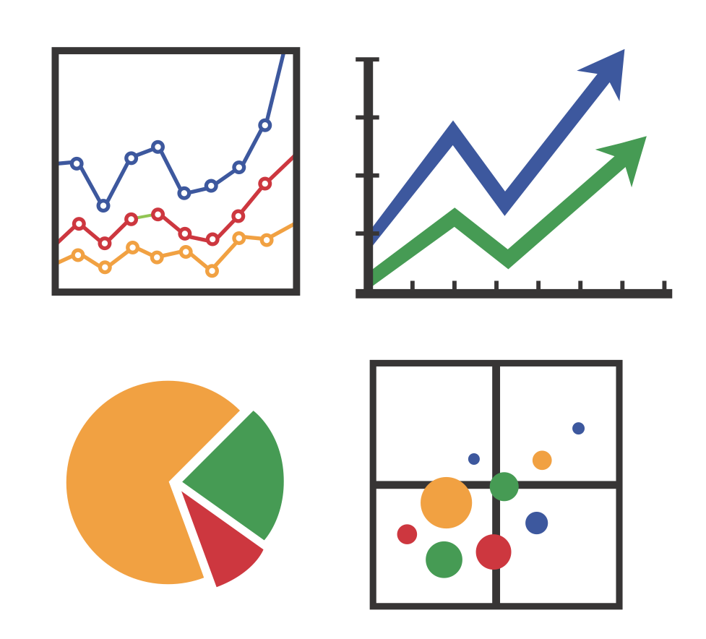

Agenda
What is Data Analysis ?
Introduction to Pandas
Advantages of Pandas
Introduction to Watson Studio
How to perform data analysis with pandas

Slide 3
What is Data Analysis ?
Notes:
Apply logical techniques to describe, condense, recap and evaluate Data and illustrate information.

Slide 4
What is Goal Data Analysis ?
Notes:
Discover useful information.
Provide insights.
Suggest conclusions.
Support decision Making.

Slide 5
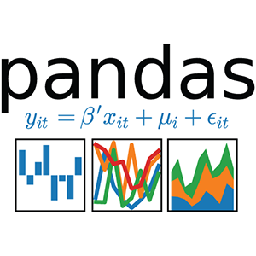
Introduction To Pandas
Pandas is a python package for data analysis.
It Provides built-in data structures which simplify the manipulation and analysis of data set.
Pandas is easy to use and powerful, but “with great power comes great responsibility”.
http://pandas.pydata.org/pandas-docs/stable/

Slide 6
Pandas: Essential Concepts
Series
DataFrame
Reading and Writing Files
Aggregating and Grouping in Pandas
Time Series analysis using pandas
Visualization in pandas

Slide 7
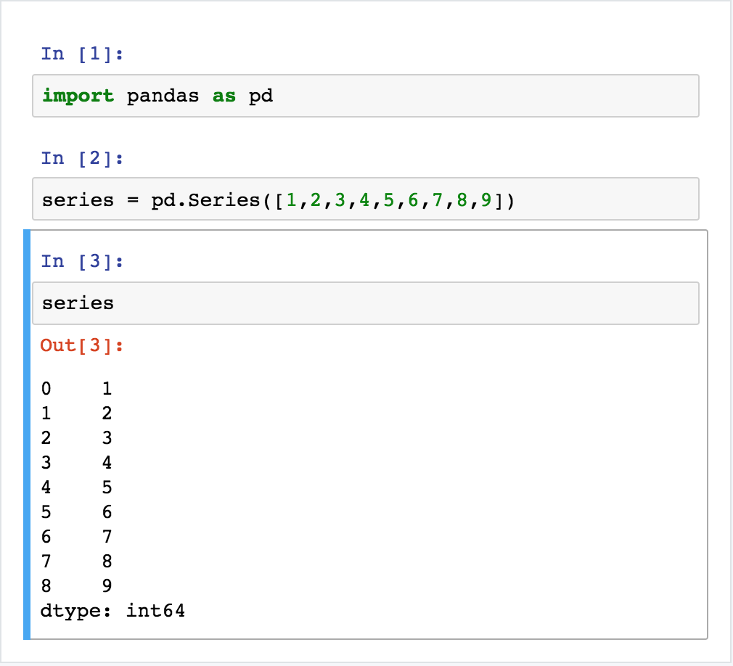
Introduction To Series In Pandas
Series in pandas is an object which is similar to python built-in list data structure, but differs from it because it has associated label with each element or better know as index.

Slide 8
Understanding Series
Index is leftward and Values are to the right. (Note:- If Index is not provided explicitly, then pandas creates RangeIndex starting from 0 to N - 1, where N is the total number of elements.)
Each series object has a data type (dtype), in the example on the right data type is int64.

Slide 9
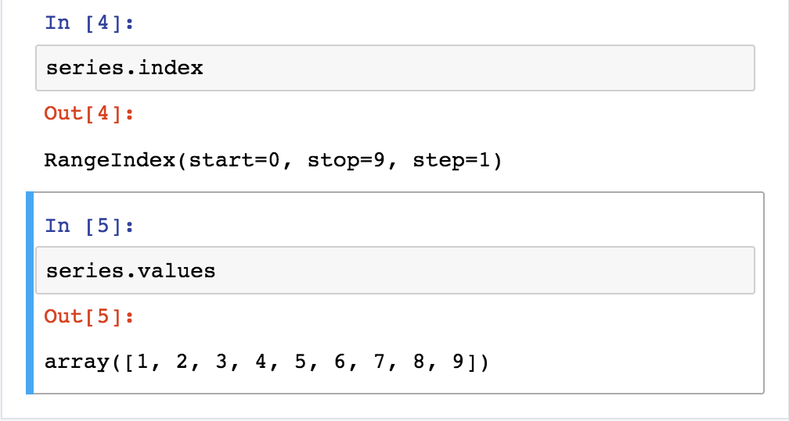
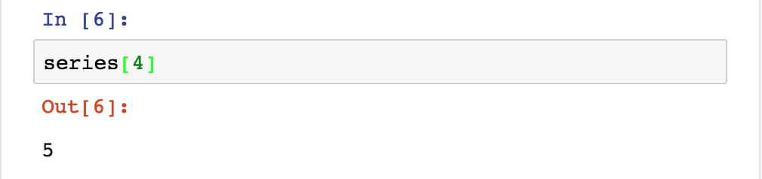
Operation On Pandas Series
Pandas series have attributes to extract it’s values and labels.
Elements can be retrieved by their labels(index).

Slide 10
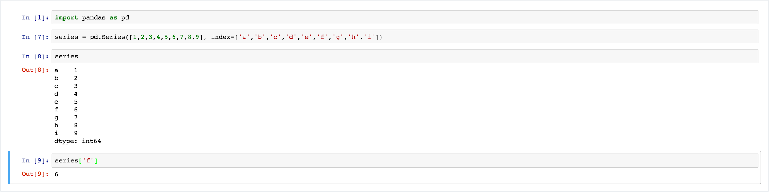
Operation On Pandas Series Continued ..
Labels (index) can be provided explicitly.
Elements can be retrieved by the provided labels(index).

Slide 11
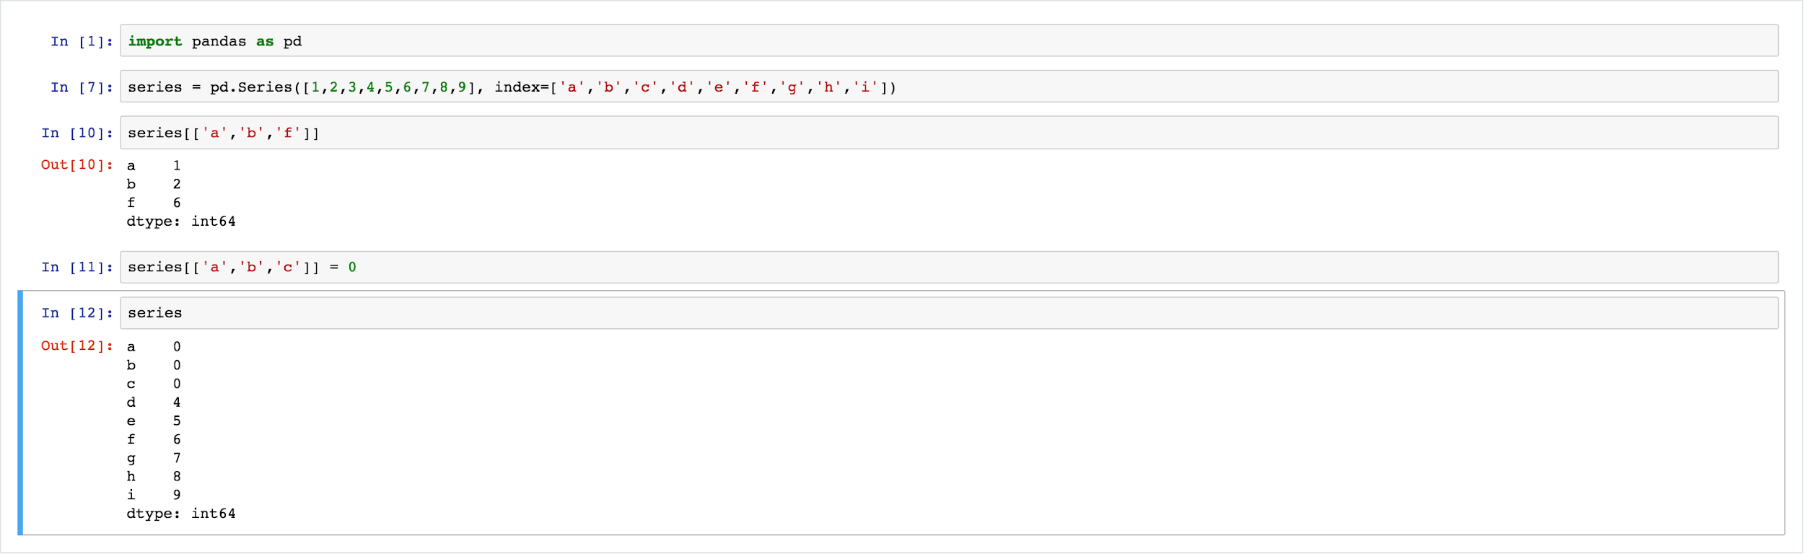
Operation On Pandas Series Continued ..
It is easy to retrieve several elements by their indexes or make group assignment.

Slide 12
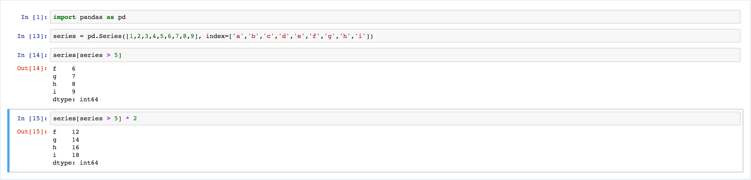
Operation On Pandas Series Continued ..
Filtering and Maths operations are easy as well.

Slide 13
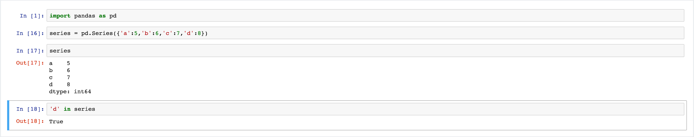
Operation On Pandas Series Continued ..
Series is very similar to dictionary, where key is an index and value is an element. Hence, we have generated a pandas series with python dictionary.

Slide 14
Introduction To DataFrame in Pandas
DataFrame in pandas is a two-dimensional data structure, i.e., data is aligned in a tabular fashion. It has rows and columns. Each column in a DataFrame is a series object, rows consist of elements in Series.
DataFrame can be constructed using built-in Python dictionary.

Slide 15
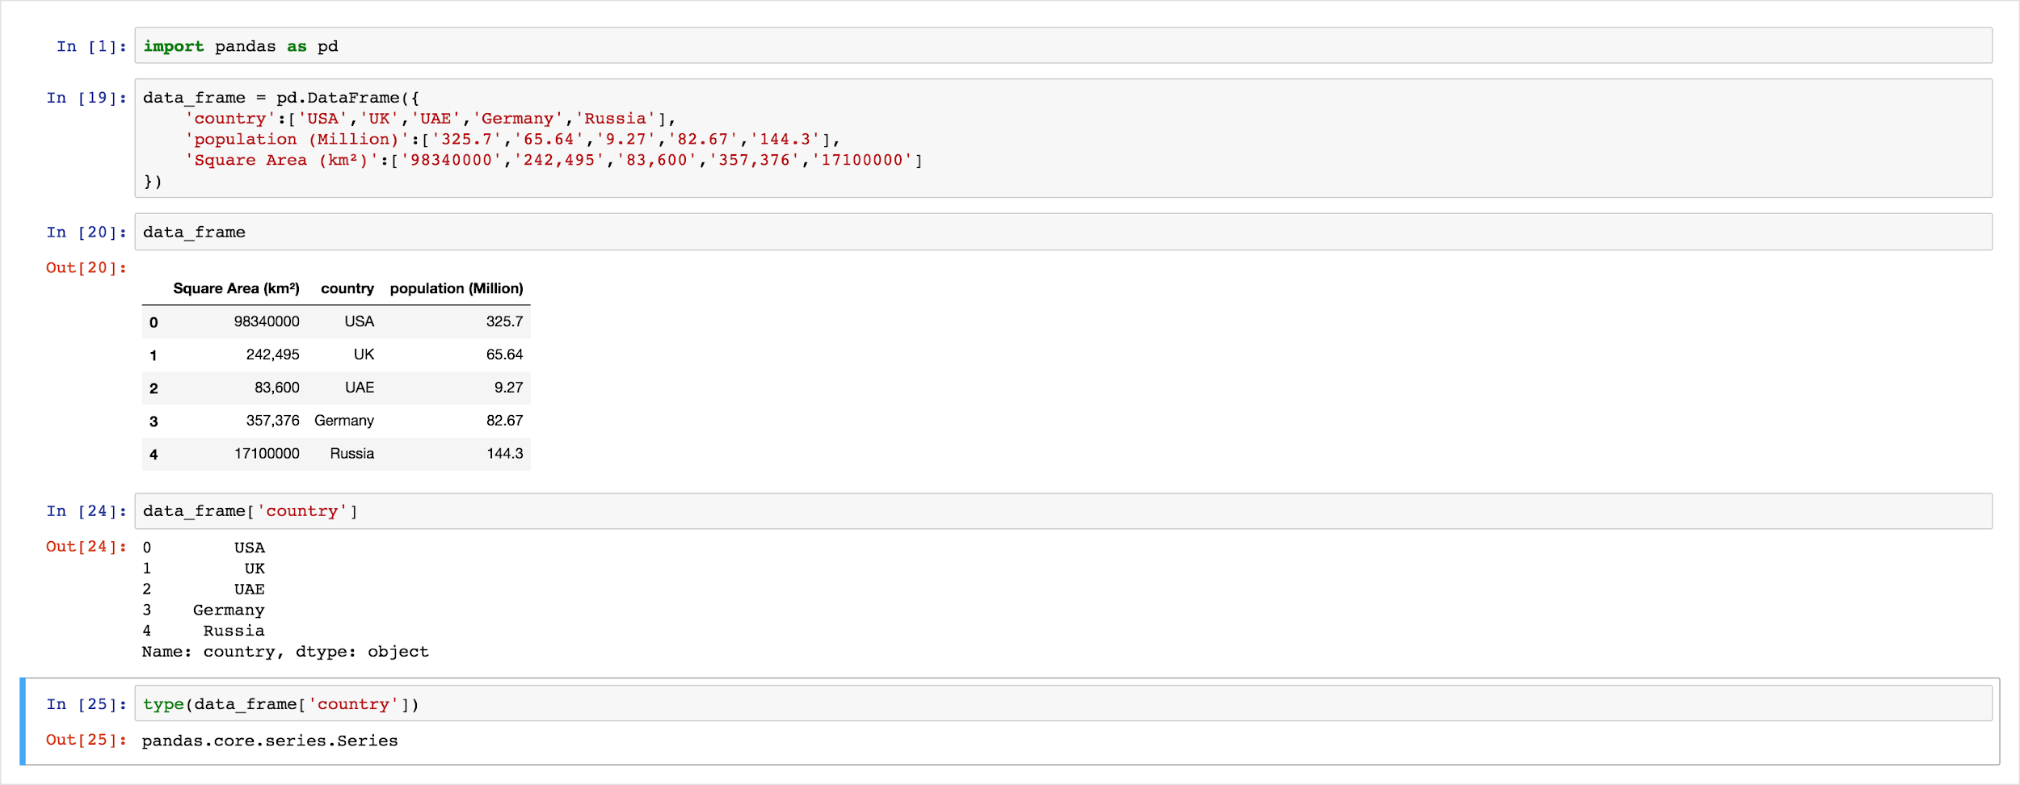
DataFrame in Pandas

Slide 16
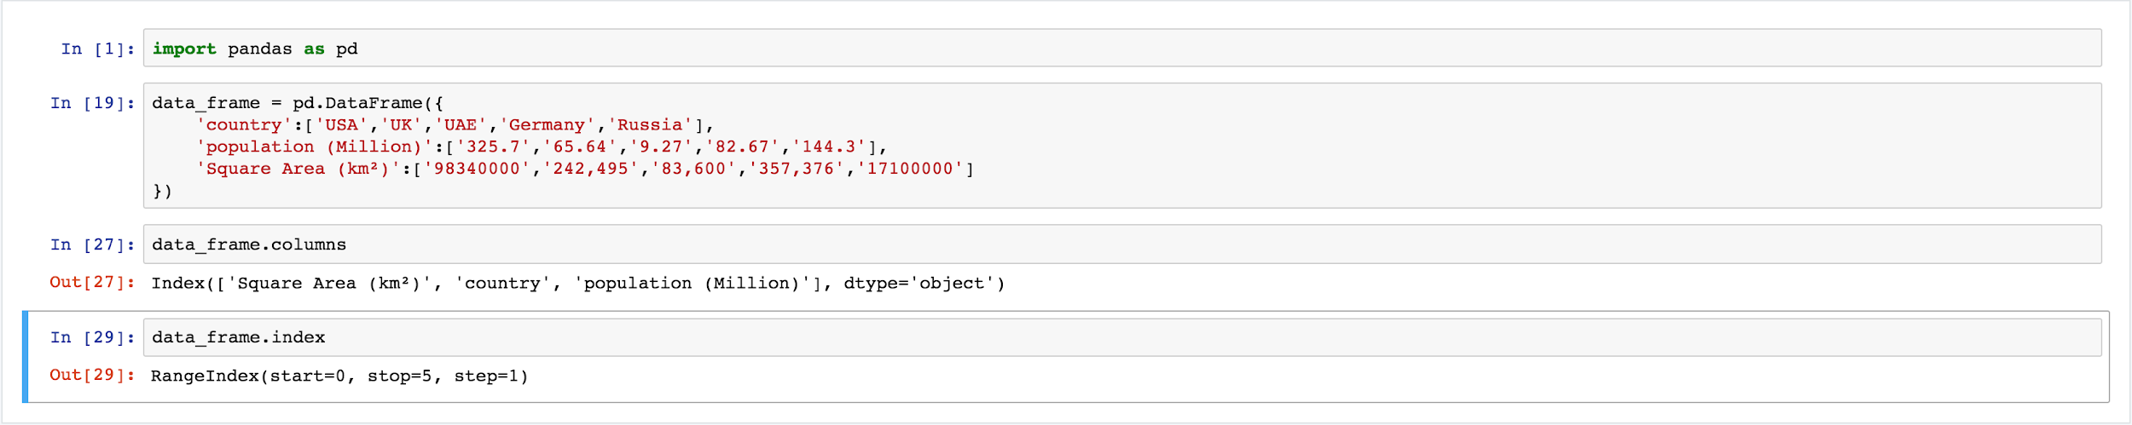
Understanding DataFrame
DataFrame object has 2 indexes: column index and row index.
In the above image the DataFrame has 5 elements from 0 to 4.

Slide 17
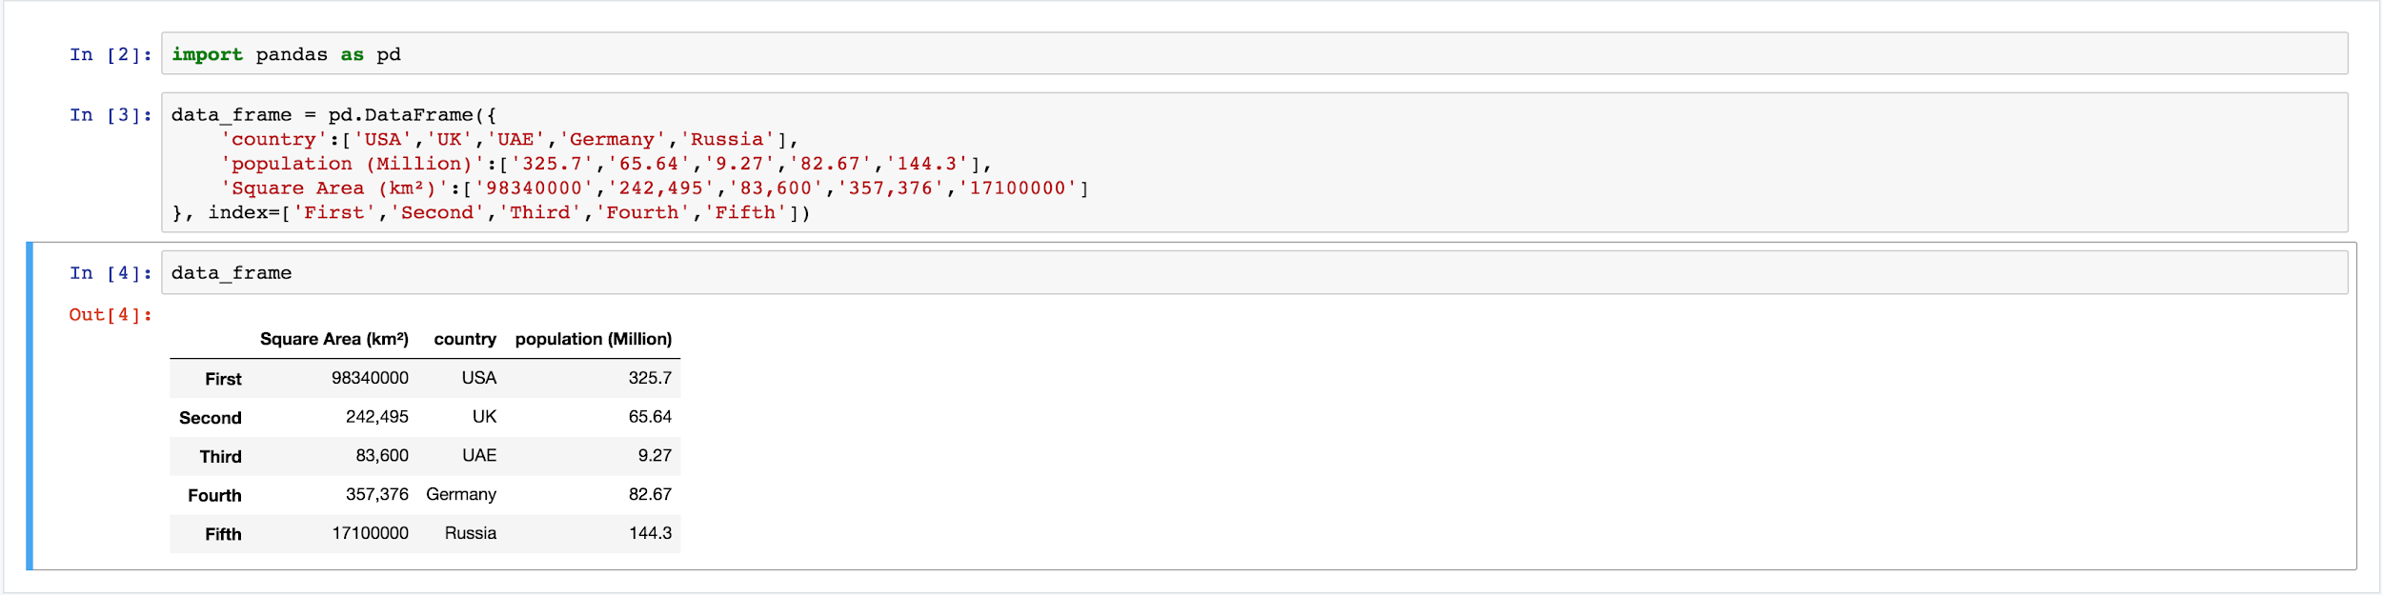
Operation On Pandas DataFrame
There are numerous ways to provide row index explicitly, for example you can provide index when creating a DataFrame or do it “on the fly” during runtime.

Slide 18
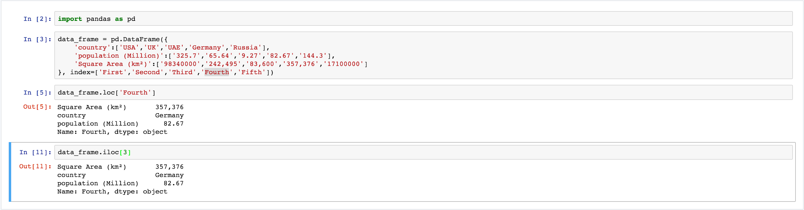
Operation On Pandas DataFrame Continued ..
Row access using index can be performed in several ways. The two most important ones are:-
using .loc and providing index label
using .iloc and providing index number

Slide 19
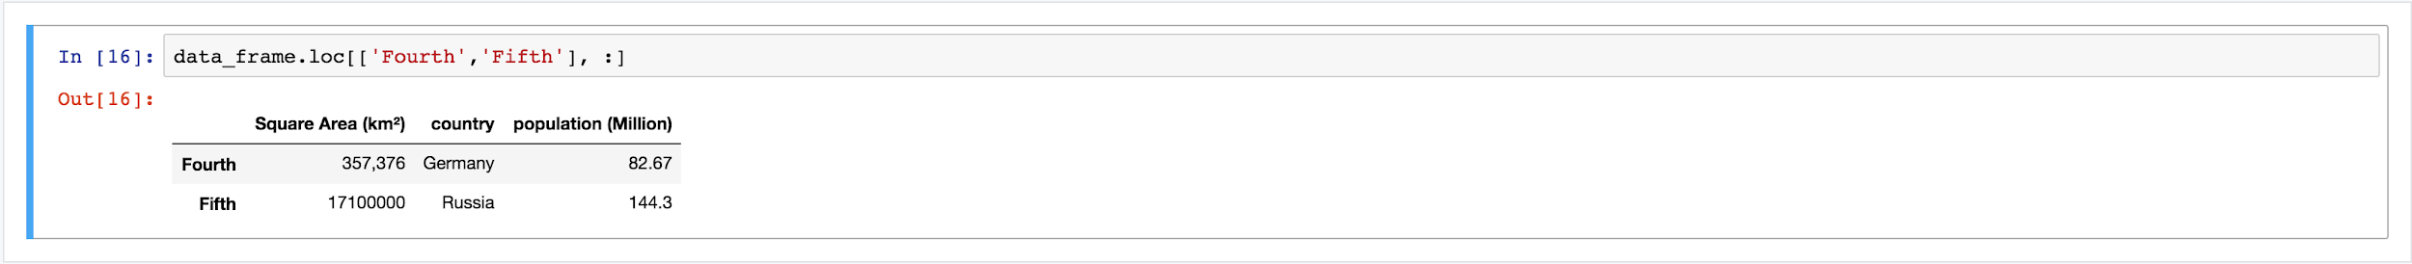
Operation On Pandas DataFrame Continued ..
Selection of particular rows and columns
.loc takes 2 arguments: index list and column list, slicing operation is supported

Slide 20
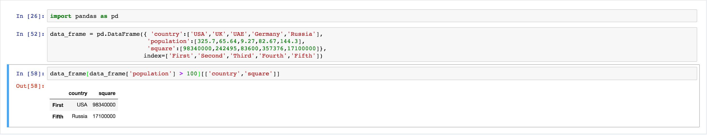
Operation On Pandas DataFrame Continued ..
Filtering can be performed using Boolean arrays.

Slide 21
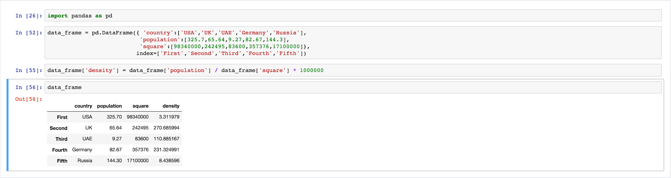
Operation On Pandas DataFrame Continued ..
Adding a new column, for example adding population density column.

Slide 22
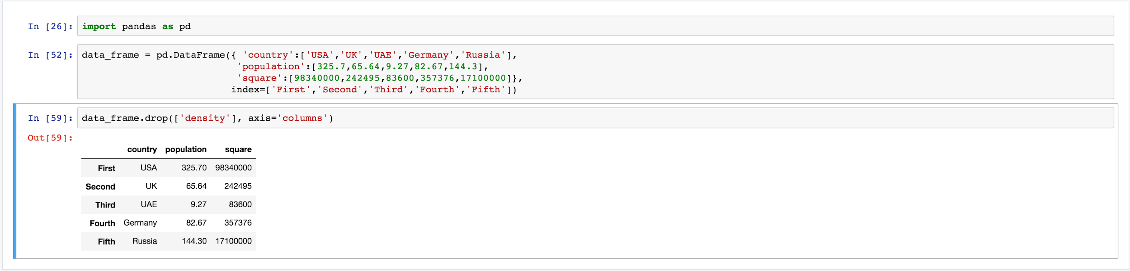
Operation On Pandas DataFrame Continued ..
Deleting a column.

Slide 23
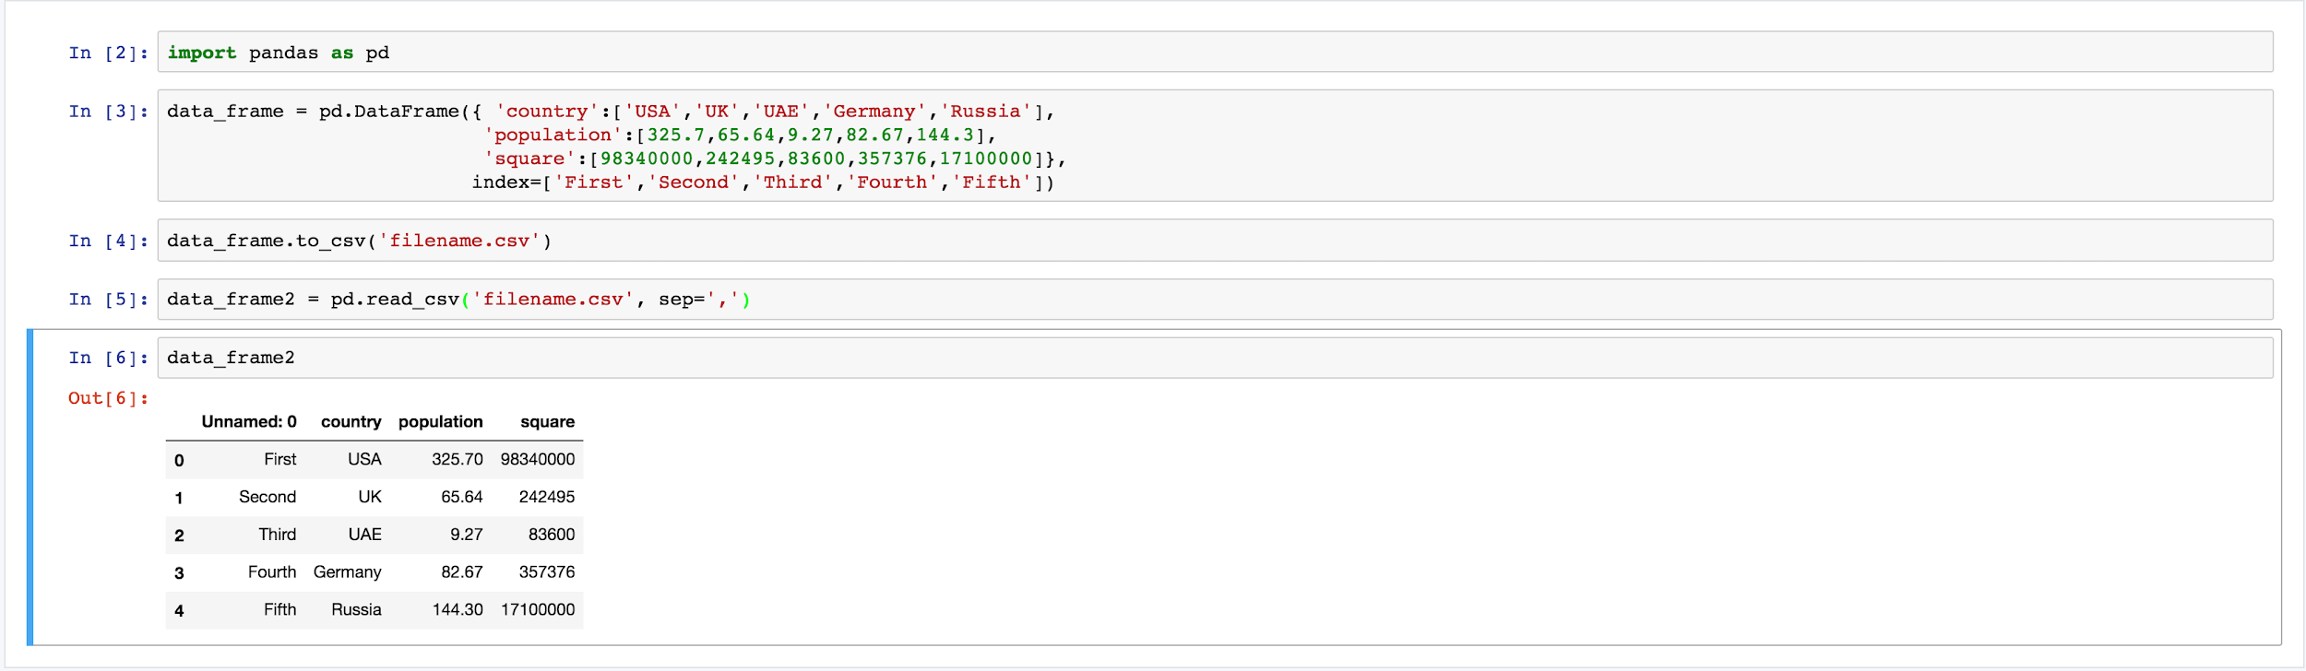
Reading and Writing Files in Pandas
Pandas support many popular file formats including CSV, XML, HTML, Excel, SQL, JSON many more.
For example, writing a dataframe to a CSV file and then reading it.

Slide 24
Reading And Writing Files in Pandas Continued ..
to_csv method takes many arguments for example, separator character.
As shown on the previous slides, named argument sep points to a separator character in CSV file called filename.csv.
There are many different ways to construct DataFrame from external sources, for example using read_sql method pandas can perform SQL query and store results inside a new DataFrame instance

Slide 25
Aggregating and Grouping in Pandas
Grouping is probably one of the most popular methods in data analysis. If you want to group data in pandas you have to use .groupby method.
In order to demonstrate aggregates and grouping in pandas I decided to choose popular Titanic dataset (https://yadi.sk/d/TfhJdE2k3EyALt)

Slide 26
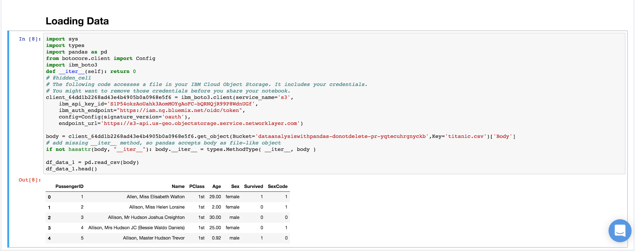

Slide 27
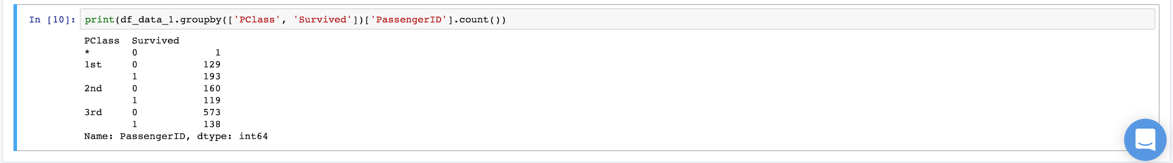
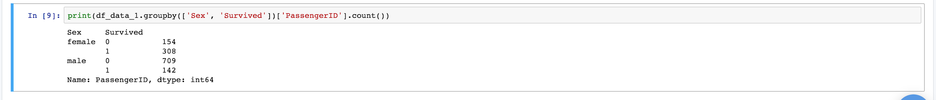
Aggregating and Grouping in Pandas Continued ..
Let’s calculate how many passengers (women and men) survived and how many did not, we will use .groupby as stated above.
Now, let’s analyze the same data by cabin class

Slide 28
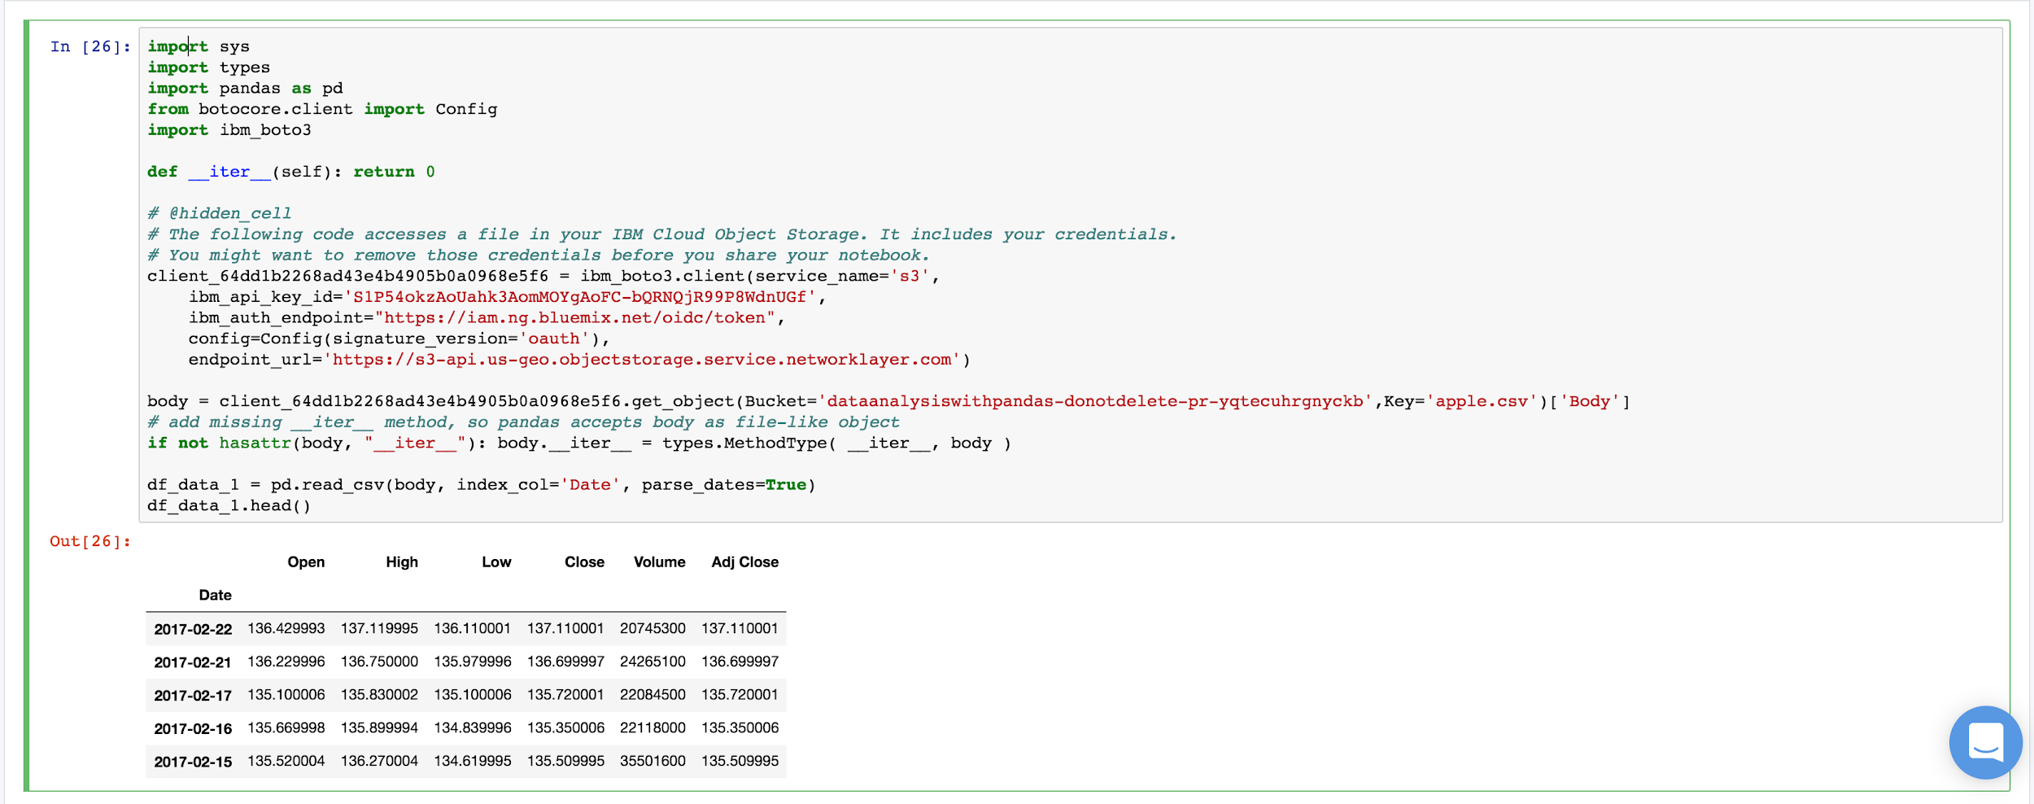
Time series analysis using Pandas
Pandas was created to analyze time series data. In order to illustrate how easy it is, We will use Apple’s last 5 year stock prices (https://yadi.sk/d/po_usmXT3ExwzV).

Slide 29
Time series analysis using Pandas Continued ..
The image on the previous slide shows a sorted DataFrame with DatetimeIndex by Date column. If datetime column is different from ISO8601 format, then you have to use built-in pandas function pandas.to_datetime to format it.
Let’s now calculate mean closing price.
But what about specific time period?

Slide 30
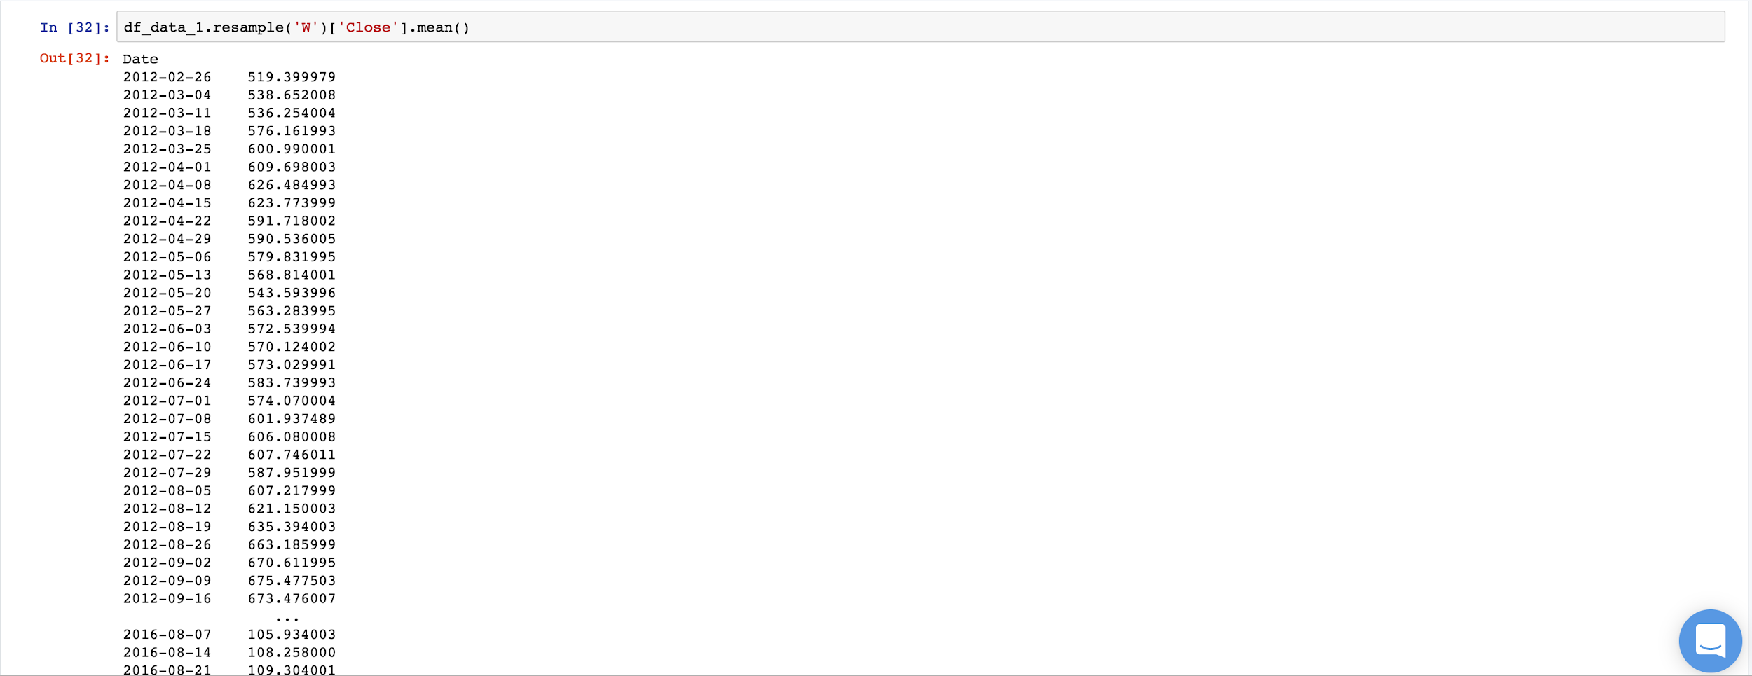
Time series analysis using Pandas Continued ..
Let’s calculate mean of closing price by weeks.

Slide 31
Time series analysis using Pandas Continued ..
Resampling is a very powerful tool when it comes to time series analysis.
Resampling can be defined as a number of string aliases, given to useful common time series frequencies. In the above image, I am using “W”.
For more information on resampling, refer pandas official documentation (http://pandas.pydata.org/pandas-docs/stable/timeseries.html#offset-aliases)

Slide 32
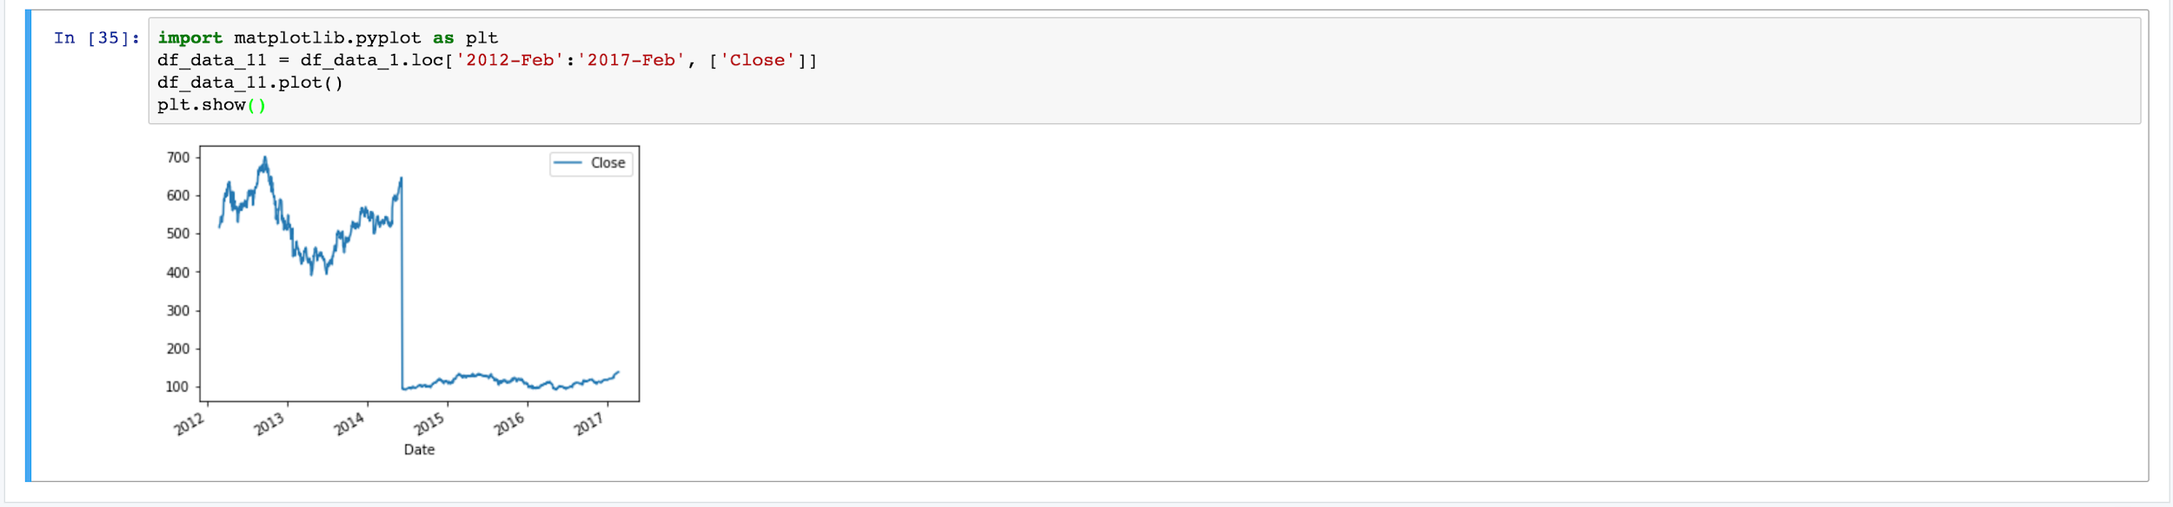
Visualization in Pandas
For visualization pandas use library called matplotlib.
Let’s see how Apple stock prices change over time on a graph:
Taking Closing price between Feb, 2012 and Feb, 2017

Slide 33
Visualization in Pandas Continued ..
Values of X-axis are represented by index values of DataFrame (by default if not provide explicitly), Y-axis represents the closing price.

Slide 34
Advantage Of Pandas
Pandas have several advantages over other solutions such as NumPy, Statsmodels, SciPy etc.
A Pandas DataFrame can have non-homogeneous data i.e you can have different data types(int, float, string, datetime etc.) all in one place.
Good IO capabilities.
Pandas have built in functionality for a lot of common data-processing applications, for example:- easy group by syntax, easy joins (which is extremely efficient in pandas), rolling windows.

Slide 35
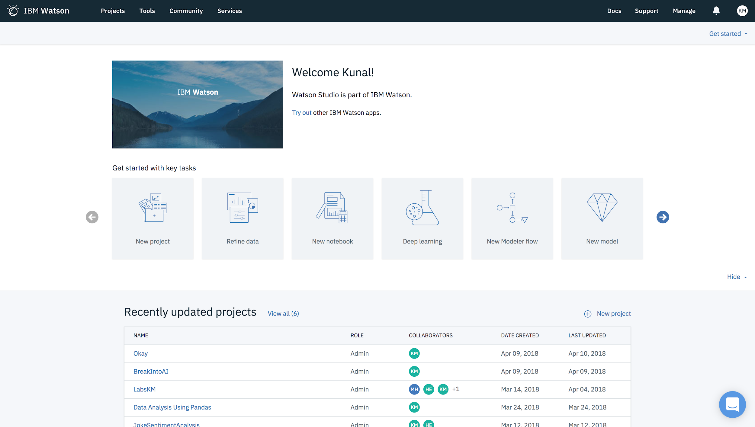
Introduction To IBM Watson Studio

Slide 36
IBM Watson Studio
Watson Studio is a cloud based development and deployment environment for Machine Learning, Deep Learning, Data Governance and Data Exploration.
A platform build for business analyst, data engineer, data scientist and developer to simplify their tasks with an intuitive UI and provide massive computing power.
A platform where insights can be traced back to models, projects, notebooks and data sources and where model can evolve and automatically update themselves.

Slide 37
Advantages Of IBM Watson Studio For Data Analysis.
IBM Watson Studio is an IDE (Integrated Development Environment), available on IBM Cloud, with many advantages such as:-
Offering easier access to large amounts of data while decreasing the total time of analysis.
Rapid development experience with access to tools and utilities that break down language barriers.
Ability to integrate and connect to multiple data sources, allows refining, and accessing big data engines.

Slide 38
May the force of Pandas Be With You :)

