Slide 1
Introduction to Node-Red
Mehak Manwani Cloud Developer Advocate Advocate/mehak.manwani@ae.ibm.com

Slide 2
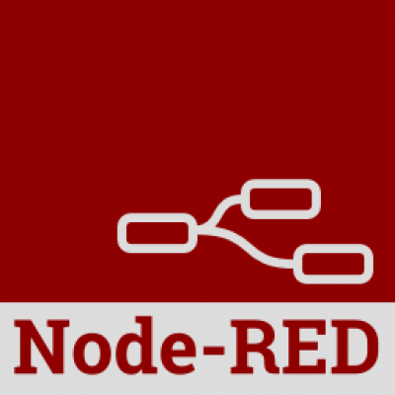
Node-Red
Visual Programming Tool
Flow Based Programming
Built on NodeJS
Open Source
Multi-Platform Deployments
More details on:
https://nodered.org/
https://github.com/node-red/node-red
Notes:
A little history:
In November 1997, C.F. Jeff Wu gave the inaugural lecture entitled "Statistics = Data Science?"^{[11]} for his appointment to the H. C. Carver Professorship at the University of Michigan.^{[12]} In this lecture, he characterized statistical work as a trilogy of data collection, data modeling and analysis, and decision making. In his conclusion, he initiated the modern, non-computer science, usage of the term "data science" and advocated that statistics be renamed data science and statisticians data scientists

Slide 3
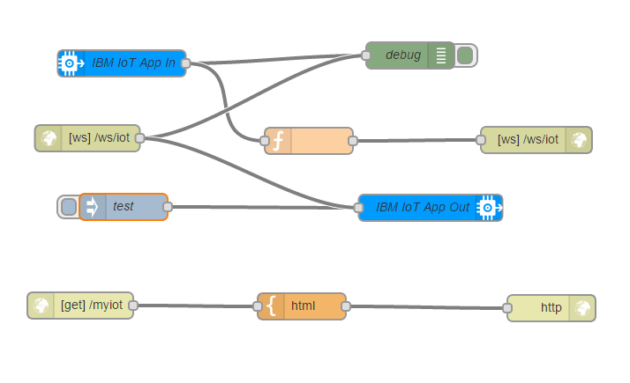

Node-Red
Use Cases
IoT Applications
Deploy applications that can easily interface with MQTT, TCP, UDP, MQLight, and Watson IoT
Build dashboards to visualize data
Deploy on RaspberryPi and gateways
Notes:
A little history:
In November 1997, C.F. Jeff Wu gave the inaugural lecture entitled "Statistics = Data Science?"^{[11]} for his appointment to the H. C. Carver Professorship at the University of Michigan.^{[12]} In this lecture, he characterized statistical work as a trilogy of data collection, data modeling and analysis, and decision making. In his conclusion, he initiated the modern, non-computer science, usage of the term "data science" and advocated that statistics be renamed data science and statisticians data scientists

Slide 4
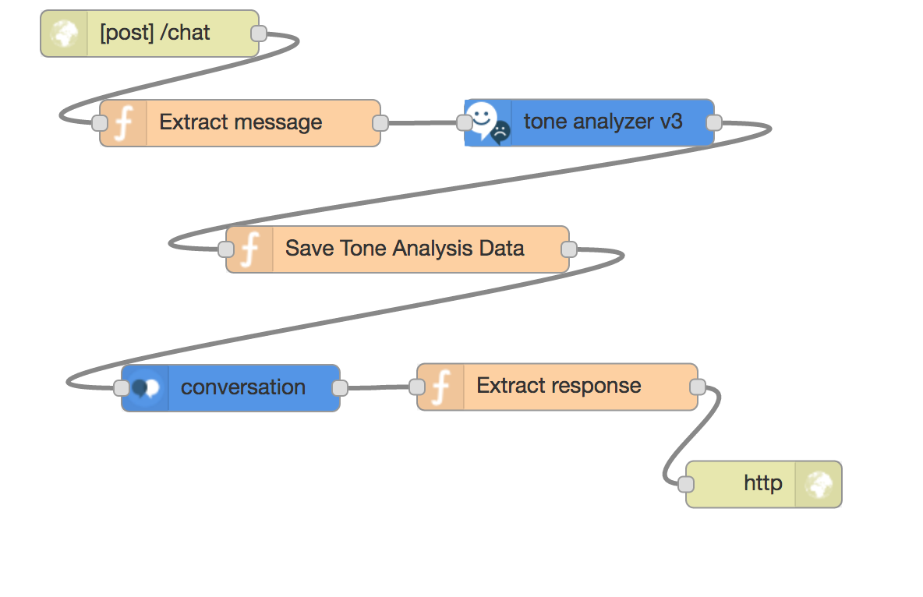
Node-Red
Use Cases
Web Applications
Deploy on a server or on the cloud (IBM Cloud, AWS, Azure)
100s of available 3rd part integrations and addons
Connect to IBM Watson
Build routes and connect to databases
Notes:
A little history:
In November 1997, C.F. Jeff Wu gave the inaugural lecture entitled "Statistics = Data Science?"^{[11]} for his appointment to the H. C. Carver Professorship at the University of Michigan.^{[12]} In this lecture, he characterized statistical work as a trilogy of data collection, data modeling and analysis, and decision making. In his conclusion, he initiated the modern, non-computer science, usage of the term "data science" and advocated that statistics be renamed data science and statisticians data scientists

Slide 5
Node-Red
Other Cool Stuff
Run Node Red in Docker - https://nodered.org/docs/platforms/docker
Embed into Existing NodeJS App - https://nodered.org/docs/embedding
Importing NodeJS Libraries - https://nodered.org/docs/writing-functions.html
Notes:
A little history:
In November 1997, C.F. Jeff Wu gave the inaugural lecture entitled "Statistics = Data Science?"^{[11]} for his appointment to the H. C. Carver Professorship at the University of Michigan.^{[12]} In this lecture, he characterized statistical work as a trilogy of data collection, data modeling and analysis, and decision making. In his conclusion, he initiated the modern, non-computer science, usage of the term "data science" and advocated that statistics be renamed data science and statisticians data scientists

Slide 6

Useful Links
Learn – develop – connect
IBM Code (developer.ibm.com/code)
IBM Developer Works (ibm.com/developerworks)
GitHub (github.com/watson-developer-cloud
github.com/IBM-Cloud
github.com/IBM)
Learning Lab - Coursera - Udacity - more

Slide 7
Code Lab
Sign-up for IBM Cloud: http://ibm.biz/devfest
Github Repository: https://github.com/Kuroi-Yuki/Simple-Exercises-In-NodeRED
Notes:
A little history:
In November 1997, C.F. Jeff Wu gave the inaugural lecture entitled "Statistics = Data Science?"^{[11]} for his appointment to the H. C. Carver Professorship at the University of Michigan.^{[12]} In this lecture, he characterized statistical work as a trilogy of data collection, data modeling and analysis, and decision making. In his conclusion, he initiated the modern, non-computer science, usage of the term "data science" and advocated that statistics be renamed data science and statisticians data scientists

