Slide 1
Introduction to Kubernetes
IBM Cloud DevFest

Slide 2
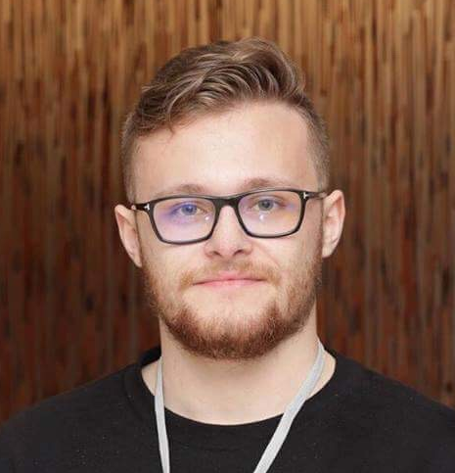
Meet the Speaker
Alexander Al Basosi
Cloud Developer Advocate, IBM Cloud
alexander.al.basosi@ae.ibm.com
http://ibm.biz/AlexAlBasosi/

Slide 3
Agenda
Overview of Code Lab
Linux Containers
Docker
Kubernetes
Kubernetes Architecture

Slide 4
Deploy Hyperledger Fabric Network on IBM Cloud

Slide 5
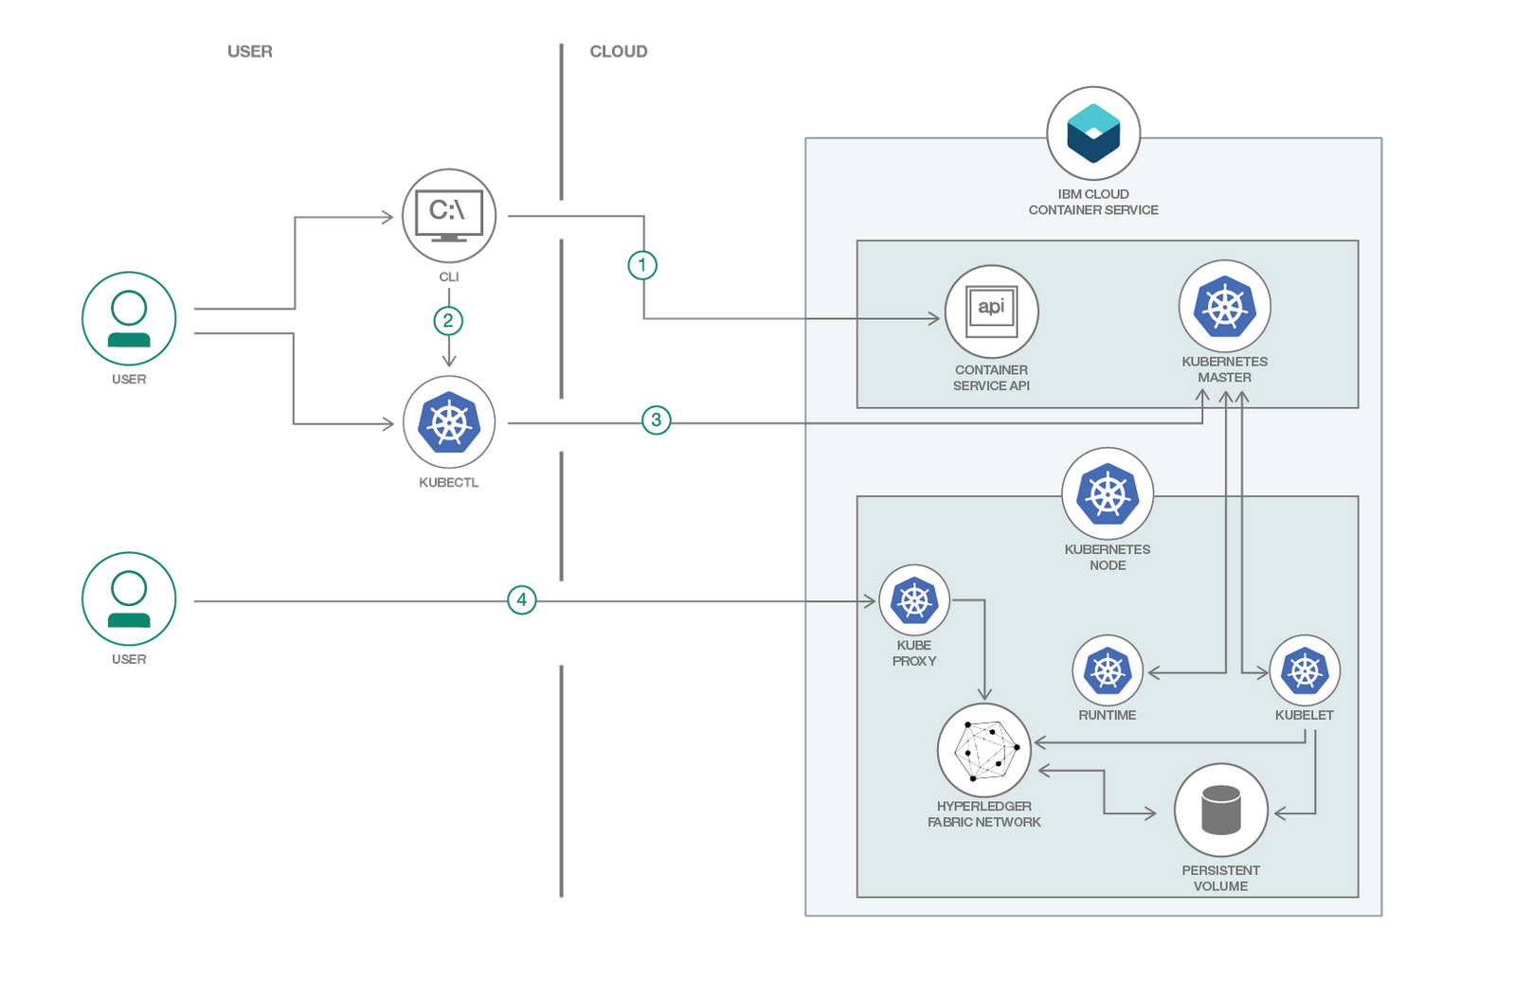

Slide 6
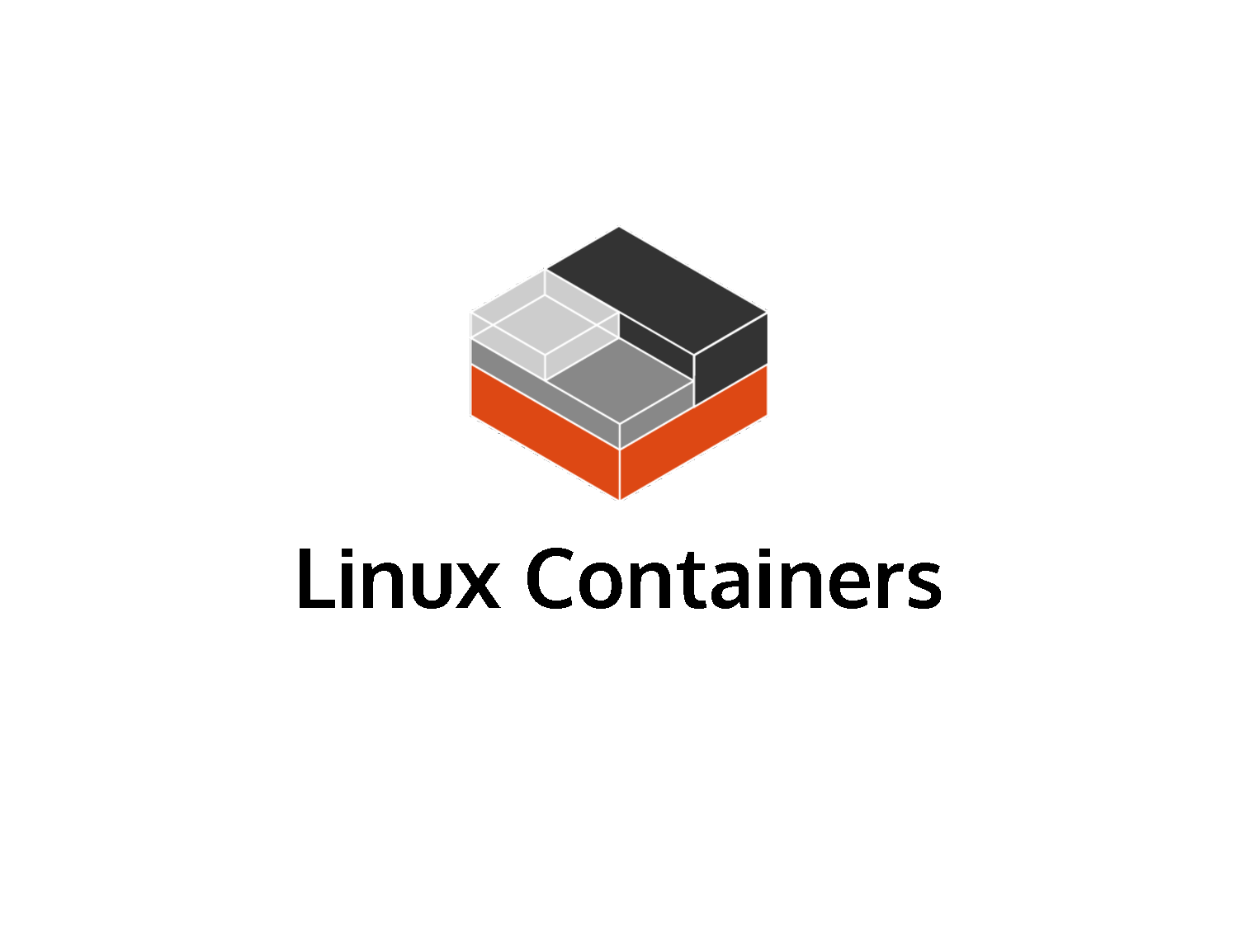

Slide 7
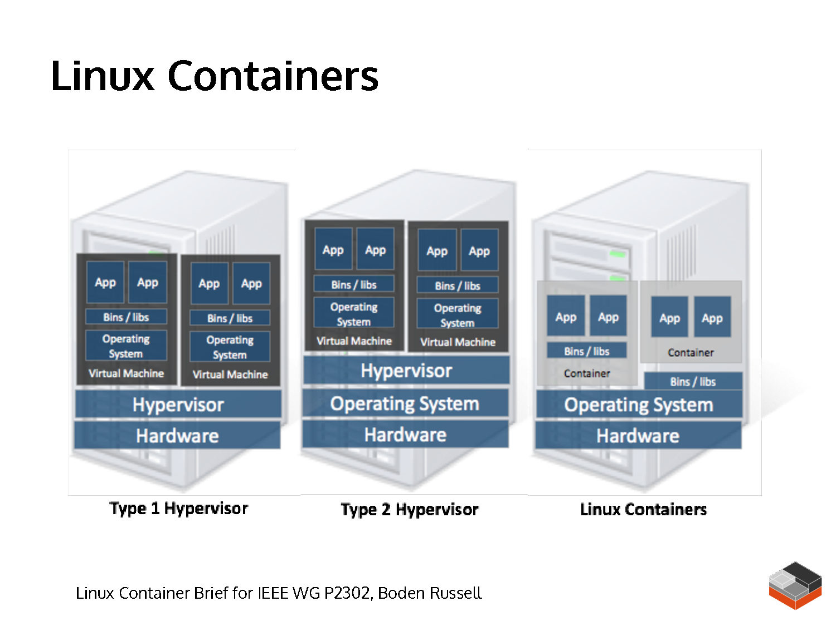

Slide 8
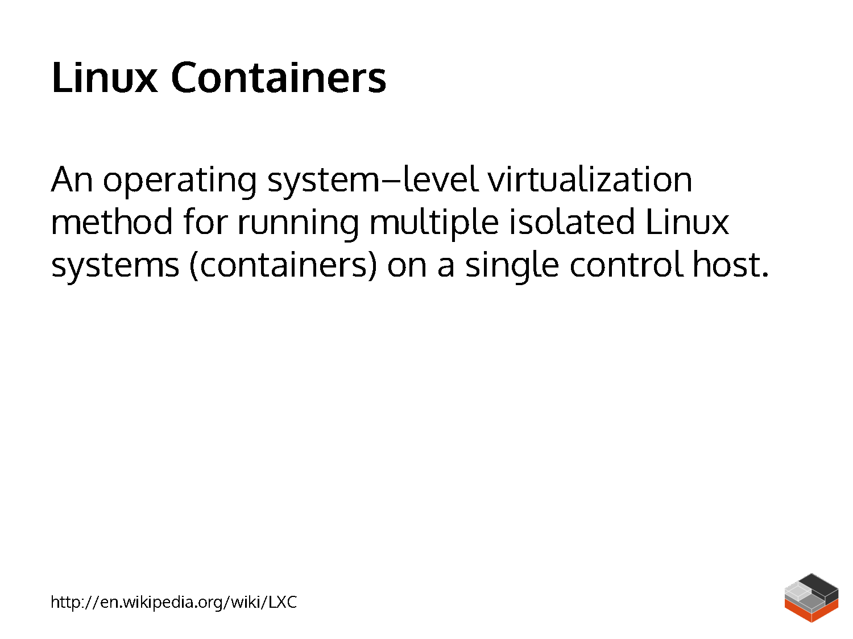

Slide 9
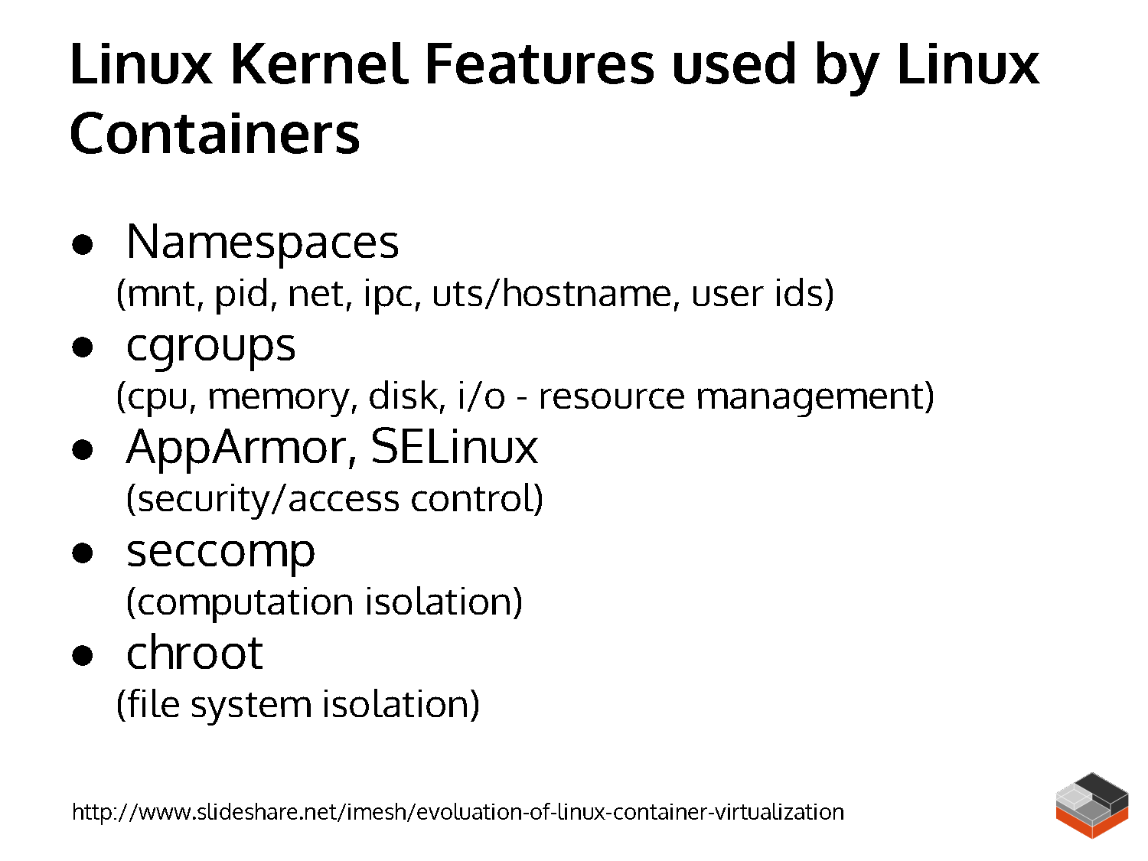

Slide 10
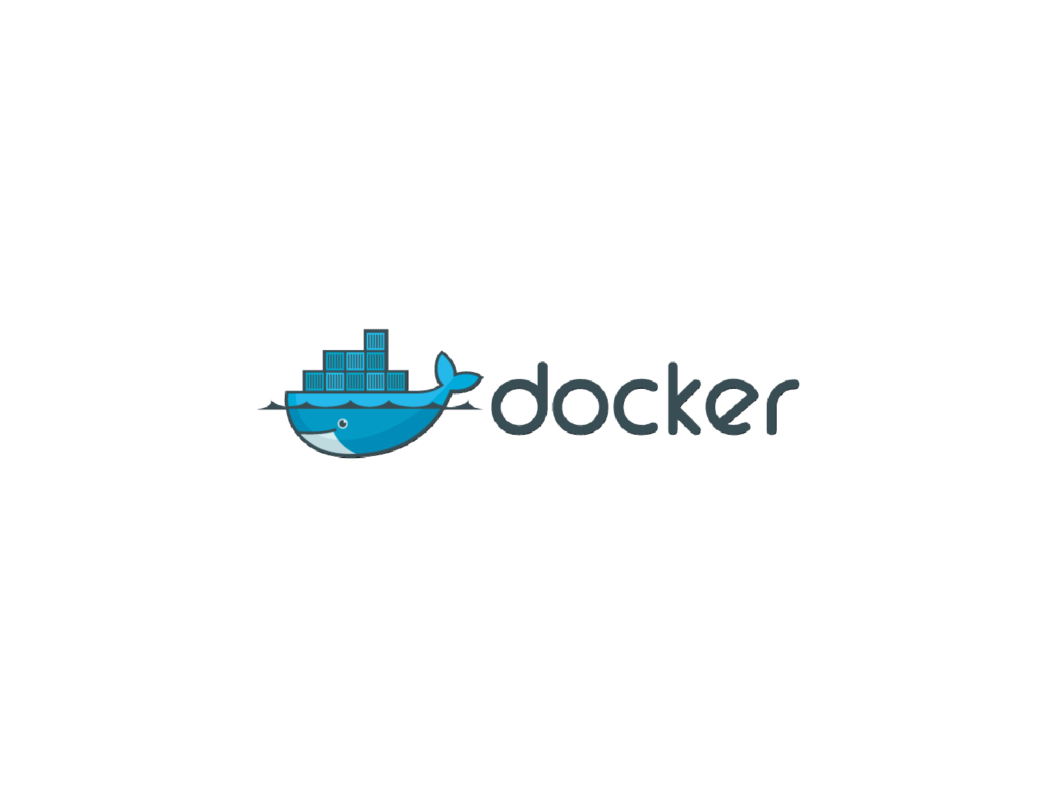

Slide 11
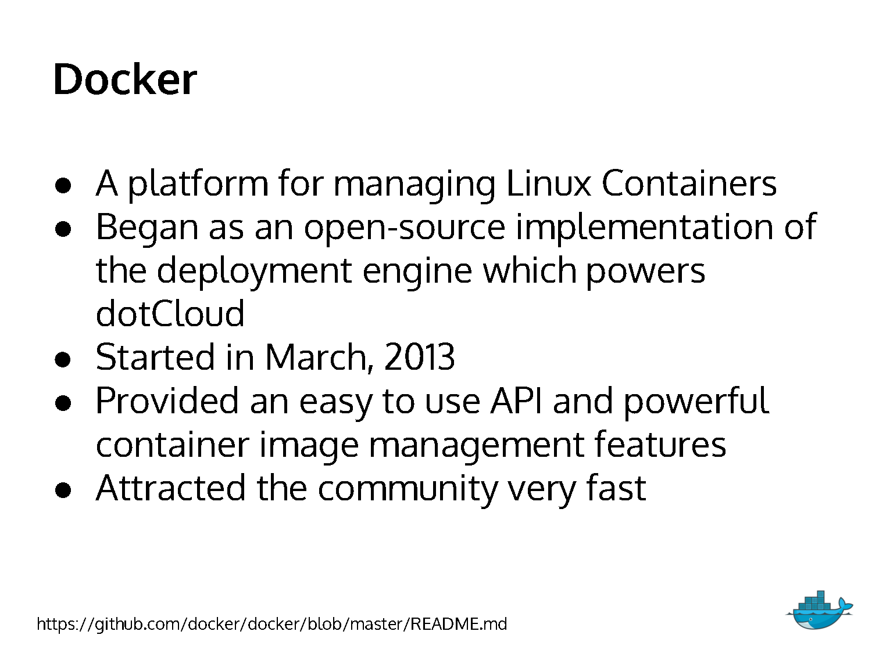

Slide 12
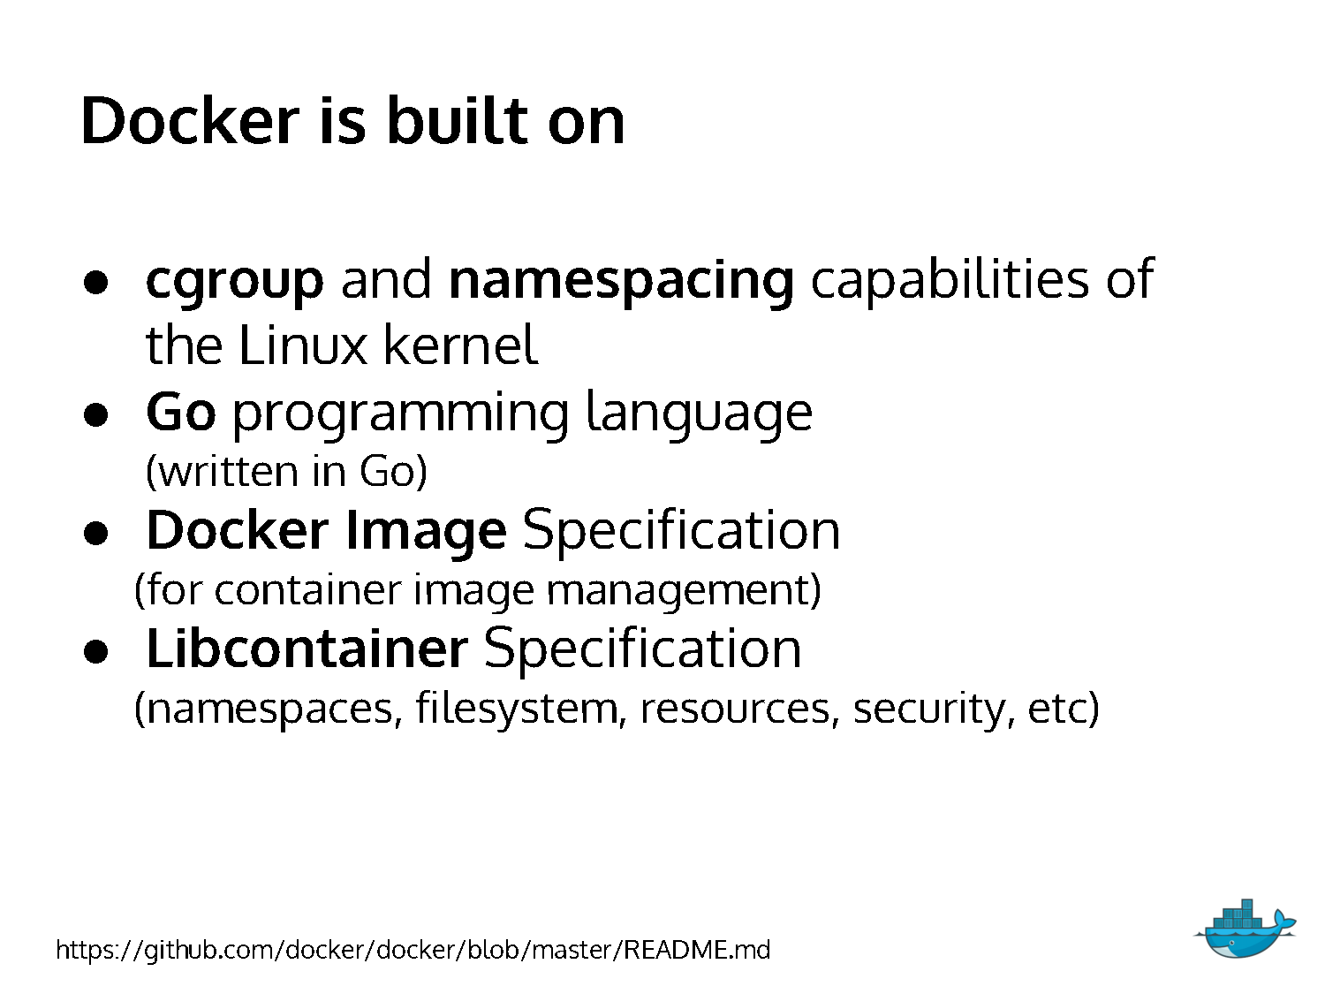

Slide 13
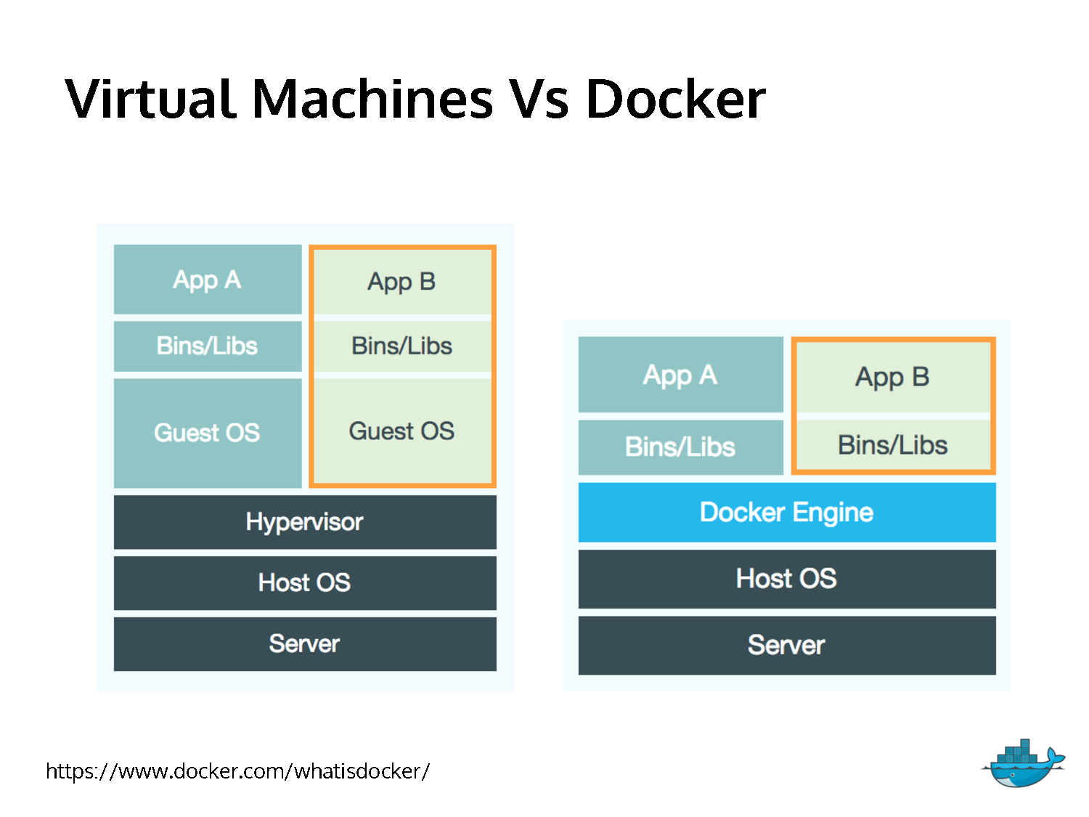

Slide 14
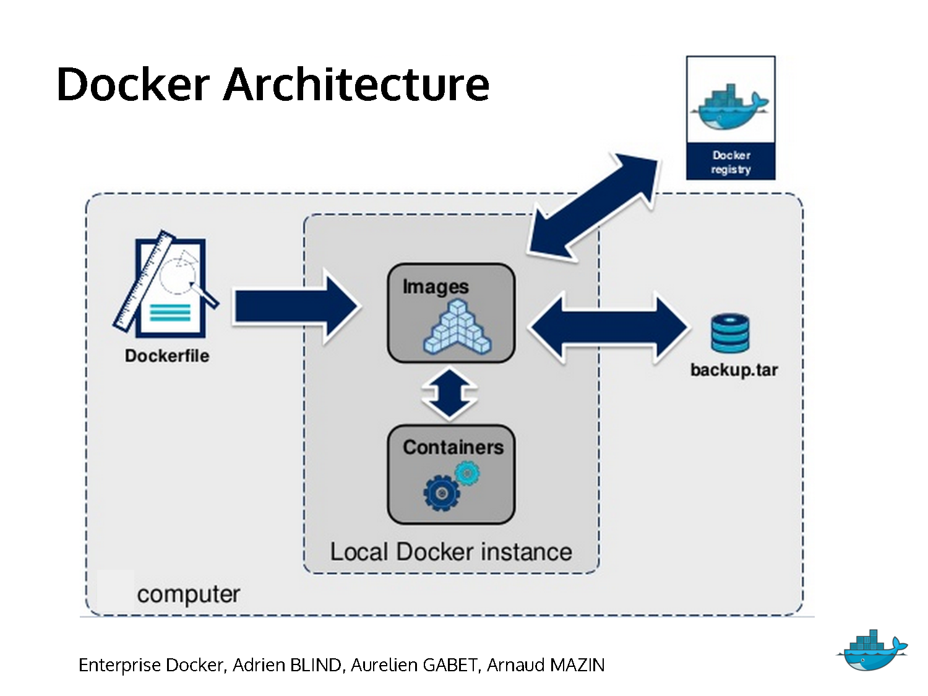

Slide 15
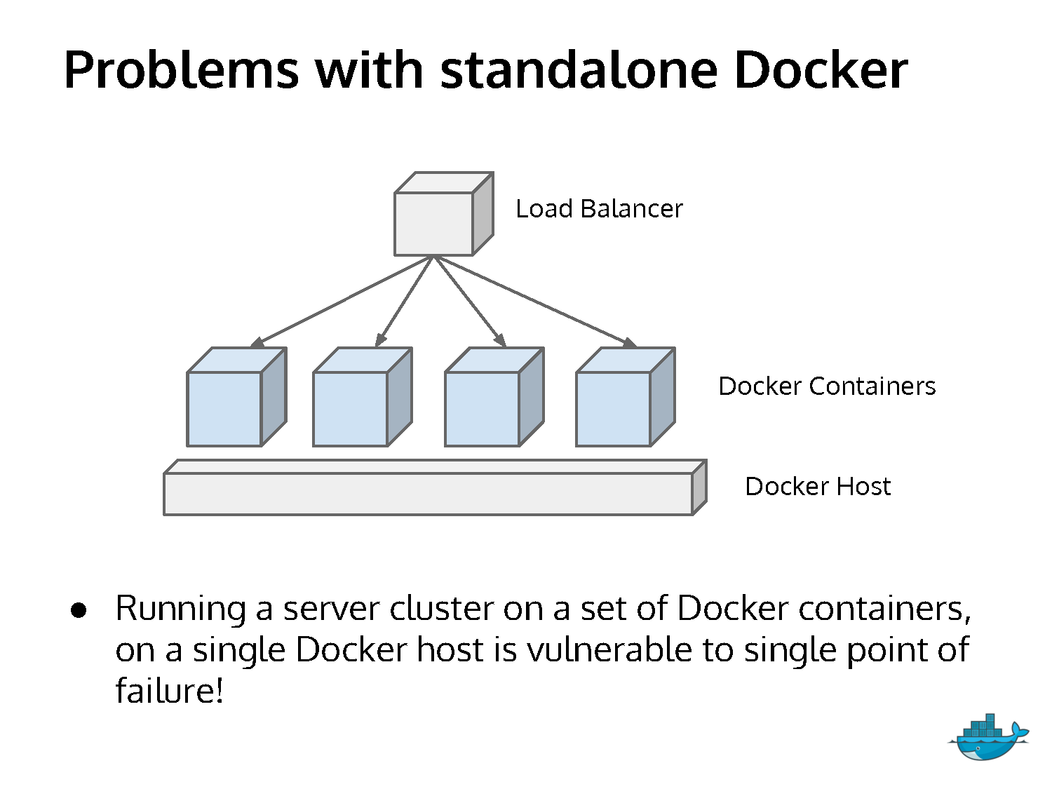

Slide 16
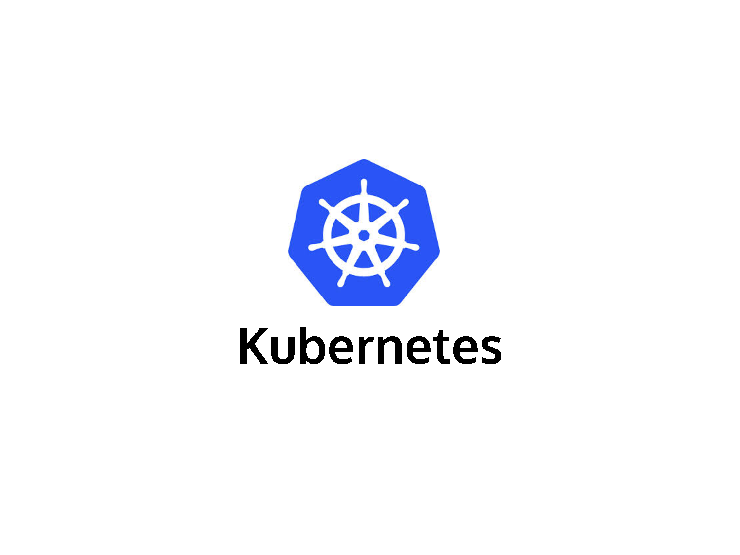

Slide 17
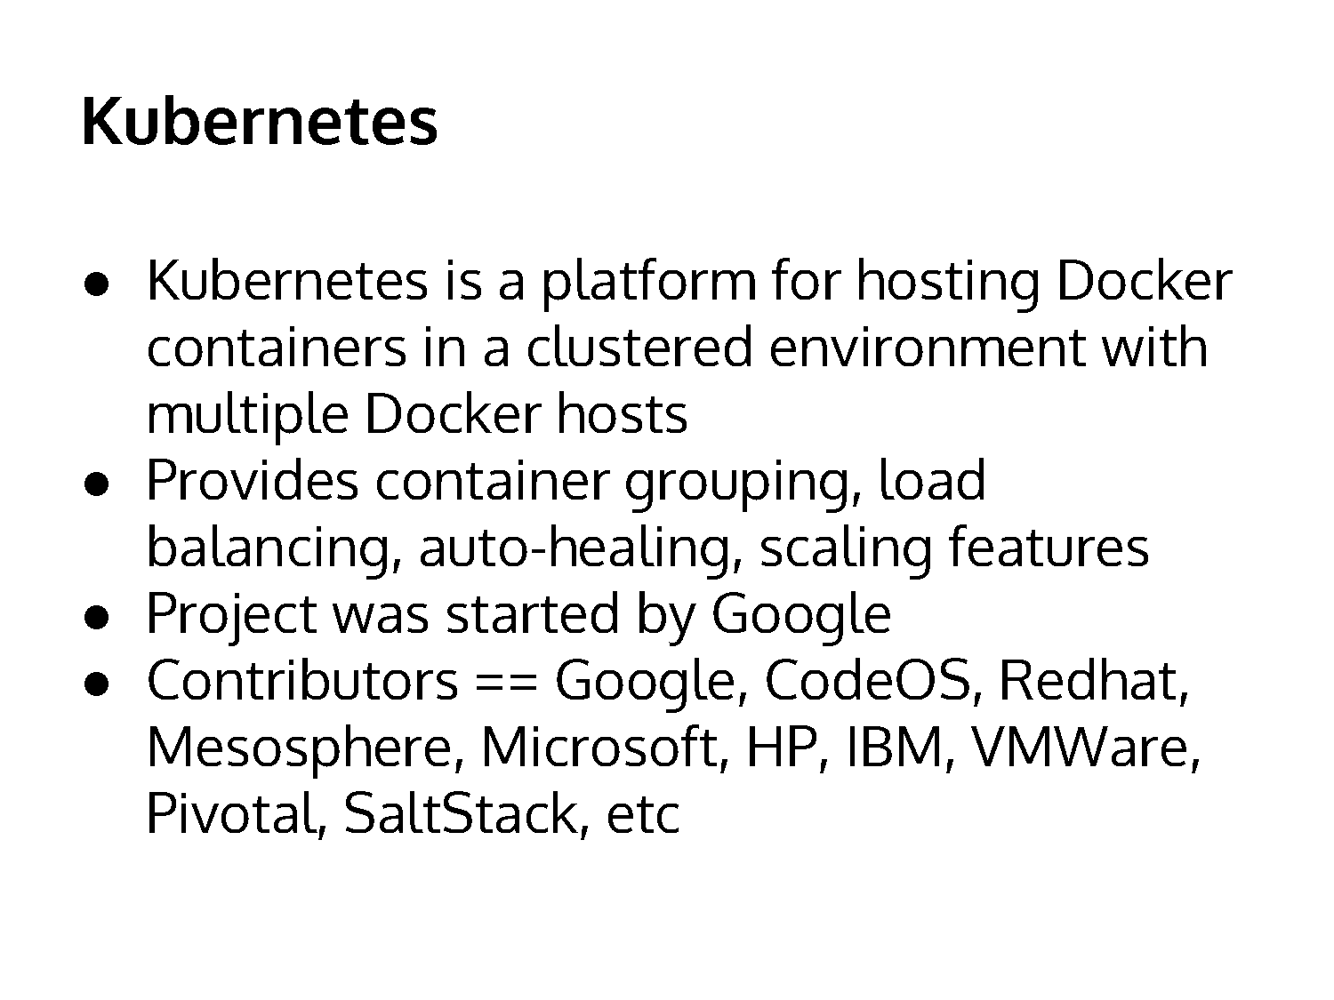

Slide 18
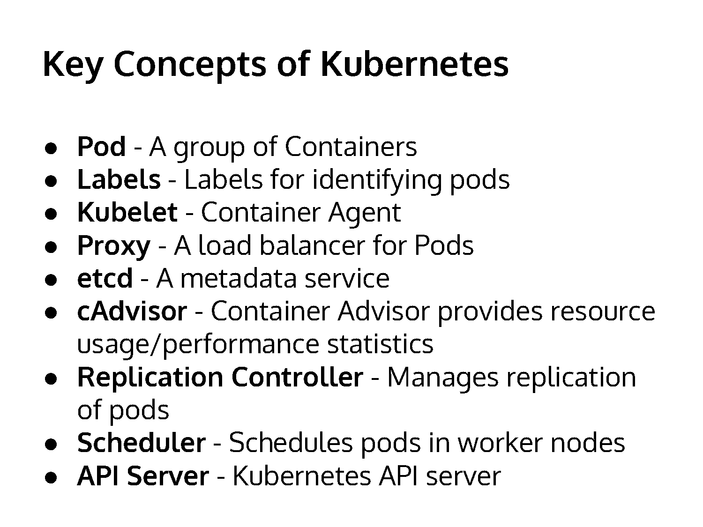

Slide 19
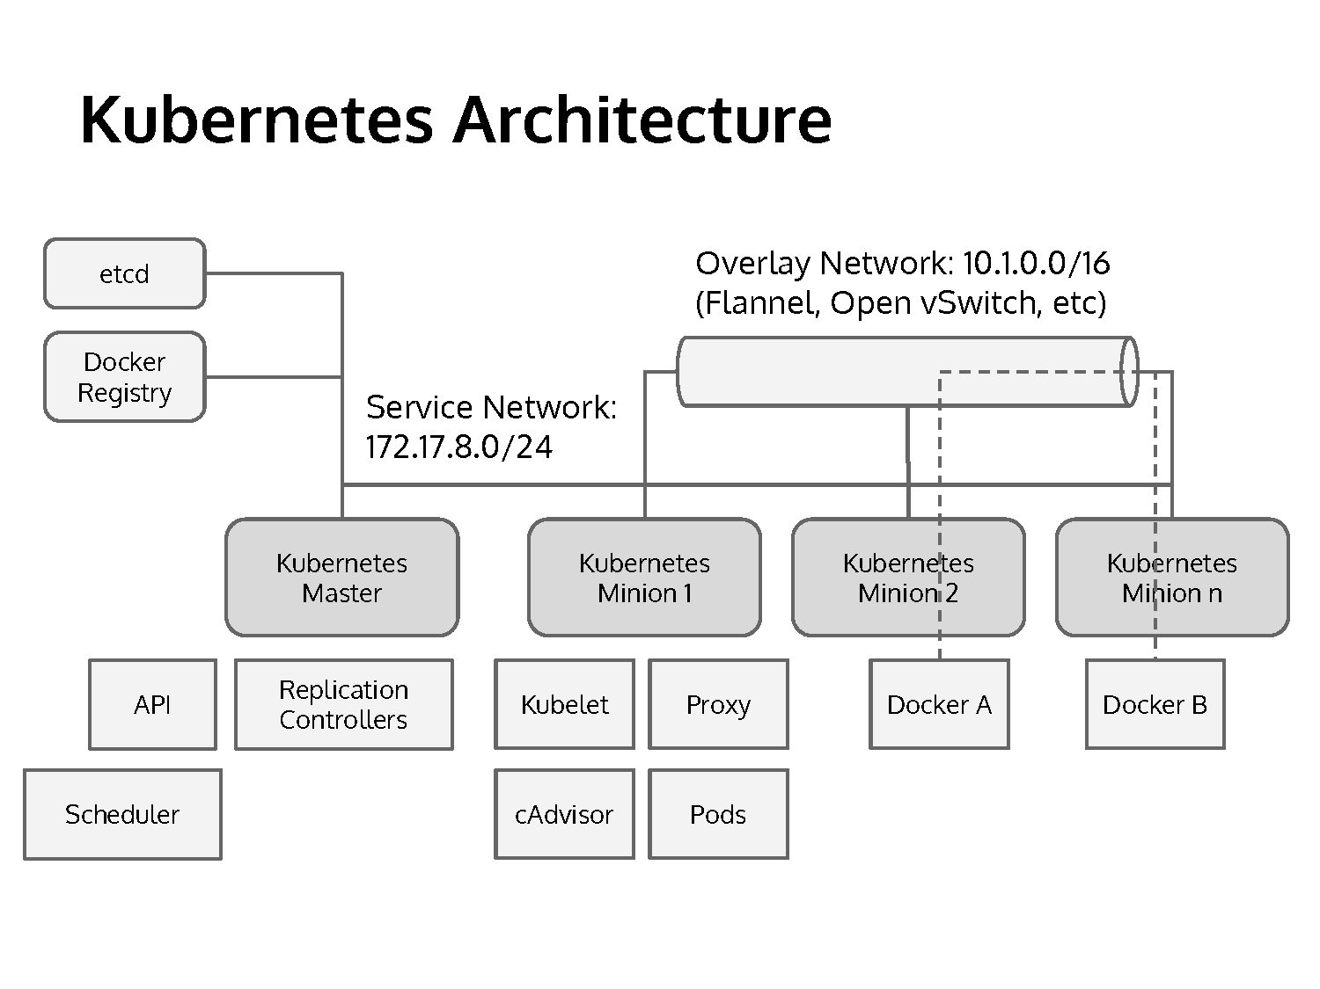
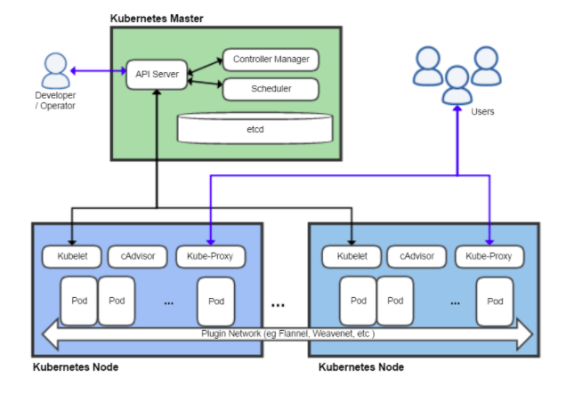

Slide 20
References
https://www.slideshare.net/imesh/an-introduction-to-kubernetes
https://vitalflux.com/quick-glance-at-kubernetes-architectural-building-blocks/

Slide 21

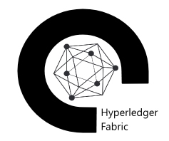
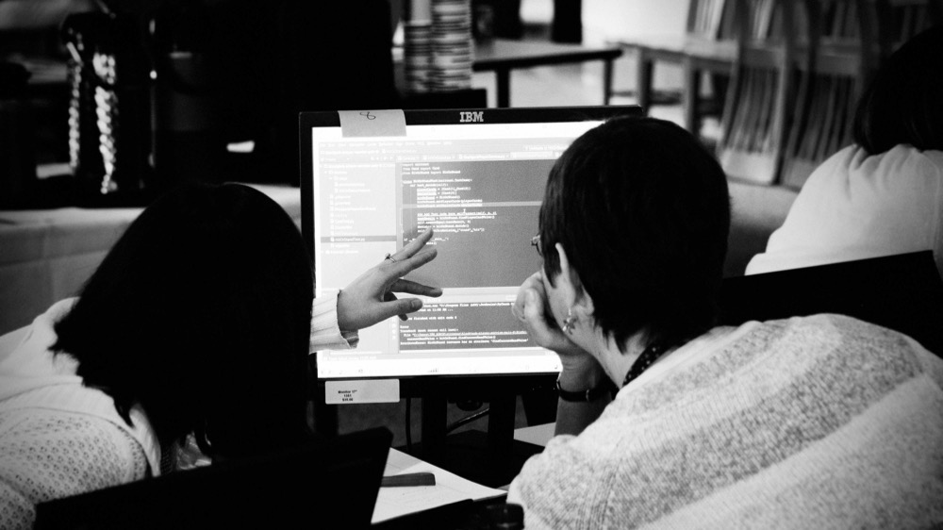
Thank you
ibm.biz/AlexAlBasosi
twitter.com/AlexAlBasosi
github.com/AlexAlBasosi
developer.ibm.com/code

