Slide 1
Data Store Scale

Slide 2
Bluemix
IBM Bluemix DevOps Services
Build
Stage
Test
Prod red/black
Google
Facebook
Browser
Container Group
SSO
File:
File:
IBM Cloud
File:
Object Store v2
File:
App
(car records)
Device
Secure Gateway
Upload
Car specs
On-prem
Service records
Warehouse
Secure Gateway Client
(medical records)

Slide 3
Bluemix
Container Group
App
(car records)
Secure Gateway
On-prem
File Storage
Mock Up on Prem
App
car records)
Secure Gateway Client

Slide 4
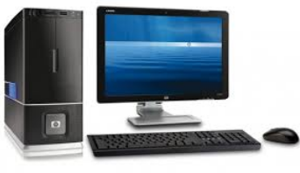



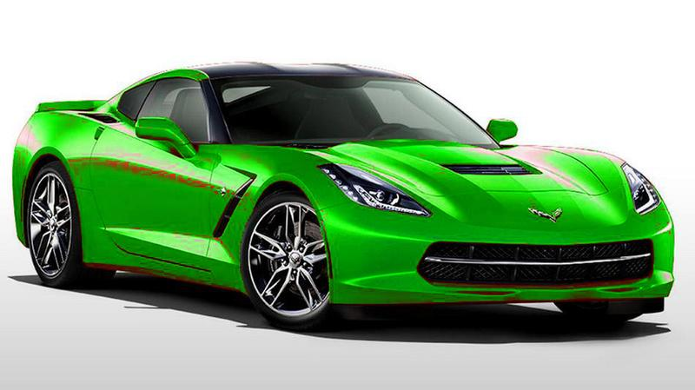
Files, sales receipts, …
Customer provided data
Mechanics data
Ping current data

Slide 5
Questions
Object Storage v1 and v2 – are they merging?
Block Storage – availability for June?
VPN: Capability via UI (Add VPN button). Availability for June? Alternatively – via REST API
SDN (software defined network): Infrastructure layer. VPN and Firewall built on top of it. Availability for June?

Slide 6
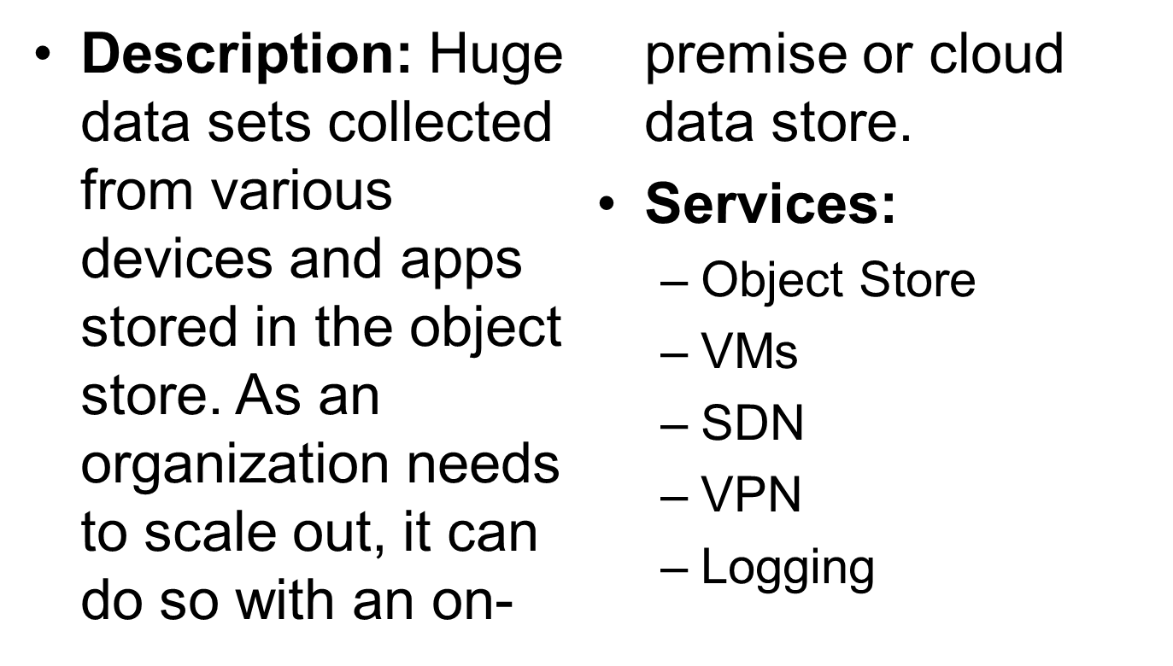
Data Store Scale

Slide 7
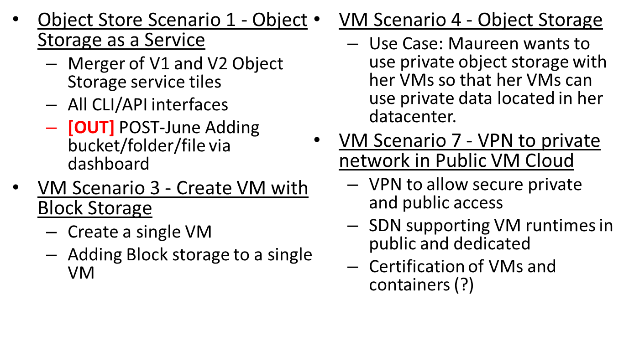
Data Store Scale
Design Scenarios for June

