Slide 1
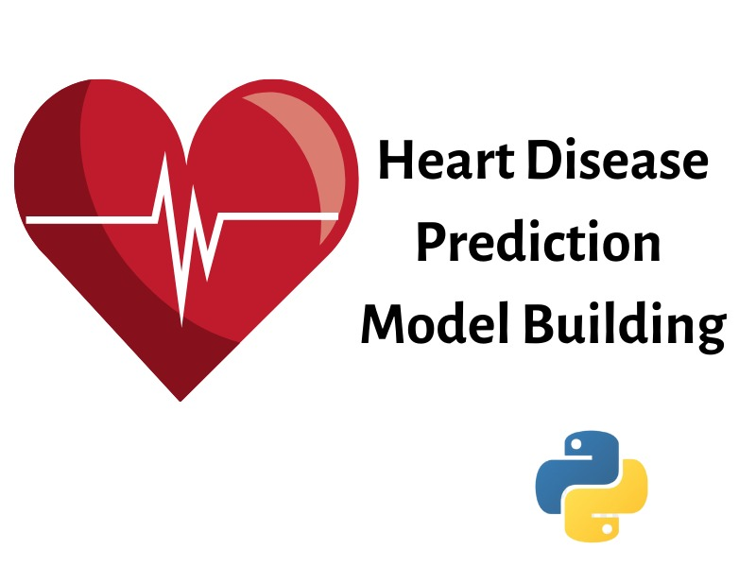
NALAIYA THIRAN
Visualizing and Predicting Heart Diseases with an Interactive Dash Board
1.Sangeeth Kanna P
2.Uma Maheshwari D
3.Subhashree B
4.Vishnupriya G

Slide 2
DOMAIN
Data Analytics
OBJECTIVES
The aim of this project is to predict and visualize various heart diseases with an interactive dashboard. This dashboard is used to visualize the various trends in different heart diseases.

Slide 3
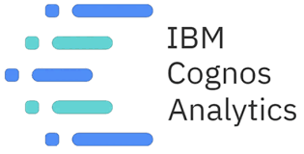
IDEATION
Using various visualization tools like IBM Cognos to visualize parameters that lead to various heart diseases.

Slide 4


IDEATION
Taking major attributes like blood pressure, glucose level ,ECG cholesterol and other underlying medical conditions.

Slide 5
IDEATION
Early analysis of health statistics to prevent heart disease

Slide 6

IDEATION
Our EDA detects mistakes, finds appropriate data, checks assumptions and determines the correlation among the explanatory variables (Like blood pressure,ECG)

Slide 7
SOFTWARE REQUIRED
IBM Cognos
Python
PROCESS FLOW
The Dataset is first obtained which includes data of various heart related disease.
The Dataset is then processed with the help of Data Analytics using Python
The analysed dataset is analysed & visualized in an interactive dashboard using IBM Cognos.

Slide 8
TIMELINE
MONTH 2
MONTH 3
MONTH 1
Preprocess the data set in order to enhance the visualization graph
The third month is implementing the visualized dataset into an interactive dashboard
The second month is about visualizing and analysing the data set obtained.

Slide 9
THANK YOU

