Slide 1


Slide 2

+ Marketing Spend by R&D Spend colored by State
+ Marketing Spend by R&D Spend colored by State
+ Profit
+ Administration by R&D Spend colored by State
+ R&D Spend by State

Slide 3
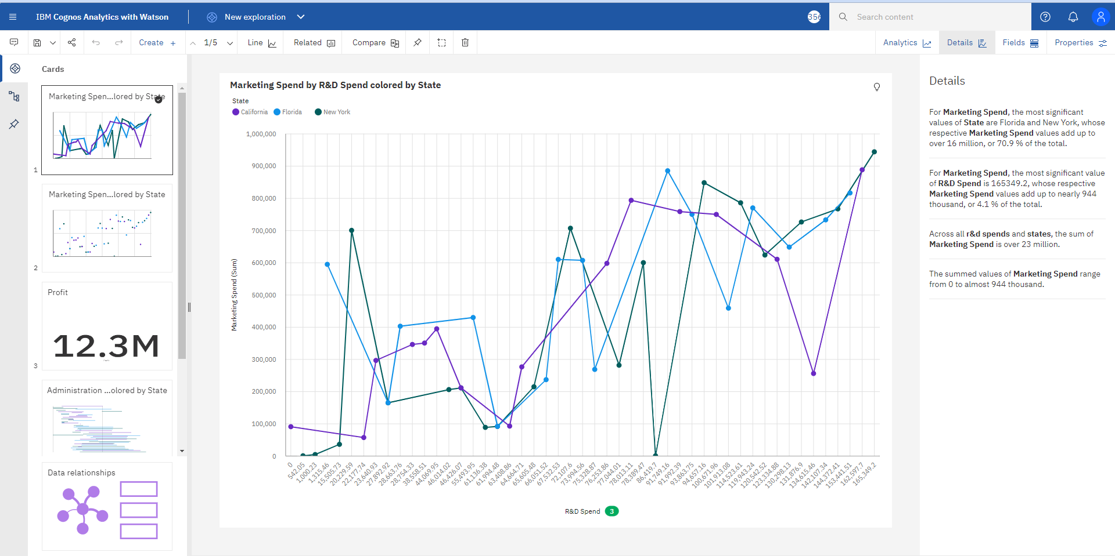
Marketing Spend by R&D Spend colored by State

Slide 4
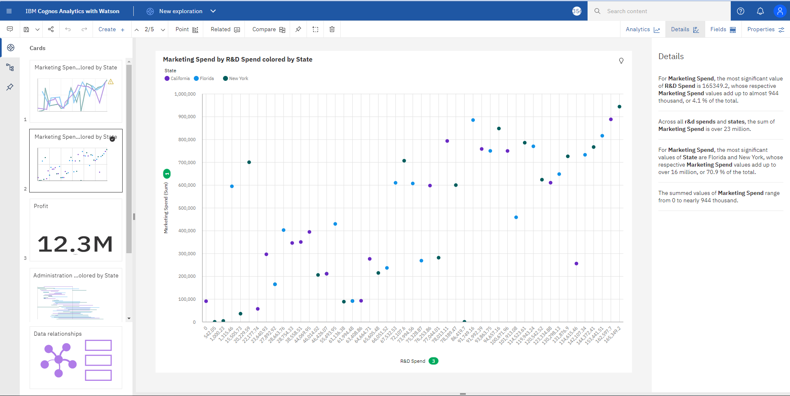
Marketing Spend by R&D Spend colored by State

Slide 5
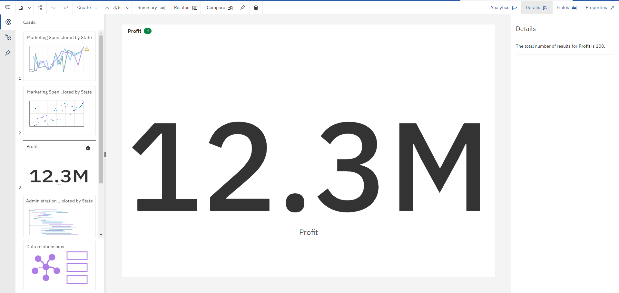
Profit

Slide 6
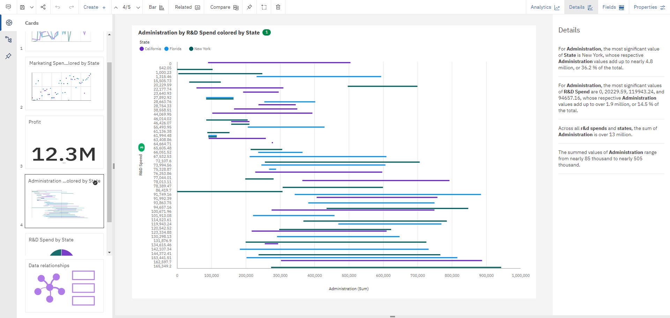
Administration by R&D Spend colored by State

Slide 7
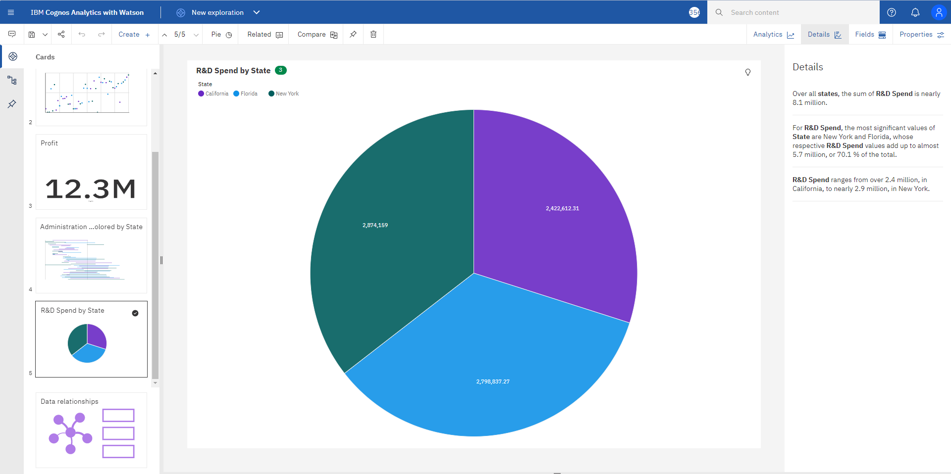
R&D Spend by State

