Slide 1

THIAGARAJAR COLLEGE OF ENGINEERING
GAS LEAKAGE MONITORING SYSTEM
Team Members:
Mahalakshmi C - 19D047
Raji Santhoshi T G - 19D070
Laila B G - 19D043
Durga Devi G - 19D117

Slide 2

BRAINSTORMING
Person 1:
- Laila B G
If the LPG sensor senses gas leak from industry, sensor output goes to active low and it is overlooked by Arduino UNO and gas leakage is noticed.

Slide 3

Person 2:
- Mahalakshmi C
If the gases can be leaked in industries or home, then it will detect by using gas sensor after that it gives alert sound to the people by using buzzer.

Slide 4
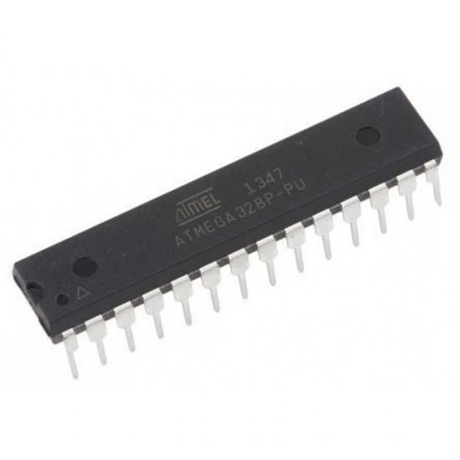
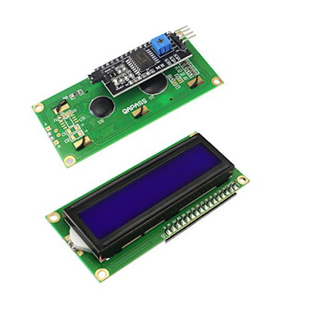
Person 3:
- Raji Santhoshi T G
We can propose to build the system using a MQS gas detection sensor and interface it with Atmega 328 microcontroller along with an LCD Display.
Atmega 328p
LCD Display

Slide 5
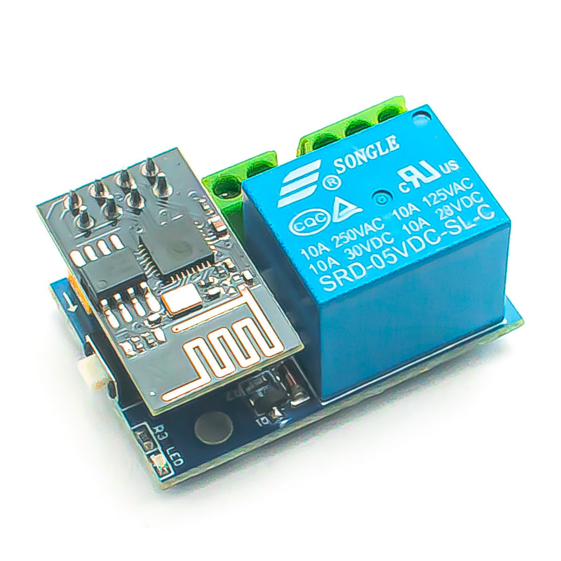
Person 4:
- Durga Devi G
We can read gas leakage in industries at a time we can measure and upload it to a ThingSpeak cloud using FPGA and ESP8276 module.
ESP8276 module

Slide 6
By grouping the ideas of the team members, we have proposed a solution to the problem.
The gas leakage monitoring system consists of Gas sensor, Buzzer, Arduino UNO, bread board and connecting wires.
The leakage gas can be detected by using the gas sensor.
It gives the alert sound when recognizing the leakage.
So that people can alert and huge exploitation can be avoided.

