Slide 1


Assignment-1: Health monitoring system for mines and mine workers

Slide 2
OBJECTIVE
→To monitor and measure work environmental parameters like,
1) Level of Coal Dust.
2)Noise.
3) Whole body vibration (WBV).
4)Level of UV rays.
5)Temperature and Humidity.
6)Harmful chemical Gases.
→To store the measured values in cloud.
→Alerts if the monitored value are above the critical level.

Slide 3
Components required
Arduino Uno
Mq2 senor
Vibration sensor
Temperature and Humidity sensor-dht11
UV ray sensor-ML8511
Air Quality Sensor-(Mq-135)
Nodemcu-esp8266
Buzzer
Connecting wires.

Slide 4
Sensors used:
MQ135 Sensor
MQ2 sensor
DHT11 sensor module
Measures temperature and humidity in mine.
Monitor And measures Coal dust in mine
Monitor and measures hazardous chemical gases.
UV sensor ML8511
Measures and monitors atmospheric ultraviolet radiation.
Vibration Sensor
Vibration of Human Body

Slide 5
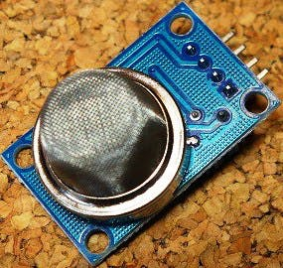
MQ-2 Sensor
The MQ-2 smoke sensor is sensitive to smoke and to the following flammable gases:
LPG, Butane, Propane ,Methane, Alcohol, Hydrogen
The resistance of the sensor is different depending on the type of the gas.
The smoke sensor has a built-in potentiometer that allows you to adjust the sensor sensitivity according to how accurate you want to detect gas.

Slide 6
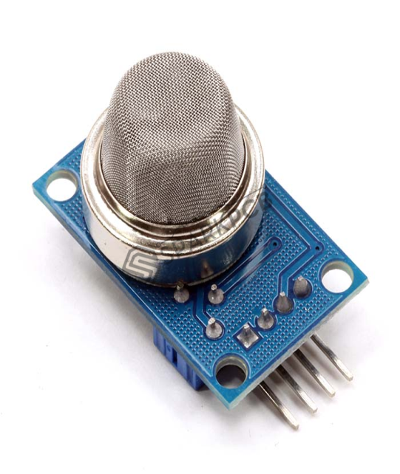
MQ135 GAS SENSOR
MQ135 Gas Sensor is an air quality sensor for detecting a wide range of gases, including NH3, NO, alcohol, benzene, smoke and CO2. Ideal for use in office or factory.
MQ135 gas sensor has high sensitivity to Ammonia, Sulfide and Benzene steam, also sensitive to smoke and other harmful gases.

Slide 7
INTERFACING WITH ARDIUNO:
Both MQ2 and MQ135 are similar in looks
Both have same pins:
A0-Analog pin
D0-Digital pin
GND-Ground
VCC-Power
MQ2 SENSOR and MQ135 SENSOR
VCC pin of the sensor to the 5V of the Arduino.
GND of the sensor to the GND of the Arduino.
Digital pin of the sensor D0 to the digital pin number 8 of the Arduino
Analog pin of the sensor to the analog pin A0 of the Arduino.

Slide 8
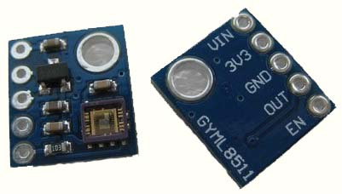
ultraViolet sensor-ML8511
The UV Sensor has 5 pins Vin, 3V3, GND, OUT, EN.
Some of the modules don’t have Vin pin which is not used too.
This sensor detects 280-390nm light most effectively.
It outputs an analog voltage that is linearly related to the measured UV intensity (mW/cm2).

Slide 9
INTERFACING WITH ARDIUNO:
EN and 3V3 pin – 3.3V of Arduino
3V3 pin – A1 of Arduino
OUT pin – A0 of Arduino
GND PIN – GND of Arduino
The UV Sensor ML8511 has Photodiode sensitive to UV-A and UV-B.
Then it has an internal Embedded operational amplifier which will convert photocurrent to voltage output depending on the UV light intensity.

Slide 10
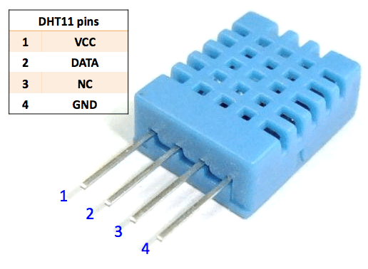
TEMPERATURE AND HUMIDITY SENSOR:
It has a resistive humidity component and a thermistor to measure the surrounding air.
Measurement Range
Humidity Accuracy
Temperature Accuracy
20-90%RH 0-50C
±5％RH
±2℃
GND pin
0V
VCC pin
Needs to be connected to VCC of Ardiuno
5V
D2
Pin is used to communicate between sensor and Ardiuno
DATA pin
Needs to be connected to GND of Ardiuno

Slide 11
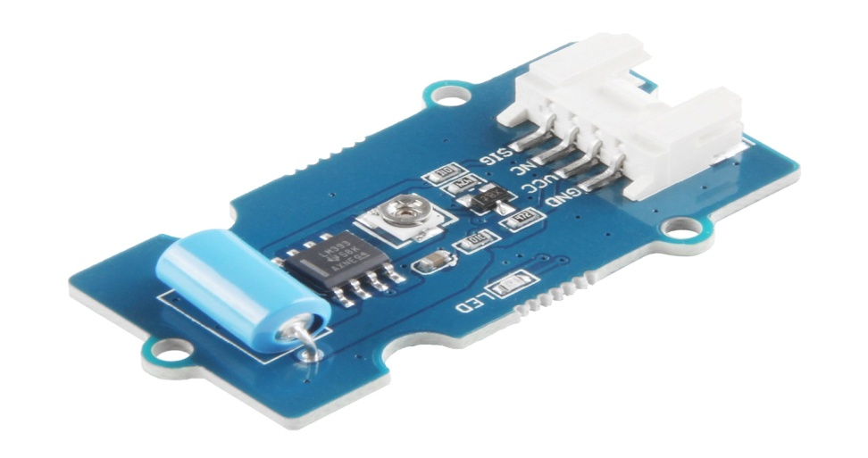
Vibration sensor:
SW-420 is a cost-effective vibration sensor module consists of SW-420 and Comparator LM393.
The module is embedded with an SW-420 Vibration Sensor, a 10K potentiometer to alter the sensitivity, and an LM393 comparator that produces a smooth digital output.

Slide 12
Block diagram:
ML8511
NODEMCU
ARDUINO UNO
MQ2 SENSOR
DHT11
CLOUD
VIBRATION SENSOR
BUZZER
POWER SUPPLY

Slide 13
THANK YOU
By,
Kavshiya K

