Slide 1


SALEM COLLEGE OF ENGINEERING AND TECHNOLOGY
Signs With Connectivity for Better Road Safety
Presented by,
Saranya B
Sandhiya P
Santhiya S
Kariyaraman R
Sakthikala K

Slide 2
OBJECTIVES
Introduction
Exisiting Problem
Proposed Solution
Communication Systems
Functional Requirements
Non-Functional Requirements
Data Flow Diagrams
Technical Architecture
JIRA
Advantages
Disadvantages
Conclusion
Future Scope

Slide 3
Introduction
The aim of the model is to prevent the collision of vehicles by using ultrasonic sensor interfaced with Arduino UNO.
The ultrasonic system is used to calculate the distance between the vehicle and the obstacle, then the Arduino microcontroller is used to process the signal and to prevent collision using the auto speed reduction system.
The proposed system comprises an idea of having safety while driving.
By the study on ultrasonic sensor, we come to know that it uses the sonar waves to calculate the accurate distance between two objects.

Slide 4
Exisiting Problem
Over the years, it has been evolved to modern transportation systems such as road, train, an air transportation.
With the development of technology, intelligent transportation systems have been enriched with Information and Communications Technology (ICT).
Nowadays, smart city concept that integrates ICT and Internet-of-Things (IoT) have been appeared to optimize the efficiency of city operations and services.

Slide 5
Proposed Solution
A future trend in intelligent transportation systems is “smart road signs” that incorporate smart codes (e.g., visible at infrared) on their surface to provide more detailed information to smart vehicles.
Such smart codes make road sign classification problem aligned with communication settings more than conventional classification.
This enables us to integrate well-established results in communication theory.
e.g., error-correction methods, into road sign classification problem.

Slide 6
Communication Systems
Many times, in the road accidents, human lives will be lost due to delayed medical assistance. Hence road accident deaths are more prominent.
There exist many accident prevention systems which can prevent the accidents to certain extent, but they do not have any facility to communicate to the relatives in case accident happens.
In this paper, the authors made an attempt to develop a car accident detection and communication system which will inform the relatives, nearest hospitals and police along with the location of the accident.
In the last they concluded that, Smart Road accident and communication system has been developed. Experiments have been conducted by implementing the system in a toy car.
It is observed that the system is working properly.

Slide 7
Functional Requirements
FR No. | Functional Requirement (Epic) | Sub Requirement (Story / Sub-Task)
FR-1 | User Visibility | Signs boards should be made with LED’s which are bright colored and are capable of attracting the drivers attention but it should also not be too distracting or blinding cause it may lead to accidents.
FR-2 | User Understanding | For better understanding of the driver ,the signs should bebig ,clear and legible and it can also include illustration which will make it easily understanding to the drive .
FR-3 | User Convenience | The display should be big enough that it should even be visible from far distance clearly.

Slide 8
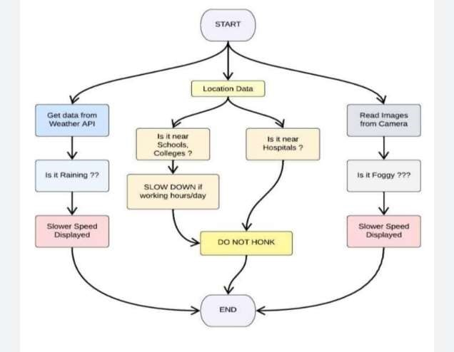
Data Flow Diagrams
D
ata flow
:
diagrams

Slide 9
Non-Functional Requirements
FR No. | Non-Functional Requirement | Description
NFR-1 | Usability | It should be able to upgrade when there is a need for it.
NFR-2 | Security | It should have good security so that no other person is able to hack and display their own directions.
NFR-3 | Reliability | It should be able to display to
 |  | information correctly and error– free.
NFR-4 | Performance | It should be able to automatically update itself when a certain weather or traffic problem occurs.
NFR-5 | Availability | It should be available 24/7 sothat it can be beneficial to the customer i.e .the driver
NFR-6 | Scalability | It should be able to easily changed and upgrade according to change and need in requirement

Slide 10
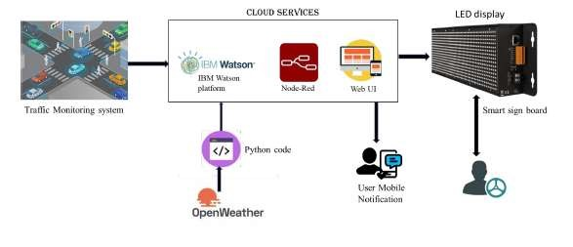
Technical Architecture

Slide 11
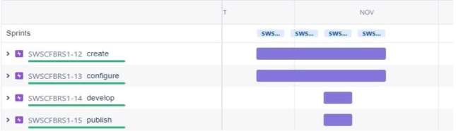
JIRA

Slide 12
Advantages
Monitor the Traffic
Used to keep in check over speeding drivers
Helps people to change direction when under a time constraint
Ensure safety of drivers and passengers
Helps in finding the number of passengers in a vehicle so as to maintain the convert limitfor passenger
Helps in supervising the roads and catch criminals

Slide 13
Disadvantages
It times of complete shutdown , Inverts cannot be used for every single.
Sometimes malfunctioning or even hacking can be done

Slide 14
Conclusion
This project will be very helpful and it is a very necessary project which will reduce a whole lot of accidents and save lines this project can be used by the government to improve road safety

Slide 15
Future Scope
The population of the world just become 8 billion so as the population
Grows the numbers of people in metropolitan cities increase which in turn leads to a lot of people using cars and roads .
Hence ,roads should be safe for the people to use .
The scope for this project will skyrocket in the coming years this project also is very flexible that is a lot of new ideas can be added to this base idea.

Slide 16
THANKING YOU

