Slide 1
Cloud computing based on plasma donation application
Present by
Gnana abina
Ashika c
Indhuja m
Geetha m

Slide 2
CONTENTS:
❖INTRODUCTION
❖OBJECTIVE
❖EXISTING METHOD
❖PROPOSED METHOD
❖DATAFLOW DIAGRAM
❖MODULES
❖RESULT
❖ FUTURE ENHANCEMENT
❖CONCLUSION

Slide 3
INTRODUCTION 1.1PROJECT OVERVIEW In a plasma-only donation, the liquid portion of the donor’s blood is separated from the cells. Blood is drawn from one arm and sent through a high-tech machine that collects the plasma. The donor’s red blood cells and platelets are then returned to the donor along with some saline. 1.2 PURPOSE The most common uses of plasma donations include individuals who have experienced a severe trauma, burn or shock, adults or children with cancer, and people with liver or clotting factor disorders.

Slide 4
Objective
Source plasma and recovered plasma are used to produce therapies that treat people with rare, chronic diseases and disorders such as primary immunodeficiency, hemophilia and a genetic lung disease, as well as in the treatment of trauma, burns and shock.

Slide 5
2.LITERATURE SURVEY 2.1 EXISTING PROBLEM “Donation is completely painless and harmless. There is no risk at all. You can do it every 15 days because we usually don’t take out any blood from you. The red blood cells are filtered and put back into your arteries. 2.2 REFERENCES 1.Safe blood and blood products. Module 1: Safe blood donation. Geneva: World Health Organization; 2002. [17 August 2012]. http://www​.who.int/bloodsafety​/transfusion_services​/bts_learningmaterials​/en/index.html. 2.Blood donor selection. Guidelines on assessing donor suitability for blood donation. Annex 3. Geneva: World Health Organization; 2012. [17 August 2012]. http://www​.who.int/bloodsafety​/voluntary_donation​/blood_donor​_selection_counselling/en/ [PubMed] 3.Aide-mémoire. Blood safety. Geneva: World Health Organization; 2002. [17 August 2012]. http://www​.who.int/bloodsafety​/publications​/who_bct_02_03/en/index.html. 4.WHO/IFRC. Towards 100% voluntary blood donation: A global framework for action. Geneva: World Health Organization; 2010. [17 August 2012]. http://www​.who.int/bloodsafety​/publications​/9789241599696/en/ [PubMed] 2.3 PROBLEM STATEMENT DEFINITION plasma donation is safe for healthy adults. There’s no risk of contracting disease. New, sterile equipment is used for each donor. Some people may feel nauseous, lightheaded, or dizzy after donating blood.

Slide 6
DISADVANTAGES 1.Bruising. When you donate blood, you sit or lie on a reclining chair with your arm extended on an armrest. … 2.Continued bleeding. … 3.Dizziness, lightheadedness, and nausea. … 4.Pain. … 5.Physical weakness. … 6.Time-consuming. … 7.But donating blood can do a lot o

Slide 7
Proposed meathod
A needle is placed into a vein in your arm. Plasma is collected through a process call plasmapheresis and is conducted in cycles that may take up to an hour. Whole blood is drawn. The plasma is separated from the red blood cells and other cellular components

Slide 8
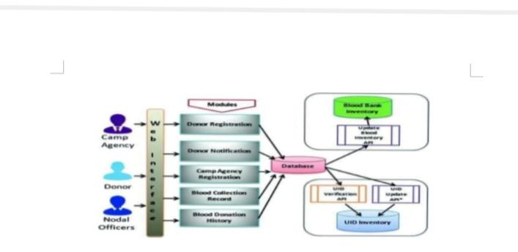
Block DIAGRAM

Slide 9
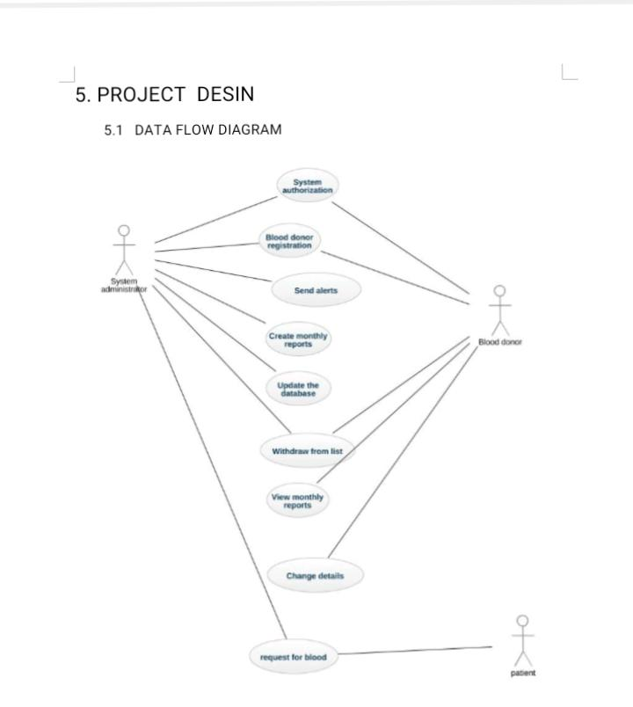
Data flow diagram

