Slide 1
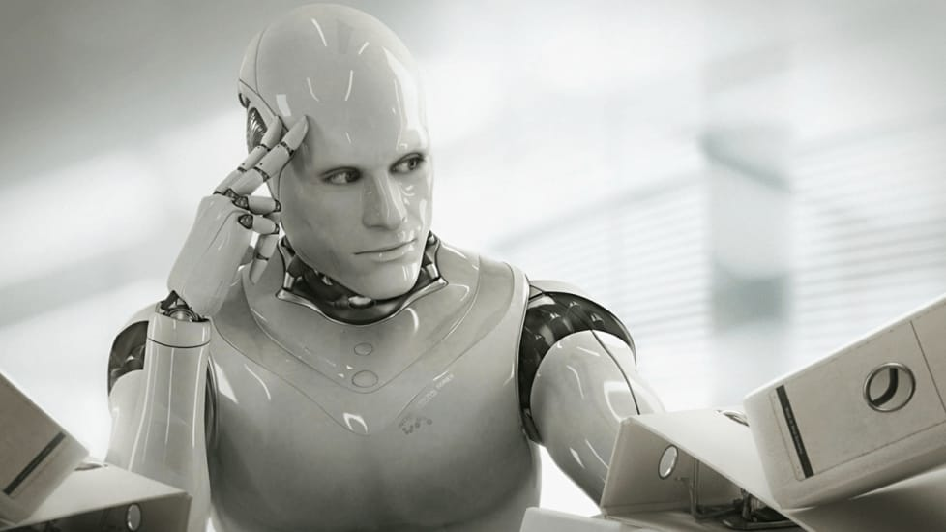
Empathy Map Towards our project
What are the project's major risks in terms of time and costs?
Have I cast the right people for the project?
How can I keep track of the project’s progress?
What do they
THINK AND FEEL?
What really counts
Major preoccupations
Worries & aspirations
What are the most critical obstacles or constraints?
What happens if the project isn't successful?
What areas should the team focus on the most for this particular project?
How will the project impact our friendship?
What are the most important decisions that the team needs to make for this project?
DEEPAABISHEK.P.K
MADHAVAN.V
JEGADISH.M
How Might Our Project Evolve over Time?
ASHWINKRISHNA.M
What do they
HEAR?
What friends say
What boss say
What influence say
Are there any other topics to talk about?
What do they
SEE?
Environment
Friends
What the market offers
Who Will Benefit From Your Project?
Will I be a burden to the team
I hope I don't hold back my teammates from their potential
What technologies and tools can the team use to complete this project?
Do We Need Specific Information or Advice?
What are the changes can we bring to the project
What is the
THOUGHTS ON AI
AI doesn't have to be evil to destroy humanity
It seems probable that once the machine thinking method had started, it would not take long to outstrip our feeble powers
The coming era of Artificial Intelligence will not be the era of war, but be the era of deep compassion and non-violence
Some people worry that artificial intelligence will make us feel inferior
PAIN
Fears
Frustration
obstacles
GAIN
Wants/needs
Measures of success
obstacles
Sometimes I find that I'm lacking on something
I should be able to blend in with my communication skills
I can do better on some occations
Am I contributing enough for the team?
I would be more confident from here on
I will use the skills I've gained only for good purposes
Will I be criticized by my teammates for my inability
I can make many projects in future without fear.

