Slide 1



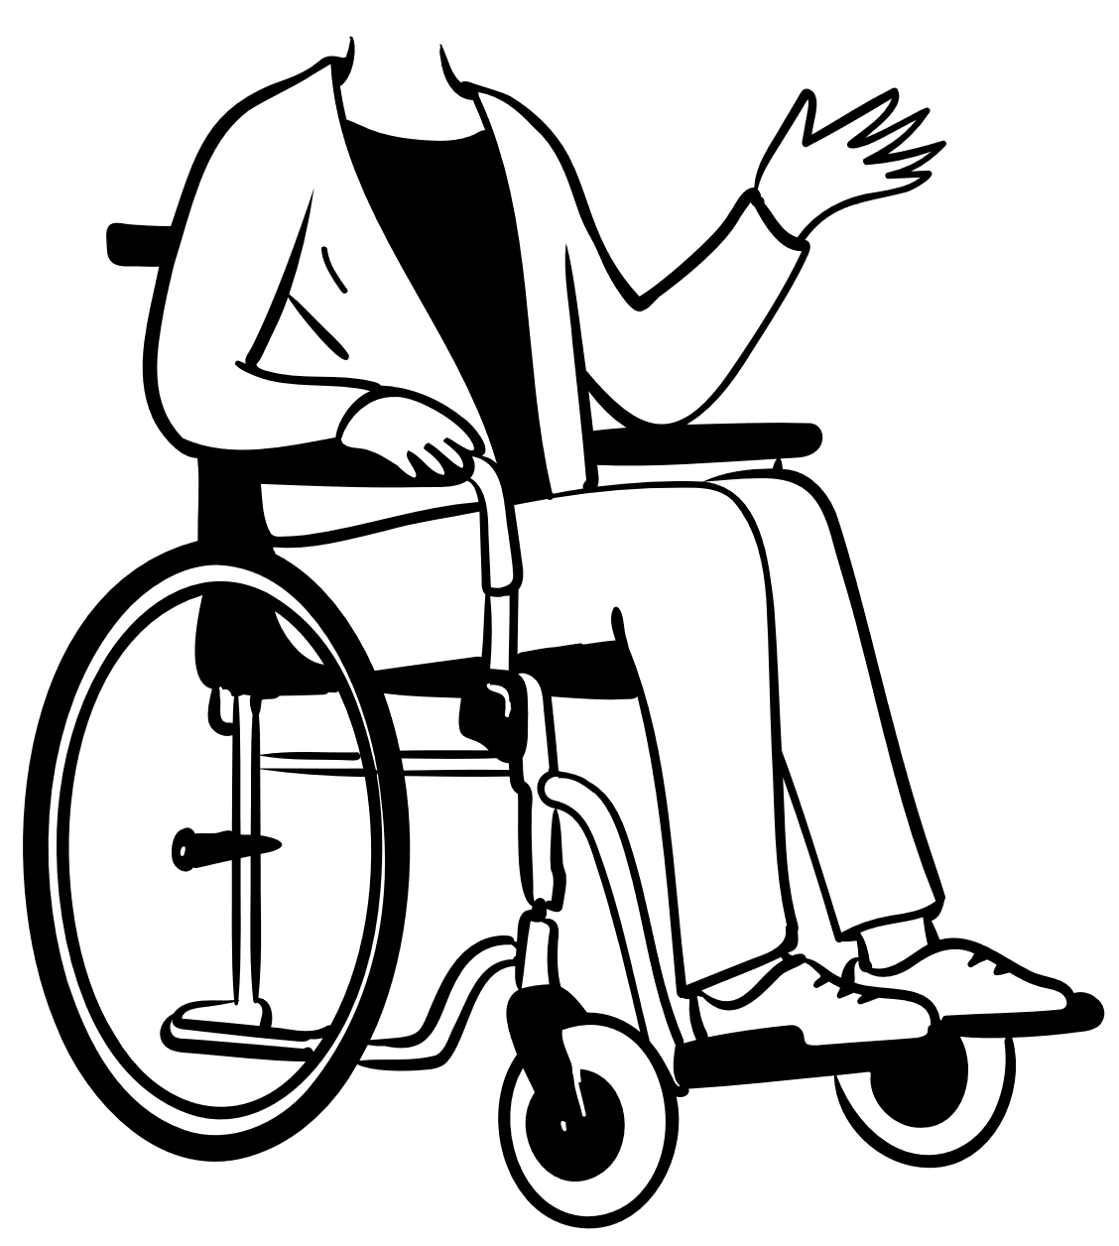
PERSONAL ASSISTANCE FOR SENIOR’S WHO ARE SELF RELIANT

Slide 2
TEAM MEMBERS
MOMIN SHAFI – 1904092
NITHIN BALAJI K S – 1904098
NITTISH J – 1904099
PRVAEEN RAJ S R –1904103

Slide 3
PROBLEM STATEMENT
Today, most people can expect to live into their seventies and beyond. According to the United Nations, the number of people aged 60 years or older is projected to grow by 56 percent worldwide by 2030.
Our health and well-being lie at the center of this massive shift in demographics. Many of these people will have physical impairments (loss of hearing, eyesight or mobility) or dementia or Alzheimer’s and need an increasing amount of care.

Slide 4

EXISTING SOLUTION
Karantis360 is an automated personal monitoring and alerting system, using intelligent, wirelessly linked to a discreet, mobile device which sends reports and alerts to carers and family members.
It has been developed specifically to promote independent, home living for the elderly, infirm, those living with Alzheimer’s or dementia and to enable early release from hospital for other clients where monitoring is required.
Using a non-intrusive system of sensors, machine learning and automatic data communication, Karantis360 flags exceptions to routines and habits, such as whether your client has got out of bed, is sitting in a chair, has boiled the kettle and so on.
By analysing activity data and comparing it to expected patterns, the system identifies when your client’s activity is out-of-the-ordinary and sends you an immediate alert, so you can respond quickly and effectively to any potential emergency.

Slide 5
INFERENCE FROM EXISTING SOLUTION
It is a totally new development in assisted living, designed to help you transform delivery of care for your elderly or infirm clients and those living with Alzheimer’s and/or dementia.
Allows clients to stay in their own home promotes safe independent living, leading to happier and healthier cared-for individuals.
Enables you to deliver a higher quality of care provides immediate information, plus client facts, so your carers can react quickly and appropriately, every time.
Improves transparency and accountability keeps you, your staff and family members fully informed, addressing one of the key issues in elderly care today.
Reduces your costs maximises prioritisation and deployment of carers; improves management processing; saves you time and money.
Frees your time for caring reduces the admin burden, thus freeing up time for you and your staff to put the personal caring back into care provision.
And if you’re in the NHS or a provider of hospital services you’ll be able to free-up beds earlier, with the assurance that patients can be monitored at home, reducing costs and helping you meeting waiting time and other KPIs.

Slide 6
YOUR IDEA
Sometimes elderly people forget to take their medicine at the correct time.
They also forget which medicine He / She should take at that particular time.
And it is difficult for doctors/caretakers to monitor the patients around the clock. To avoid this problem, this medicine reminder system is developed.
An app is built for the user (caretaker) which enables him to set the desired time and medicine. These details will be stored in the IBM Cloudant DB.
If the medicine time arrives the web application will send the medicine name to the IoT Device through the IBM IoT platform.
The device will receive the medicine name and notify the user with voice commands.

