Slide 1

Continual Learning Long Short Term Memory
Qinghan Xue, Xiaolong Wang, Steven Eliuk
-- Record ID: 96168934
-- Global Chief Data Office (GCDO)

Slide 2
Continual Learning
Performance decreasing of deep models on previous tasks while learning new tasks
2018
data 1
2019
data 2

Slide 3
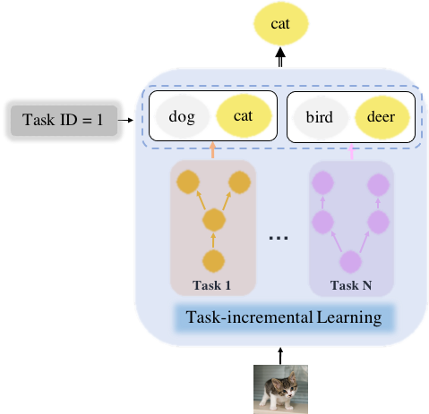
Continual Learning (Cont.)
Need task id during the inference process

Slide 4

Continual Learning in NLP
Prior works adapt Finetune, Learning Without Forgetting (LWF), Elastic Weight Consolidation (EWC) from Computer Vision field
They are not initially designed for sequential data
https://colah.github.io/posts/2015-08-Understanding-LSTMs/

Slide 5
Limitations
Finetune, EWC, LWF
Parameters side
Lots of human designed parameters
How to decide the percentage of keeping the old information
Loss function side
how to keep consistency and good performance if tasks are different
Model structure side
network structure needs to be same (except the last layer)
Experiments listed in the later slides

Slide 6
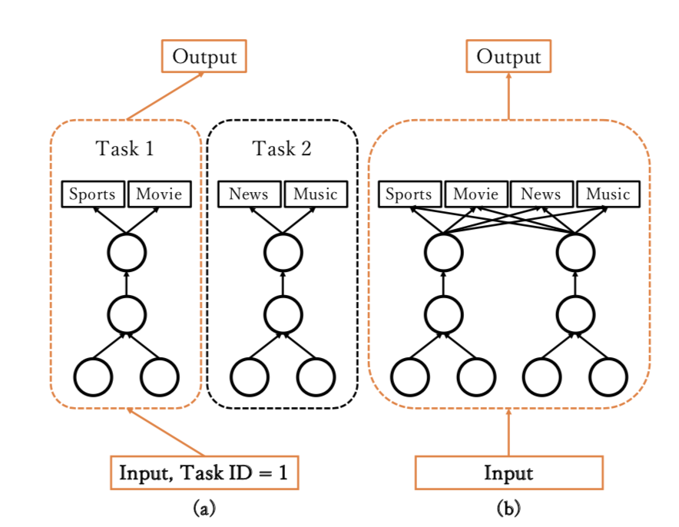
Our Inventions
A novel Continual Learning Long Short Term Memory (CL-LSTM) cell is proposed to prevent catastrophic forgetting
Less parameter settings, no need to have the uniform network, incrementally learn the correlations even if tasks are different
It doesn’t require task IDs to perform inference, which is more practical in real-world scenarios

Slide 7
Continual Learning LSTM
Contribution 1:
Continual Learning LSTM: Design continual learning module at LSTM cell level
h_{out}^{(t)}
h₁^{(t-1)}
M₁
h₁^{(t)}
M₂^{b}
M₂^{c}
h₂^{(t-1)}
M₂
h₂^{(t)}
M₃^{b}
M₃^{c}
h₃^{(t-1)}
M₃
h₃^{(t)}
x^{(t)}

Slide 8
Continual Learning LSTM: 1st task
h_{out}^{(t)}
F
out₁
h₁^{(t-1)}
M₁
h₁^{(t)}
task: 1
x^{(t)}

Slide 9
Continual Learning LSTM: 2nd task
h_{out}^{(t)}
F
out₁
out₂
h₁^{(t-1)}
M₁
h₁^{(t)}
M₂^{b}
M₂^{c}
h₂^{(t-1)}
M₂
h₂^{(t)}
task: 2
x^{(t)}

Slide 10
Continual Learning LSTM: 3rd task
h_{out}^{(t)}
F
out₁
out₂
out₃
h₁^{(t-1)}
M₁
h₁^{(t)}
M₂^{b}
M₂^{c}
h₂^{(t-1)}
M₂
h₂^{(t)}
M₃^{b}
M₃^{c}
h₃^{(t-1)}
M₃
h₃^{(t)}
task: 3
x^{(t)}

Slide 11
Continual Learning LSTM: Test
h_{out}^{(t)}
F
out₁
out₂
out₃
Contribution 2:
h₁^{(t-1)}
M₁
h₁^{(t)}
M₂^{b}
M₂^{c}
h₂^{(t-1)}
M₂
h₂^{(t)}
M₃^{b}
M₃^{c}
h₃^{(t-1)}
M₃
h₃^{(t)}
task: ?
x^{(t)}

Slide 12
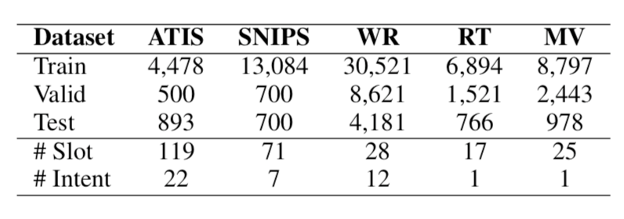
Experiments: Spoken Language Understanding
Evaluate on popular NLP datasets

Slide 13
Experiments: Spoken Language Understanding
Slot filling & intent detection: word/sentence classification
ground | transportation | in | phoenix
0 | 0 | 0 | B-city_name
atis_ground_service
Evaluation metrics:
Slot filling: F1 score
Intent detection: classification accuracy
Overall: semantic accuracy
Exemplars: 50 ~ 500

Slide 14
Experiments: Spoken Language Understanding
Slot filling & intent detection: word/sentence classification
Evaluation metrics:
Slot filling: F1 score
Intent detection: classification accuracy
Overall: semantic accuracy
Exemplars: 50 ~ 500
Report avg metrics over all tasks

Slide 15
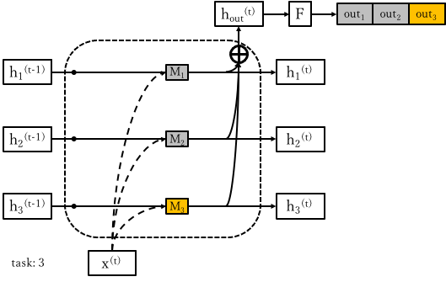
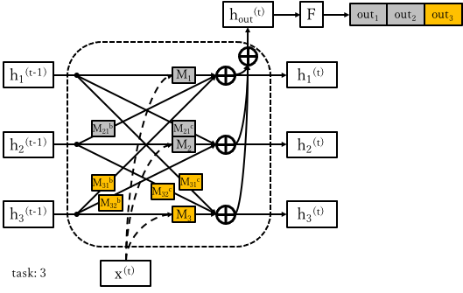
Revised Schema
CL-LSTM⁻
CL-LSTM⁺

Slide 16
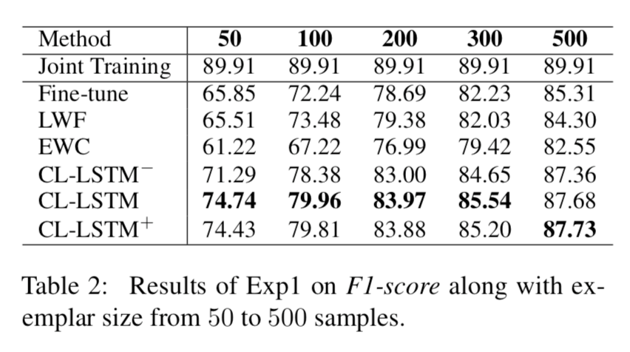
Experiments: Spoken Language Understanding

Slide 17
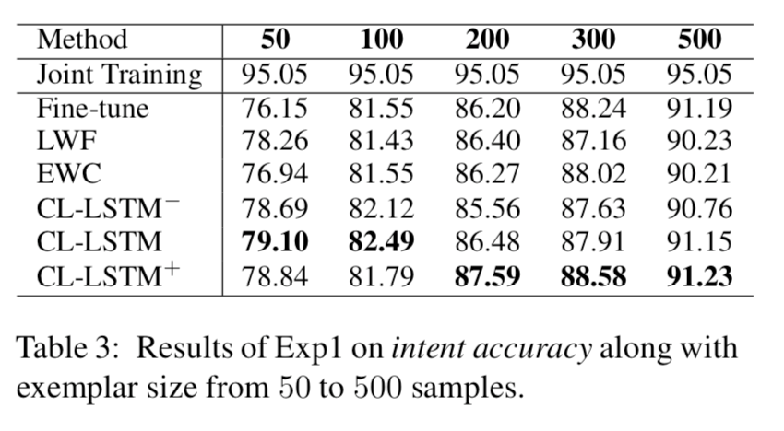
Experiments: Spoken Language Understanding

Slide 18
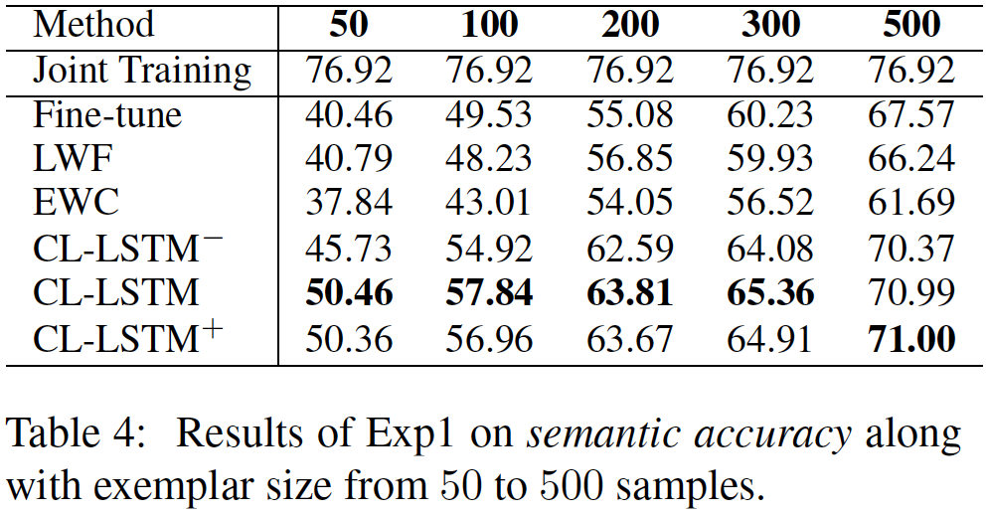
Experiments: Spoken Language Understanding

Slide 19
Continual Learning LSTM: Test
h_{out}^{(t)}
F
out₁
out₂
out₃
h₁^{(t-1)}
M₁
h₁^{(t)}
M₂^{b}
M₂^{c}
h₂^{(t-1)}
M₂
h₂^{(t)}
M₃^{b}
M₃^{c}
h₃^{(t-1)}
M₃
h₃^{(t)}
task: ?
x^{(t)}

Slide 20
Continual Learning LSTM: Test
h_{out}^{(t)}
F
out₁
out₂
out₃
h₁^{(t-1)}
M₁
h₁^{(t)}
M₂^{b}
M₂^{c}
h₂^{(t-1)}
M₂
h₂^{(t)}
M₃^{b}
M₃^{c}
h₃^{(t-1)}
M₃
h₃^{(t)}
task: ?
x^{(t)}

Slide 21
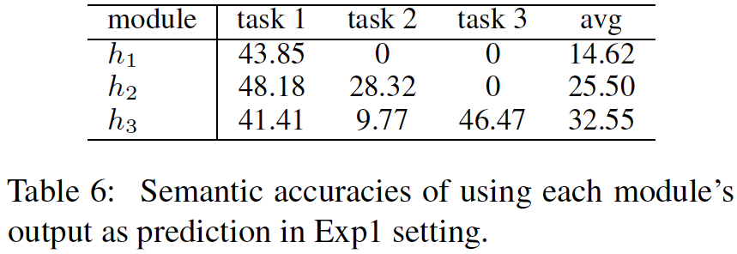
Experiments: Spoken Language Understanding
h_{out}: 50.46

Slide 22
Thanks for Your Attention!

