Slide 1
KAIROS-6G
KAIROS-6G
KPI-Aware Intelligent Reasoning for Operations and SUNRISE-6G
Evidence-grounded explainability layer for federated 6G experiments
Motivation • Architecture • Sustainability • Relevance

Slide 2
Motivation
Motivation: 6G experiments need explainable operations
Problem
Federated testbeds create heterogeneous workflows, telemetry, logs, and model artifacts.
Need
Operators must connect intent, workflow state, KPI deviations, and evidence.
KAIROS answer
Closed loop from operator intent to anomaly detection, memory, and explanation.
Core idea: convert noisy KPI streams into inspectable, repeatable, evidence-backed operational reasoning.

Slide 3
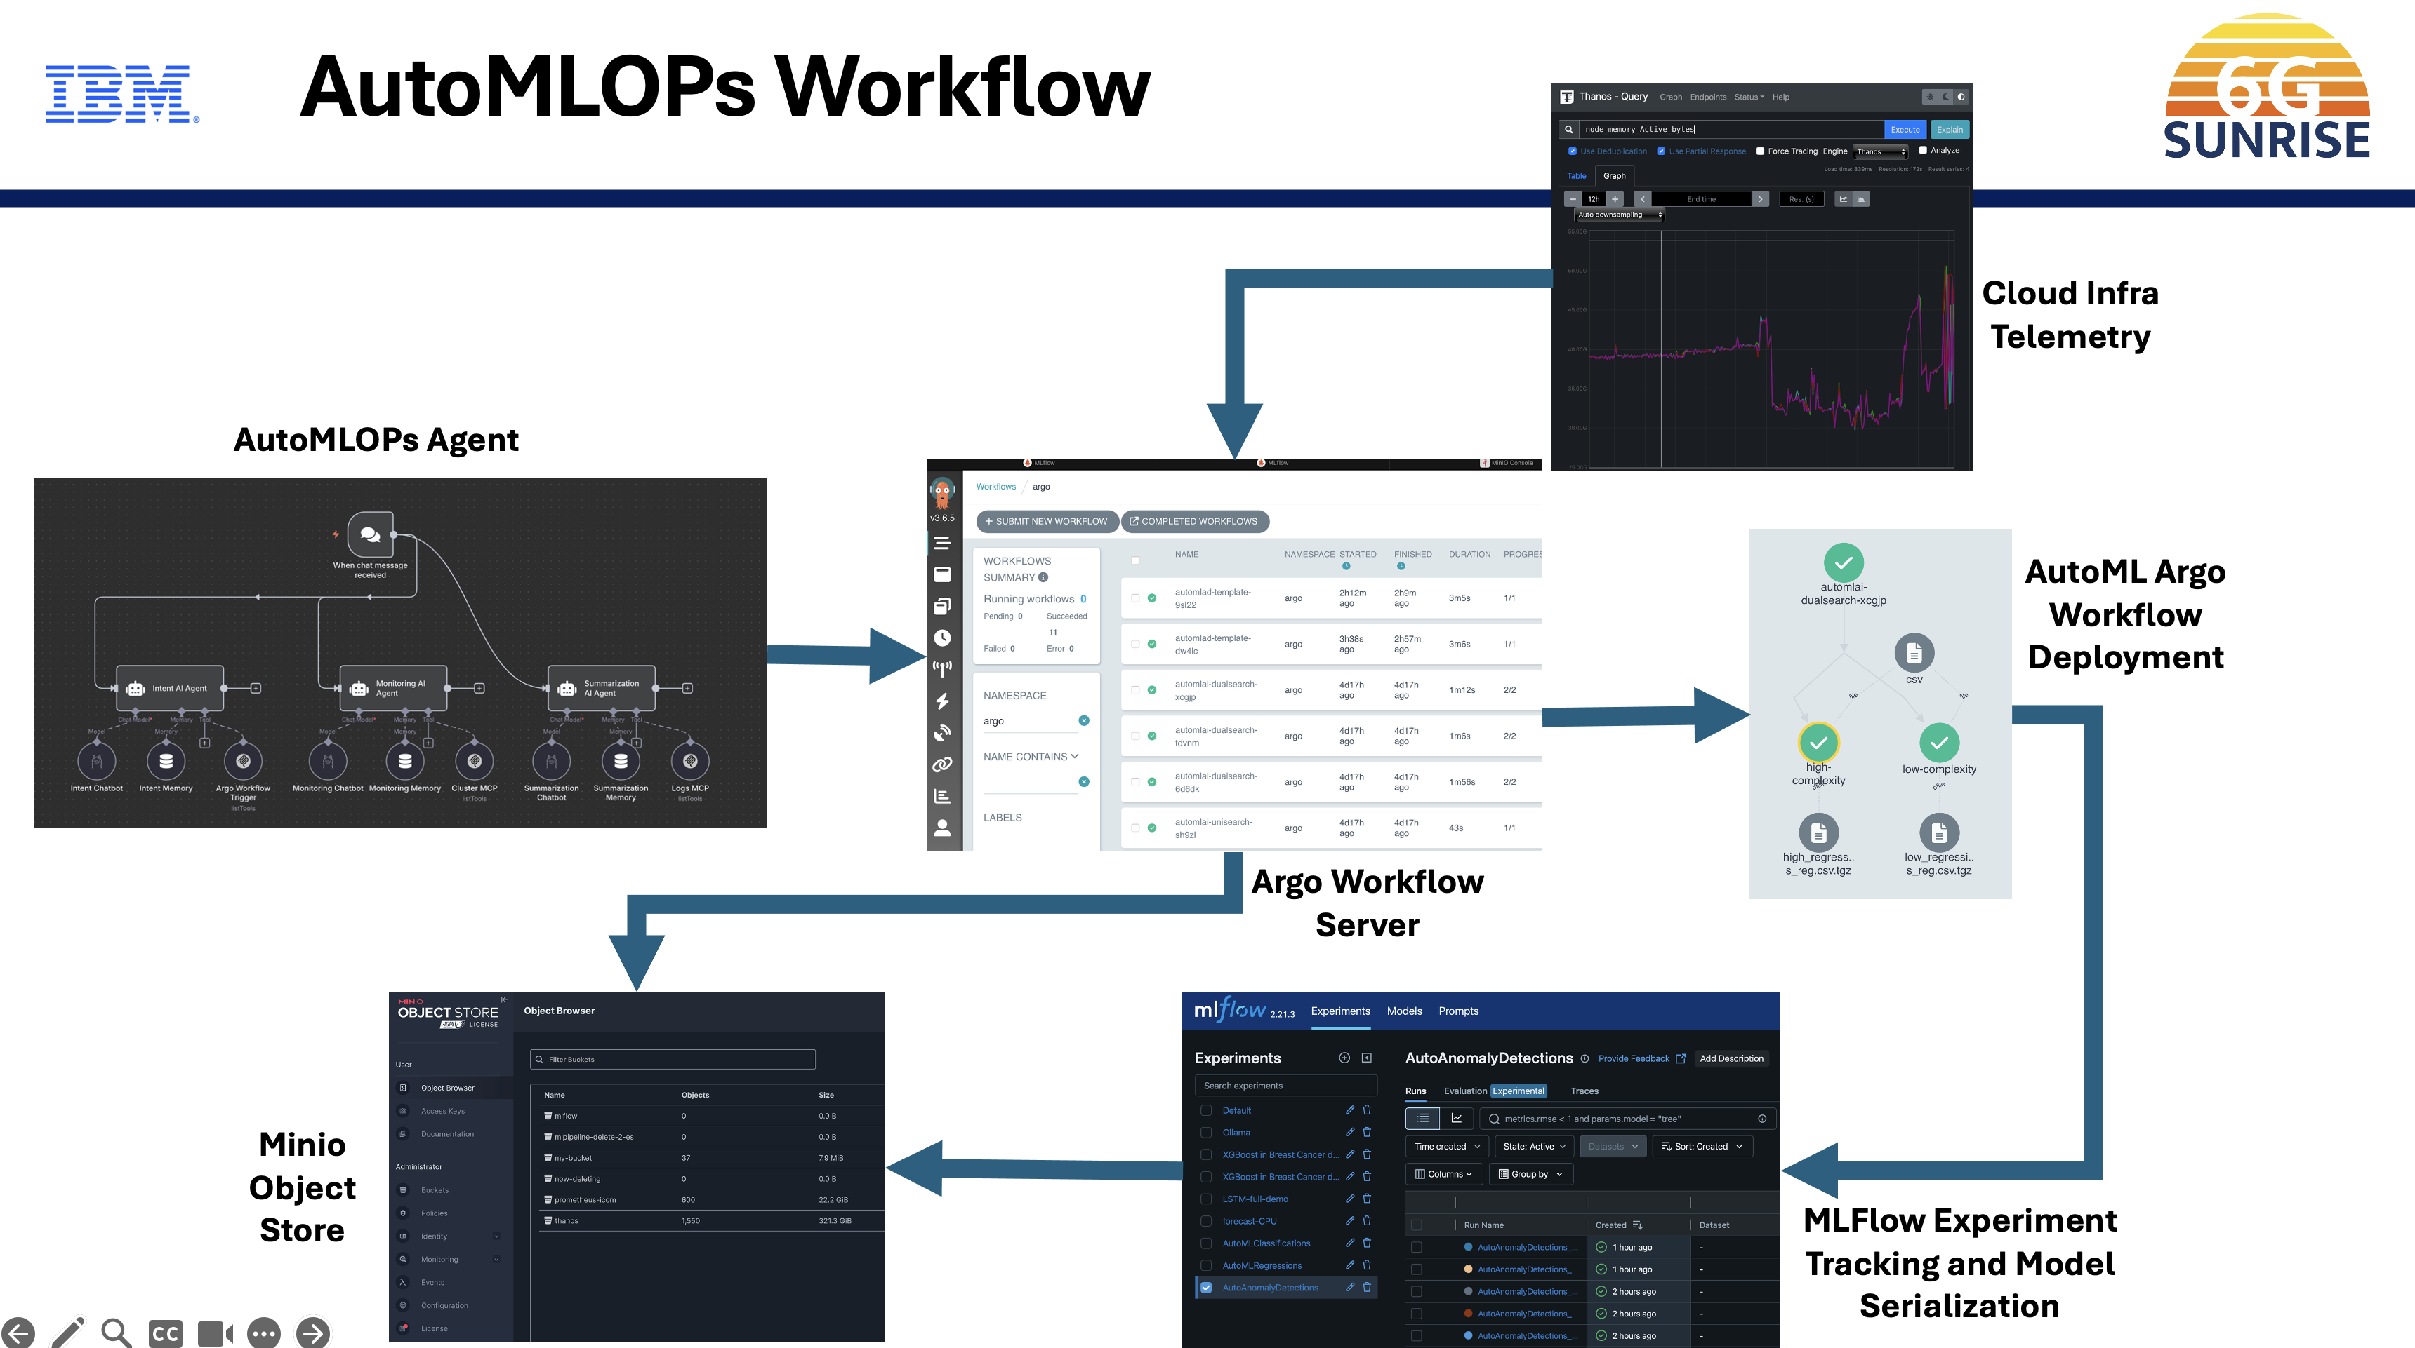

Slide 4
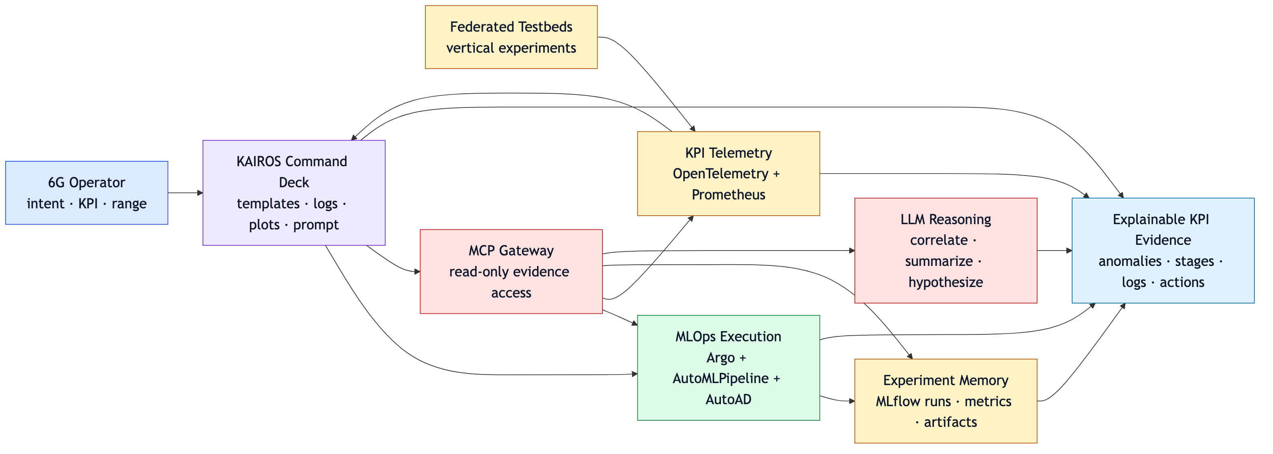
KAIROS-6G
KPI-Aware Intelligent Reasoning for Operations and SUNRISE-6G
Architecture: four planes connected by shared evidence
Interaction
Command deck
Execution
Argo + AutoML
Observability
OTel + Prometheus
Reasoning
LLM + MCP
Automation stays separate from explanation; identifiers and timestamps join workflow, KPI, anomaly, and MLflow evidence.

Slide 5
Evidence Loop
Evidence loop: from intent to explanation
Evidence loop: from intent to explanation
Closed-loop reasoning links workflow automation, KPI telemetry, anomaly detection, experiment memory, and trusted explanation.
2. Argo
workflow run
Intent
1. Intent
operator request
Argo
KPIs
AutoAD
MLflow
→
→
3. KPIs
telemetry traces
KAIROS
Reasoning Hub
↑
→
←
↓
LLM/MCP
explain
6. MCP + LLM
evidence answer
4. AutoAD
anomaly events
←
←
5. MLflow
experiment memory
AutoAD turns raw telemetry into anomaly events. MLflow preserves parameters, metrics, artifacts, and detector settings. MCP retrieves scoped evidence; LLM summarizes hypotheses, limits, and next checks.
Trust boundary: read-only evidence by default; workflow mutations require explicit operator approval.
Trust boundary: read-only evidence by default; mutating actions stay approval-gated.

Slide 6
Sustainability and Relevance
Sustainability and relevance for SUNRISE-6G
For experimenters: faster diagnosis and clearer reports
Repeatable workflows replace one-off scripts
Evidence bundles support onboarding and troubleshooting
Cross-testbed comparison becomes practical
Redacted, attributed context supports trustworthy AI
Operational memory survives after demos finish
For testbeds: reusable recipes and comparable operations
For federation: shared knowledge base across lifecycle
Bottom line: KAIROS makes 6G operations inspectable, repeatable, reusable, and human-accountable.

