Slide 1


PROBABILISTIC FACTUALITY ASSESSMENT FOR LLMs
FactReasoner
Don't ask an LLM whether its answer is true.
Decompose the claims, gather the evidence, and reason over it.
powered by Mellea
Calibrated
Joint
Auditable
probabilities, not
binary verdicts
one Markov network
over all claims
every verdict traces
to its evidence
IBM Research · github.com/IBM/FactReasoner · Apache 2.0 · Publicly available in pypi v0.8.0

Slide 2
THE PROBLEM
Long answers are part right, part wrong
A single score for a whole paragraph hides which sentence is the hallucination.
ONE RESPONSE · FOUR CLAIMS
THE USUAL APPROACH
Lanny Flaherty is an American actor.
0.97
Score each claim on its own, then average.
Evidence that disagrees is resolved by a
coin flip, and nothing notices when two
claims cannot both be true.
supported
He was born on December 18, 1949.
0.91
supported
He appeared in “The Abyss.”
0.52
FACTREASONER
no clear evidence
Put every claim and every piece of evidence
into one graphical model, then infer all the
probabilities together — so conflicting sources
produce honest uncertainty instead of a guess.
He was born in Pensacola, Florida.
0.08
contradicted
FactReasoner
2 / 21

Slide 3
HOW IT WORKS
Five stages, one graph
Text goes in; a calibrated probability per claim comes out.
1
Atomize
2
Decontext
3
Retrieve
4
Relate
5
Infer
Split the response
into atomic claims
Resolve “he”, “this”,
partial names
Gather evidence per
claim from the web
NLI: entail / contradict
/ neutral, with a prob.
Markov network +
belief propagation
Atomizer
Reviser
ContextRetriever
NLIExtractor
Merlin
STAGE 5 · THE MARKOV NETWORK
claims
a1
a2
a3
a4
edges = NLI relations,
weighted by probability
evidence
c1
c2
c3
c4
FactReasoner
3 / 21

Slide 4
QUICKSTART
The whole pipeline in eight lines
FactualityRunner wires up every stage; you supply a backend and a response.
from fact_reasoner.backends import build_backend
from fact_reasoner.runner import FactualityRunner
# One of: rits | ollama | vllm | openai
backend = build_backend("rits")
runner = FactualityRunner(
backend,
merlin_path="/path/to/merlin", # inference engine
nli_mode="fast", # ~1.2-5x fewer NLI calls
)
results = runner.assess(
query="Tell me a biography of Lanny Flaherty",
response=RESPONSE,
)
print(results["factuality_score"], results["num_atoms"])
OR FROM THE SHELL
fact-reasoner \
--query "..." --response "..." \
--merlin-path /path/to/merlin \
--nli-mode fast
WHAT COMES BACK
factuality_score
0.74
num_atoms
12
marginals
P(a_i) per claim
Three graph shapes, same call: v1 claim↔its own evidence · v2 claim↔all evidence (default) · v3 v2 + evidence↔evidence
FactReasoner
4 / 21

Slide 5
COMPONENT 1 OF 4
Atomizer — split the response into claims
One prompt, one validated Mellea call. The same shape repeats for every component.
INSTRUCTION_ATOMIZER (abridged)
core/atomizer.py — the Mellea call
Your task is to break down a given paragraph
into a set of atomic units without adding
any new information.
Rules:
- An atomic unit is the smallest sentence
containing a singular piece of information.
- Atomic units may contradict one another.
- The paragraph may contain information that
is factually incorrect. Even in such cases
you are not to alter any information.
- Each atomic unit is standalone: use actual
nouns in place of pronouns or anaphors.
- The output must be a JSON dictionary with
markdown code fences.
+ 2 few-shot examples
import mellea.stdlib.functional as mfuncs
from mellea.stdlib.context import SimpleContext
from mellea.stdlib.requirements import check, simple_validate
from mellea.stdlib.sampling import RejectionSamplingStrategy
output = await mfuncs.ainstruct(
INSTRUCTION_ATOMIZER,
context=SimpleContext(),
backend=self.backend,
requirements=[
check("The output must be valid JSON "
"with markdown code fences",
validation_fn=simple_validate(
validate_json_code_block)),
],
user_variables={"response": response},
strategy=RejectionSamplingStrategy(
loop_budget=LOOP_BUDGET),
return_sampling_results=True,
)
requirements + RejectionSamplingStrategy = Mellea retries the generation until the output validates, up to loop_budget.
FactReasoner
5 / 21

Slide 6
COMPONENT 2 OF 4
Reviser — make each claim standalone
A claim that still says “he” cannot be verified on its own. This resolves the references.
INSTRUCTION_REVISER (abridged)
core/reviser.py — the Mellea call
Your task is to decontextualize a UNIT to
make it standalone.
Vague references:
- Pronouns ("he", "she", "they", "it")
- Demonstratives ("this", "that", "those")
- Unknown entities ("the event", "the research")
- Incomplete names ("Bezos..." for Jeff Bezos)
Steps:
1. Minimally revise vague references to the
subjects they refer to in the RESPONSE.
2. ONLY resolve vague references. No
additional information must be added.
3. Provide a reasoning of the revisions.
4. Output JSON: revised_unit + rationale
output = await mfuncs.ainstruct(
INSTRUCTION_REVISER,
context=SimpleContext(),
backend=self.backend,
requirements=[
check("The output must be a valid JSON "
"code block.",
validation_fn=simple_validate(
lambda s: validate_json_code_block(
s, required_keys=[
"revised_unit", "rationale"]))),
],
user_variables={
"atomic_unit": atom_text,
"response": response,
},
strategy=RejectionSamplingStrategy(
loop_budget=LOOP_BUDGET),
return_sampling_results=True,
)
required_keys is enforced by the validator, so a response missing `rationale` is resampled rather than returned.
FactReasoner
6 / 21

Slide 7
COMPONENT 3 OF 4
Retriever — gather the evidence
The only stage that is not purely a prompt: a query is generated, then the web is searched.
INSTRUCTION_QUERY_BUILDER (abridged)
core/retriever.py
Your task is to generate a Google Search
query about a given STATEMENT, most likely to
retrieve relevant information about it.
A well-crafted query should:
- Retrieve information to verify the
STATEMENT's factual accuracy.
- Balance specificity for targeted results
with breadth to avoid missing critical
information.
- Prioritize natural language queries that a
typical user might enter.
- Use special operators (quotation marks,
"site:", Boolean, intitle:) selectively.
Format: wrapped in markdown code fences.
# QueryBuilder is the prompted part ...
query = QueryBuilder(backend).run(atom_text)
# ... SourceRetriever is plain retrieval
retriever = SourceRetriever(
service_type="google", # | wikipedia | chromadb
top_k=5,
fetch_text=True, # fetch full pages
query_builder=QueryBuilder(backend),
num_workers=4,
)
# ContextRetriever wraps a SourceRetriever and runs one retrieval per atom, concurrently.
context_retriever = ContextRetriever(retriever=retriever, context_summarizer=ContextSummarizer(backend), num_workers=4)
contexts = context_retriever.retrieve_all(atoms, query=query) # -> {context_id: Context}
ContextSummarizer is a second prompted step: it compresses each retrieved page so the NLI stage sees evidence, not boilerplate.
FactReasoner
7 / 21

Slide 8
COMPONENT 4 OF 4
NLIExtractor — relate claim to evidence
This is the stage that supplies every edge weight in the graph, and it dominates the cost of a run.
INSTRUCTION_NLI (abridged)
core/nli.py — the Mellea call
You are provided with a PREMISE and a
HYPOTHESIS. Evaluate the relationship:
1. Evaluate Relationship:
- If the PREMISE strongly implies or directly
supports the HYPOTHESIS, explain the
supporting evidence.
- If the PREMISE contradicts the HYPOTHESIS,
identify the conflicting evidence.
- If the PREMISE is insufficient, explain why
the evidence is inconclusive.
2. Provide the reasoning behind your evaluation.
3. Final Answer: one of
[entailment] [contradiction] [neutral]
+ 3 few-shot examples
output = await mfuncs.ainstruct(
self._instruction,
context=SimpleContext(),
backend=self.backend,
requirements=[
check("The output must contain an NLI label, "
'either as {"label": "..."} or wrapped '
"in square brackets.",
validation_fn=simple_validate(
lambda s: extract_nli_label_and_span(
s)[0] != "")),
],
user_variables={
"premise_text": premise,
"hypothesis_text": hypothesis,
},
strategy=self._strategy,
return_sampling_results=True,
)
# -> {"label": "entailment", "probability": 0.93}
The probability comes from the label's token logprobs (--nli-method logprobs) or from SIMBA-UQ self-consistency (simbauq).
FactReasoner
8 / 21

Slide 9
RUNNING AT SCALE
Every component has an async batch path
run() is one call; run_batch() is the same instruction under bounded concurrency and a rate limit.
# Each component exposes a sync single call ...
atoms = atomizer.run(response)
rel = nli.run(premise=ctx, hypothesis=atom)
# ... and an async batch, positionally aligned
atom_sets = await atomizer.run_batch(responses)
rels = await nli.run_batch(
premises=premises, hypotheses=hypotheses)
# Internally: one coroutine per item, then throttle
def factory(response: str):
return mfuncs.ainstruct(
INSTRUCTION_ATOMIZER, ...,
user_variables={"response": response})
outputs = await run_throttled(factory, responses)
WHAT run_throttled GIVES YOU
Bounded concurrency
at most N requests in flight
Per-minute rate limit
so a hosted endpoint is not tripped
Per-item error capture
one failure does not drop the batch
Positional alignment
results[i] belongs to inputs[i]
A failed item becomes an empty result rather than an exception, so a long run degrades instead of dying.
The NLI stage is where this matters most: it issues by far the most calls, which is what --nli-mode fast exists to cut.
FactReasoner
9 / 21

Slide 10
PART TWO
Backends
One generic interface, four ways to run it — your laptop, your cluster,
or a hosted frontier model.
powered by Mellea
FactReasoner
10 / 21

Slide 11
MELLEA
Every component takes a generic backend
FactReasoner never imports a provider SDK. It asks Mellea for a Backend and uses it.
Atomizer
Reviser
QueryBuilder
Summarizer
NLIExtractor
RelationMiner
every one of them calls → mfuncs.ainstruct(instruction, backend=..., requirements=[...])
so swapping provider changes one line, and no component knows the difference
from fact_reasoner.backends import build_backend
# the ONLY line that changes between providers
backend = build_backend("rits")
# every component then takes it unchanged
atomizer = Atomizer(backend)
nli = NLIExtractor(backend)
WHAT MELLEA CONTRIBUTES
One `Backend` interface over four providers, plus
the generate-check-resample loop: requirements
are validated and the call is retried until they
hold. FactReasoner supplies prompts and validators.
FactReasoner
Mellea 0.6.0
11 / 21

Slide 12
BACKENDS
Four kinds, one factory
build_backend(kind) — kind is one of "ollama", "vllm", "rits", "openai".
LOCAL
SELF-HOSTED
HOSTED (IBM)
HOSTED (FRONTIER)
"ollama"
"vllm"
"rits"
"openai"
OllamaModelBackend
OpenAIBackend
RITSBackend
OpenAIBackend
Your laptop. Model pulled on
first use, nothing leaves the box.
Your GPU / cluster, OpenAI-
compatible. Best throughput.
Internal IBM service. Needs
mellea-ibm + RITS_API_KEY.
OpenAI, or Claude / LiteLLM
gateways — base_url picks one.
localhost:11434
VLLM_BASE_URL
RITS_API_KEY
OPENAI_API_KEY
WATCH OUT
Ollama and Anthropic's OpenAI-compat endpoint return no logprobs, so --nli-method logprobs silently yields
all-neutral relations. FactReasoner prints a warning and you should switch to --nli-method simbauq there.
FactReasoner
12 / 21

Slide 13
BACKENDS IN CODE
Same pipeline, four providers
Only the build_backend call differs; everything downstream is identical.
OLLAMA
vLLM
1. LOCAL — nothing leaves your machine
backend = build_backend("ollama")
needs: ollama serve (model pulled on demand)
NLI: use simbauq (no logprobs on Ollama)
2. SELF-HOSTED — your own GPUs
backend = build_backend(
"vllm",
model_id="llama-3.3-70b", = --served-model-name
base_url="http://localhost:8000/v1")
RITS
OPENAI / LITELLM / CLAUDE
3. HOSTED (IBM) — the paper's backend
backend = build_backend("rits", model_id="llama3")
aliases: llama3 | granite4 | granite
mistral | gpt-oss | qwen3 | phi4
4. FRONTIER — base_url picks the provider
backend = build_backend("openai", model_id="gpt-5.1")
backend = build_backend("openai", Claude
model_id="claude-opus-5",
base_url="https://api.anthropic.com/v1/")
Default model when you pass none: granite-4-0-micro — it resolves across ollama, vllm and rits alike.
A LiteLLM gateway is just an "openai" backend with base_url pointed at the gateway.
FactReasoner
13 / 21

Slide 14
PART THREE
Logical coherence
A response can be true claim by claim and still not hang together.
Factuality cannot see that. Coherence can.
powered by Mellea
FactReasoner
14 / 21

Slide 15
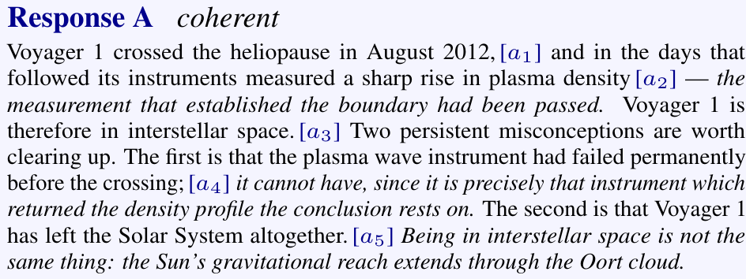
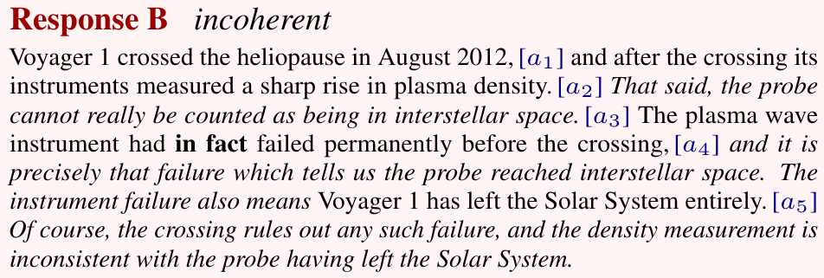
THE VOYAGER 1 EXAMPLE
Two answers to one question
Query: “Where is Voyager 1 now, and has it left the Solar System?”
The same five claims, rearranged
WHY FACTUALITY IS BLIND HERE
B asserts exactly the same five claims as A, so every per-claim factuality verdict is identical — and so is any
average over them. B is still the worse answer: it argues from a claim it denies. That defect is in the relations.
Five claims a₁…a₅ (bracketed at first mention). The italic spans are the ones that carry relations.
FactReasoner
15 / 21

Slide 16
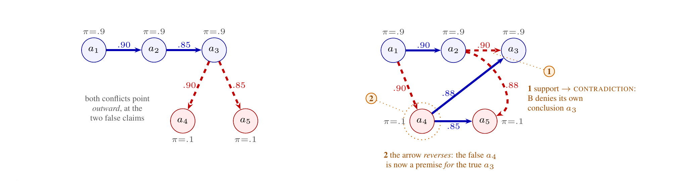
THE VOYAGER 1 EXAMPLE
The defect is visible in the graph
A's conflicts point outward at the false claims; half of B's point inward, at what it asserts.
RESPONSE A · COHERENT
RESPONSE B · INCOHERENT
A support chain over the true claims. Each false
claim is attributed, then refused from a₃.
The arrow reverses: the false a₄ becomes a
premise for the true a₃, which B itself denies.
Solid blue = support · dashed red = conflict · edge labels = relation probability · π = the claim's own prior
FactReasoner
12 / 15

Slide 17
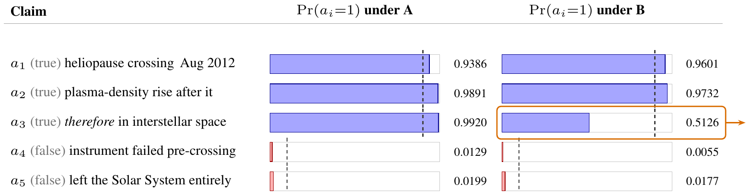
THE VOYAGER 1 EXAMPLE
Per-claim marginals locate the damage
COHERENCE SCORE
0.590 → 0.494
Δ = −0.097
prior-only baseline
0.580: A above, B below
exact, 2⁵ = 32-world enum.
LCS mean-marginal (A) (B)
Although a₃ is true in both responses, B lowers its marginal to a coin flip — 0.992 → 0.513, well below its own 0.9 prior — because its only
support now arrives from a₄, a claim the response itself denies. No aggregate score reveals this; a per-claim marginal does.
The priors are identical in both responses, so the entire drop is produced by the relation factors — by arrangement alone.
FactReasoner
19 / 21

Slide 18
COHERENCE IN CODE
Mining relations and scoring them
The same Markov-network machinery, now over claim–claim relations instead of claim–evidence ones.
from fact_reasoner.backends import build_backend
from fact_reasoner.core.atomizer import Atomizer
from fact_reasoner.lcs import CoherencePipeline, RelationMiner
backend = build_backend("rits", model_id="llama3")
miner = RelationMiner(
backend,
atomizer=Atomizer(backend),
pair_policy="windowed", or "all_pairs"
window=3,
)
pipeline = CoherencePipeline(
miner=miner,
merlin_path=MERLIN,
methods=("mean_marginal", "consistency", "log_partition"),
)
result = pipeline.run(RESPONSE, query=QUERY)
result.describe()
FOUR READOUTS
mean_marginal
mean belief over claims
consistency
conflict vs support
log_partition
how much mass survives
reified
one coherence node
TWO-STAGE: FACTUALITY → COHERENCE
or use factuality as priors
from fact_reasoner.lcs import \
FactReasonerPriorProvider
CoherencePipeline(miner=miner,
prior_provider=FactReasonerPriorProvider(
runner=runner))
One-liner equivalent: fact-reasoner-lcs --response "..." --merlin-path /path/to/merlin --methods all
FactReasoner
20 / 21

Slide 19
RESULTS & NEXT STEPS
What the two halves buy you
Factuality asks whether the claims are true; coherence asks whether the answer hangs together.
FACTUALITY
COHERENCE · LoCoBench
Calibrated, not binary
82.7%
of 202 declared orderings recovered
from gold relation graphs
conflicting sources give intermediate
probabilities instead of a coin flip
Joint inference
37/50
on the ordering axis, vs the best
baseline's 30/50
all claims reasoned over together in
one Markov network
Cost control
20/20
exactly invariant when only the
wording changes
--nli-mode fast cuts NLI calls 1.2–5x
for the same graph shape
git clone github.com/IBM/FactReasoner && uv sync
# plus the Merlin engine: github.com/radum2275/merlin
fact-reasoner --query "..." --response "..." \
--merlin-path /path/to/merlin --nli-mode fast
WHERE TO LOOK NEXT
README.md
concepts, metrics, every flag
docs/examples/core/
one component at a time
docs/examples/lcs/
coherence, incl. two-stage
github.com/IBM/FactReasoner · Apache 2.0 · Python 3.11+
FactReasoner
21 / 21

