Slide 1

Kubeflow Repositories

Slide 2
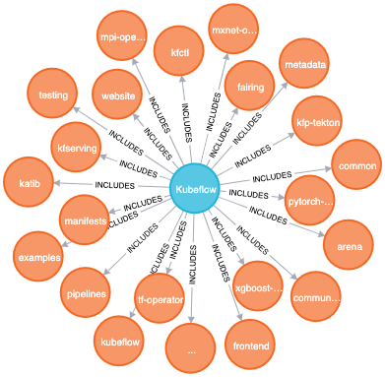
Overview of Kubeflow Repositories
Kubeflow is an open, community driven project to make it easy to deploy and manage an ML stack on Kubernetes
https://kubeflow.org
Kubeflow org (github.com/kubeflow) is a collection of many repositories

Slide 3
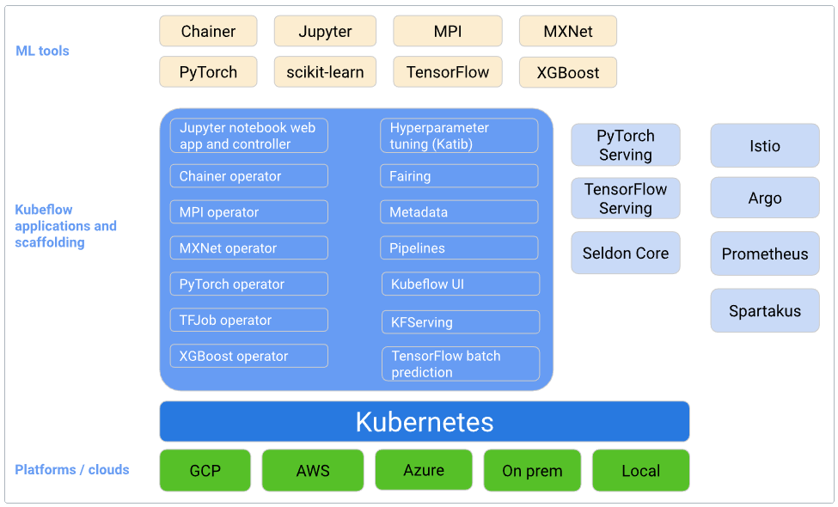
Overview of Kubeflow Repositories
https://www.kubeflow.org/docs/started/kubeflow-overview/

Slide 4
Overview of Kubeflow Repositories
kubeflow – machine learning toolkit for Kubernetes
Main repo, provides access management, central dashboard, jupyter web app, notebook controller, profile controller and more cloud native deployments and services
website – Kubeflow’s public website
Documentation, source code for https://www.kubeflow.org/
community – information about the Kubeflow community including proposals and governance information
examples – a repository to host extended examples and tutorials
end-to-end, component-focused and demos
code-intelligence – ML-powered developer tools, using Kubeflow
manifests – a repository for Kustomize manifests
Kubeflow installs with Kustomize, this repo provides KfDef manifests containing the Kustomize applications
kfctl – a CLI for deploying and managing Kubeflow
Build, deploy and manage Kubeflow
Kubeflow Operator

Slide 5
Overview of Kubeflow Repositories
metadata – repository for assets related to Metadata
Tracking and managing metadata of machine learning workflows
Includes info about executions, models, datasets and other artifacts
testing – test infrastructure and tooling for Kubeflow
common – common APIs and libraries shared by other Kubeflow operator repositories
Common controller code helpers for operators generated by kube-builder or operator-sdk
frontend – repository for Kubeflow frontend
pipelines – machine learning pipelines for Kubeflow
Reusable end-to-end ML workflows built using the Kubeflow Pipelines SDK
Workflow engine through Argo, Pipelines SDK and UI
kfp-tekton – experimental project exploring Tekton and KFP integration
Kubeflow Pipelines with Tekton

Slide 6
Overview of Kubeflow Repositories
tf-operator – tools for ML/Tensorflow on Kubernetes
mpi-operator – Kubernetes operator for allreduce-style distributed training
mxnet-operator – a Kubernetes operator for mxnet jobs
pytorch-operator – tools for ML/Tensorflow on Kubernetes
katib – repository for hyperparameter tuning
fairing – Python SDK for building, training, and deploying ML models
kfserving – serverless inferencing on Kubernetes
Others

