Slide 1
Lale.JL: Library for Automated Machine Learning
https://github.com/ibm/Lale.jl
Paulito Palmes, Kiran Kate, Martin Hirzel, Avi Shinnar

Slide 2
AutoML: Automated Machine Learning
Inspiration
Planned pipeline (some choices of operators and hyperparameters are still free)
generate
Search space (optimizers: GridSearchCV, Hyperopt, SMAC, …)
edit
acquire
Data Scientist
Trainable pipeline (all choices of operators and hyperparameters are bound)
decode
Point in search space
train
loop
Trained pipeline (learnable coefficients are bound)
evaluate
Metrics

Slide 3
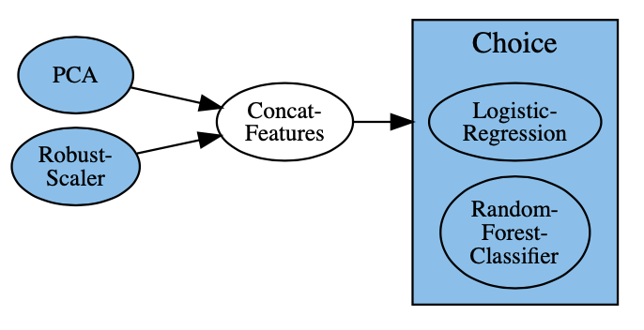
AutoML with Lale.jl
planned_pipeline = (PCA & RobustScaler)
>> ConcatFeatures
>> (LogisticRegression | RandomForestClassifier)
visualize(planned_pipeline)
Inspiration
Planned pipeline (some choices of operators and hyperparameters are still free)
edit
Data Scientist
pipeline combinators | op3 = op1 >> op2 | pipe (add dataflow edge)
 | op3 = op1 & op2 | union (no added edge)
 | op3 = op1 | op2 | choice (AutoML picks one)

Slide 4
AutoML with Lale.jl
optimizer = LalePipeOptimizer(planned_pipeline, max_evals=10, cv=3)
opt_trained = fit(optimizer, train_X, train_y)
predictions = predict(opt_trained, test_X)
accuracy = score(:accuracy, predictions, test_y)
Planned pipeline (some choices of operators and hyperparameters are still free)
generate
Search space (optimizers: GridSearchCV, Hyperopt, SMAC, …)
acquire
Trainable pipeline (all choices of operators and hyperparameters are bound)
decode
Point in search space
train
loop
Trained pipeline (learnable coefficients are bound)
evaluate
Metrics

Slide 5
AutoML with Lale.jl
planned_pipeline = (PCA & RobustScaler)
>> ConcatFeatures
>> (LogisticRegression | RandomForestClassifier)
visualize(planned_pipeline)
pipeline combinators | op3 = op1 >> op2 | pipe (add dataflow edge)
 | op3 = op1 & op2 | union (no added edge)
 | op3 = op1 | op2 | choice (AutoML picks one)
optimizer = LalePipeOptimizer(planned_pipeline, max_evals=10, cv=3)
opt_trained = fit(optimizer, train_X, train_y)
predictions = predict(opt_trained, test_X)
accuracy = score(:accuracy, predictions, test_y)

Slide 6

Value Proposition
Library for semi-automated data science
Easy-to-use automated ML
Automated ML consistent with manual ML
Transparent, understandable pipelines
Iterate with robust, reproducible pipelines
Expert-level control for human inspiration
Consistency across AutoML optimizers
6

Slide 7

github.com/ibm/lale.jl
7

