Slide 1

Instructor-led
Lab session (2752): Introduction
Build Reusable Agentic AI Patterns for Cold Chain: Predictive & Autonomous Workflows

Slide 2
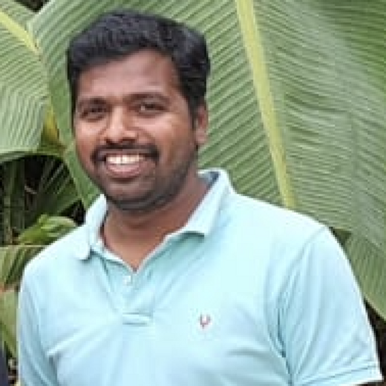
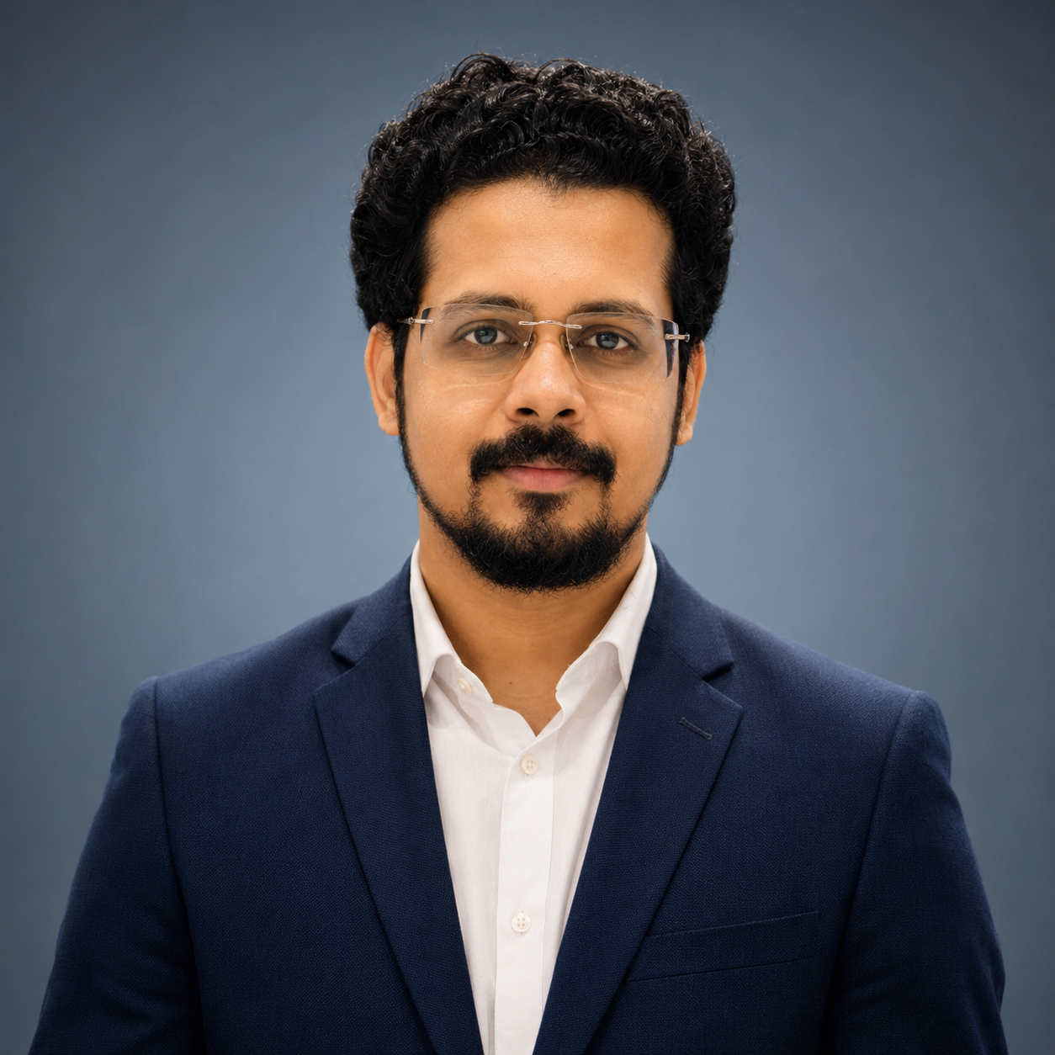
Instructors
Shanmugaraja Selvam
Solution Architect, IBM
—
shanmsel@in.ibm.com
+91-9019608384
Niteesh Nair
AI Engineer, IBM
—
niteesh.nair@ibm.com
+91-8401284151

Slide 3
What you will learn
01 Configure and start the pre-built FleetOps backend; verify its REST APIs via Swagger UI
02 Build a FastAPI temperature-forecasting service using IBM Granite TTM-R2 with IBM Bob
03 Define five watsonx Orchestrate agents (weather · station · route · decision · notification) and upload their Python tools
04 Register watsonx Orchestrate connections and wire all five agent IDs to the fleet backend
05 Complete a Carbon-based live dashboard using IBM Bob in Agent mode
06 Run the end-to-end agentic pipeline on TRUCK-003 and observe the autonomous reroute decision

Slide 4
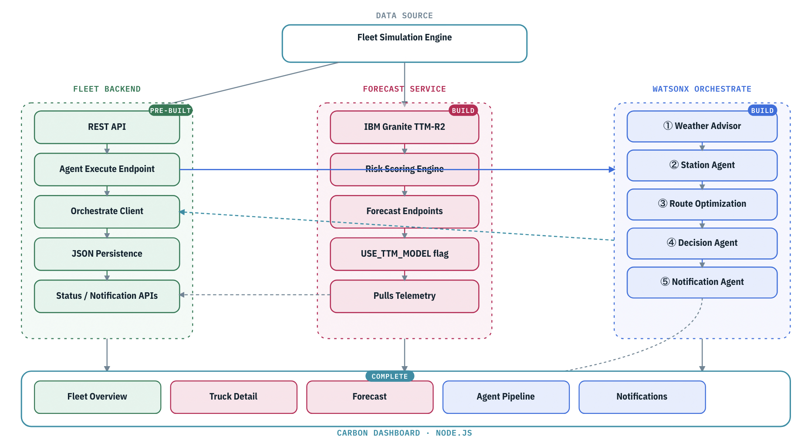
Phase 1 Architecture — In-Trip AI Agent Emergency Response
Three services · Fleet Backend (pre-built :8085) · Forecast Service (Phase 2 :5001) · watsonx Orchestrate Agents (Phase 3) · Carbon Dashboard (Phase 4 :4000)

Slide 5
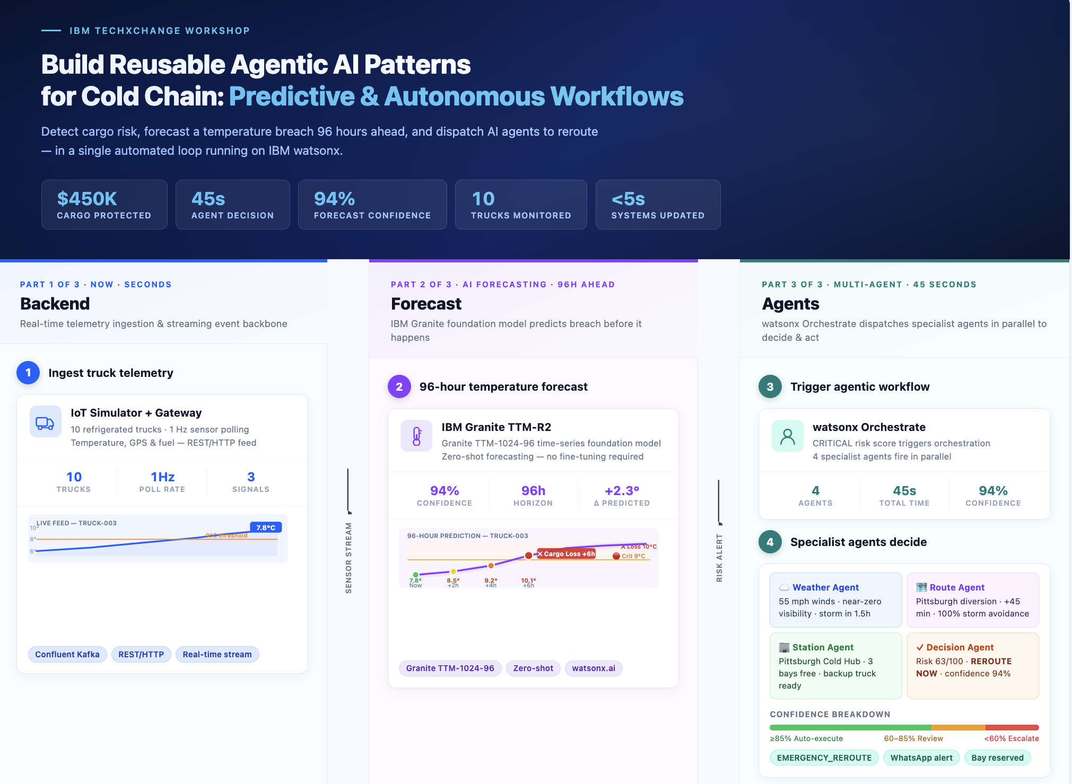
Phase 1 Architecture — In-Trip AI Agent Emergency Response

Slide 6
Before you begin
Sign in to IBM Bob,
Check Techzone environment (Watsonx Orchestrate).
GitHub with your assigned accounts.
Clone the given repository to a directory.
Open the lab guide to find detailed information on the hands-on.

Slide 7
Success criteria
Use IBM Bob Modes For Forecast and agent creation
Trigger agent workflow and change routes for trucks having emergency
Create complete logistics application
Live dashboard with alert visualization, maps and telemetry data
Customized modifications for app and dashboard

Slide 8
Notices and disclaimers
© 2026 IBM Corporation. All rights reserved.
This document is distributed "as is" without any warranty, either express or implied. In no event shall IBM be liable for any damage arising from the use of this information, including but not limited to, loss of data, business interruption, loss of profit or loss of opportunity.
Examples presented are illustrative only. Actual results will vary based on client configurations and conditions and, therefore, generally expected results cannot be provided.
Workshops, sessions, and associated materials may have been prepared by independent session speakers and do not necessarily reflect the views of IBM.
Not all offerings are available in every country in which IBM operates.
Statements regarding IBM's future direction, intent, or product plans are subject to change or withdrawal without notice, and represent goals and objectives only.
IBM, the IBM logo, and ibm.com are trademarks or registered trademarks of IBM Corporation, in in the U.S. and/or other countries Other product and service names might be trademarks of IBM or other companies. A current list of IBM trademarks is available on ibm.com/trademark.
Certain comments made in this presentation may be characterized as forward looking under the Private Securities Litigation Reform Act of 1995.
Forward-looking statements are based on a company's current assumptions regarding future business and financial performance. Those statements by their nature address matters that are uncertain to different degrees and involve a number of factors that could cause actual results to differ materially. Additional information concerning these factors is contained in the Company's filings with the SEC. Copies are available from the SEC, from the IBM website, or from IBM Investor Relations.
Any forward-looking statement made during this presentation speaks only as of the date on which it is made. The Company assumes no obligation to update or revise any forward-looking statements except as required by law; these charts and the associated remarks and comments are integrally related and are intended to be presented and understood together.
IBM TechXchange | © 2026 IBM Corporation

Slide 9
Thank You
Shanmugaraja Selvam
Solution Architect, IBM EMEA Build Engineering
shanmsel@in.ibm.com
Niteesh Nair
AI Engineer, IBM EMEA Build Engineering
Niteesh.nair@ibm.com

