Slide 1
Introduction to fp-go
Functional programming library for Go
https://github.com/IBM/fp-go
Carsten Leue

Slide 2
What we will talk about
Why a library for functional programming for Golang?
What does the library offer and how does the code look like?
Performance considerations and conclusion

Slide 3
Disclaimer
This presentation is not sponsored or approved by IBM. All those involved are voluntarily engaging in their individual capacities.
The statements in these slides are my own and don't necessarily represent IBM's positions, strategies or opinions.

Slide 4
Acknowlegements
Implementation and design are largely inspired by the awesome fp-ts library by Giulio Canti
https://gcanti.github.io/fp-ts/
https://gcanti.github.io/io-ts/

Slide 5









My personal journey to Functional Programming
J2EE
Frontend
CM
Mainframe
Containers
my project and language journey ...
Projects used imperative languages. Why?
Platform requirements
Integration into existing ecosystem
Skill set of development team
Trends...

Slide 6

My personal journey to Functional Programming
Some key challenges in my experience
Testability
Extensibility/Refactoring
Race Conditions
State Management
Much of our code that addressed the above challenges followed principles also found in functional programming

Slide 7
Why functional programming?
Pure functions
Composition
Managed Side Effects
Immutability
Map/Filter/Reduce/...
Ease of Debugging/Reasoning/Testing
Modularization
Parallelization
Compact, yet readable code

Slide 8
Why functional programming?
Pure functions
Composition
Managed Side Effects
Immutability
Map/Filter/Reduce/...
Ease of Debugging/Reasoning/Testing
Modularization
Parallelization
Compact, yet readable code

Slide 9
Why Go for FP?
Huge ecosystem
Good concurrency model
Nice compiler toolchain
Self-contained binaries
Cross compilation
Fast
Because you might need to integrate with an existing system
docker, kubernetes, terraform, ...

Slide 10
Why you might decide not to choose Go for FP?
Designed to be an imperative language
Strong opinion in the community about the idiomatic way to write code
Generics type system still evolving

Slide 11
FP friendly Go language features
Generics (template types) since 1.18 (2022)
Higher order functions
Closures
Functions are first-class entities
Strong Typing

Slide 12
Explicit type
// addInts adds two integers
func addInts(left, right int) int {
return left + right
}
Type with constraint
Type reference
// addNumbers adds two numbers
func addNumbers[T N.Number](left, right T) T {
return left + right
}

Slide 13
Reference to closure
func captureValue[T any](captured T) func() string {
return func() string {
return fmt.Sprintf("Value: %v", captured)
}
}
func Example_closure() {
hof := captureValue("Carsten") // func() string
fmt.Println(hof())
// Output:
// Value: Carsten
}
Function as variable

Slide 14
Not part of the Go language so far
Immutable data types
Type parameters for methods
Function overloading
Type variance
Tuples are no real data types
Higher kinded types

Slide 15
Motivation behind creating the fp-go library
Encourage testable code
Composition patterns motivate writing small, pure, testable functions
Managed side effects provide a clean separation of effects from pure code
Immutability of data structures in the library motivate to follow the same pattern in business logic
Maintainability
Reduce boilerplate in favour of higher level abstractions
Avoid nested if/else statements to reduce complexity
Avoid early exits to make the code readable line by line

Slide 16
Concepts Supported by fp-go
Map/Filter/Reduce/Chain/…
For slices and maps
For many more monadic types
Function Composition
Pipe/Flow
Collection of Monads
Either
Option
IO, IOEither, ...
Reader, ReaderIO, ReaderIOEither

Slide 17
Concepts Supported by fp-go
Monoids/Semigroups
Optics
Lenses
Prism
Traversal
ISO
HTTP
Concurrency
IOEither, ReaderIOEither

Slide 18
Installation and Usage
https://github.com/IBM/fp-go
Installation
go mod init myexample
go get github.com/IBM/fp-go
Usage
package main
import (
"fmt"
A "github.com/IBM/fp-go/array"
F "github.com/IBM/fp-go/function"
)
func main() {
}

Slide 19
Map/Filter/Reduce
func Example_map() {
f := func(i int) int {
return i * 2
}
input := []int{1, 2, 3, 4}
// idiomatic go
res1 := make([]int, 0, len(input))
for _, i := range input {
res1 = append(res1, f(i))
}
fmt.Println(res1)
// map
res2 := A.Map(f)(input)
fmt.Println(res2)
// Output:
// [2 4 6 8]
// [2 4 6 8]
}
Notice the curried functions
func Example_reduce() {
input := []int{1, 2, 3, 4}
// reduce
red := A.Reduce(N.MonoidSum[int]().Concat, 0)(input)
fmt.Println(red)
// fold
fld := A.Fold(N.MonoidSum[int]())(input)
fmt.Println(fld)
// Output:
// 10
// 10
}

Slide 20
Monadic Operations
// Pointed
func Of[A any](A) HKT[A]
// Functor
func Map[A, B any](func(A) B) func(HKT[A]) HKT[B]
func MapTo[A, B any](B) func(HKT[A]) HKT[B]
// Chain
func Chain[A, B any](func(A) HKT[B]) func(HKT[A]) HKT[B]
func ChainTo[A, B any](HKT[B]) func(HKT[A]) HKT[B]
func ChainFirst[A, B any](func(A) HKT[B]) func(HKT[A]) HKT[A]
// Apply
func Ap[A, B any](HKT[A]) func(HKT[func(A) B]) HKT[B]
// Derived
func Flatten[A, B any](HKT[HKT[A]]) HKT[A]
func Reduce[A, B any](func(B, A) B, B) func(HKT[A]) HKT[B]
Consistent set of monadic operations for all types
Readable because code patterns are recognizable across monads
Maintainable learning curve since there exists an manageable set of operations
😞 limited ability to write fully generic code since there exist no higher-kinded types
Chain is an alias for Bind or FlatMap
// PipeN composes n functions with a start value
func PipeN[T0, ..., Tn any](t0 T0, f1 func(T0) T1, ...) Tn
// FlowN composes n functions into a single function
func FlowN[T0, ..., Tn any](f1 func(T0) T1, ...) func(T0) Tn

Slide 21
Function Composition
func Example_composition_pipe() {
filter := func(i int) bool {
return i%2 == 0
}
double := func(i int) int {
return i * 2
}
input := []int{1, 2, 3, 4}
res := F.Pipe2(
input,
A.Filter(filter),
A.Map(double),
)
fmt.Println(res)
// Output:
// [4 8]
}
func Example_composition_flow() {
filter := func(i int) bool {
return i%2 == 0
}
double := func(i int) int {
return i * 2
}
input := []int{1, 2, 3, 4}
filterAndDouble := F.Flow2(
A.Filter(filter),
A.Map(double),
) // func([]int) []int
fmt.Println(filterAndDouble(input))
// Output:
// [4 8]
}
FlowN enables point-free style
Index needed due to missing function overloading 😞
Curried, so functions compose well

Slide 22
Immutability
Lower case fields are package-private
type Person struct {
name string
age int
}
func (p Person) GetName() string {
return p.name
}
func (p Person) GetAge() int {
return p.age
}
func (p Person) SetName(name string) Person {
p.name = name
return p
}
func (p Person) SetAge(age int) Person {
p.age = age
return p
}
func MakePerson(name string, age int) Person {
return Person{name, age}
}
func Example_immutability_struct() {
p1 := MakePerson("Carsten", 52)
// func(int) func(Person) Person
setAge := F.Curry2(F.Swap(Person.SetAge))
p2 := F.Pipe1(
p1,
setAge(53),
)
fmt.Println(p1)
fmt.Println(p2)
}
Go does not offer the concept of immutable types 😞
fp-go implements immutability by-contract
modifications of arrays/records create copies
Immutability for structs can be simulated
pass-by-value
getters/setters
Operates on a copy for each call
Setter accessed on type has binary signature

Slide 23
Optics
func Example_immutability_optics() {
// Lens[Person, int]
ageLens := L.MakeLens(Person.GetAge, Person.SetAge)
// func(Person) Person
incAge := L.Modify[Person](N.Inc[int])(ageLens)
p1 := MakePerson("Carsten", 52)
p2 := incAge(p1)
fmt.Println(p1)
fmt.Println(p2)
// Output:
// {Carsten 52}
// {Carsten 53}
}
Representation of composable getters and setters on immutable data types
Lens, Optional, Prism, ISO, Traversal
Advantages
Immutable, Composable, Type Safe, Readable, Testable
Plays well with functional concepts

Slide 24
Optics
func Example_immutability_lenses() {
// Lens[Person, string]
nameLens := L.MakeLens(Person.GetName, Person.SetName)
// Lens[Client, Person]
personLens := L.MakeLens(Client.GetPerson, Client.SetPerson)
// Lens[Client, string]
clientNameLens := F.Pipe1(
personLens,
L.Compose[Client](nameLens),
)
// func(Client) Client
upperName := L.Modify[Client](strings.ToUpper)(clientNameLens)
c1 := MakeClient("Böblingen", "Carsten", 52)
c2 := upperName(c1)
fmt.Println(c1)
fmt.Println(c2)
// Output:
// {{Carsten 52} {Böblingen}}
// {{CARSTEN 52} {Böblingen}}
}
type Person struct {
name string
age int
}
type Address struct {
city string
}
type Client struct {
person Person
address Address
}
func (c Client) GetPerson() Person {
return c.person
}
// More getters and setters
…
Focus on a sub-field of Client

Slide 25
Error Handling
Errors are represented as the error interface
Operations that can fail return a value or an error
No exceptions
Errors are handled on the composition layer
fp-go
error returns use Either[E, T]
error handling via the Either monad using composition
Idiomatic Go
error returns use a multi return value (T, error)
error handling via if/else

Slide 26
Error Handling
func validatePort(port int) (int, error) {
if port > 0 {
return port, nil
}
return 0, fmt.Errorf("Value %d is not a valid port number", port)
}
func Example_either_monad() {
// func(string) E.Either[error, int]
atoi := E.Eitherize1(strconv.Atoi)
// func(int) E.Either[error, int]
valPort := E.Eitherize1(validatePort)
// func(string) E.Either[error, string]
makeUrl := F.Flow3(
atoi,
E.Chain(valPort),
E.Map[error](S.Format[int]("http://localhost:%d")),
)
fmt.Println(makeUrl("8080"))
// Output:
// Right[<nil>, string](http://localhost:8080)
}
func Example_either_idiomatic() {
makeUrl := func(port string) (string, error) {
parsed, err := strconv.Atoi(port)
if err != nil {
return "", err
}
valid, err := validatePort(parsed)
if err != nil {
return "", err
}
return fmt.Sprintf("http://localhost:%d", valid), nil
}
url, err := makeUrl("8080")
if err != nil {
panic(err)
}
fmt.Println(url)
// Output:
// http://localhost:8080
}
Why does fp-go diverge from idiomatic style?
Multi-return values
no first-class entities
do not enforce an xor semantic
not composable
Either Monad
composable
can be used transitively
fits with the rest of the FP ecosystem
avoid early exits

Slide 27
Switching between the Worlds
func Example_either_worlds() {
// func(string) E.Either[error, int]
atoi := E.Eitherize1(strconv.Atoi)
// func(int) E.Either[error, int]
valPort := E.Eitherize1(validatePort)
// func(string) E.Either[error, string]
makeUrl := F.Flow3(
atoi,
E.Chain(valPort),
E.Map[error](S.Format[int]("http://localhost:%d")),
)
// func(string) (string, error)
makeUrlGo := E.Uneitherize1(makeUrl)
url, err := makeUrlGo("8080")
if err != nil {
panic(err)
}
fmt.Println(url)
// Output:
// http://localhost:8080
}
Go → fp-go
EitherizeN
Convert from multi return values to Either
OptionizeN
Convert from (value, bool) to Option
fp-go → Go
UneitherizeN/UnoptionizeN
Fold

Slide 28
Managed Side Effects
Side effects are operations that alter or rely on state outside of the scope of a function
Reading/Writing files, accessing the environment, logging, random numbers, time, HTTP requests, etc
We try to isolate side effects from pure functions such that their execution is effectful, but their composition remains pure
type IO[A any] func() A

Slide 29
Managed Side Effects
type Sample struct {
Value int `json:"a"`
}
func (s Sample) getValue() int {
return s.Value
}
func Example_io_flow() {
// IOE.IOEither[error, string]
text := F.Pipe2(
"data/file1.txt",
file.ReadFile,
IOE.Map[error](B.ToString),
)
// IOE.IOEither[error, int]
value := F.Pipe3(
"data/file2.json",
file.ReadFile,
IOE.ChainEitherK(J.Unmarshal[Sample]),
IOE.Map[error](Sample.getValue),
)
// IOE.IOEither[error, string]
result := F.Pipe1(
IOE.SequenceT2(text, value),
IOE.Map[error](func(res T.Tuple2[string, int]) string {
return fmt.Sprintf("Text: %s, Number: %d", res.F1, res.F2)
}),
)
fmt.Println(result())
// Output:
// Right[<nil>, string](Text: Some data, Number: 10)
}
Signature
Easily recognizable as side effect (returns a value without input)
Why?
Execution pushed to the boundary
Pure composability
Retry/Concurrency/...

Slide 30
Managed Side Effects
type Sample struct {
Value int `json:"a"`
}
func (s Sample) getValue() int {
return s.Value
}
func Example_io_flow() {
// IOE.IOEither[error, string]
text := F.Pipe2(
"data/file1.txt",
file.ReadFile,
IOE.Map[error](B.ToString),
)
// IOE.IOEither[error, int]
value := F.Pipe3(
"data/file2.json",
file.ReadFile,
IOE.ChainEitherK(J.Unmarshal[Sample]),
IOE.Map[error](Sample.getValue),
)
// IOE.IOEither[error, string]
result := F.Pipe1(
IOE.SequenceT2(text, value),
IOE.Map[error](func(res T.Tuple2[string, int]) string {
return fmt.Sprintf("Text: %s, Number: %d", res.F1, res.F2)
}),
)
fmt.Println(result())
// Output:
// Right[<nil>, string](Text: Some data, Number: 10)
}
Managed effect created but not executed
Signature
Easily recognizable as side effect (returns a value without input)
Why?
Execution pushed to the boundary
Pure composability
Retry/Concurrency/...
Error handling via composition
Traversal, per default concurrently
Actual execution

Slide 31
Comparison to idiomatic style
func Example_io_flow() {
// IOE.IOEither[error, string]
text := F.Pipe2(
"data/file1.txt",
file.ReadFile,
IOE.Map[error](B.ToString),
)
// IOE.IOEither[error, int]
value := F.Pipe3(
"data/file2.json",
file.ReadFile,
IOE.ChainEitherK(J.Unmarshal[Sample]),
IOE.Map[error](Sample.getValue),
)
// IOE.IOEither[error, string]
result := F.Pipe1(
IOE.SequenceT2(text, value),
IOE.Map[error](func(res T.Tuple2[string, int]) string {
return fmt.Sprintf("Text: %s, Number: %d", res.F1, res.F2)
}),
)
fmt.Println(result())
// Output:
// Right[<nil>, string](Text: Some data, Number: 10)
}
func io_flow_idiomatic() error {
// []byte
file1AsBytes, err := os.ReadFile("data/file1.txt")
if err != nil {
return err
}
// string
text := string(file1AsBytes)
// []byte
file2AsBytes, err := os.ReadFile("data/file2.json")
if err != nil {
return err
}
var value Sample
if err := json.Unmarshal(file2AsBytes, &value); err != nil {
return err
}
// string
result := fmt.Sprintf("Text: %s, Number: %d", text, value.Value)
fmt.Println(result)
return nil
}

Slide 32
Comparison to idiomatic style
func Example_io_flow() {
// IOE.IOEither[error, string]
text := F.Pipe2(
"data/file1.txt",
file.ReadFile,
IOE.Map[error](B.ToString),
)
// IOE.IOEither[error, int]
value := F.Pipe3(
"data/file2.json",
file.ReadFile,
IOE.ChainEitherK(J.Unmarshal[Sample]),
IOE.Map[error](Sample.getValue),
)
// IOE.IOEither[error, string]
result := F.Pipe1(
IOE.SequenceT2(text, value),
IOE.Map[error](func(res T.Tuple2[string, int]) string {
return fmt.Sprintf("Text: %s, Number: %d", res.F1, res.F2)
}),
)
fmt.Println(result())
// Output:
// Right[<nil>, string](Text: Some data, Number: 10)
}
func io_flow_idiomatic() error {
// []byte
file1AsBytes, err := os.ReadFile("data/file1.txt")
if err != nil {
return err
}
// string
text := string(file1AsBytes)
// []byte
file2AsBytes, err := os.ReadFile("data/file2.json")
if err != nil {
return err
}
var value Sample
if err := json.Unmarshal(file2AsBytes, &value); err != nil {
return err
}
// string
result := fmt.Sprintf("Text: %s, Number: %d", text, value.Value)
fmt.Println(result)
return nil
}
Lazy
Eager

Slide 33
Managed Side Effects and Concurrency
Traversals are based on the applicative
Side effects often represent I/O operations
I/O can benefit from concurrent execution without exhausting CPU
go-routines are optimized to handle I/O
Sequence/Traversals
Accept sets of IO to be run as a batch
Applicative controls concurrent or sequential access
// Ap is an alias of [ApPar]
func Ap[B, E, A any](ma IOEither[E, A]) func(IOEither[E, func(A) B]) IOEither[E, B]
// ApPar applies function and value in parallel
func ApPar[B, E, A any](ma IOEither[E, A]) func(IOEither[E, func(A) B]) IOEither[E, B]
// ApSeq applies function and value sequentially
func ApSeq[B, E, A any](ma IOEither[E, A]) func(IOEither[E, func(A) B]) IOEither[E, B]

Slide 34
Performance Considerations
In general fp-go comes with a small performance overhead because
Combinators create instances of higher order functions
Traversals create copies to ensure immutability
Differences mostly seen in micro-benchmarks
Performance advantage for I/O operations
Due to the ease of concurrency

Slide 35
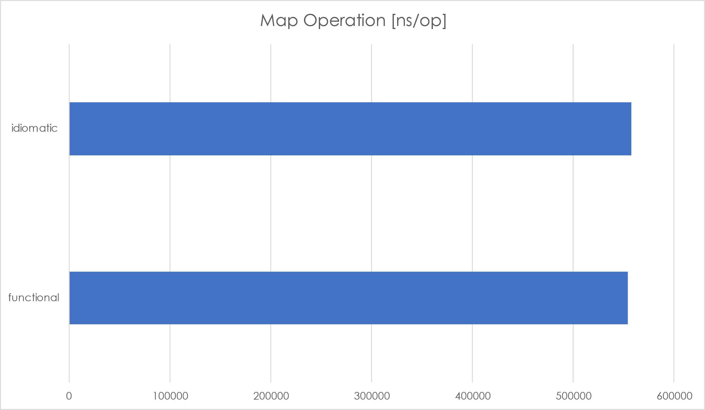
Performance Considerations
A.Map(strings.ToUpper)(data)
var result = make([]string, 0, len(data))
for _, value := range data {
result = append(result, strings.ToUpper(value))
}

Slide 36
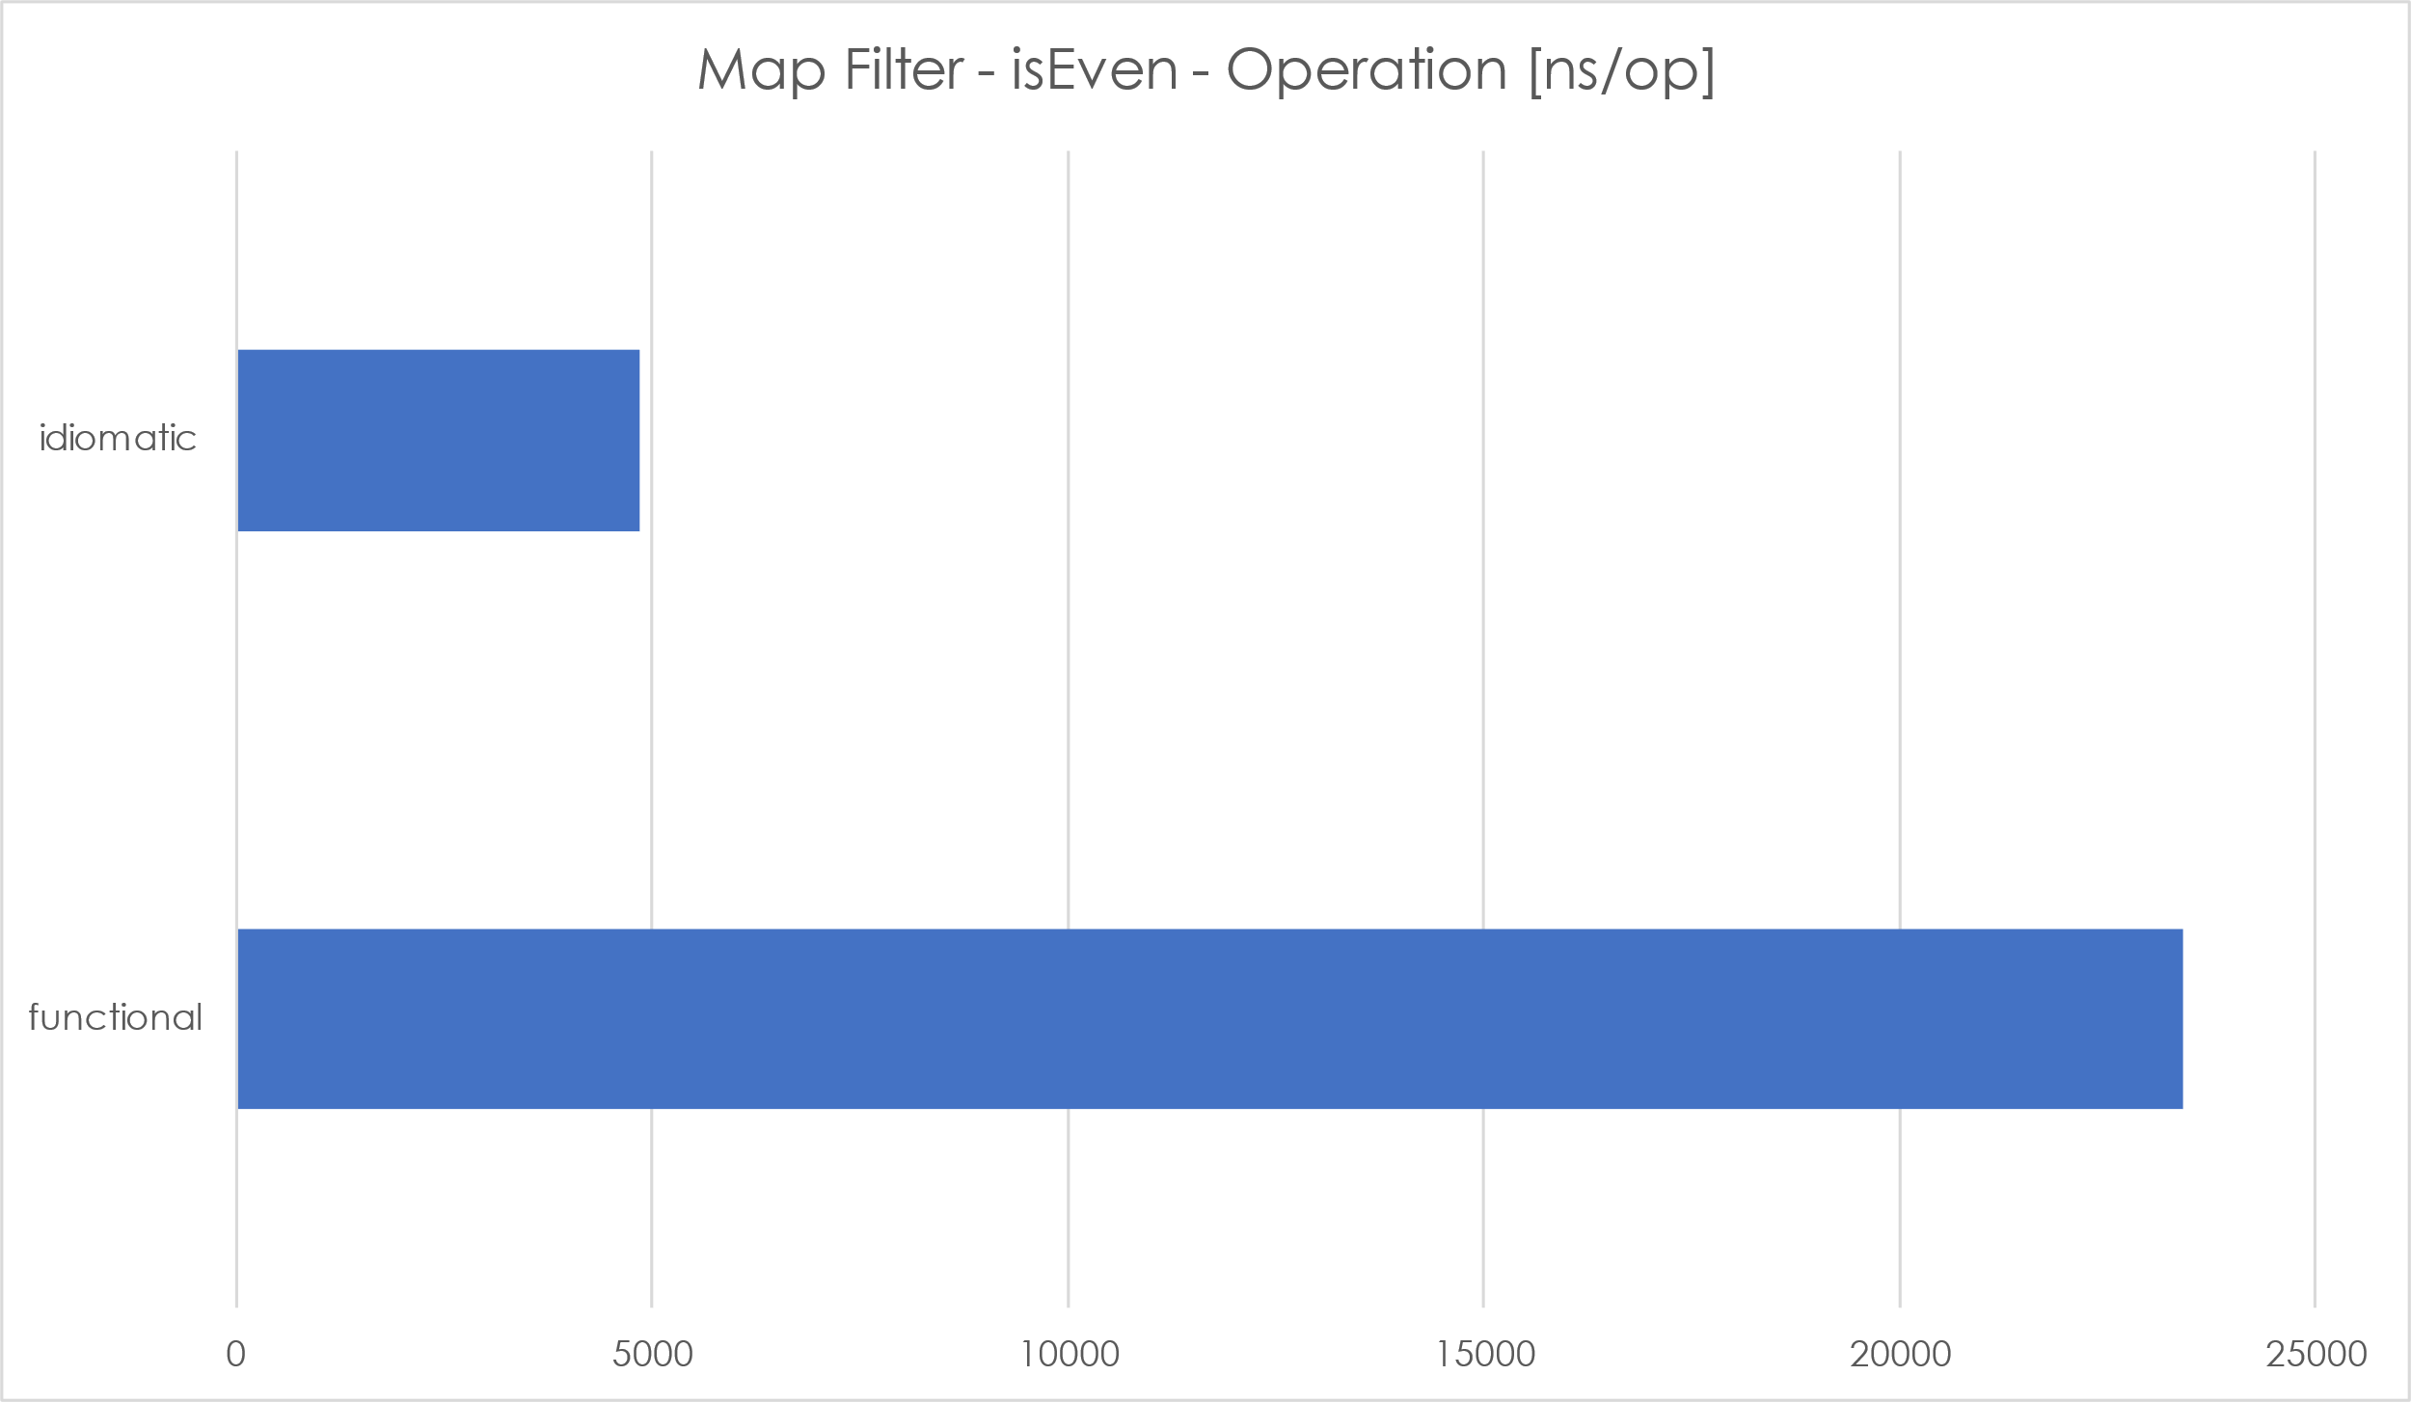
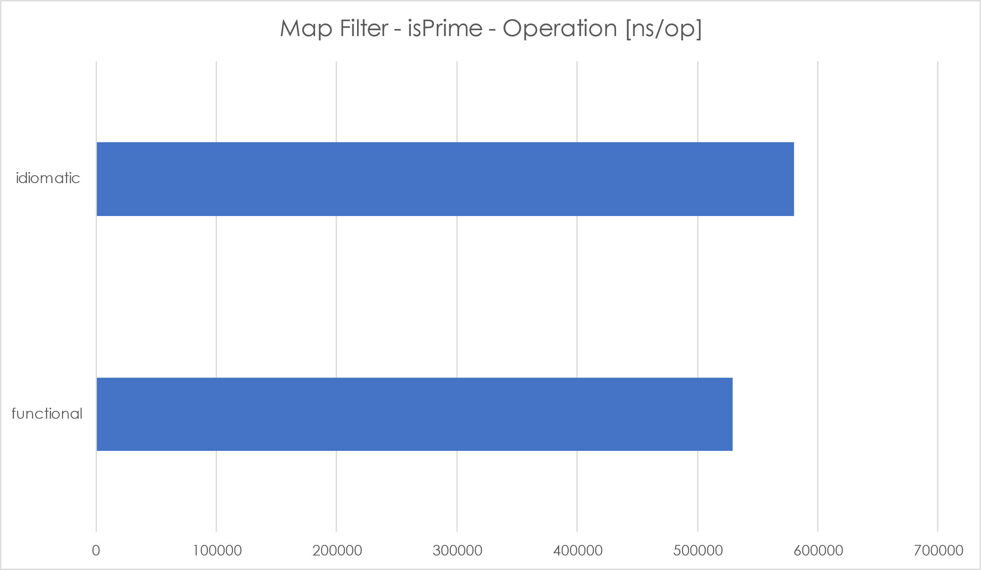
Performance Considerations
Filter/Map with a fast isEven predicate
Filter/Map with a slow isPrime predicate

Slide 37
Performance Considerations
func heterogeneousHttpRequests(count int) R.ReaderIOEither[[]T.Tuple2[PostItem, CatFact]] {
// prepare the http client
client := H.MakeClient(HTTP.DefaultClient)
readSinglePost := H.ReadJson[PostItem](client)
readSingleCatFact := H.ReadJson[CatFact](client)
single := F.Pipe2(
T.MakeTuple2("https://jsonplaceholder.typicode.com/posts/1", "https://catfact.ninja/fact"),
T.Map2(H.MakeGetRequest, H.MakeGetRequest),
R.TraverseTuple2(
readSinglePost,
readSingleCatFact,
),
)
return F.Pipe1(
A.Replicate(count, single),
R.SequenceArray[T.Tuple2[PostItem, CatFact]],
)
}
Concurrent by default
Concurrent by default

Slide 38
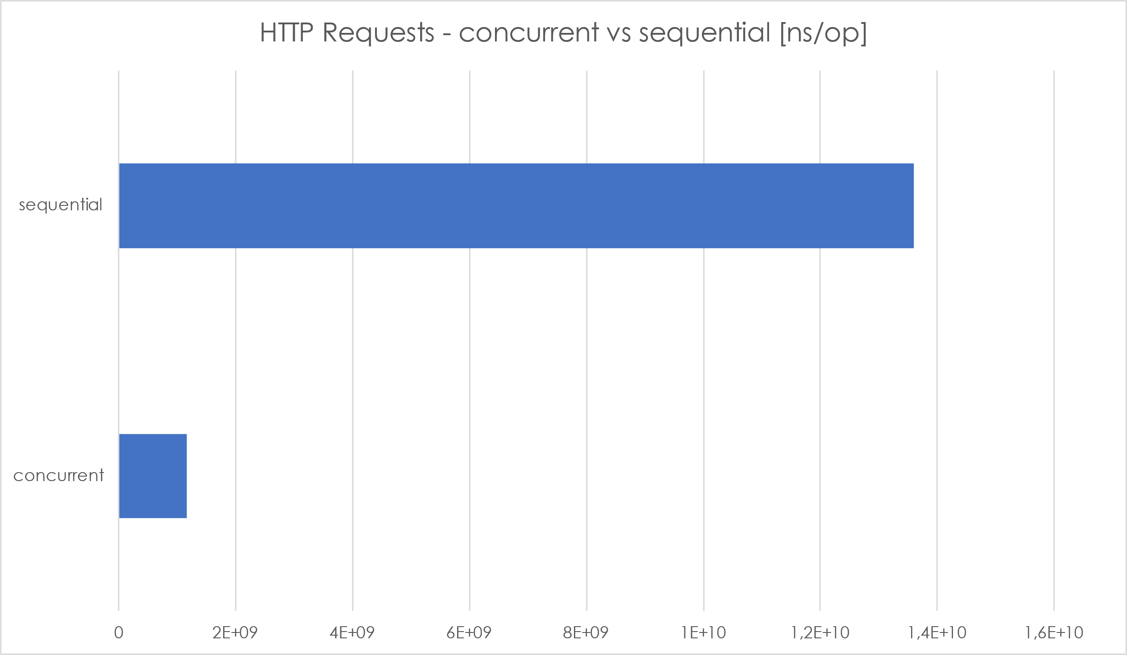
Performance Considerations
Making HTTP GET requests
no surprise, the concurrent way is much faster
→ Traversal/Sequences make it easy to parallelize code

Slide 39
Examples and Tutorials
Samples exist alongside the code and in the samples folder:
https://github.com/IBM/fp-go/tree/main/samples
Adaption of the code examples in Professor Frisby’s Mostly Adequate Guide to Functional Programming
Samples and tutorials for fp-ts also largely apply to fp-go

Slide 40
References
https://github.com/IBM/fp-go
https://github.com/gcanti/fp-ts
https://github.com/gcanti/monocle-ts
https://github.com/MostlyAdequate/mostly-adequate-guide
https://betterprogramming.pub/investigate-functional-programming-concepts-in-go-1dada09bc913
https://betterprogramming.pub/investigating-the-i-o-monad-in-go-3c0fabbb4b3d

Slide 41
Thank you!

Slide 42
Backup

Slide 43
Traversals
Traversals convert sequences of types into types of sequences
Array (slices)
Records (maps)

