Slide 1
Crypto Agility
in the Federal Enterprise
PQC
ZTA
Agentic AI + Data
Synchronizing PQC Migration, Zero Trust,
Agentic AI and Data Security, and Model Artifact Governance
Model Artifacts
Core thesis
Federal agencies are not only migrating cryptography. They are migrating trust — at machine scale.
IBM Federal Talk · Crypto Agility + PQC + ZTA + AI
01
Notes:
Open by framing crypto agility as a systems-engineering discipline across PQC, Zero Trust, AI data security, and model artifact governance.

Slide 2
Why This Matters Now
Agentic AI adoption is the forcing function: federal modernization is creating a crypto-agility moment.
PQC migration
Zero Trust implementation
Current modernization pressure
Current modernization pressure
Current modernization pressure
Agentic AI adoption (machine identities now outnumber humans ~82:1 to 144:1)
Cloud / SaaS / API modernization
PKI + identity modernization
AI model governance
Dependency that becomes crypto debt
Dependency that becomes crypto debt
Dependency that becomes crypto debt
Civilian and DoD federal track
NSS track
NSM-10 / OMB M-23-02
Inventory, prioritize, and transition non-NSS cryptographic systems.
NIST IR 8547 (Initial Public Draft): deprecate RSA/ECC after 2030, disallow after 2035.
CNSA 2.0 / CNSSP-15
New NSS acquisitions: CNSA 2.0 compliant by Jan. 1, 2027 unless profile exceptions apply.
Agencies that modernize ZTA and AI without crypto agility are not just building tomorrow’s PQC backlog — they are turning a finite migration inventory into a continuously regenerating one.
IBM Federal Talk · Crypto Agility + PQC + ZTA + AI
02
Notes:
Sources: NIST PQC FIPS announcement; OMB M-23-02; NSA CNSA 2.0 FAQ Version 2.1. Use this slide to establish both civilian and NSS tracks.

Slide 3
Crypto Agility Is a System Capability
It is more than algorithm substitution.
Crypto agility = the ability to change cryptographic mechanisms safely, under governance, without rebuilding the mission system.
Algorithm agility
Protocol agility
Key agility
Policy agility
Posture agility
Move to FIPS 203/ML-KEM, FIPS 204/ML-DSA or FIPS 205/SLH-DSA (hybrid where appropriate).
Negotiate approved suites without brittle fallback or silent downgrade.
Rotate, revoke, reissue, replace, and validate without mission disruption.
Enforce rules centrally rather than hard-coding application logic.
Continuously report what cryptography is actually in use.
If you cannot see it, you cannot migrate it. If you cannot govern it, you cannot make it agile.
IBM Federal Talk · Crypto Agility + PQC + ZTA + AI
03
Notes:
Define crypto agility as algorithm, protocol, key, policy, and posture agility. It requires architecture, policy, telemetry, testing, governance, and acquisition discipline.

Slide 4
PQC Migration Is Broader Than Algorithms
The scope includes trust chains, long-lived data, and HNDL + HNFL exposure.
Traditional crypto scope
Expanded AI + data scope
TLS / VPN / SSH / IPsec / S/MIME / QUIC
PKI, certificates, trust anchors
Code signing, secure boot, software updates
KMS, HSMs, device + workload identity
Mission archives and file stores
AI model repositories and registries
Vector databases and retrieval stores
Prompt logs, embeddings, derived data
Two harvest axes change the timeline: HNDL and HNFL
Harvest-Now, Decrypt-Later (HNDL): Harvest-Now, Forge-Later (HNFL): public signing keys and token samples can be harvested today to forge valid identities and signatures. HNDL steals what was said; HNFL forges who is speaking.
Mission archives
Coalition comms
Citizen / health / financial data
AI corpora + vector stores
Only key and posture agility can protect harvested-class data and rotate anchors before they become forgeable.
IBM Federal Talk · Crypto Agility + PQC + ZTA + AI
04
Notes:
Sources: OMB M-23-02 and CISA automated PQC discovery and inventory strategy. Use HNDL to justify funding discovery now.

Slide 5
Zero Trust Expands the Cryptographic Surface
ZTA multiplies the cryptographic trust relationships PQC must account for.
ZTA core shift
Zero Trust focuses on protecting users, assets, resources, services, workflows, and network accounts — not static network perimeters.
User authentication
Device certificates
Workload identity
Session encryption
API access
Service mesh
Privileged access
Continuous authorization
Zero Trust does not reduce the need for cryptography; it expands the dependency surface — and only crypto agility can govern a surface this large.
IBM Federal Talk · Crypto Agility + PQC + ZTA + AI
05
Notes:
Source: NIST SP 800-207. Make the point that ZTA increases cryptographic identity, device, workload, API, and session dependencies.

Slide 6
Agentic AI: The Identity Multiplier
Agents are not just data to protect — they are cryptographic actors at machine scale.
What an agent does
Agents authenticate, invoke tools, call other agents, execute plans, and persist state. Agent workflows commonly rely on quantum-vulnerable asymmetric cryptography across TLS, mTLS, OAuth/OIDC, signed artifacts, workload identity, and trust anchors.
Agent identity
Tool invocation
Inter-agent mTLS
Orchestration trust
Memory & state
Model signing
Data provenance
Runtime negotiation
Agentic AI adds cryptographic actors at machine scale: runtime-negotiated, NHI-dense, high-churn. Agility must live in the identity fabric, not the application.
IBM Federal Talk · Crypto Agility + PQC + ZTA + AI
06

Slide 7
AI Models May Contain Cryptographic or Secret Material
Concrete case
A fine-tuned model is exported from development. Its serialized config, checkpoint metadata, or deployment package retains a bearer token, API credential, signing reference, or environment-derived secret. The model is published to an internal registry outside secret-scanning, key-management, CBOM, or crypto-inventory workflows.
1 · Protection crypto
2 · Embedded material
3 · Functional behavior
Encryption at rest
TLS for transfer
Signed model packages
Registry authentication
API tokens / credentials
Keys or key fragments
Certificates / trust anchors
Secrets in config or checkpoints
Encryption-like, keyed, or round-key-like parameter behavior
Oracle-like behavior (detailed under MBOM-PQC)
Model artifacts can become cryptographic assets, secret-bearing assets, or discovery targets — posture agility (discovery) must extend into the artifacts themselves.
IBM Federal Talk · Crypto Agility + PQC + ZTA + AI
07
Notes:
Use this to make the novel thesis concrete: model artifacts are not automatically cryptographic assets, but high-risk model artifacts should be evaluated for protection crypto, embedded secrets, and cryptographic behavior.

Slide 8
MissionShare: A Legacy Mission Application
One named example to follow through the rest of the deck.
MissionShare Core
AI Retrieval
Users
Encrypted file exchange
Mission coordination
Backend services
Archived mission content
Vector retrieval
Prompt/context logging
Desktop client
Mobile client
Mission teams
Trust + ATO
PKI / certificates
Key storage
Update signing
Audit logging
AI capability: AI-assisted retrieval from archived mission content — plus AI agents that orchestrate retrieval and tasking, authenticated via the agency’s OAuth authorization server.
IBM Federal Talk · Crypto Agility + PQC + ZTA + AI
08
Notes:
MissionShare is a fictional federal secure file-transfer and mission-collaboration application. It uses one AI capability: AI-assisted retrieval from archived mission content.

Slide 9
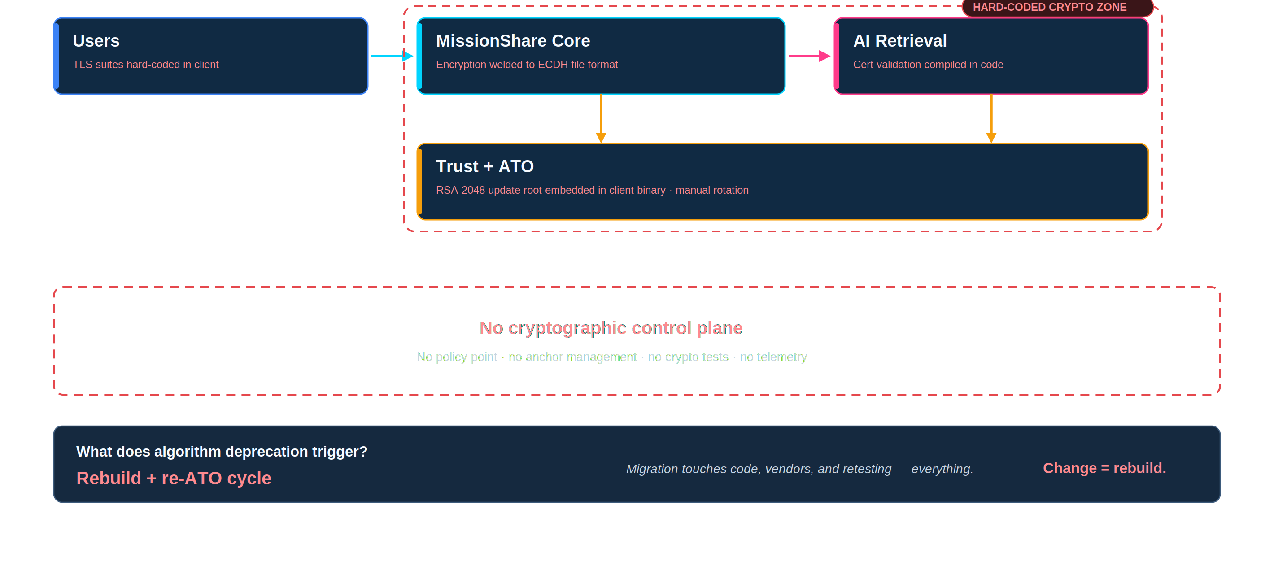
Not Crypto-Agile: MissionShare Today
Cryptography as sediment: decisions buried in every component — and no control plane to draw.
IBM Federal Talk · Crypto Agility + PQC + ZTA + AI
09

Slide 10
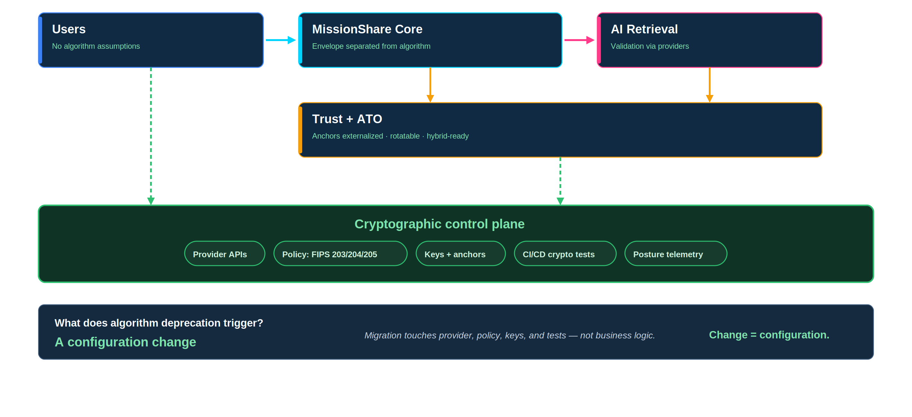
Crypto-Agile: Same Boxes, One New Layer
Cryptographic decisions move into a governed control plane — change becomes configuration, not rebuild.
IBM Federal Talk · Crypto Agility + PQC + ZTA + AI
10

Slide 11
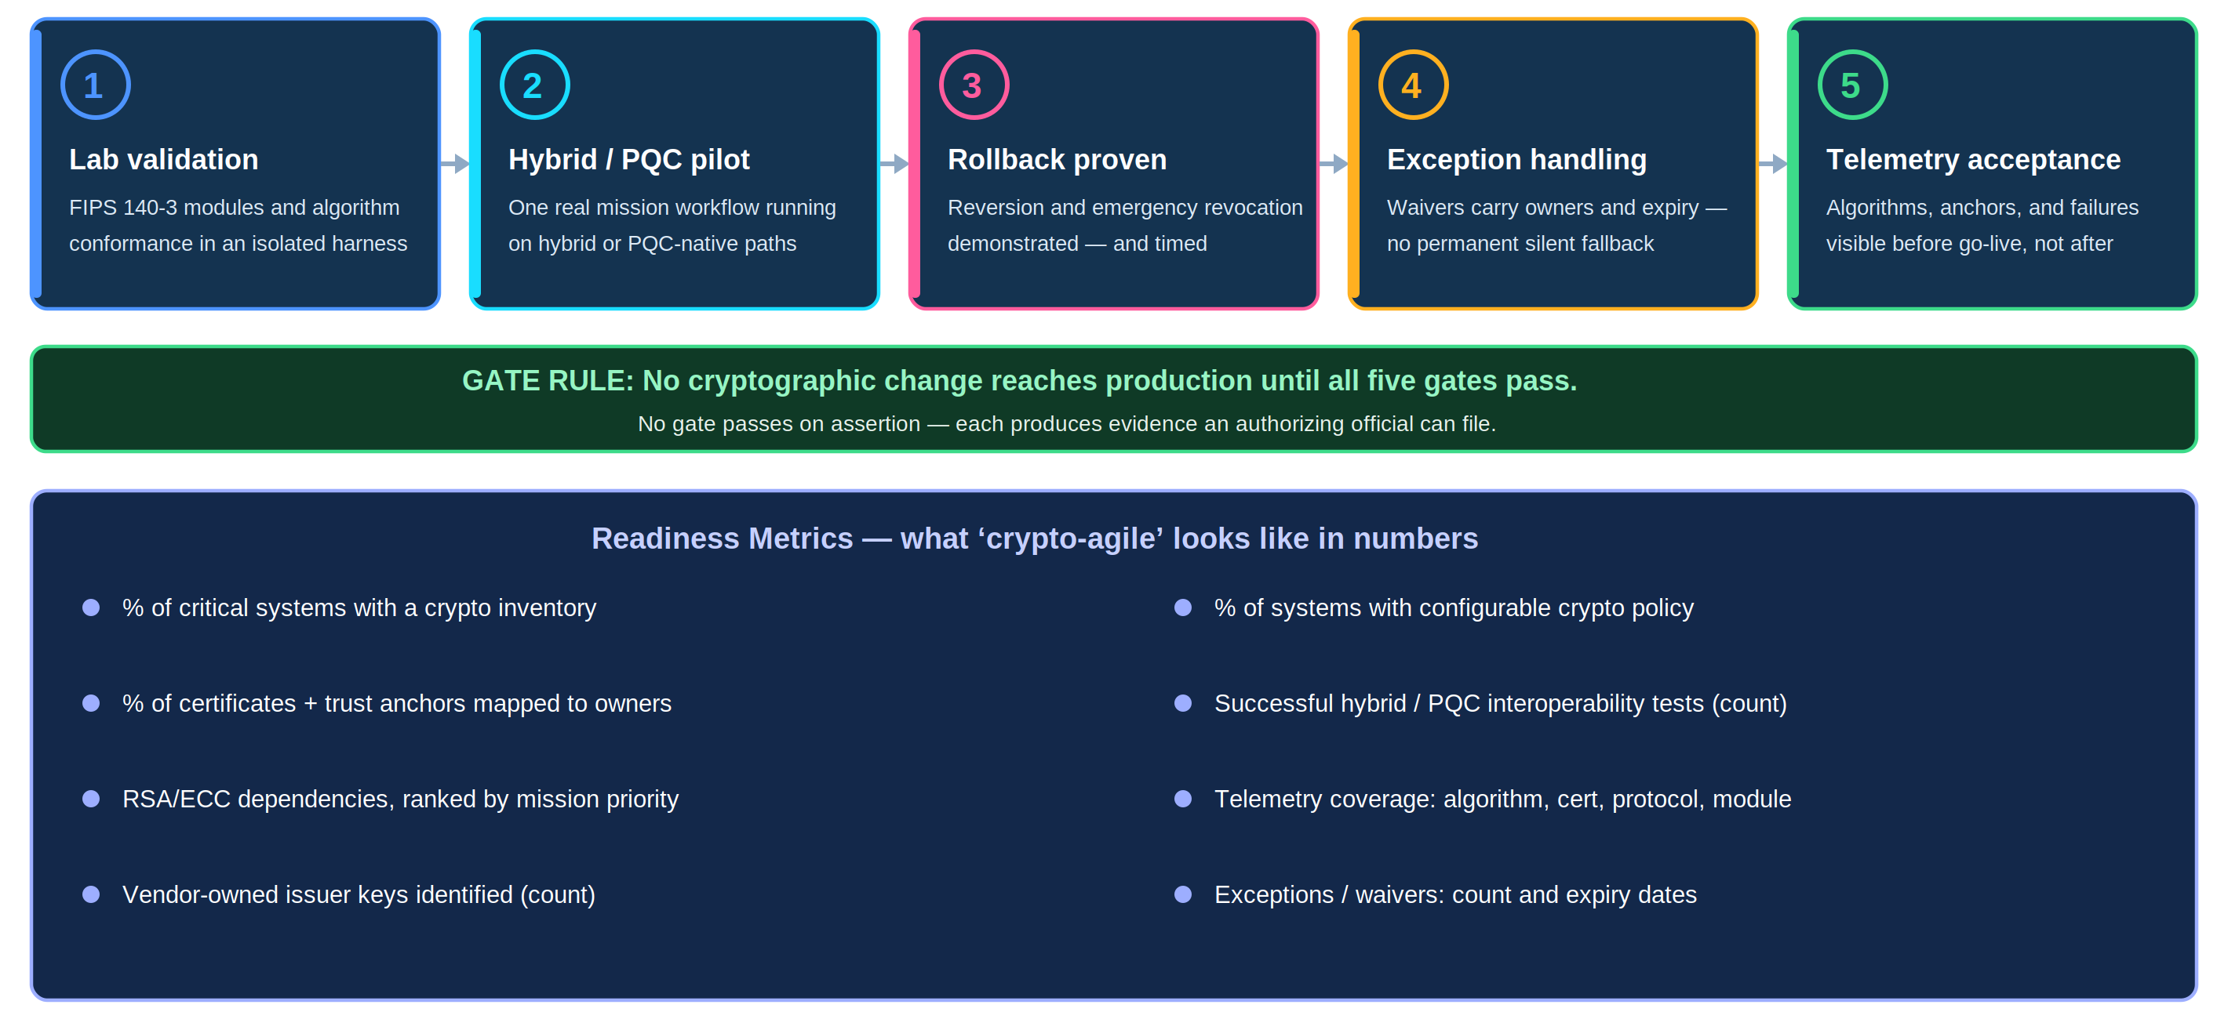
Testing and Interoperability Gates
Five gates between a cryptographic change and production — each produces evidence, not assertions.
IBM Federal Talk · Crypto Agility + PQC + ZTA + AI
13

Slide 12
Acquisition and Governance
What federal buyers should require.
Technical evidence
AI + model evidence
Governance evidence
Crypto inventory + CBOM/SBOM + FIPS 140-3 evidence
Identity-provider / authorization-server PQC roadmap
Cryptographic posture telemetry
AI BOM / model inventory (MBOM-PQC for high-risk)
Model signing + provenance
AI data-flow protection + registry controls
Algorithm and protocol configurability
Key lifecycle, rollback, and transition plans
CNSA 2.0 / CNSSP-15 alignment where NSS-adjacent
Every new federal system should be acquired as if cryptography will change again — because it will.
IBM Federal Talk · Crypto Agility + PQC + ZTA + AI
15
Notes:
Mention exact FIPS 140-3 module certificates, version, operational environment, approved mode, PQC roadmap, and substitution plan. For NSS-adjacent procurements, request CNSA 2.0/CNSSP-15 alignment and exceptions/waivers.

Slide 13
Crypto Agility Is the Foundation for Future Trust
PQC is broader than algorithms.
Zero Trust expands cryptographic dependencies; agentic AI multiplies cryptographic actors at machine scale.
AI creates sensitive data stores and trust chains.
Model artifacts may be cryptographic discovery targets.
Crypto agility is a systems-engineering discipline that supports PQC migration, Zero Trust, AI data security, model governance, and mission resilience.
When the standard changes, does the agency execute a governed transition — or start a rebuild?
IBM Federal Talk · Crypto Agility + PQC + ZTA + AI
16
Notes:
Let the final line close the room. Do not add text after it.

