Slide 1

Type-Driven Automated Learning with Lale
Martin Hirzel, Kiran Kate, Avi Shinnar, Pari Ram, and Guillaume Baudart
Tuesday 4 November 2019
https://github.com/ibm/lale

Slide 2
Value Proposition
Augment, but don’t replace, the data scientist.
Automation
Easy search and tuning of pipelines
Usability
Like scikit-learn plus types
Interop
Python building blocks & beyond

Slide 3
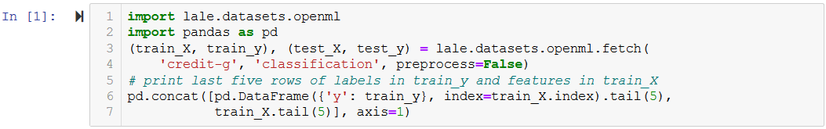
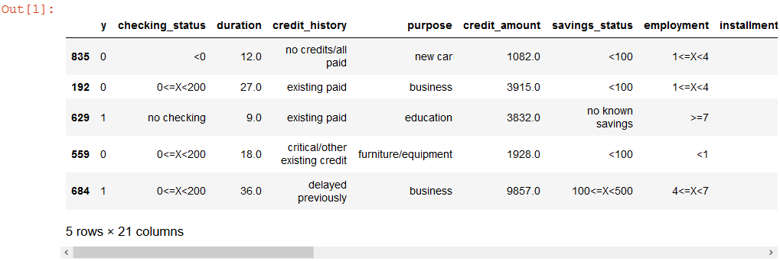
Categorical + Continuous Dataset
https://nbviewer.jupyter.org/github/IBM/lale/blob/master/examples/talk_2019-1105-lale.ipynb

Slide 4
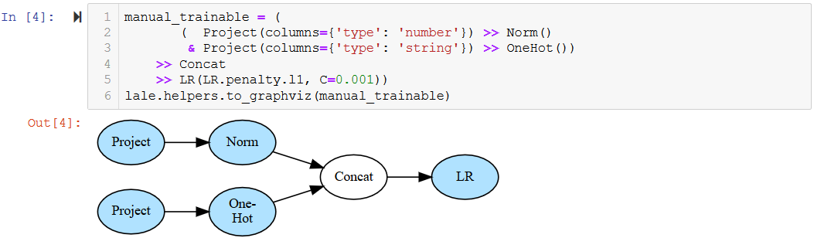
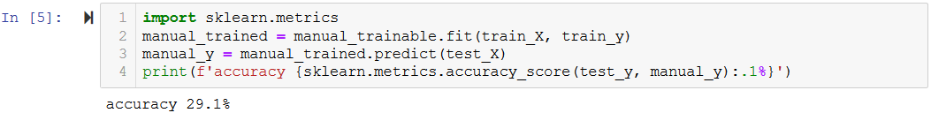
Manual Pipeline

Slide 5
Pipeline Combinators
Lale features | Name | Description | Scikit-learn features
>> or make_pipeline | pipe | feed to next | make_pipeline
& or make_union | and | run both | make_union or ColumnTransformer
| or make_choice | or | choose one | N/A (specific to given Auto-ML tool)

Slide 6
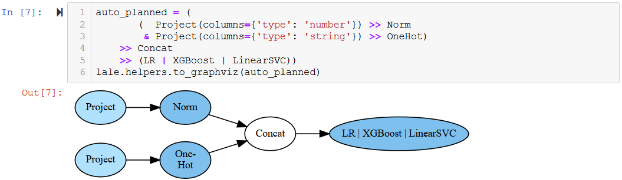
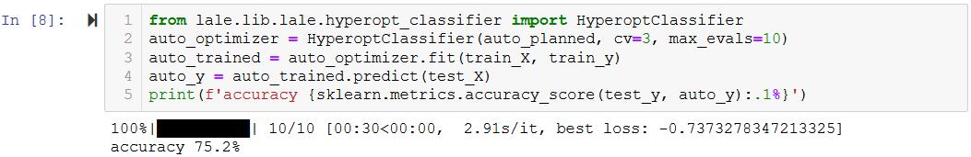
Automated Pipeline

Slide 7
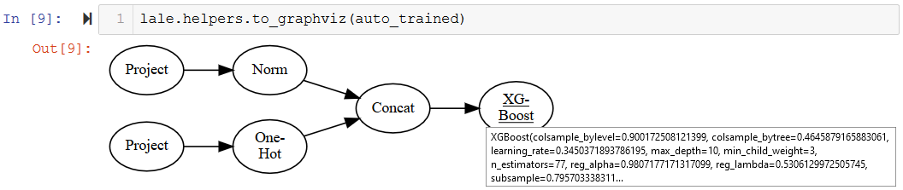
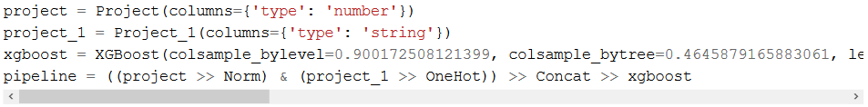
Displaying Automation Results

Slide 8
Bindings as Lifecycle: Venn Diagram
 | Individual operator | Pipeline
Meta-model | schemas, priors | steps, grammar
Planned |  | graph topology
Trainable | hyperparameters | operator choices
Trained | learned coefficients
arrange
init
fit
compose (>>, &, |)
“Type-Driven Automated Learning with Lale”, https://arxiv.org/pdf/1906.03957.pdf

Slide 9
Semi-Automated Data Science
Manual control over automation | Examples
Restrict available operator choices | Interpretable Based on licenses Based on GPU requirements
Tweak graph topology | Custom preprocessing Multi-modal data Fairness mitigation
Tweak hyperparameter schemas | Adjust range for continuous Restrict choices for categorical
Expand available operator choices | Wrap existing library Write your own operators
arrange, init, freeze
pipeline = (
( Project(columns={'type': 'number'}) >> Norm
& Project(columns={'type': 'string'}) >> OneHot)
>> Concat
>> (LR | XGBoost | LinearSVC))
search, fit, score
Data Scientist
pretty-print, visualize

Slide 10
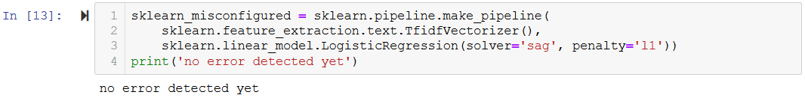
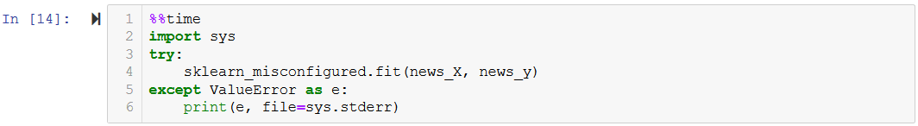
Constraints in Scikit-learn

Slide 11
Type-Driven Manual Learning in Lale
Schemas
Data Scientist
validate
edit/display
Hyperparameters
Trainable Pipeline
Project
Norm
Concat
XGBoost
Project
OneHot

Slide 12
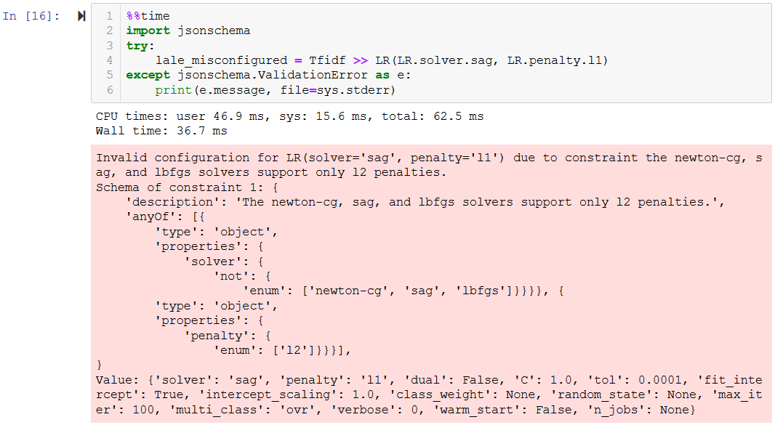
Constraints in Lale

Slide 13
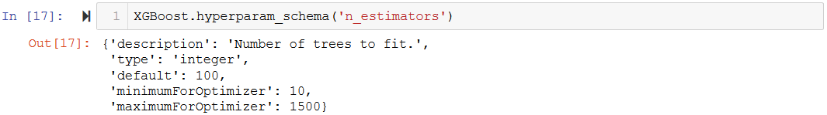
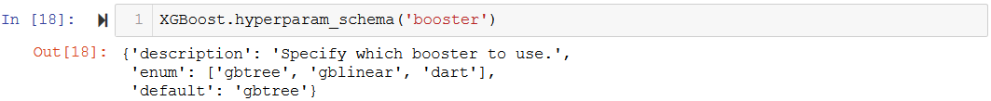
Types as Documentation

Slide 14
Constraints in Auto-ML
Problem: Some automated trials raise exceptions
Solution 1: Unconstrained search space
{solver: [linear,sag,lbfgs], penalty: [l1,l2]}
Catch exception (after some time)
Return made-up loss np.float.max
Solution 2: Constrained search space
{solver: [linear,sag,lbfgs], penalty: [l1,l2]} and (if solver: [sag,lbfgs] then penalty: [l2])
No exceptions (no time wasted)
No made-up loss

Slide 15
Types as Search Spaces
Planned Pipeline
Search Space
Lale can generate search spaces for various Auto-ML tools including hyperopt, GridSearchCV, and SMAC
generate
Project
Norm
Concat
LR | XGBoost | LinearSVC
Project
OneHot
edit/display
Schemas
Data Scientist
acquire
Hyperparameters
Trainable Pipeline
Search Point
Sample from search space, encoded by given Auto-ML tool
decode
Project
Norm
Concat
XGBoost
Project
OneHot
“Type-Driven Automated Learning with Lale”, https://arxiv.org/pdf/1906.03957.pdf

Slide 16
Types as Single Source of Truth
Planned Pipeline
Search Space
Lale can generate search spaces for various Auto-ML tools including hyperopt, GridSearchCV, and SMAC
generate
Project
Norm
Concat
LR | XGBoost | LinearSVC
Project
OneHot
edit/display
Schemas
Data Scientist
validate
acquire
edit/display
Hyperparameters
Trainable Pipeline
Search Point
Sample from search space, encoded by given Auto-ML tool
decode
Project
Norm
Concat
XGBoost
Project
OneHot
“Type-Driven Automated Learning with Lale”, https://arxiv.org/pdf/1906.03957.pdf

Slide 17
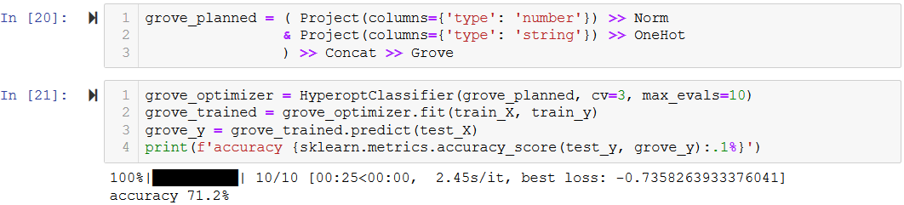
Customizing Types

Slide 18
Scikit-learn Compatible Interopability
Modality | Dataset | Pipeline (bold: best found choice)
Text | Movie reviews (sentiment analysis) | (BERT | TFIDF) >> (LR | MLP | KNN | SVC | PAC)
Table | Car (structured with categorical features) | J48 | ArulesCBA | LR | KNN
Images | CIFAR-10 (image classification) | ResNet50
Time-series | Epilepsy (seizure classification) | WindowTransformer >> (KNN | XGBoost | LR) >> Voting

Slide 19
Ongoing Work
General improvements
More operators
More Auto-ML tools
More robustness
Resource usage
Memory
Compute
Expressiveness
Grammars
Ensembles
We welcome your suggestions and contributions!

Slide 20

Conclusion
Automation
Easy search and tuning of pipelines
Usability
Like scikit-learn plus types
Interop
Python building blocks & beyond
Types as Search Spaces
Bindings as Lifecycle
github.com/ibm/lale
Scikit-learn compatible interop

