Slide 1
Lale: Type-Driven Auto-ML with Scikit-Learn
Talk at ICML Expo, 12 July 2020
Guillaume Baudart, Martin Hirzel, Kiran Kate, Parikshit Ram, and Avraham Shinnar
IBM Research AI

Slide 2
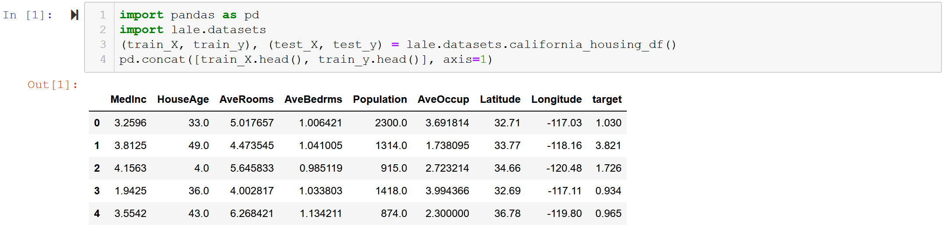
Example Dataset
sklearn California housing
pandas dataframe
schema for error-checking
numeric features ➔ no cleaning / encoding
numeric target ➔ use regression model

Slide 3
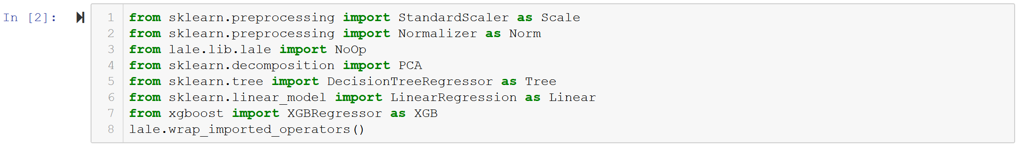
Importing Operators
most directly from sklearn, also lale, xgboost
wrap_imported_operators attaches schemas for type-driven Auto-ML

Slide 4
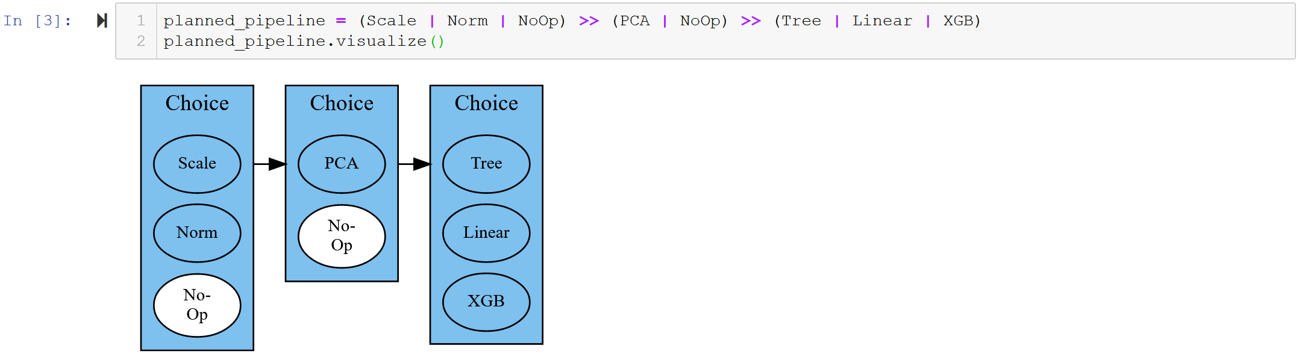
Planned Pipeline
pipe combinator >> for dataflow edges
or combinator | for auto algorithm selection
elided init args XGB(…) for hyperparameter tuning

Slide 5
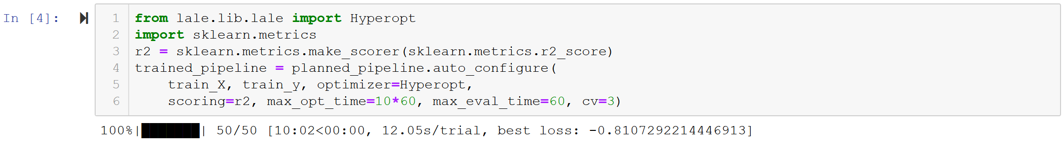
auto_configure
type-driven: uses operator schemas
creates search space for optimizer (here: Hyperopt)

Slide 6
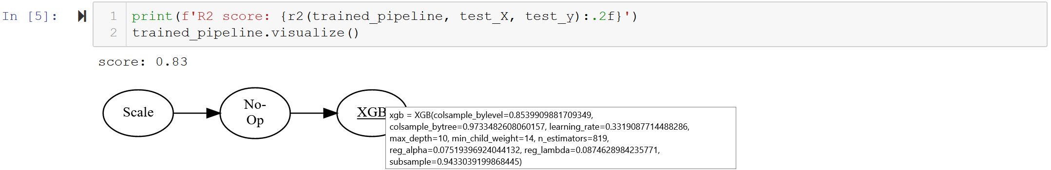
Trained Pipeline
concrete operators
concrete hyperparameters (tooltip on mouse-over)
scikit-learn compatible
links to documentation

Slide 7
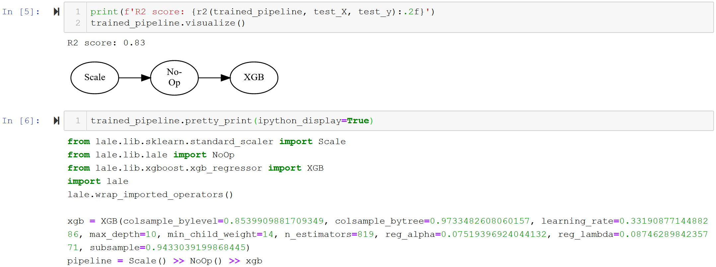
pretty_print
consistent syntax for input and output or Auto-ML
consistent syntax for manual ML and Auto-ML

Slide 8
 | Learn more
“Lale: Consistent Automated Machine Learning”, Guillaume Baudart, Martin Hirzel, Kiran Kate, Parikshit Ram, and Avraham Shinnar. KDD Workshop on Automation in Machine Learning (AutoML@KDD), August 2020. | search space generation error checking higher-order operators pipeline grammars
“Mining Documentation to Extract Hyperparameter Schemas”, Guillaume Baudart, Peter Kirchner, Martin Hirzel, and Kiran Kate. ICML Workshop on Automated Machine Learning (AutoML@ICML), July 2020. | input: Python docstring output: JSON schema

Slide 9


github.com/ibm/lale

