Slide 1

Type-Driven Automated Learning with Lale
Guillaume Baudart, Martin Hirzel, Kiran Kate, Pari Ram, and Avi Shinnar
Thursday 9 April 2020
https://github.com/ibm/lale

Slide 2
Manual Machine Learning
Inspiration
Data Scientist
Trainable pipeline (all choices of operators and hyperparameters are bound)
edit
train
Trained pipeline (learnable coefficients are bound)
evaluate
Metrics

Slide 3
Iterated Manual Machine Learning
Inspiration
Patience
Rigor
display
Data Scientist
Trainable pipeline (all choices of operators and hyperparameters are bound)
edit
train
loop
Trained pipeline (learnable coefficients are bound)
evaluate
Metrics

Slide 4
AutoML: Automated Machine Learning
Patience
Planned pipeline (some choices of operators and hyperparameters are still free)
generate
Search space (optimizers: GridSearchCV, Hyperopt, SMAC, …)
edit
acquire
Data Scientist
Trainable pipeline (all choices of operators and hyperparameters are bound)
decode
Point in search space
train
loop
Trained pipeline (learnable coefficients are bound)
evaluate
Metrics

Slide 5
Iterated AutoML
Inspiration
Patience
Planned pipeline (some choices of operators and hyperparameters are still free)
generate
Search space (optimizers: GridSearchCV, Hyperopt, SMAC, …)
edit
outer loop
acquire
Data Scientist
Trainable pipeline (all choices of operators and hyperparameters are bound)
decode
Point in search space
display
train
inner loop
Trained pipeline (learnable coefficients are bound)
evaluate
Metrics

Slide 6
Problem Statement
Library for semi-automated data science
Easy-to-use automation
Consistency of manual vs. automated experience
Consistency across AutoML optimizers
Display and iterative refinement
Expert-level control for human inspiration

Slide 7
Open-Source AutoML Technologies
Jupyter notebooks
scikit-learn
other operators: XGBoost, AIF360, …
other optimizers: Hyperopt, SMAC, …
GridSearchCV
metrics
operators
pipelines
pandas
Dataframe
numpy
ndarray
dtype
OpenML datasets

Slide 8
Lale’s Place in the Open-Source Stack
Jupyter notebooks
Lale
operator schemas
search space generators
scikit-learn
other operators: XGBoost, AIF360, …
other optimizers: Hyperopt, SMAC, …
GridSearchCV
metrics
operators
pipelines
pandas
Dataframe
numpy
ndarray
dtype
OpenML datasets

Slide 9
Operators, Pipelines, and Lifecycle
PlannedIndividualOp
schemas
() →TrainableIndividualOp
PlannedOperator
PlannedPipeline
steps edges
() → TrainablePipeline
1..n
TrainableOperator
fit(X,y?) →TrainedOperator
TrainableIndividualOp
hyperparams
fit(X,y?) →TrainedIndividualOp
TrainablePipeline
fit(X,y?) → TrainedPipeline
1..n
TrainedOperator
one of: - predict(X) → y - transform(X_{in}) → X_{out}
TrainedIndividualOp
learned coefficients
TrainedPipeline
1..n
Legend:
subtype (“is a”)
attribute (“has a”)

Slide 10
Example
Dataset
Manual machine learning
Hyperparameter tuning
Inspecting AutoML results
Algorithm selection

Slide 11
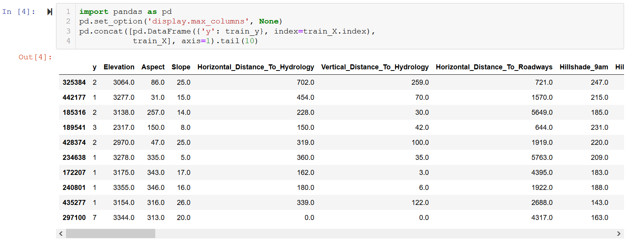
Example: Covertype Dataset
https://nbviewer.jupyter.org/github/IBM/lale/blob/master/examples/talk_2020-0327-lale.ipynb

Slide 12
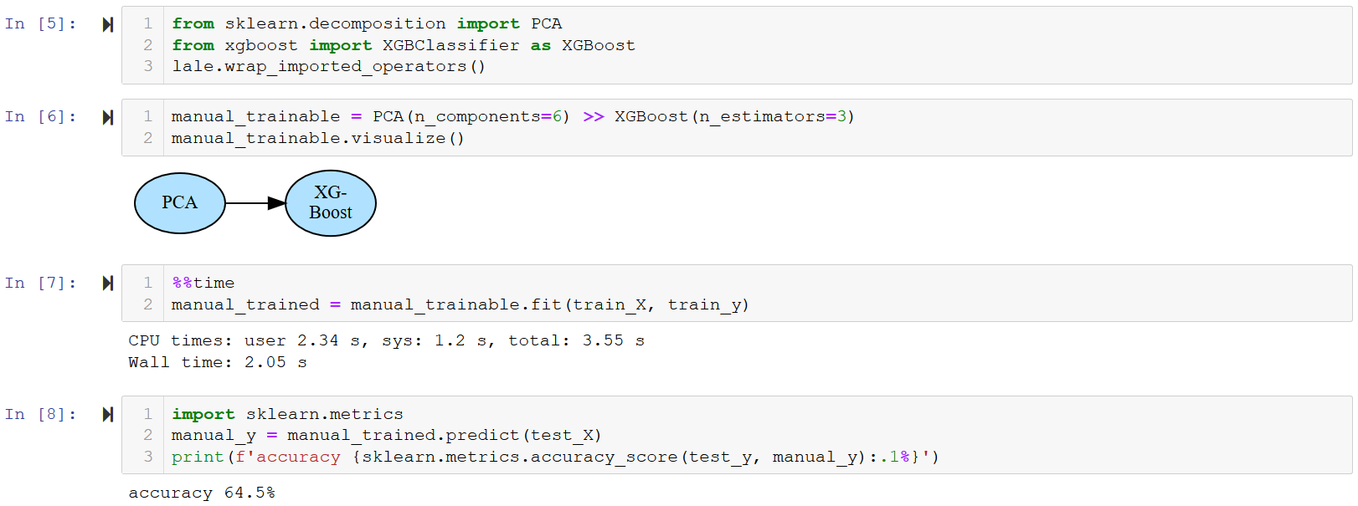
Example: Manual Machine Learning
https://nbviewer.jupyter.org/github/IBM/lale/blob/master/examples/talk_2020-0327-lale.ipynb

Slide 13
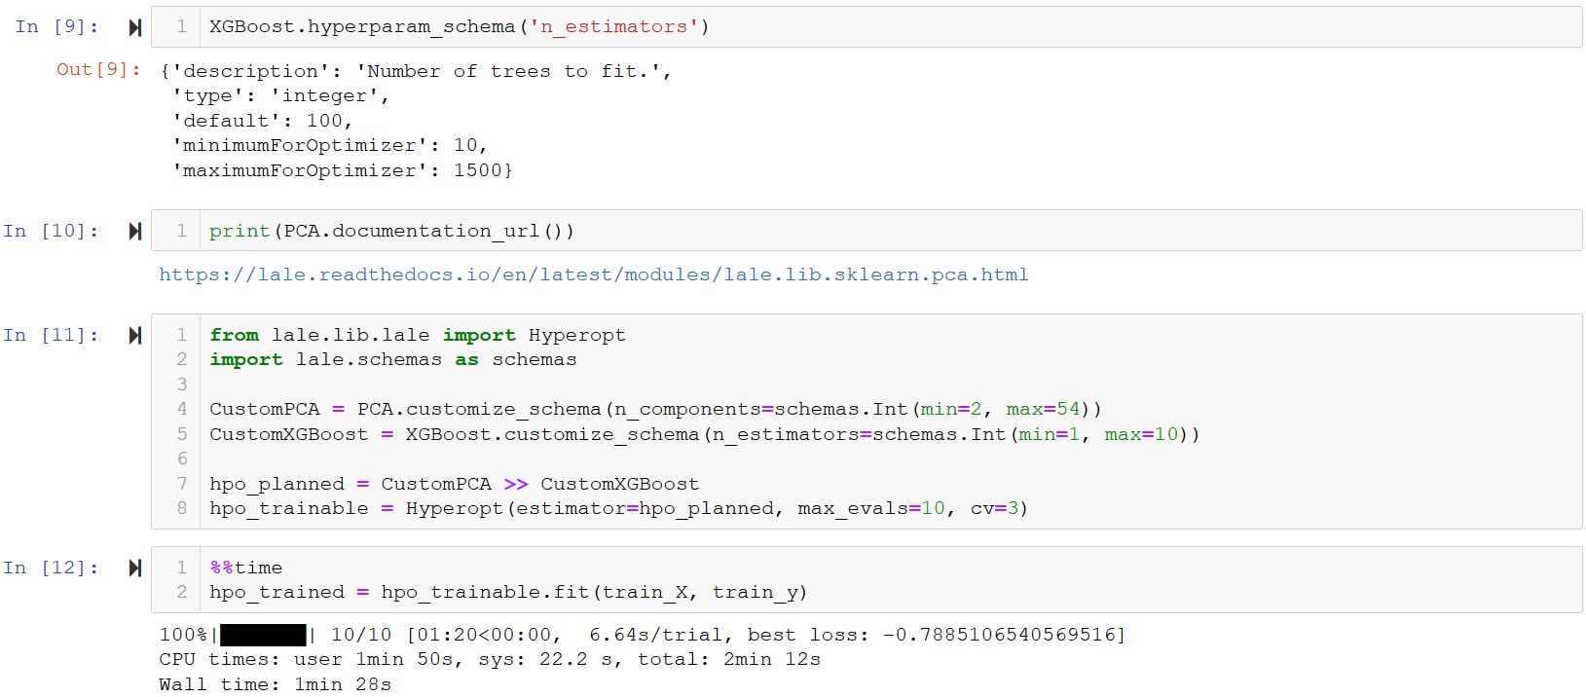
Example: Hyperparameter Tuning
https://nbviewer.jupyter.org/github/IBM/lale/blob/master/examples/talk_2020-0327-lale.ipynb

Slide 14

Types as Search Spaces
Planned pipeline (some choices of operators and hyperparameters are still free)
generate
Search space (optimizers: GridSearchCV, Hyperopt, SMAC, …)
edit
acquire
Data Scientist
Trainable pipeline (all choices of operators and hyperparameters are bound)
decode
Point in search space
train
loop
Trained pipeline (learnable coefficients are bound)
evaluate
Metrics

Slide 15
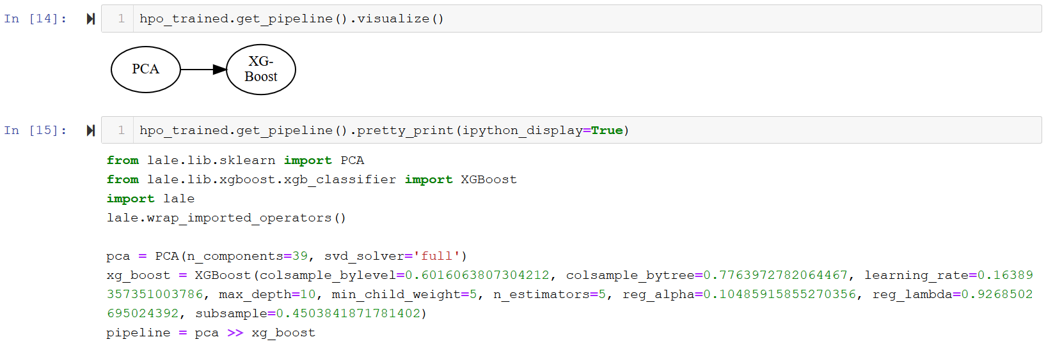
Example: Inspecting AutoML Results
https://nbviewer.jupyter.org/github/IBM/lale/blob/master/examples/talk_2020-0327-lale.ipynb

Slide 16
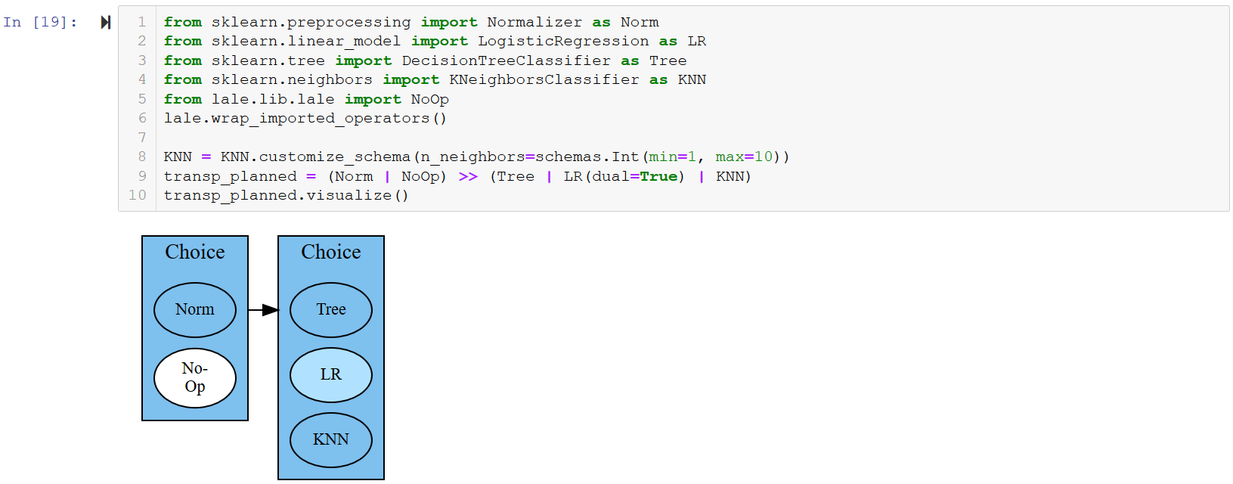
Example: Algorithm Selection
https://nbviewer.jupyter.org/github/IBM/lale/blob/master/examples/talk_2020-0327-lale.ipynb

Slide 17
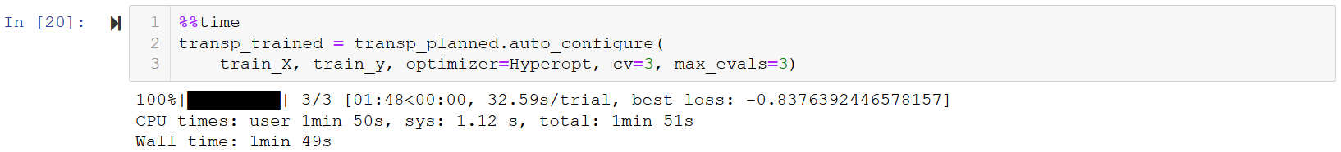
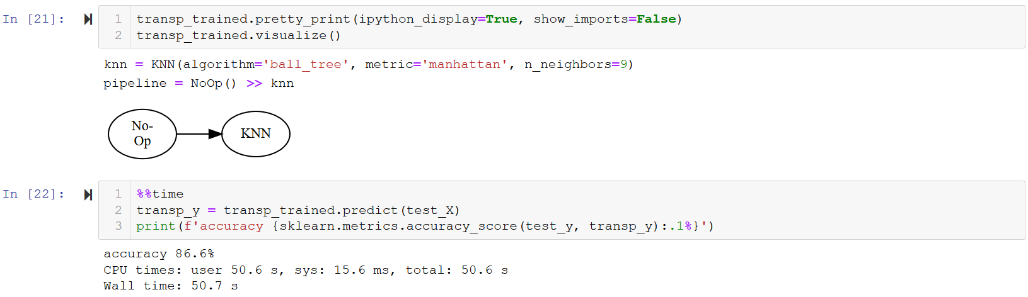
Example: Combined Algorithm Selection and Hyperparameter Tuning
https://nbviewer.jupyter.org/github/IBM/lale/blob/master/examples/talk_2020-0327-lale.ipynb

Slide 18
Expert-Level Control
Custom metrics
Non-linear pipelines
Higher-order operators
Adding new operators

Slide 19
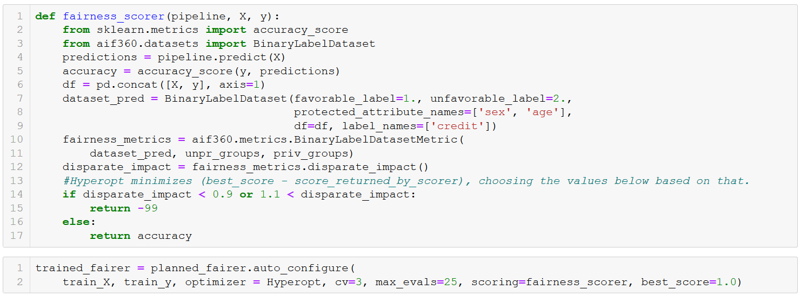
Custom Metrics
https://nbviewer.jupyter.org/github/IBM/lale/blob/master/examples/demo_aif360.ipynb

Slide 20
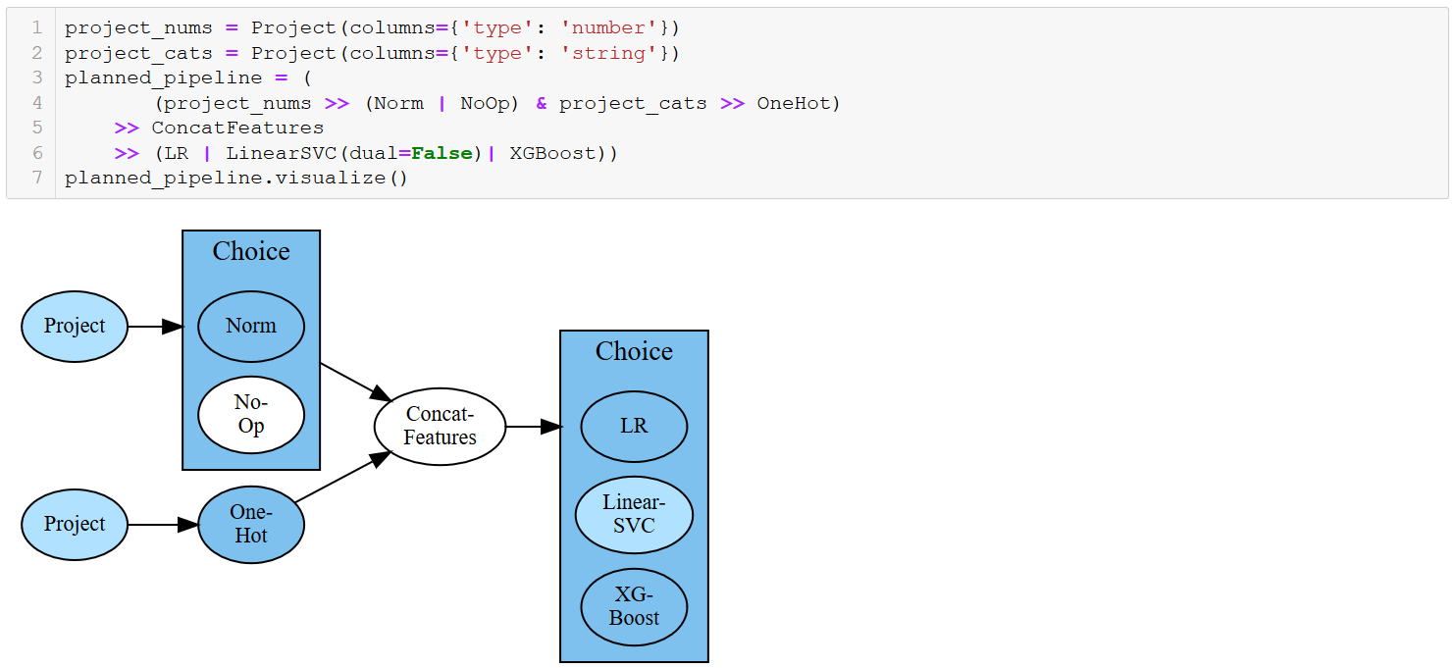
Non-Linear Pipelines
https://nbviewer.jupyter.org/github/IBM/lale/blob/master/examples/talk_2020-0302-lale.ipynb

Slide 21
Pipeline Combinators
Lale features | Name | Description | Scikit-learn features
>> or make_pipeline | pipe | feed to next | make_pipeline
& or make_union | and | run both | make_union or ColumnTransformer
| or make_choice | or | choose one | N/A (specific to given Auto-ML tool)

Slide 22
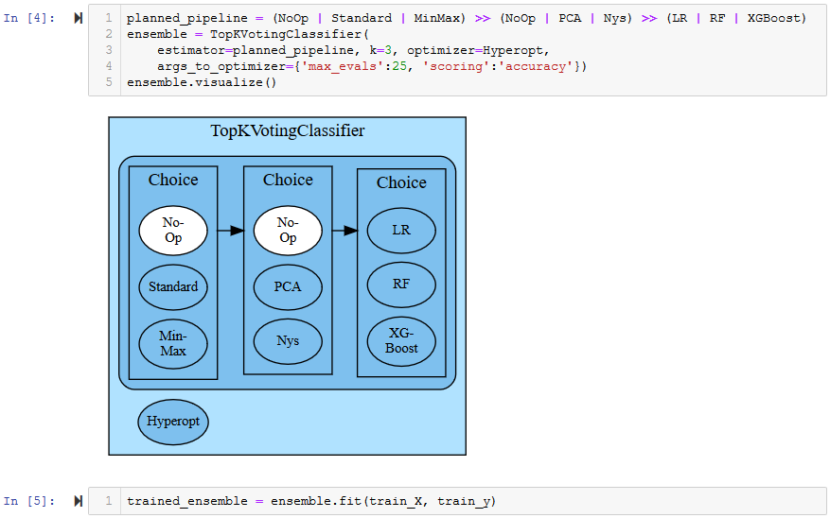
Higher-Order Operators (1/2)
https://nbviewer.jupyter.org/github/IBM/lale/blob/master/examples/demo_top_k_voting_classifier.ipynb

Slide 23
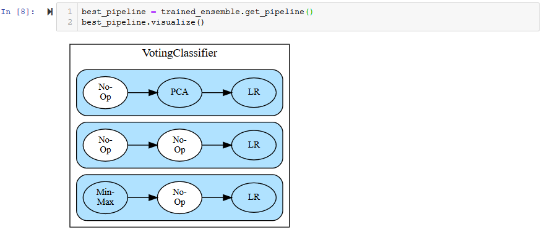
Higher-Order Operators (2/2)
https://nbviewer.jupyter.org/github/IBM/lale/blob/master/examples/demo_top_k_voting_classifier.ipynb

Slide 24
Adding New Operators
https://nbviewer.jupyter.org/github/IBM/lale/blob/master/examples/docs_new_operators.ipynb
Write class with __init__, fit, and predict or transform
Write JSON schemas for hyperparameters and datasets
Call lale.operators.make_operator
Write tests for your new operator
Currently supported operators
Package | Count | Description
lale.lib.sklearn | 45 | Hand-curated scikit-learn operators
lale.lib.autogen | 115 | Auto-extracted scikit-learn operators
lale.lib.xgboost | 2 | Gradient-boosted random forests
lale.lib.aif360 | 1 | Fairness mitigator (incomplete)
… other lale.lib | 25 | … other packages

Slide 25
Type-Driven Automated Learning
Types as search spaces
E.g., continuous hyperparameter range
E.g., categorical hyperparameter enum
Types as documentation
E.g., lale.readthedocs.io/en/latest/modules/lale.lib.sklearn.pca.html
Types for feature engineering
E.g., Project(columns={'type': 'string’})
Types for error checking
E.g., datasets, hyperparameters, constraints

Slide 26
Conclusion
Library for semi-automated data science
https://github.com/ibm/lale
Suggested actions:
Try it out and send us feedback
Contribute new operators
Do original research (AutoML optimizers, AI fairness, fast AutoML, …)

